Slide 1
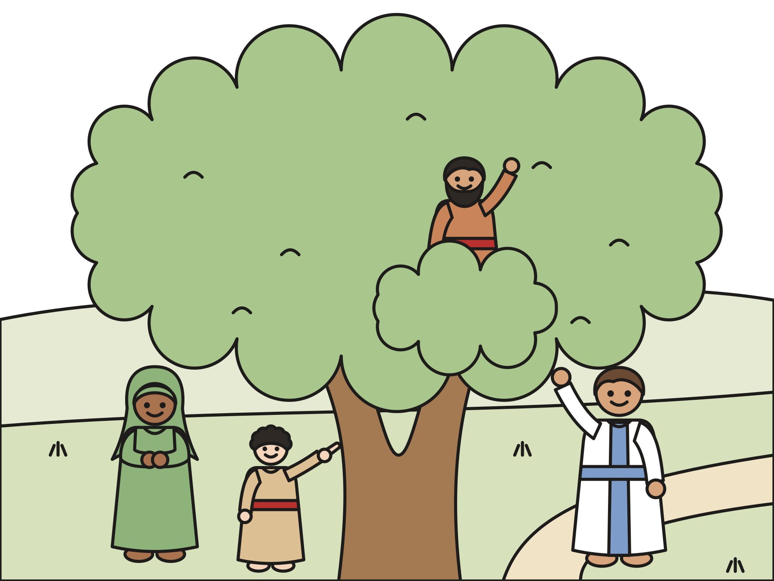
Sunday school · Ages 7–9
Zacchaeus climbs a tree
Luke 19:1–10
Mainline Christian
Notes:
Welcome the children. Today’s story comes from Luke 19:1–10.

Slide 2

Welcome!
How does it feel when someone remembers your name?
Notes:
Welcome each child by name. Ask the question and let two or three children answer. Say: Today we meet a man that nobody wanted to be friends with. But Jesus knew his name.

Slide 3

Zacchaeus lived in Jericho.
His job was collecting tax money. He was very rich.
Notes:
Long ago, in a town called Jericho, there lived a man named Zacchaeus. The Bible calls Jericho “the city of palm trees.” Say it together: Zak-KEY-us. His job was collecting tax money, the money people pay to the rulers of the land. He was the boss of the tax collectors, and he was very rich.

Slide 4

Nobody liked him.
Sometimes he made people pay too much. He kept the extra money.
Notes:
The people in Jericho did not like Zacchaeus. Sometimes he made people pay more than they should, and he kept the extra money for himself. Zacchaeus had lots of money. He did not have many friends.

Slide 5
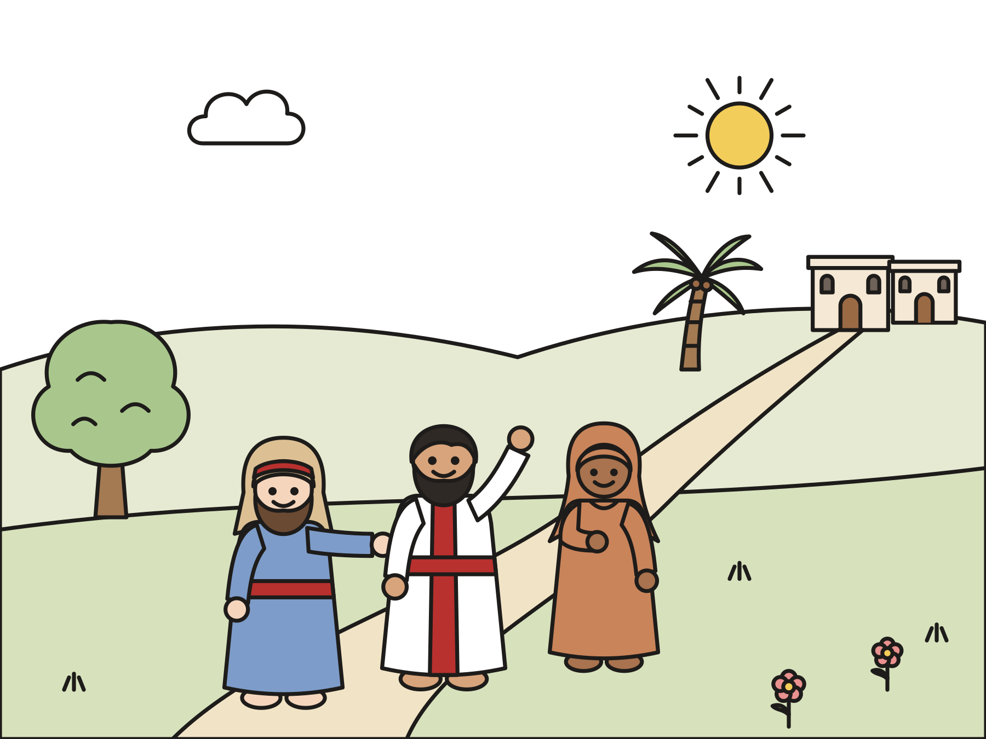
Jesus is coming!
A big crowd filled the road. Zacchaeus wanted to see Jesus.
Notes:
One day the news ran through town: Jesus is coming! Zacchaeus had heard that Jesus was kind to everyone, even people nobody else liked. He wanted to see Jesus very much. But a big crowd filled the road.

Slide 6

Up the tree!
Zacchaeus could not see over the crowd. So he ran ahead and climbed a tree.
Notes:
Zacchaeus stood on his tiptoes. He jumped up and down. He was short, and nobody moved over to let him through. Then he had an idea! He ran ahead and climbed up, up, up into a big sycamore tree. Now he could see the whole road.

Slide 7
Zacchaeus, hurry and come down!
Jesus stopped, looked up, and called him by name.
Notes:
Jesus walked down the road. When he came to the tree, he stopped. He looked up, right at Zacchaeus. “Zacchaeus, hurry and come down! Today I must stay at your house.” Jesus knew his name!

Slide 8
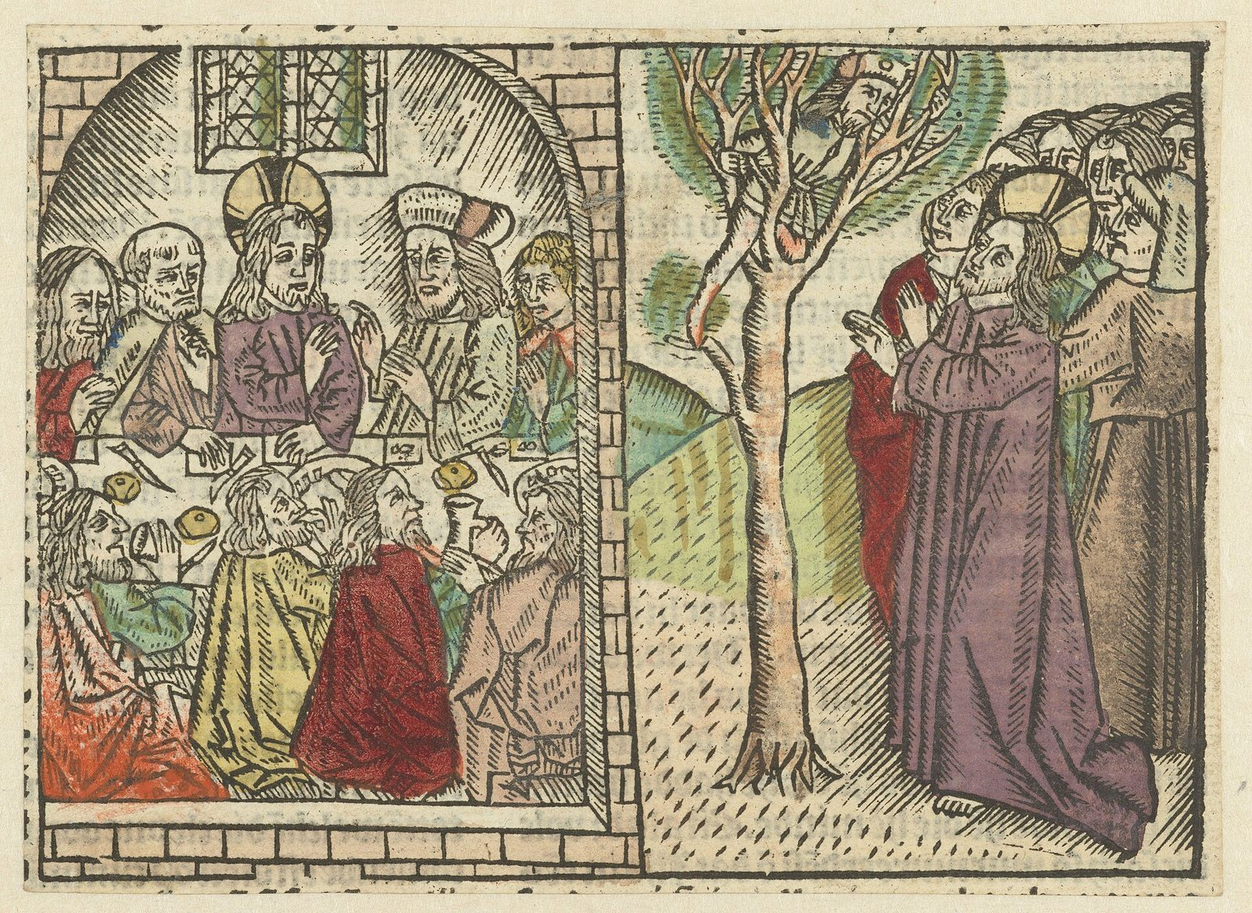
Zacchaeus was so happy!
He hurried down and welcomed Jesus to his house.
Notes:
Zacchaeus hurried down the tree as fast as he could. He was so happy! This picture is more than five hundred years old. Can you find Zacchaeus in the tree? Can you find Jesus eating at his house?

Slide 9

The people grumbled.
“Why is Jesus going to that man’s house?”
Notes:
The people in the crowd grumbled and folded their arms. “Why is Jesus going to his house? Doesn’t Jesus know what Zacchaeus has done?” Jesus went to Zacchaeus’s house anyway.

Slide 10

Zacchaeus changed.
“I will give half to the poor. I will pay people back four times as much!”
Notes:
Zacchaeus felt Jesus’s love, and something changed in his heart. He stood up and said, “Jesus, I will give half of everything I have to the poor. If I took too much from anyone, I will pay them back four times as much!” Zacchaeus was making things right.

Slide 11
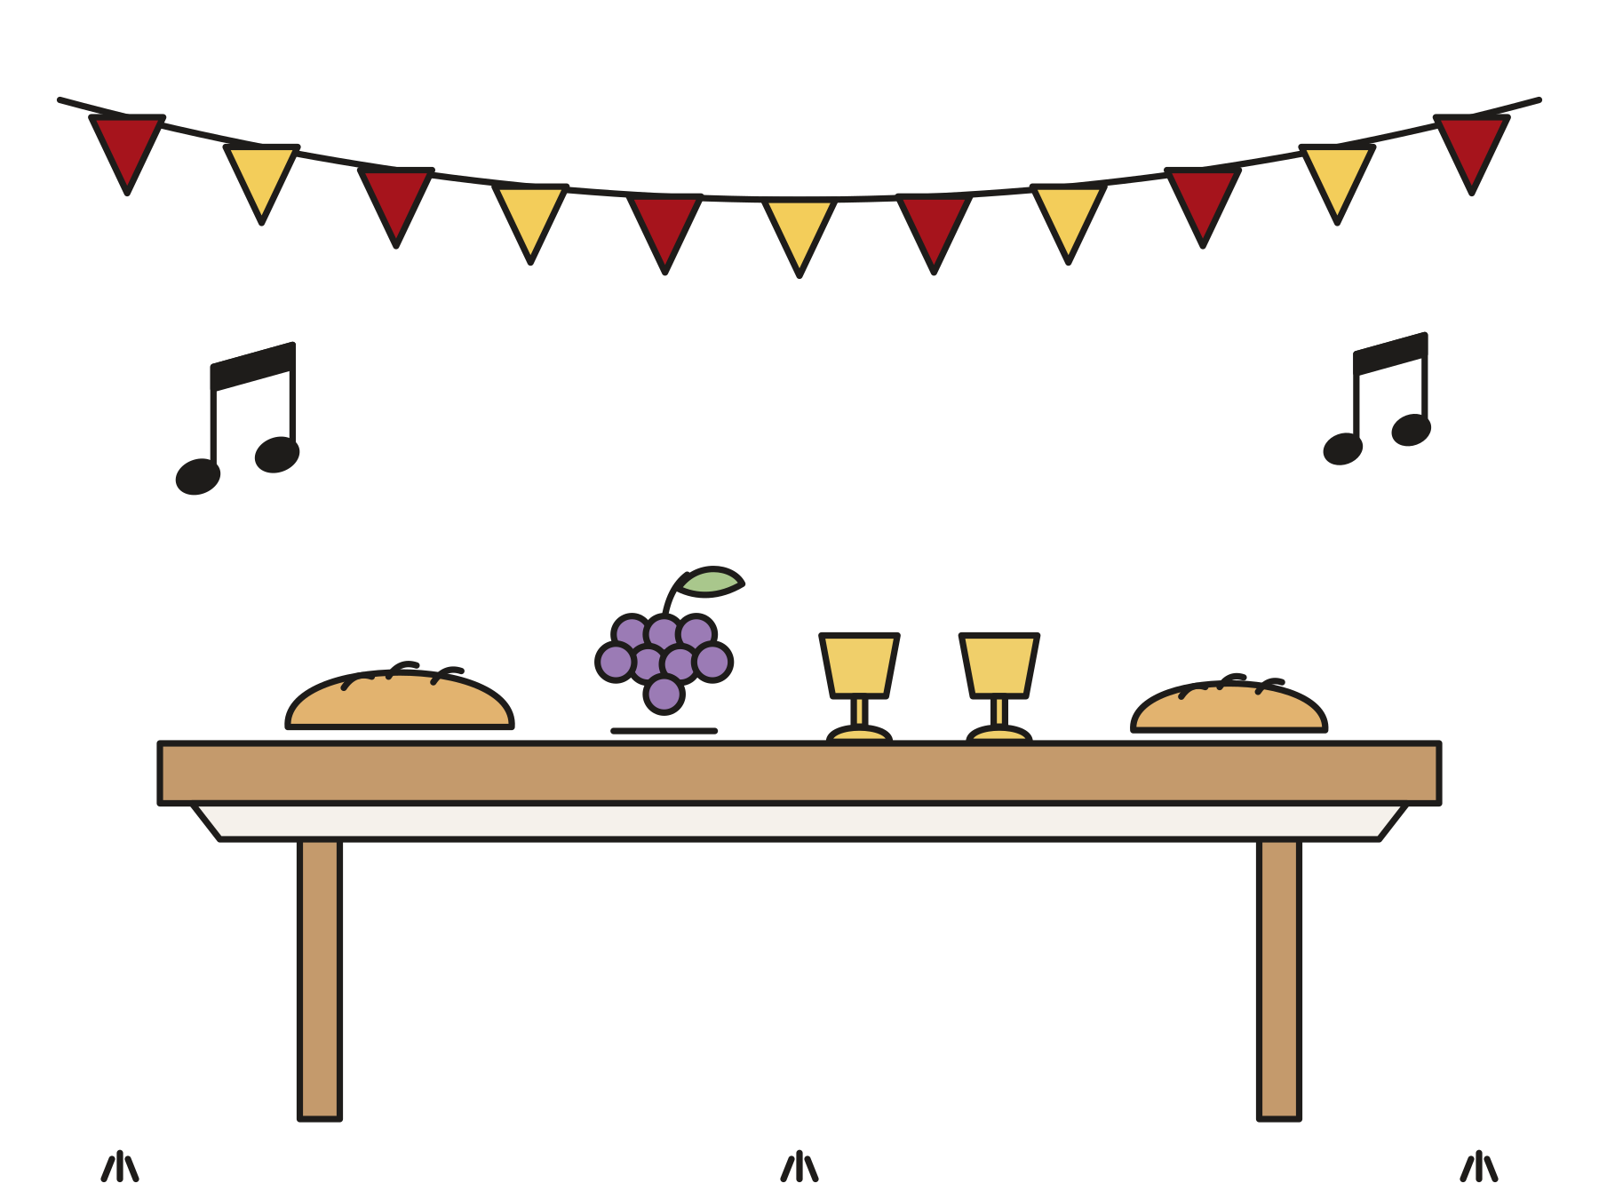
Jesus came to find the lost.
“For the Son of Man came to seek and to save that which was lost.”
Luke 19:10
Notes:
Jesus said, “Today, salvation has come to this house.” Then he said these words. Read the verse together. Jesus came to look for people who are lost and bring them home to God.

Slide 12
Jesus knows your name.
Jesus loves you. We can welcome others, like Jesus welcomed Zacchaeus.
Notes:
The people thought nobody could love Zacchaeus. But Jesus did! Jesus loved him first, and that love changed his heart. Jesus sees you too. Jesus knows your name, and Jesus loves you.

Slide 13
I wonder…
I wonder how Zacchaeus felt when Jesus called his name.
Notes:
Wait quietly for answers. Every answer is welcome.

Slide 14
I wonder…
I wonder who feels left out today, and how we could welcome them.
Notes:
Let the children think out loud. There are no wrong answers.

Slide 15
Question 1 of 7
What was Zacchaeus’s job?
He caught fish
He baked bread
A
B
He took care of sheep
He collected tax money
C
D
Notes:
Read the question and the choices aloud, and let the children answer. Then show the answer: He collected tax money. Zacchaeus was the boss of the tax collectors in Jericho.

Slide 16
Question 1 of 7
What was Zacchaeus’s job?
He caught fish
He baked bread
A
B
He took care of sheep
He collected tax money
C
D
The answer is D. Zacchaeus was the boss of the tax collectors in Jericho.
Notes:
The answer is D: He collected tax money. Zacchaeus was the boss of the tax collectors in Jericho.

Slide 17
Question 2 of 7
Why did Zacchaeus climb a tree?
To see Jesus
To pick fruit
A
B
To take a nap
To find a bird’s nest
C
D
Notes:
Read the question and the choices aloud, and let the children answer. Then show the answer: To see Jesus. He was short, and the crowd was in the way. From the tree he could see.

Slide 18
Question 2 of 7
Why did Zacchaeus climb a tree?
To see Jesus
To pick fruit
A
B
To take a nap
To find a bird’s nest
C
D
The answer is A. He was short, and the crowd was in the way. From the tree he could see.
Notes:
The answer is A: To see Jesus. He was short, and the crowd was in the way. From the tree he could see.

Slide 19
Question 3 of 7
What did Jesus say to Zacchaeus?
Hurry and come down!
Stay up there!
A
B
Go away!
Who are you?
C
D
Notes:
Read the question and the choices aloud, and let the children answer. Then show the answer: Hurry and come down!. Jesus said, “Zacchaeus, hurry and come down, for today I must stay at your house.”

Slide 20
Question 3 of 7
What did Jesus say to Zacchaeus?
Hurry and come down!
Stay up there!
A
B
Go away!
Who are you?
C
D
The answer is A. Jesus said, “Zacchaeus, hurry and come down, for today I must stay at your house.”
Notes:
The answer is A: Hurry and come down!. Jesus said, “Zacchaeus, hurry and come down, for today I must stay at your house.”

Slide 21
Question 4 of 7
How did Zacchaeus feel when Jesus came to his house?
Angry
Happy
A
B
Bored
C
Notes:
Read the question and the choices aloud, and let the children answer. Then show the answer: Happy. The Bible says Zacchaeus welcomed Jesus joyfully.

Slide 22
Question 4 of 7
How did Zacchaeus feel when Jesus came to his house?
Angry
Happy
A
B
Bored
C
The answer is B. The Bible says Zacchaeus welcomed Jesus joyfully.
Notes:
The answer is B: Happy. The Bible says Zacchaeus welcomed Jesus joyfully.

Slide 23
Question 5 of 7
Why did the people grumble?
They were hungry
It was raining
A
B
They wanted to climb the tree
They did not like Zacchaeus
C
D
Notes:
Read the question and the choices aloud, and let the children answer. Then show the answer: They did not like Zacchaeus. They did not think Jesus should visit him. Jesus went anyway, because he loved Zacchaeus.

Slide 24
Question 5 of 7
Why did the people grumble?
They were hungry
It was raining
A
B
They wanted to climb the tree
They did not like Zacchaeus
C
D
The answer is D. They did not think Jesus should visit him. Jesus went anyway, because he loved Zacchaeus.
Notes:
The answer is D: They did not like Zacchaeus. They did not think Jesus should visit him. Jesus went anyway, because he loved Zacchaeus.

Slide 25
Question 6 of 7
What did Zacchaeus do after Jesus came?
He bought a bigger house
He gave to the poor and paid people back
A
B
He climbed another tree
He kept all his money
C
D
Notes:
Read the question and the choices aloud, and let the children answer. Then show the answer: He gave to the poor and paid people back. He gave half of his things to the poor and paid people back four times as much.

Slide 26
Question 6 of 7
What did Zacchaeus do after Jesus came?
He bought a bigger house
He gave to the poor and paid people back
A
B
He climbed another tree
He kept all his money
C
D
The answer is B. He gave half of his things to the poor and paid people back four times as much.
Notes:
The answer is B: He gave to the poor and paid people back. He gave half of his things to the poor and paid people back four times as much.

Slide 27
Question 7 of 7
What does this story teach us about Jesus?
Jesus knows us and loves us
Jesus likes only tall people
A
B
Jesus is too busy for us
Jesus loves only rich people
C
D
Notes:
Read the question and the choices aloud, and let the children answer. Then show the answer: Jesus knows us and loves us. Jesus saw Zacchaeus, called him by name, and came to his house. Jesus loves you too.

Slide 28
Question 7 of 7
What does this story teach us about Jesus?
Jesus knows us and loves us
Jesus likes only tall people
A
B
Jesus is too busy for us
Jesus loves only rich people
C
D
The answer is A. Jesus saw Zacchaeus, called him by name, and came to his house. Jesus loves you too.
Notes:
The answer is A: Jesus knows us and loves us. Jesus saw Zacchaeus, called him by name, and came to his house. Jesus loves you too.

Slide 29

Great job!
You finished all 7 questions.
Notes:
Thank the children for listening so well.

Slide 30
Our memory verse
“Zacchaeus, hurry and come down, for today I must stay at your house.”
Luke 19:5
Notes:
Say the verse with motions. “Zacchaeus” (shade your eyes and look up). “hurry and come down” (climb down hand over hand). “for today I must stay” (stamp your feet). “at your house” (make a roof with your hands). Then say it again with each child’s name in place of Zacchaeus.

Slide 31
Make Zacchaeus in a tree
Trace your hand and arm on brown paper.
Trace your hands on green paper.
Cut out and glue your tree.
Tape a small Zacchaeus to a stick.
Slide him up through the leaves!
Notes:
Show a finished tree first. A grown-up cuts the slit in the leaves before the children slide Zacchaeus through. Write at the bottom: Jesus knows my name!

Slide 32
Hurry and come down!
Sit in a circle.
One person walks around the outside.
Tap a friend: “(Name), hurry and come down!”
Say “Welcome!” and walk around together.
The new friend takes the next turn.
Notes:
Walk, do not run. Keep playing until every child has been called by name.

Slide 33
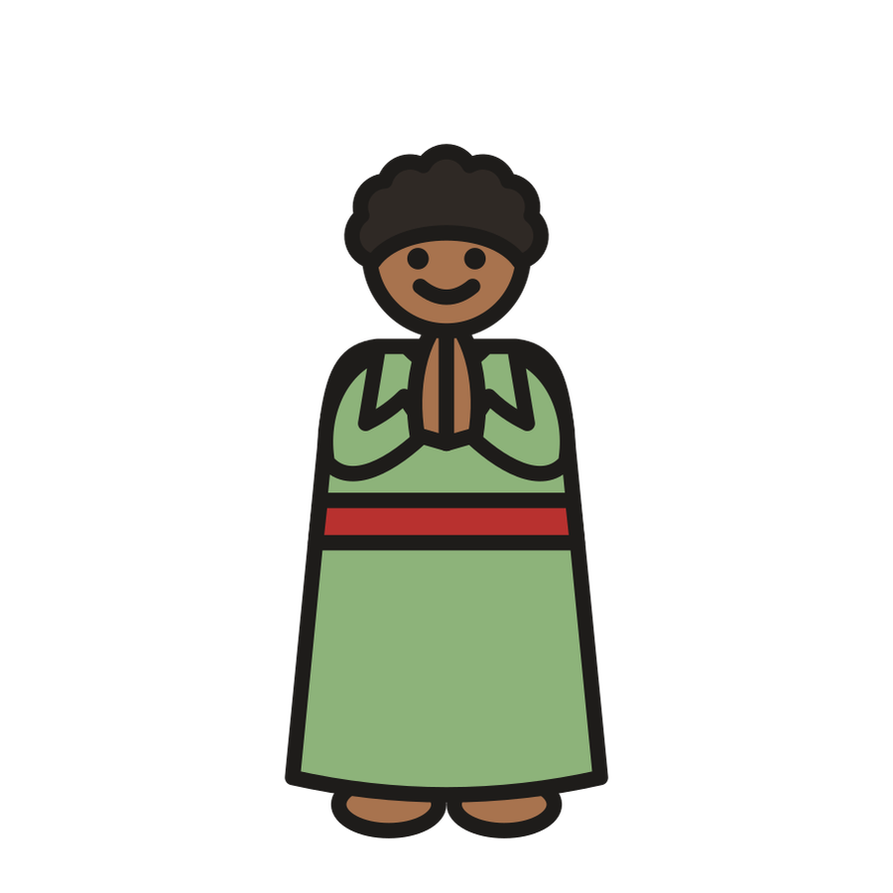
Let’s pray
Dear Jesus, thank you for knowing my name. Help me share with others and welcome people who feel left out. Amen.
Notes:
Read the prayer one line at a time and let the children repeat each line after you.

