Slide 1
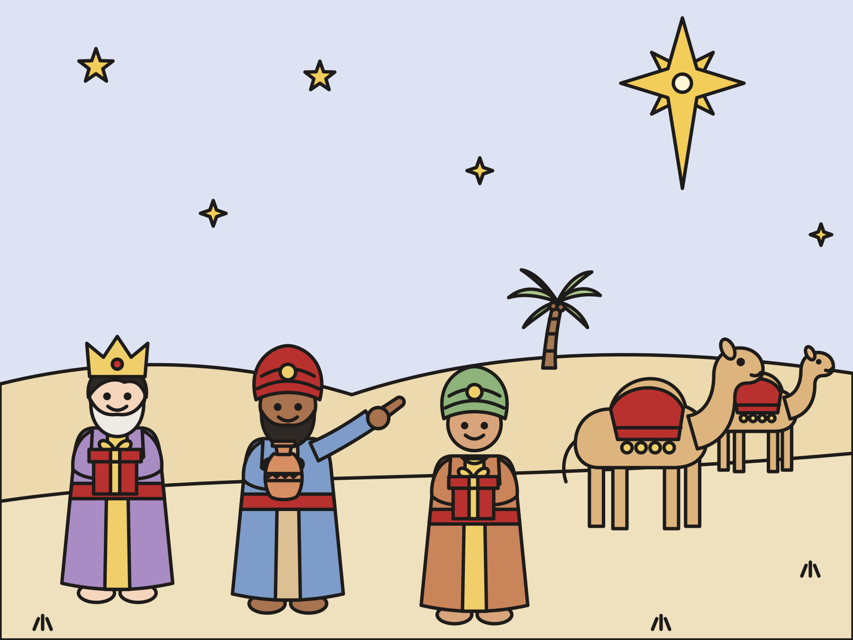
Sunday school · Ages 7–9
The wise men follow the star
Matthew 2:1–12
Mainline Christian
Notes:
Welcome the children. Today’s story comes from Matthew 2:1–12.

Slide 2

Welcome!
Have you ever followed a map or a sign to find your way?
Notes:
Welcome each child by name. Ask the question and let two or three children answer. Say: Today we will hear about some travelers who followed a star.

Slide 3

Wise men saw a new star.
They lived far away in the east. The star told them a new king was born.
Notes:
Far away in the east lived some wise men. They studied the night sky. One night they saw a bright new star. They said, “This star means a new king is born. Let’s go and find him!”

Slide 4
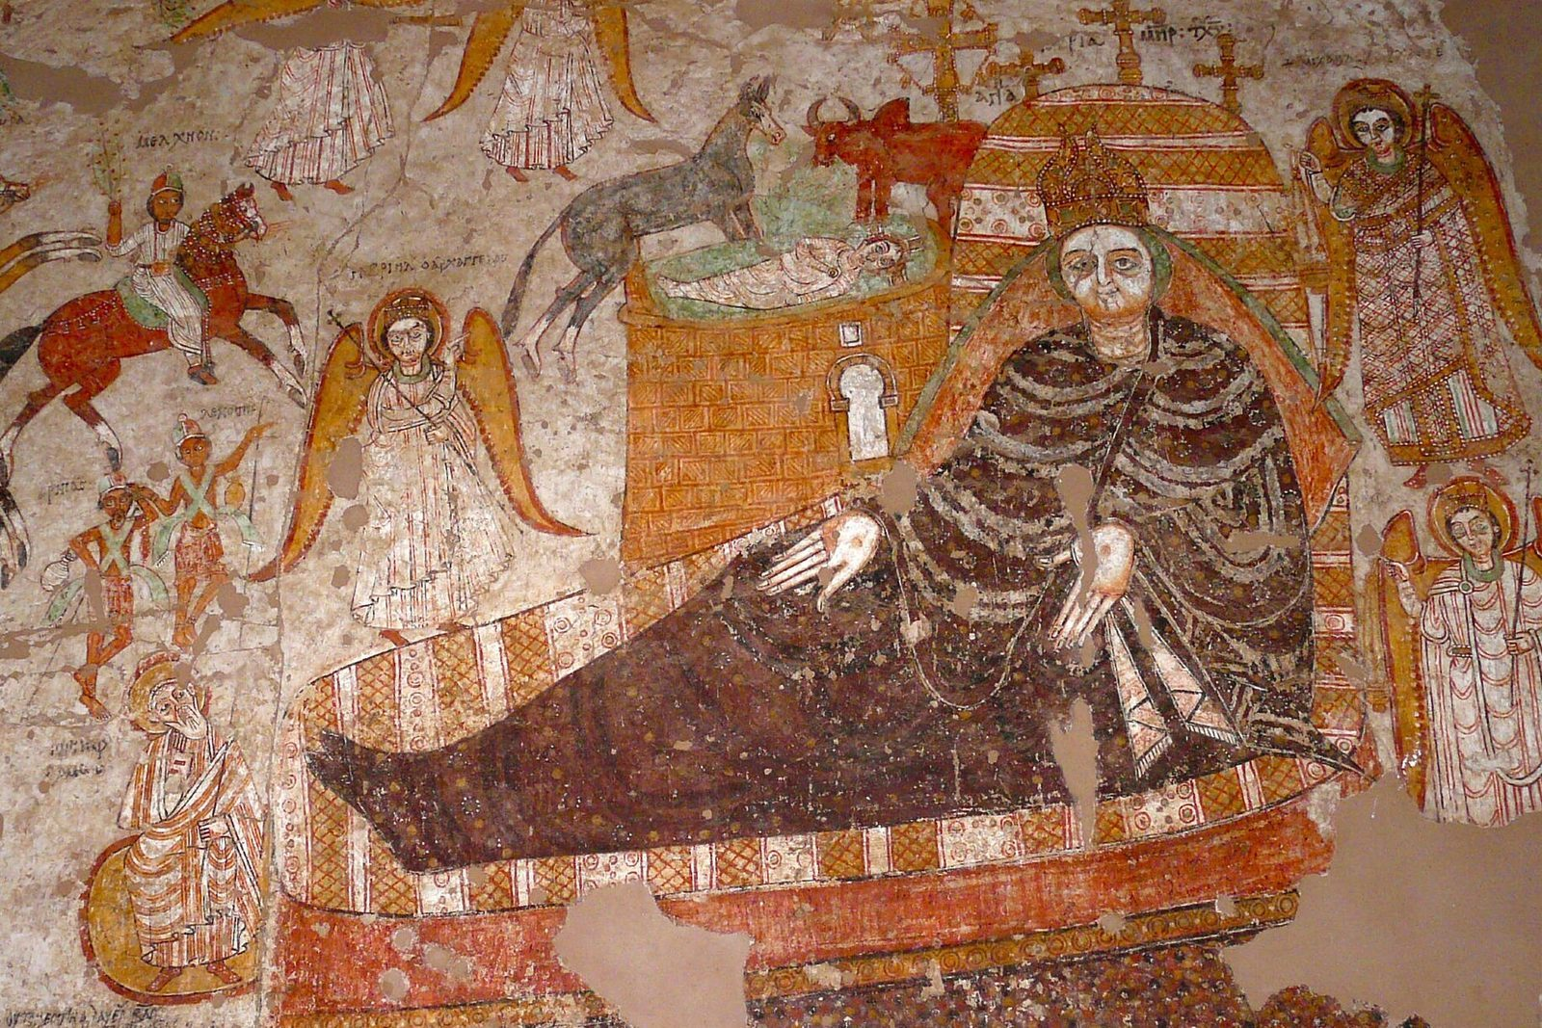
A long, long trip
They followed the star for many days and nights.
Notes:
They packed their treasures and set off. This painting is about 1,000 years old. It comes from a church in Nubia, in Africa. Can you find the wise men riding in on horses on the left side?

Slide 5

“Where is the baby king?”
King Herod was worried. He wanted to be the only king.
Notes:
The wise men came to the big city of Jerusalem. They asked King Herod, “Where is the new baby king? We saw his star.” Herod was worried. He did not want another king. Everyone in Jerusalem was worried too.

Slide 6
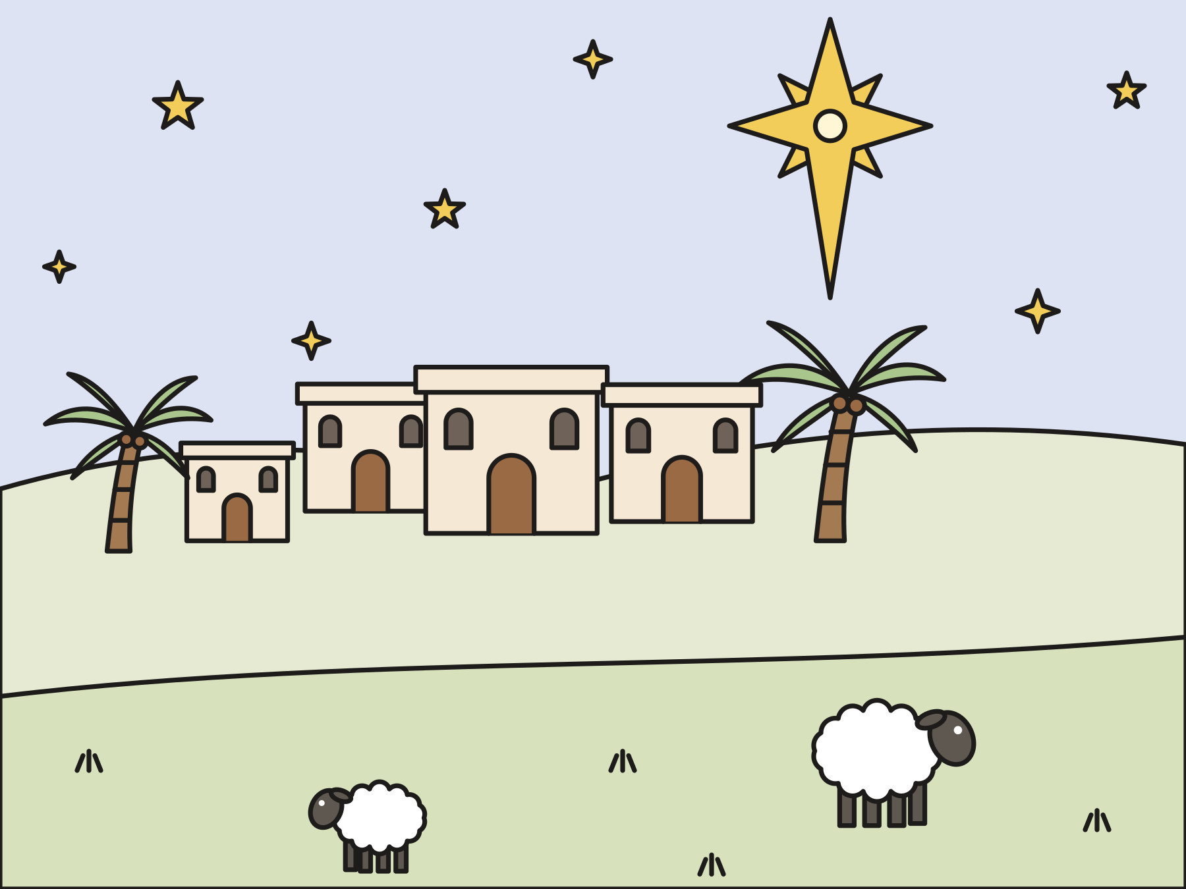
Go to Bethlehem!
God’s prophet Micah said a leader would come from little Bethlehem.
Notes:
Herod asked the teachers who knew God’s book. They read the words of the prophet Micah: a great leader would come from the little town of Bethlehem. Herod sent the wise men there. He said, “When you find the child, come back and tell me.” But Herod had a mean plan.

Slide 7
The star stopped!
“When they saw the star, they rejoiced with exceedingly great joy.”
Matthew 2:10
Notes:
The star went ahead of the wise men all the way to Bethlehem. Then it stopped right over one house. The wise men were so happy! The Bible says they rejoiced with exceedingly great joy.

Slide 8
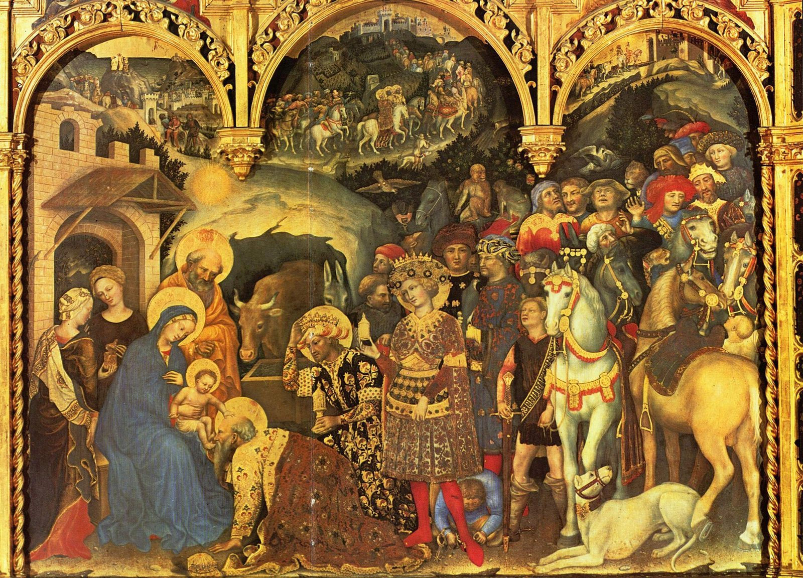
They found Jesus.
Jesus was with his mother, Mary. The wise men knelt down and worshiped him.
Notes:
They went inside the house. There was Jesus with his mother, Mary. The wise men knelt down and worshiped him. Gentile da Fabriano painted this picture about 600 years ago. He painted the wise men as kings in fancy clothes.

Slide 9

Gold, frankincense, and myrrh
They opened their treasures and gave Jesus gifts.
Notes:
Then they opened their treasure boxes. Gold is a gift for a king. Frankincense is a sweet-smelling gift that people burned when they worshiped God. Myrrh is a sweet-smelling spice for perfume and medicine. People often say there were three wise men because there were three gifts. The Bible does not tell us how many came!

Slide 10
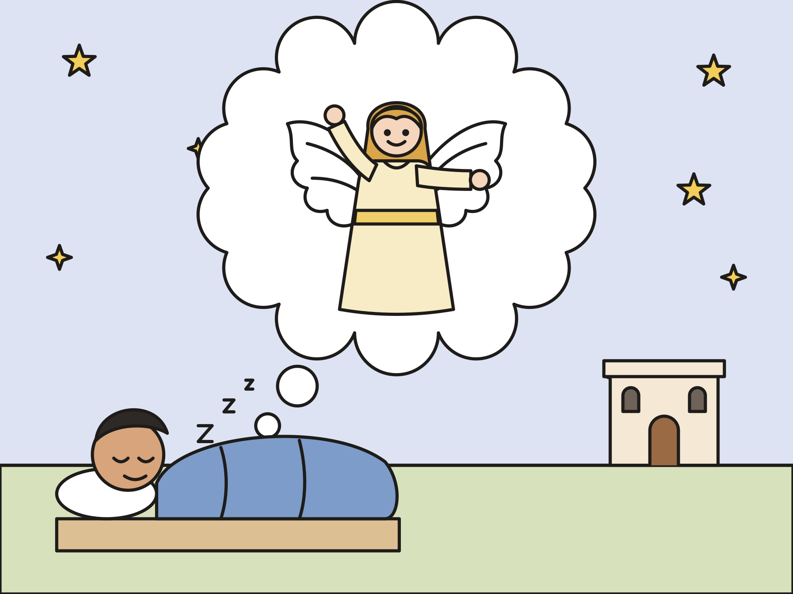
Home another way
God warned them in a dream. So they went home a different way.
Notes:
That night God warned the wise men in a dream: Do not go back to King Herod. So they went home by a different road. They kept Jesus safe.

Slide 11

God’s love is for everyone.
The wise men came from another country. God led them to Jesus too.
Notes:
The wise men came from far away. They came from another country. God led them to Jesus with a star. God’s love is for people from every land. God’s love is for you.

Slide 12
I wonder…
I wonder how the wise men felt when the star stopped.
Notes:
Wait for answers. Every answer is welcome.

Slide 13
I wonder…
I wonder what gift you would bring to Jesus.
Notes:
Let the children imagine. A song, a hug, or a drawing are all good gifts.

Slide 14
Question 1 of 8
What did the wise men see in the sky?
A rainbow
A big kite
A
B
A new star
A full moon
C
D
Notes:
Read the question and the choices aloud, and let the children answer. Then show the answer: A new star. They saw a new star and knew a new king was born.

Slide 15
Question 1 of 8
What did the wise men see in the sky?
A rainbow
A big kite
A
B
A new star
A full moon
C
D
The answer is C. They saw a new star and knew a new king was born.
Notes:
The answer is C: A new star. They saw a new star and knew a new king was born.

Slide 16
Question 2 of 8
Who did the wise men ask, “Where is the baby king?”
A fisherman
King Herod
A
B
A farmer
C
Notes:
Read the question and the choices aloud, and let the children answer. Then show the answer: King Herod. They went to King Herod in the big city of Jerusalem.

Slide 17
Question 2 of 8
Who did the wise men ask, “Where is the baby king?”
A fisherman
King Herod
A
B
A farmer
C
The answer is B. They went to King Herod in the big city of Jerusalem.
Notes:
The answer is B: King Herod. They went to King Herod in the big city of Jerusalem.

Slide 18
Question 3 of 8
In which town was Jesus born?
The North Pole
Bethlehem
A
B
A town under the sea
C
Notes:
Read the question and the choices aloud, and let the children answer. Then show the answer: Bethlehem. God’s prophet Micah said a leader would come from Bethlehem.

Slide 19
Question 3 of 8
In which town was Jesus born?
The North Pole
Bethlehem
A
B
A town under the sea
C
The answer is B. God’s prophet Micah said a leader would come from Bethlehem.
Notes:
The answer is B: Bethlehem. God’s prophet Micah said a leader would come from Bethlehem.

Slide 20
Question 4 of 8
What did the star do when it got to Bethlehem?
It fell into a lake
It stopped over the house
A
B
It turned into a bird
C
Notes:
Read the question and the choices aloud, and let the children answer. Then show the answer: It stopped over the house. The star stood still over the house where Jesus was.

Slide 21
Question 4 of 8
What did the star do when it got to Bethlehem?
It fell into a lake
It stopped over the house
A
B
It turned into a bird
C
The answer is B. The star stood still over the house where Jesus was.
Notes:
The answer is B: It stopped over the house. The star stood still over the house where Jesus was.

Slide 22
Question 5 of 8
What gifts did the wise men give Jesus?
Toys and candy
Bread and fish
A
B
Gold, frankincense, and myrrh
A robe and a ring
C
D
Notes:
Read the question and the choices aloud, and let the children answer. Then show the answer: Gold, frankincense, and myrrh. They opened their treasures and gave him gold, frankincense, and myrrh.

Slide 23
Question 5 of 8
What gifts did the wise men give Jesus?
Toys and candy
Bread and fish
A
B
Gold, frankincense, and myrrh
A robe and a ring
C
D
The answer is C. They opened their treasures and gave him gold, frankincense, and myrrh.
Notes:
The answer is C: Gold, frankincense, and myrrh. They opened their treasures and gave him gold, frankincense, and myrrh.

Slide 24
Question 6 of 8
Why do people often say there were three wise men?
They rode three camels
Three is the biggest number
A
B
They brought three gifts
C
Notes:
Read the question and the choices aloud, and let the children answer. Then show the answer: They brought three gifts. Matthew names three gifts. He does not say how many wise men came.

Slide 25
Question 6 of 8
Why do people often say there were three wise men?
They rode three camels
Three is the biggest number
A
B
They brought three gifts
C
The answer is C. Matthew names three gifts. He does not say how many wise men came.
Notes:
The answer is C: They brought three gifts. Matthew names three gifts. He does not say how many wise men came.

Slide 26
Question 7 of 8
Why did the wise men go home another way?
God warned them in a dream
They got lost
A
B
They wanted to see the beach
C
Notes:
Read the question and the choices aloud, and let the children answer. Then show the answer: God warned them in a dream. God told them not to go back to King Herod.

Slide 27
Question 7 of 8
Why did the wise men go home another way?
God warned them in a dream
They got lost
A
B
They wanted to see the beach
C
The answer is A. God told them not to go back to King Herod.
Notes:
The answer is A: God warned them in a dream. God told them not to go back to King Herod.

Slide 28
Question 8 of 8
What does this story show about God’s love?
It is only for kings
It is only for people nearby
A
B
It is for people from every land
C
Notes:
Read the question and the choices aloud, and let the children answer. Then show the answer: It is for people from every land. God led the wise men from far away to meet Jesus.

Slide 29
Question 8 of 8
What does this story show about God’s love?
It is only for kings
It is only for people nearby
A
B
It is for people from every land
C
The answer is C. God led the wise men from far away to meet Jesus.
Notes:
The answer is C: It is for people from every land. God led the wise men from far away to meet Jesus.

Slide 30
Great job!
You finished all 8 questions.
Notes:
Thank the children for listening so well.

Slide 31
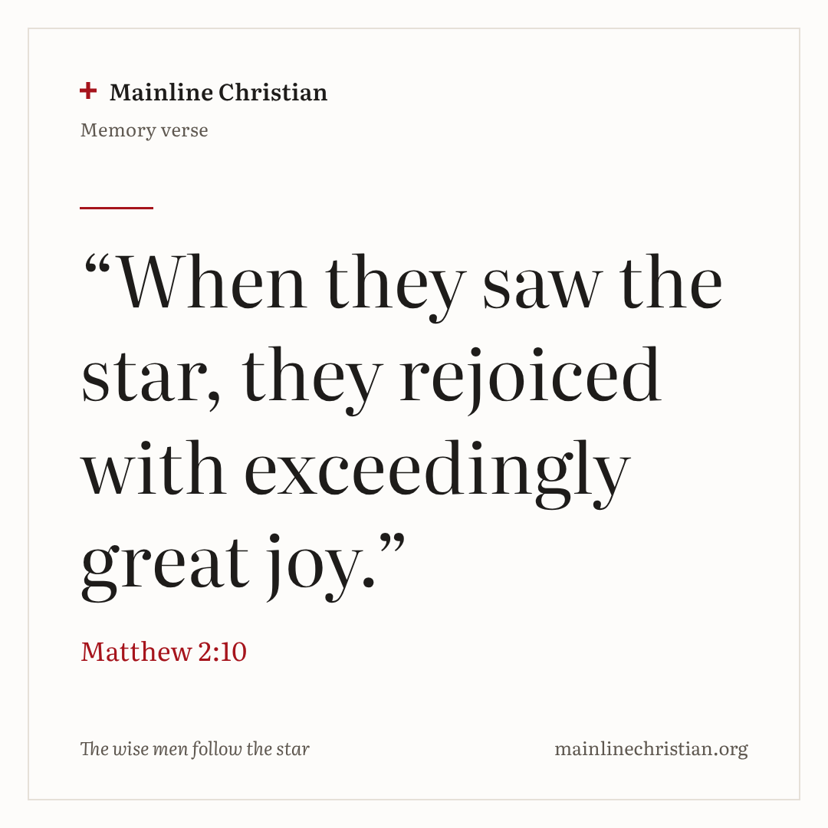
Our memory verse
“When they saw the star, they rejoiced with exceedingly great joy.”
Matthew 2:10
Notes:
Say the verse with motions. “When they saw the star” (shade your eyes and point up). “They rejoiced” (arms up high). “With exceedingly great joy” (jump or wiggle). Say it in a whisper, then in a regular voice, then with great joy.

Slide 32
Make a shining star
Trace a star on cardboard.
Cut out the star.
Wrap it in foil.
Tape a stick to the back.
Add a strip: God’s love is for everyone!
Notes:
Show a finished star first. Help with cutting the points. Fold the foil edges to the back so the front shines.

Slide 33
Follow the star
Follow the star leader around the room.
When the star stops, freeze!
At the house, kneel and say: We found Jesus!
Walk back a different way.
Notes:
Everyone gets to the house together. Give every child who wants one a turn as the star leader.

Slide 34
Let’s pray
Dear God, thank you for leading the wise men to Jesus. Thank you that your love is for everyone. Amen.
Notes:
Read the prayer one line at a time and let the children repeat each line after you.

