Slide 1

Children’s sermon
The father who ran
Luke 15:11–32
Mainline Christian
Notes:
Welcome the children. Today’s story comes from Luke 15:11–32.

Slide 2
What are shoes for?
Walking, jumping, and running!
Notes:
Hold up the running shoes. Ask: What are these for? Let the children answer.

Slide 3
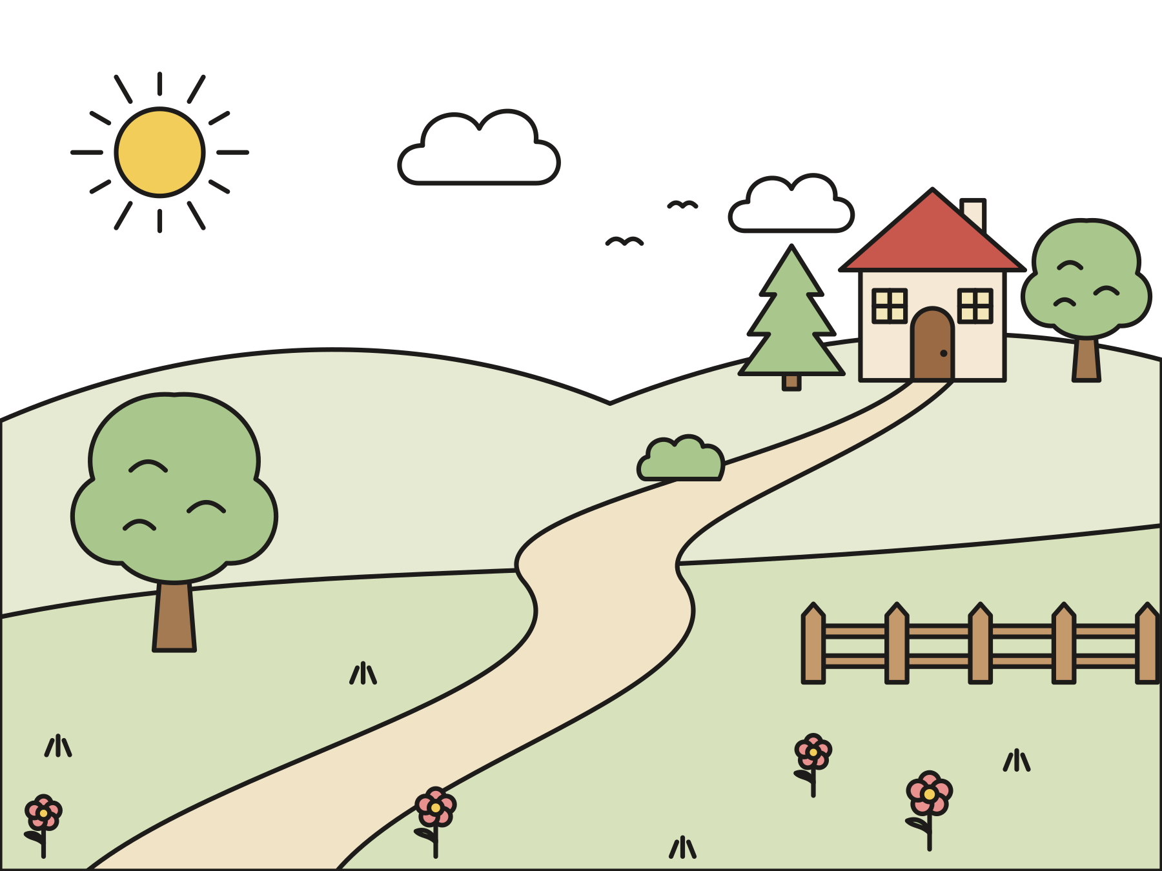
A son went far away.
He spent all his money and came home hungry and sorry.
Notes:
Jesus told a story about a son who took his father’s money and went far away. He spent it all. Then he was hungry, so he walked home to say he was sorry.

Slide 4
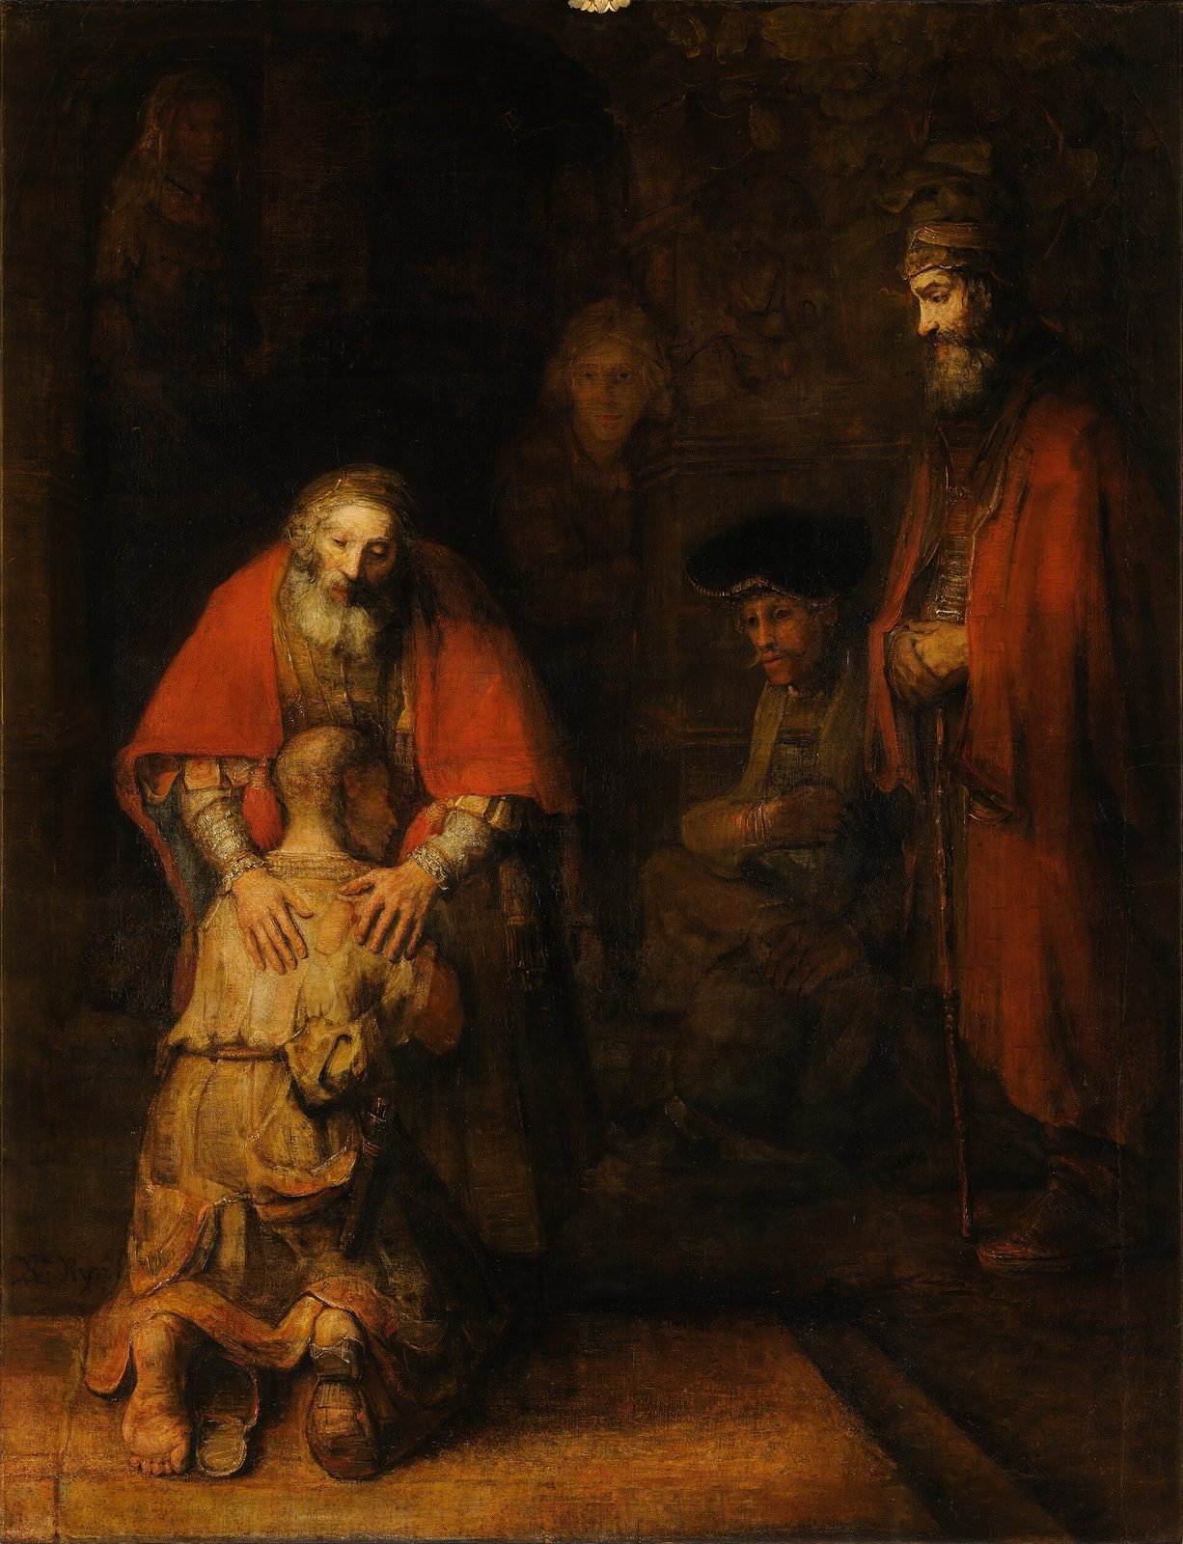
“He arose and came to his father. But while he was still far off, his father saw him and was moved with compassion, and ran, fell on his neck, and kissed him.”
Luke 15:20
Notes:
Read the verse slowly. The father did not wait at the door. He ran!

Slide 5

God runs to meet us.
When we come home to God, God comes running.
Notes:
Grown-ups in Jesus’s time did not run in the street. But this father was so glad to see his son that he ran anyway. Jesus says God loves us like that.

Slide 6
Question 1 of 3
What did the father do when he saw his son?
He ran to meet him
He hid
A
B
He went to sleep
C
Notes:
Read the question and the choices aloud, and let the children answer. Then show the answer: He ran to meet him. The father saw his son far away and ran to hug him.

Slide 7
Question 1 of 3
What did the father do when he saw his son?
He ran to meet him
He hid
A
B
He went to sleep
C
The answer is A. The father saw his son far away and ran to hug him.
Notes:
The answer is A: He ran to meet him. The father saw his son far away and ran to hug him.

Slide 8
Question 2 of 3
Who is like the father in this story?
A king
God
A
B
A pig
C
Notes:
Read the question and the choices aloud, and let the children answer. Then show the answer: God. Jesus told the story to show us that God loves us like that father.

Slide 9
Question 2 of 3
Who is like the father in this story?
A king
God
A
B
A pig
C
The answer is B. Jesus told the story to show us that God loves us like that father.
Notes:
The answer is B: God. Jesus told the story to show us that God loves us like that father.

Slide 10
Question 3 of 3
What can we do when someone comes back?
Welcome them
Stay angry
A
B
Walk away
C
Notes:
Read the question and the choices aloud, and let the children answer. Then show the answer: Welcome them. We can be glad and welcome people, just like the father did.

Slide 11
Question 3 of 3
What can we do when someone comes back?
Welcome them
Stay angry
A
B
Walk away
C
The answer is A. We can be glad and welcome people, just like the father did.
Notes:
The answer is A: Welcome them. We can be glad and welcome people, just like the father did.

Slide 12

Great job!
You finished all 3 questions.
Notes:
Thank the children for listening so well.

Slide 13
Let’s pray
Dear God, thank you for running to meet us. Help us run to welcome others. Amen.
Notes:
Ask the children to repeat each line after you.

