Slide 1
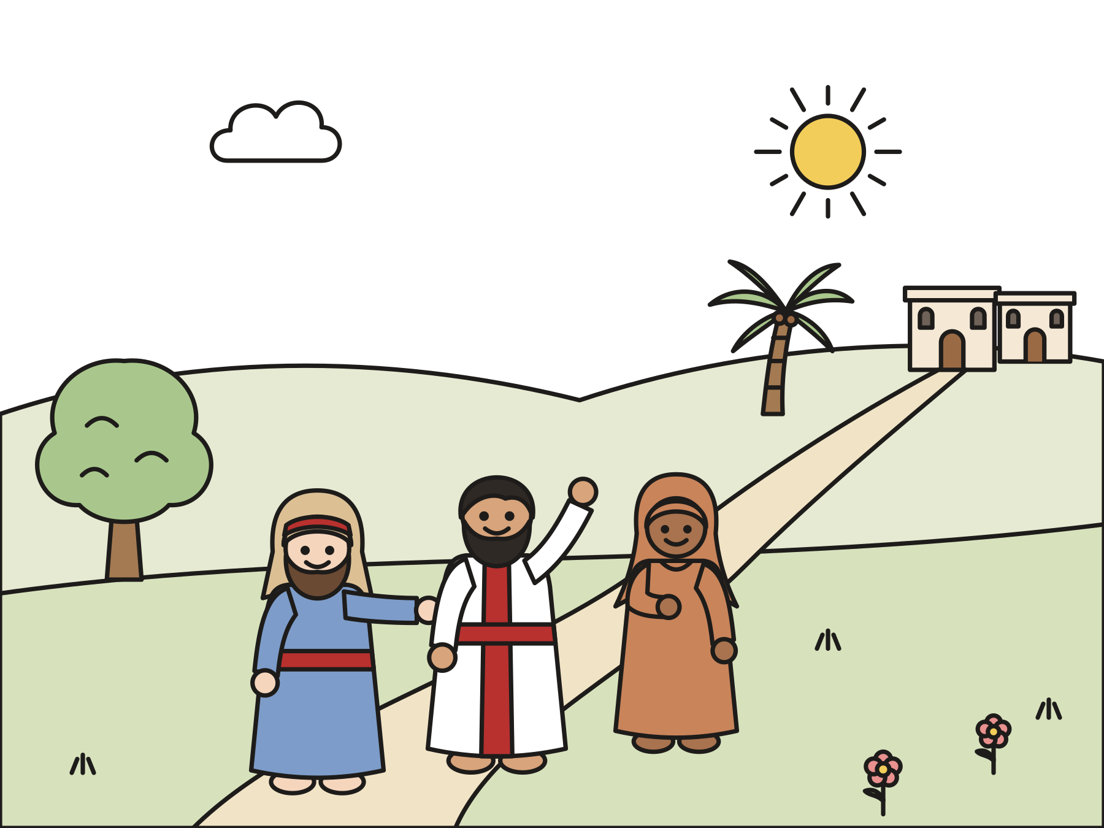
Sunday school · Ages 7–9
The one who came back to say thank you
Luke 17:11–19
Mainline Christian
Notes:
Welcome the children. Today’s story comes from Luke 17:11–19.

Slide 2

Welcome!
How many ways can you say thank you?
Notes:
Welcome each child by name. Ask the question and let two or three children answer. Say: Today’s story is about ten men who got a wonderful gift. Only one came back to say thank you.

Slide 3
Jesus was walking to Jerusalem.
Jesus and his friends walked a long, long way.
Notes:
Jesus and his friends were walking to the big city of Jerusalem. They walked past fields and hills. They came near a small village.

Slide 4

Ten men stood far away.
They had a sickness on their skin. They had to live apart.
Notes:
Outside the village, ten men were waiting. They had a skin sickness called leprosy. People with leprosy had to live away from their families. They could not come close to anyone, not even for a hug.

Slide 5
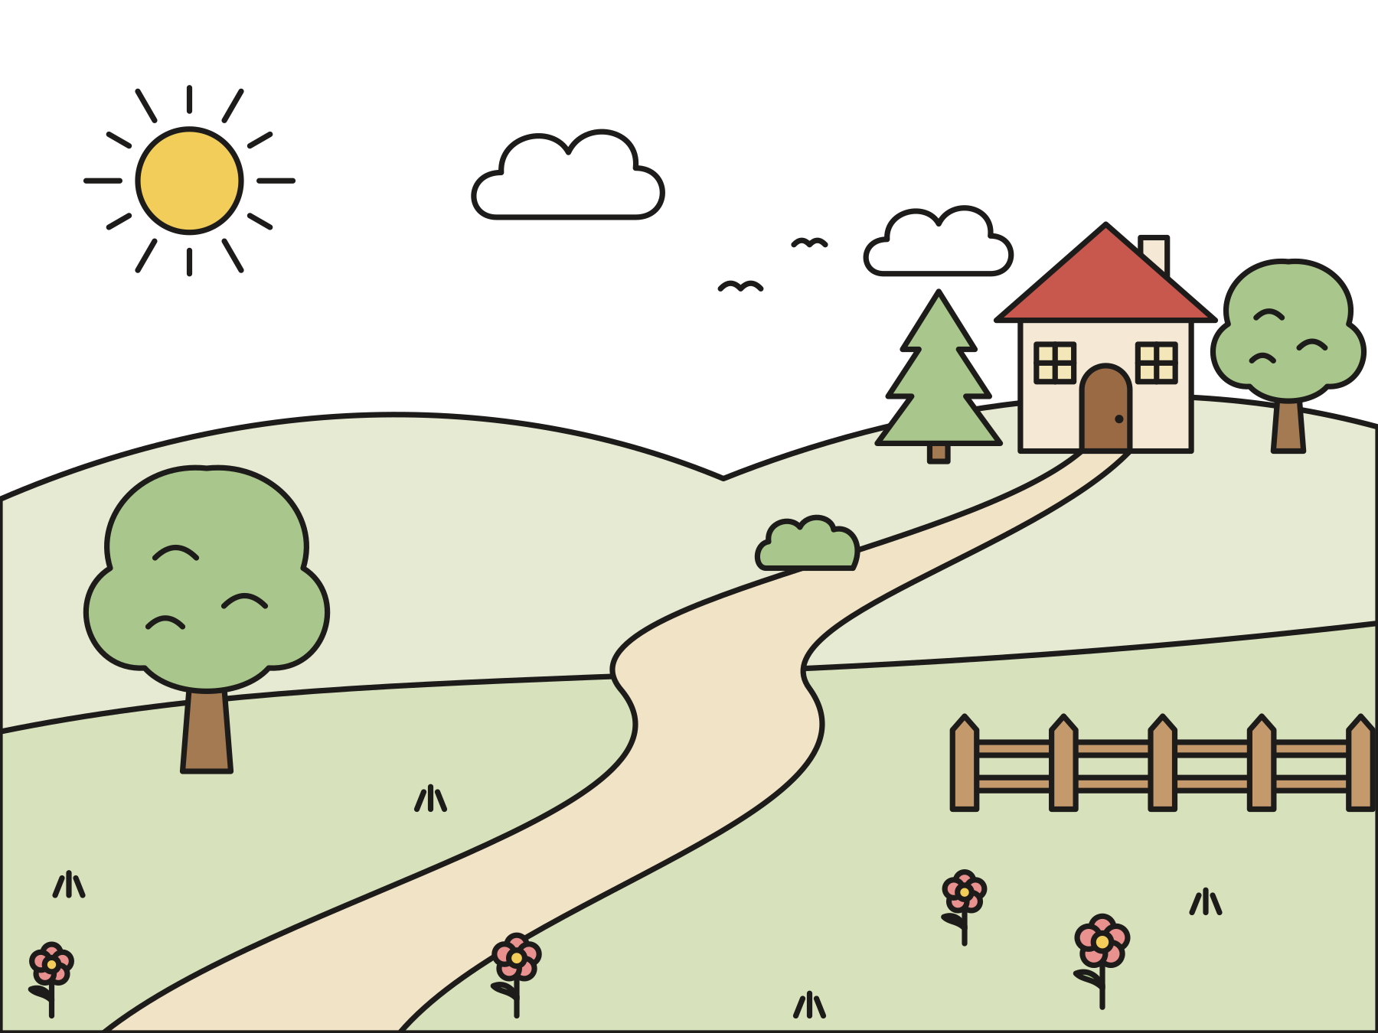
“Jesus, Master, have mercy on us!”
They shouted for help as loud as they could.
Notes:
The men saw Jesus coming. They could not come close, so they shouted as loud as they could: “Jesus, Master, have mercy on us!” That means, “Jesus, please help us!”

Slide 6

Go and show yourselves to the priests.
The priests could say, “You are well. You can go home.”
Notes:
Jesus called back, “Go and show yourselves to the priests.” The priests were the ones who could look at their skin and say, “You are well. You can go home now.” So the ten men started walking.

Slide 7

As they walked, they were healed!
Their skin was well again. They could go home!
Notes:
As they walked, something wonderful happened. Their skin got better. The sores were gone. They were healed! They could go home to their families.

Slide 8
One man turned back.
“One of them, when he saw that he was healed, turned back, glorifying God with a loud voice.”
Luke 17:15
Notes:
Nine men kept walking to find the priests, just as Jesus had said. But one man stopped. He looked at his hands and arms. He turned around and ran back to Jesus, praising God with a loud voice. He knelt at Jesus’ feet and said, “Thank you!”

Slide 9

He was a Samaritan.
He came from a different people. Jesus was glad he came back.
Notes:
The man who came back was a Samaritan. Samaritans came from a different group of people. Many of Jesus’ people did not get along with Samaritans. But this man was the one who came back to give thanks.

Slide 10
Where are the other nine?
Ten men were healed. Only one came back to say thank you.
Notes:
Jesus asked, “Weren’t ten men made well? Where are the other nine? Did only this man from another land come back to give glory to God?”

Slide 11

“Your faith has healed you.”
Jesus sent the man home, well and glad.
Notes:
Jesus said to the man, “Get up and go on your way. Your faith has made you well.” The man went home to his family, well and glad, and he knew that God loved him.

Slide 12
God’s love is for everyone.
God gives us good gifts. We can say thank you!
Notes:
God gives us so many good gifts every day. When we stop to say thank you, like the man who came back, we come close to God. And God’s love is for everyone, from every place.

Slide 13
I wonder…
I wonder why the one man turned back.
Notes:
Wait for answers. Every answer is welcome.

Slide 14
I wonder…
I wonder what gifts from God you would like to say thank you for.
Notes:
Let several children answer. There are no wrong answers.

Slide 15
Question 1 of 7
How many men called out to Jesus?
Two
Ten
A
B
Twelve
One hundred
C
D
Notes:
Read the question and the choices aloud, and let the children answer. Then show the answer: Ten. Ten men with a skin sickness called, “Jesus, Master, have mercy on us!”

Slide 16
Question 1 of 7
How many men called out to Jesus?
Two
Ten
A
B
Twelve
One hundred
C
D
The answer is B. Ten men with a skin sickness called, “Jesus, Master, have mercy on us!”
Notes:
The answer is B: Ten. Ten men with a skin sickness called, “Jesus, Master, have mercy on us!”

Slide 17
Question 2 of 7
Why did the men stand far away?
They were shy
They were sick and had to live apart
A
B
They were playing tag
They did not like Jesus
C
D
Notes:
Read the question and the choices aloud, and let the children answer. Then show the answer: They were sick and had to live apart. People with leprosy had to stay away from others until a priest said they were well.

Slide 18
Question 2 of 7
Why did the men stand far away?
They were shy
They were sick and had to live apart
A
B
They were playing tag
They did not like Jesus
C
D
The answer is B. People with leprosy had to stay away from others until a priest said they were well.
Notes:
The answer is B: They were sick and had to live apart. People with leprosy had to stay away from others until a priest said they were well.

Slide 19
Question 3 of 7
Where did Jesus tell the men to go?
To the beach
To the priests
A
B
To the market
Back to bed
C
D
Notes:
Read the question and the choices aloud, and let the children answer. Then show the answer: To the priests. Jesus said, “Go and show yourselves to the priests.” The priests could say they were well.

Slide 20
Question 3 of 7
Where did Jesus tell the men to go?
To the beach
To the priests
A
B
To the market
Back to bed
C
D
The answer is B. Jesus said, “Go and show yourselves to the priests.” The priests could say they were well.
Notes:
The answer is B: To the priests. Jesus said, “Go and show yourselves to the priests.” The priests could say they were well.

Slide 21
Question 4 of 7
When were the men healed?
After a long nap
As they walked
A
B
When they ate lunch
A year later
C
D
Notes:
Read the question and the choices aloud, and let the children answer. Then show the answer: As they walked. Luke says that as they went, they were healed.

Slide 22
Question 4 of 7
When were the men healed?
After a long nap
As they walked
A
B
When they ate lunch
A year later
C
D
The answer is B. Luke says that as they went, they were healed.
Notes:
The answer is B: As they walked. Luke says that as they went, they were healed.

Slide 23
Question 5 of 7
How many came back to say thank you?
Nine
All ten
A
B
Five
One
C
D
Notes:
Read the question and the choices aloud, and let the children answer. Then show the answer: One. Only one man turned back to praise God and thank Jesus.

Slide 24
Question 5 of 7
How many came back to say thank you?
Nine
All ten
A
B
Five
One
C
D
The answer is D. Only one man turned back to praise God and thank Jesus.
Notes:
The answer is D: One. Only one man turned back to praise God and thank Jesus.

Slide 25
Question 6 of 7
What did the man do when he came back?
He asked for money
He praised God and thanked Jesus
A
B
He ran and hid
He took a nap
C
D
Notes:
Read the question and the choices aloud, and let the children answer. Then show the answer: He praised God and thanked Jesus. He praised God with a loud voice and knelt at Jesus’ feet to say thank you.

Slide 26
Question 6 of 7
What did the man do when he came back?
He asked for money
He praised God and thanked Jesus
A
B
He ran and hid
He took a nap
C
D
The answer is B. He praised God with a loud voice and knelt at Jesus’ feet to say thank you.
Notes:
The answer is B: He praised God and thanked Jesus. He praised God with a loud voice and knelt at Jesus’ feet to say thank you.

Slide 27
Question 7 of 7
Who was the man who came back?
A king
A Samaritan from a different people
A
B
A priest
One of Jesus’ brothers
C
D
Notes:
Read the question and the choices aloud, and let the children answer. Then show the answer: A Samaritan from a different people. He was a Samaritan. God’s love is for everyone, from every place.

Slide 28
Question 7 of 7
Who was the man who came back?
A king
A Samaritan from a different people
A
B
A priest
One of Jesus’ brothers
C
D
The answer is B. He was a Samaritan. God’s love is for everyone, from every place.
Notes:
The answer is B: A Samaritan from a different people. He was a Samaritan. God’s love is for everyone, from every place.

Slide 29

Great job!
You finished all 7 questions.
Notes:
Thank the children for listening so well.

Slide 30

Our memory verse
“Give thanks to the LORD, for he is good, for his loving kindness endures forever.”
Psalm 136:1
Notes:
Say the verse with motions. “Give thanks to the LORD” (fold your hands, then lift them up). “for he is good” (thumbs up). “for his loving kindness” (hug yourself). “endures forever” (draw a big circle in the air, around and around). Say it softly, then loudly, then in a whisper.

Slide 31
Make a pop-up thank-you card
Fold your paper in half.
Cut two short slits on the fold.
Push the strip inside so it pops up.
Glue a heart on the pop-up.
Write “Thank you!” and decorate.
Notes:
Show a finished card first. Help with cutting as needed. Talk about who could get the card this week.

Slide 32
Thank-you toss
Sit in a circle.
Catch the ball and name a gift from God.
Everyone says: His loving kindness endures forever!
Toss the ball to a new friend.
Notes:
Toss gently. Children may pass and take a turn later. Every answer counts.

Slide 33
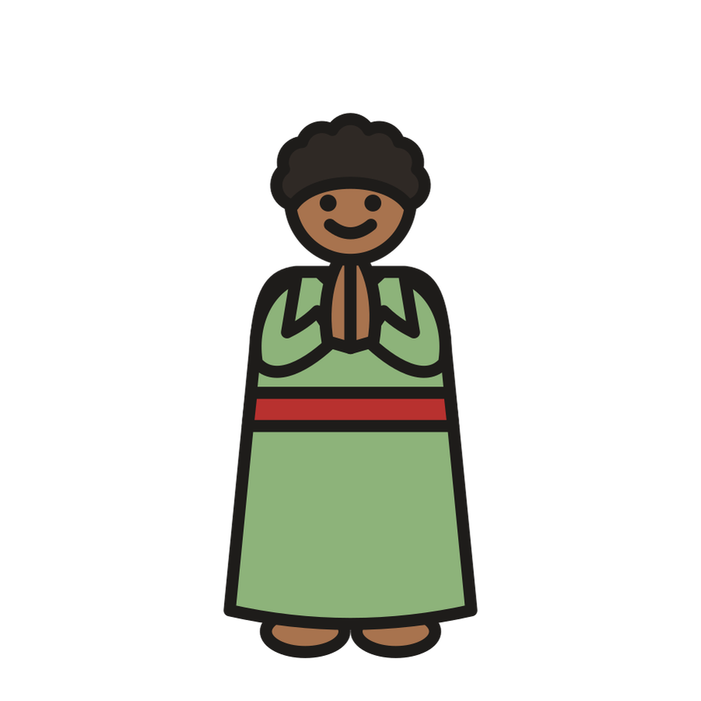
Let’s pray
Dear God, thank you for all your good gifts. Help us turn back and say thank you. Thank you for loving everyone. Amen.
Notes:
Read the prayer one line at a time and let the children repeat each line after you.

