Slide 1
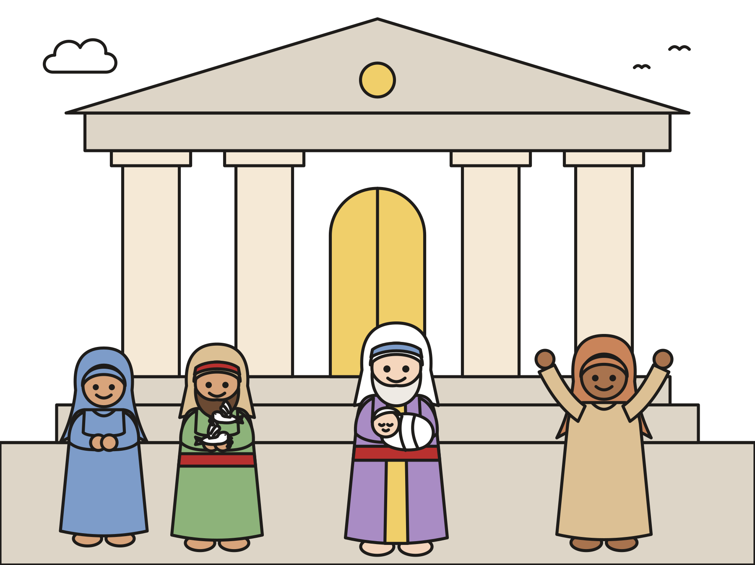
Sunday school · Ages 7–9
Simeon and Anna meet baby Jesus
Luke 2:22–40
Mainline Christian
Notes:
Welcome the children. Today’s story comes from Luke 2:22–40.

Slide 2

Welcome!
What is the hardest thing you ever had to wait for?
Notes:
Welcome each child by name. Ask the question and let two or three children answer. Say: Today we will meet two people who waited a very long time.

Slide 3

Mary and Joseph had a baby.
They named him Jesus. They wanted to thank God for him.
Notes:
When Jesus was about six weeks old, Mary and Joseph wanted to thank God for him. Jewish families did this for a first baby boy.

Slide 4

Up to the temple
They walked to God’s house in Jerusalem. They brought two birds as a gift.
Notes:
The temple was God’s house in Jerusalem. It was big and busy. Mary and Joseph did not have much money. They brought two birds, the gift for families who could not buy a lamb.

Slide 5

Simeon was waiting.
God promised Simeon he would see the one God was sending.
Notes:
Simeon loved God. He had waited for years for God to send the one God promised. God’s Holy Spirit told him, “You will see him before you die.” That day the Spirit nudged him: Go to the temple!

Slide 6
Simeon held baby Jesus.
He praised God: “My eyes have seen your salvation!”
Notes:
Simeon saw Mary and Joseph and their baby. He knew right away. He took baby Jesus in his arms and praised God. “Now I can go in peace. My eyes have seen your salvation!”

Slide 7
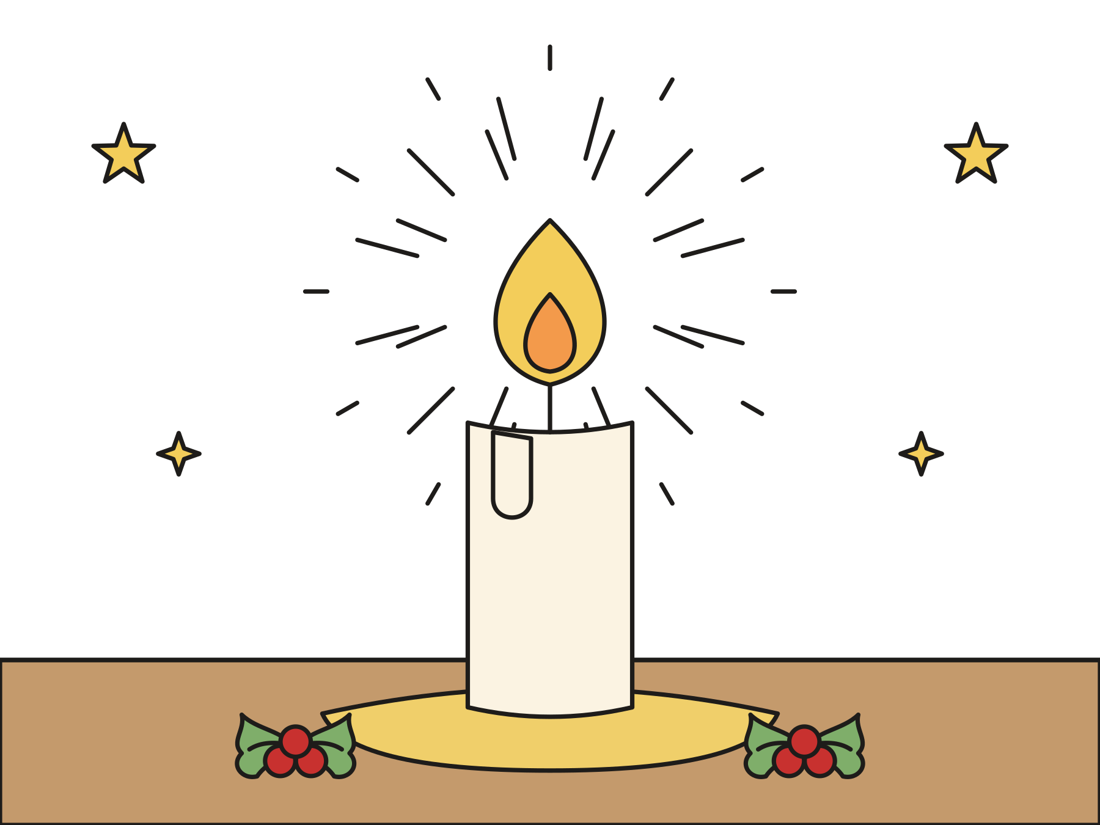
A light for everyone
Simeon said Jesus would be a light for all people.
Notes:
Simeon said this baby would be a light for all the nations, for everyone everywhere. Mary and Joseph were amazed. Simeon blessed them.

Slide 8
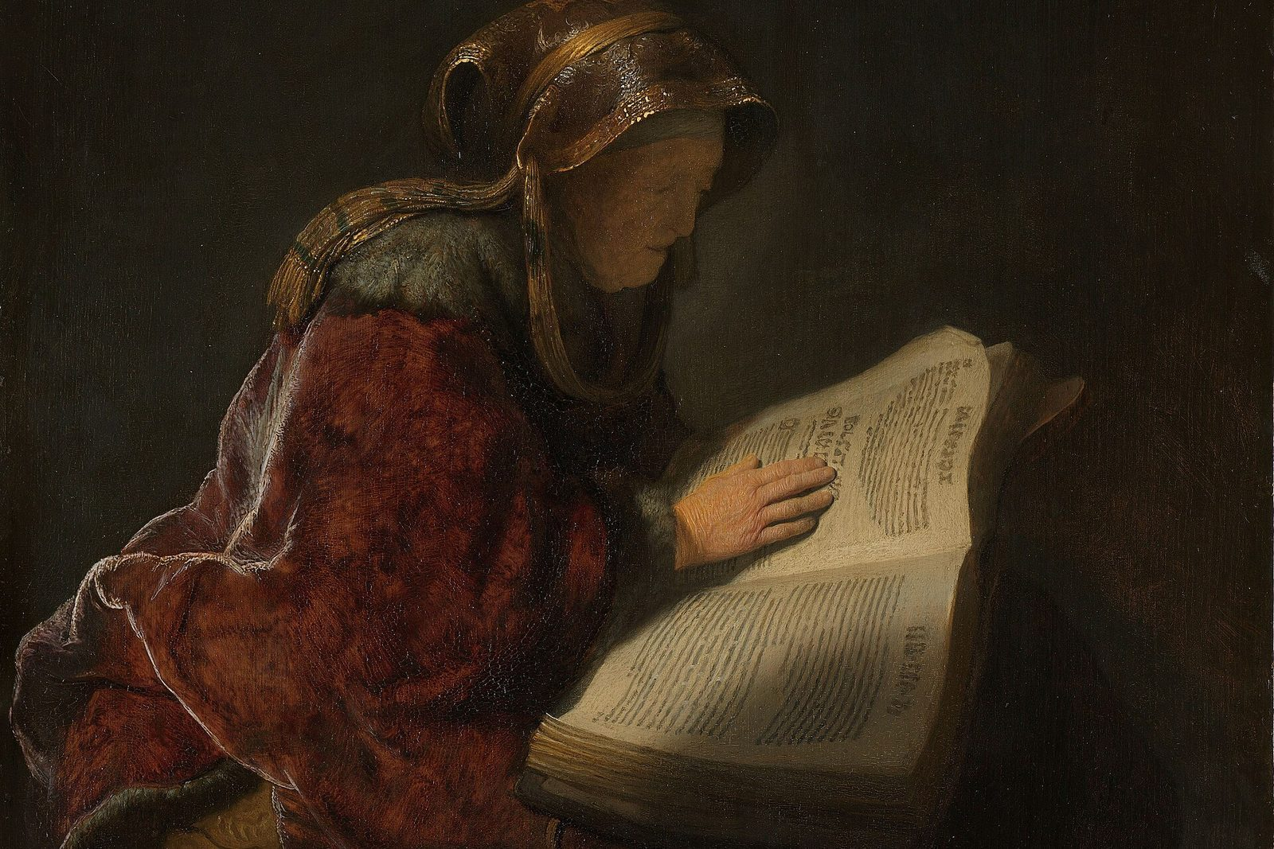
Anna came at just the right time.
Anna was very old. She prayed at the temple day and night.
Notes:
Then Anna came up. She was a prophet, a person who speaks for God. She was very, very old. Rembrandt painted this old woman reading almost 400 years ago. The museum that owns the painting thinks she is Anna.

Slide 9

Anna said thank you!
Then she told everyone about baby Jesus.
Notes:
When Anna saw Jesus, she thanked God. Then she told everyone who was waiting for God’s help. The one God promised is here!

Slide 10

Jesus grew up.
He grew strong and wise. God’s grace was upon him.
Notes:
Mary and Joseph took Jesus home to Nazareth. He grew bigger and stronger and wiser. God’s grace, God’s loving kindness, was upon him.

Slide 11

God keeps promises.
God’s love is for babies, children, grown-ups, and very old people too.
Notes:
Simeon and Anna waited a long, long time, and God kept the promise. God loves people of every age, and that means you.

Slide 12
I wonder…
I wonder how Simeon felt when he held baby Jesus.
Notes:
Wait for answers. Every answer is welcome.

Slide 13
I wonder…
I wonder what you are waiting for.
Notes:
Receive every answer gently. Some children may be waiting for something hard, like a family member to get well.

Slide 14
Question 1 of 7
Where did Mary and Joseph take baby Jesus?
To the temple in Jerusalem
To the beach
A
B
To a castle
To a farm
C
D
Notes:
Read the question and the choices aloud, and let the children answer. Then show the answer: To the temple in Jerusalem. They went to the temple, God’s house, to thank God for Jesus.

Slide 15
Question 1 of 7
Where did Mary and Joseph take baby Jesus?
To the temple in Jerusalem
To the beach
A
B
To a castle
To a farm
C
D
The answer is A. They went to the temple, God’s house, to thank God for Jesus.
Notes:
The answer is A: To the temple in Jerusalem. They went to the temple, God’s house, to thank God for Jesus.

Slide 16
Question 2 of 7
What gift did Mary and Joseph bring?
Two birds
A bag of gold
A
B
A big cake
A puppy
C
D
Notes:
Read the question and the choices aloud, and let the children answer. Then show the answer: Two birds. Two birds were the gift for families who could not buy a lamb.

Slide 17
Question 2 of 7
What gift did Mary and Joseph bring?
Two birds
A bag of gold
A
B
A big cake
A puppy
C
D
The answer is A. Two birds were the gift for families who could not buy a lamb.
Notes:
The answer is A: Two birds. Two birds were the gift for families who could not buy a lamb.

Slide 18
Question 3 of 7
What was Simeon waiting for?
A new pair of shoes
A ride on a camel
A
B
To see the one God promised
C
Notes:
Read the question and the choices aloud, and let the children answer. Then show the answer: To see the one God promised. God’s Spirit promised Simeon he would see God’s chosen one.

Slide 19
Question 3 of 7
What was Simeon waiting for?
A new pair of shoes
A ride on a camel
A
B
To see the one God promised
C
The answer is C. God’s Spirit promised Simeon he would see God’s chosen one.
Notes:
The answer is C: To see the one God promised. God’s Spirit promised Simeon he would see God’s chosen one.

Slide 20
Question 4 of 7
What did Simeon do when he saw Jesus?
He held him and praised God
He ran away
A
B
He went to sleep
C
Notes:
Read the question and the choices aloud, and let the children answer. Then show the answer: He held him and praised God. Simeon took Jesus in his arms and thanked God.

Slide 21
Question 4 of 7
What did Simeon do when he saw Jesus?
He held him and praised God
He ran away
A
B
He went to sleep
C
The answer is A. Simeon took Jesus in his arms and thanked God.
Notes:
The answer is A: He held him and praised God. Simeon took Jesus in his arms and thanked God.

Slide 22
Question 5 of 7
What did Anna do day and night?
She prayed at the temple
She sailed a boat
A
B
She baked cookies
C
Notes:
Read the question and the choices aloud, and let the children answer. Then show the answer: She prayed at the temple. Anna stayed at the temple, praying and worshiping God.

Slide 23
Question 5 of 7
What did Anna do day and night?
She prayed at the temple
She sailed a boat
A
B
She baked cookies
C
The answer is A. Anna stayed at the temple, praying and worshiping God.
Notes:
The answer is A: She prayed at the temple. Anna stayed at the temple, praying and worshiping God.

Slide 24
Question 6 of 7
Who did Anna tell about Jesus?
Nobody at all
Only her cat
A
B
Everyone who was waiting for God’s help
C
Notes:
Read the question and the choices aloud, and let the children answer. Then show the answer: Everyone who was waiting for God’s help. Anna thanked God and told everyone the good news.

Slide 25
Question 6 of 7
Who did Anna tell about Jesus?
Nobody at all
Only her cat
A
B
Everyone who was waiting for God’s help
C
The answer is C. Anna thanked God and told everyone the good news.
Notes:
The answer is C: Everyone who was waiting for God’s help. Anna thanked God and told everyone the good news.

Slide 26
Question 7 of 7
Who is Jesus a light for?
All people everywhere
Only grown-ups
A
B
Only people in Jerusalem
C
Notes:
Read the question and the choices aloud, and let the children answer. Then show the answer: All people everywhere. Simeon said Jesus would be a light for all the nations.

Slide 27
Question 7 of 7
Who is Jesus a light for?
All people everywhere
Only grown-ups
A
B
Only people in Jerusalem
C
The answer is A. Simeon said Jesus would be a light for all the nations.
Notes:
The answer is A: All people everywhere. Simeon said Jesus would be a light for all the nations.

Slide 28

Great job!
You finished all 7 questions.
Notes:
Thank the children for listening so well.

Slide 29
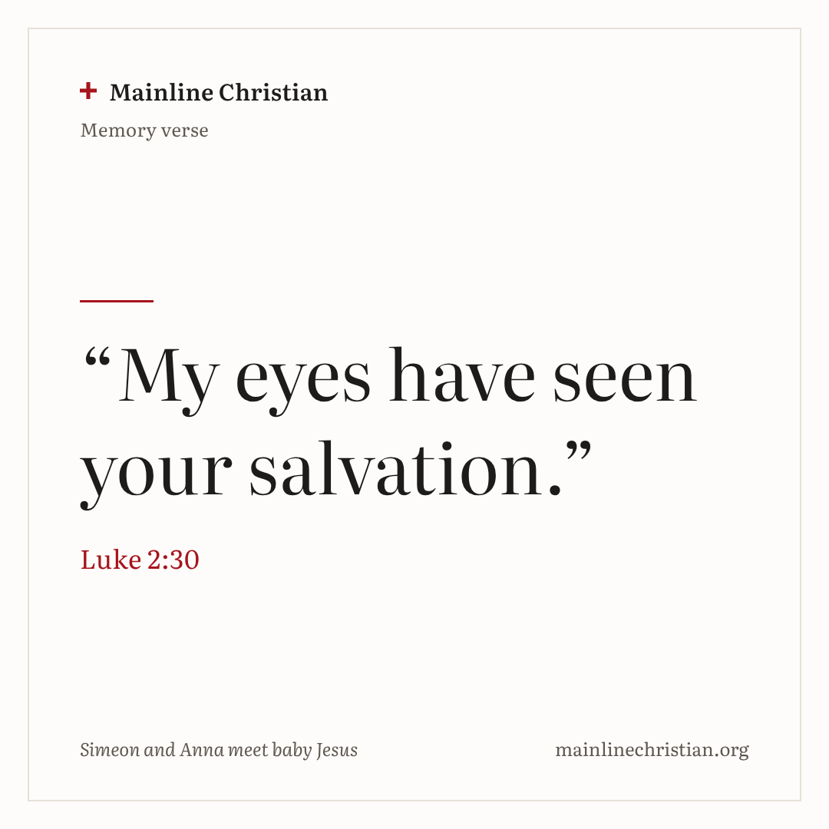
Our memory verse
“My eyes have seen your salvation.”
Luke 2:30
Notes:
Say the verse with motions. “My eyes” (point to your eyes). “Have seen” (shade your eyes and look around). “Your salvation” (rock a baby in your arms). Salvation means God’s way of saving and helping people.

Slide 30
Make a light-for-everyone candle
Wrap white paper around a tube.
Decorate your candle.
Cut a yellow flame and an orange flame.
Glue the flames together.
Tape the flame inside the top.
Notes:
Show a finished candle first. These candles use no real fire. Write “Jesus is a light for everyone!” on each candle.

Slide 31
Simeon says
If the leader says “Simeon says,” do it!
If not, freeze.
If you move by mistake, laugh and keep playing.
Notes:
Use actions from the story: rock a baby, flap like a bird, fold your hands like Anna, look up and praise God. No one is ever out.

Slide 32
Let’s pray
Dear God, thank you for keeping your promises. Thank you for Jesus, a light for everyone. Amen.
Notes:
Read the prayer one line at a time and let the children repeat each line after you.

