Slide 1
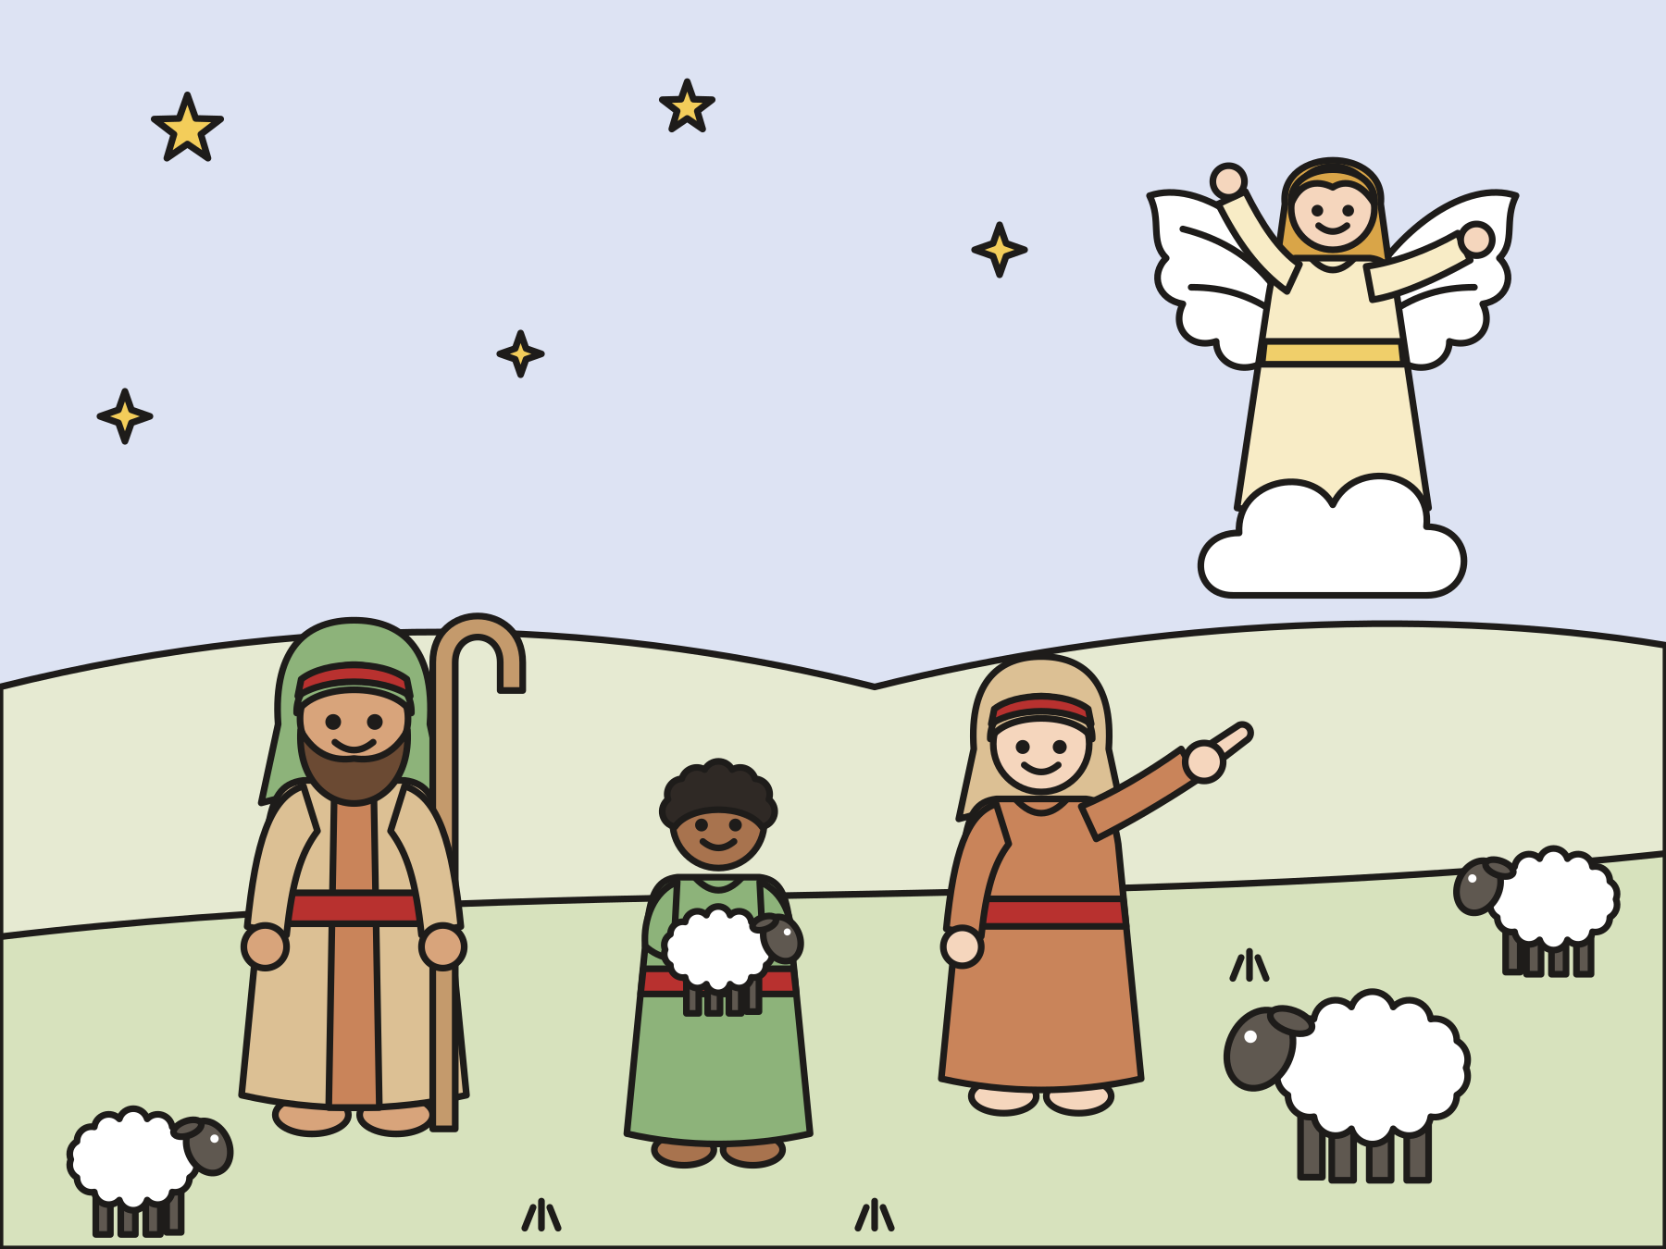
Sunday school · Ages 7–9
The shepherds hear the good news
Luke 2:8–20
Mainline Christian
Notes:
Welcome the children. Today’s story comes from Luke 2:8–20.

Slide 2

Welcome!
What is the best news you ever heard?
Notes:
Welcome each child by name. Ask the question and let two or three children answer. Say: Today’s story is about the best news anyone ever heard.

Slide 3
Shepherds in the fields
It was night. The shepherds were watching their sheep.
Notes:
On the night Jesus was born, some shepherds were out in the fields near Bethlehem. It was dark. They stayed awake to keep the sheep safe.

Slide 4
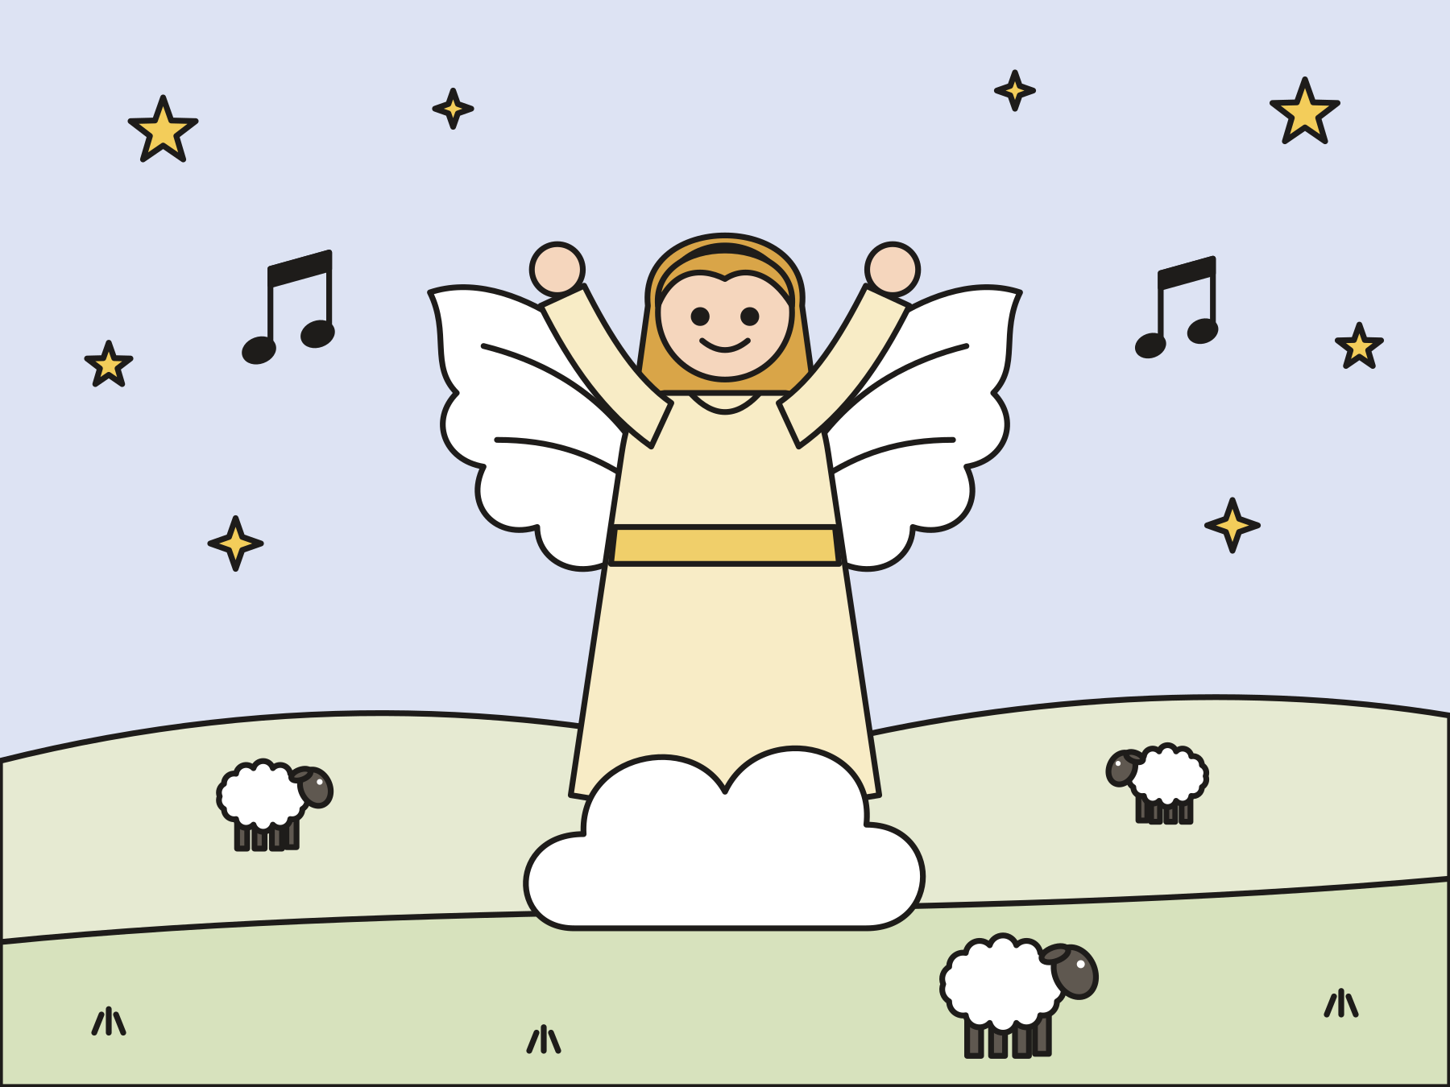
An angel came!
God’s glory shone all around. The shepherds were scared.
Notes:
Suddenly an angel of the Lord stood in front of them. Bright light shone all around. The shepherds were terrified!

Slide 5
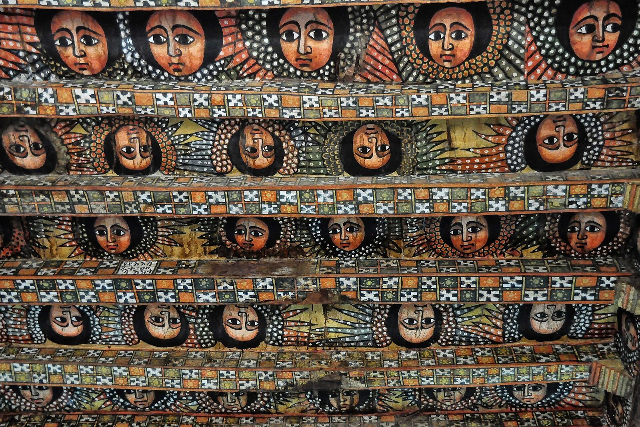
Don’t be afraid!
“Don’t be afraid, for behold, I bring you good news of great joy which will be to all the people.”
Luke 2:10
Notes:
The angel said, Don’t be afraid! I have good news. It is for all the people. These angels are painted on the ceiling of a church in Ethiopia, in Africa.

Slide 6

A Savior is born!
You will find a baby wrapped in cloth, lying in a manger.
Notes:
The angel said, Today a Savior is born in Bethlehem. Here is how you will know him. You will find a baby wrapped in cloth, lying in a manger.

Slide 7
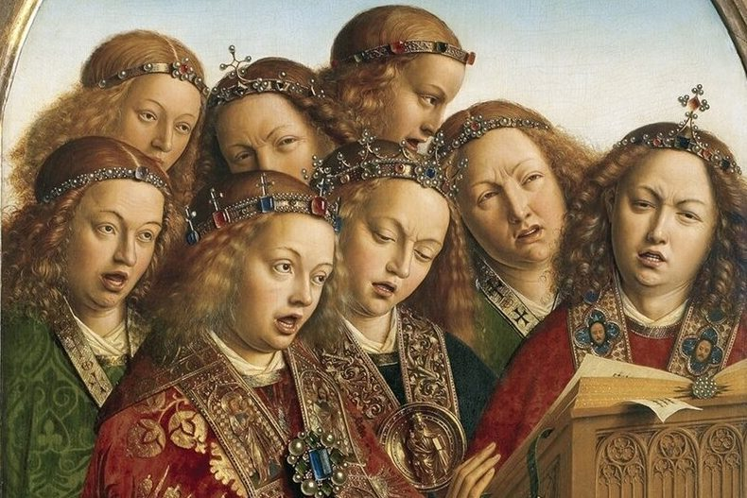
Glory to God!
“Glory to God in the highest, on earth peace”
Luke 2:14
Notes:
Then the whole sky filled with angels. They praised God and sang. Let’s say their song together!

Slide 8
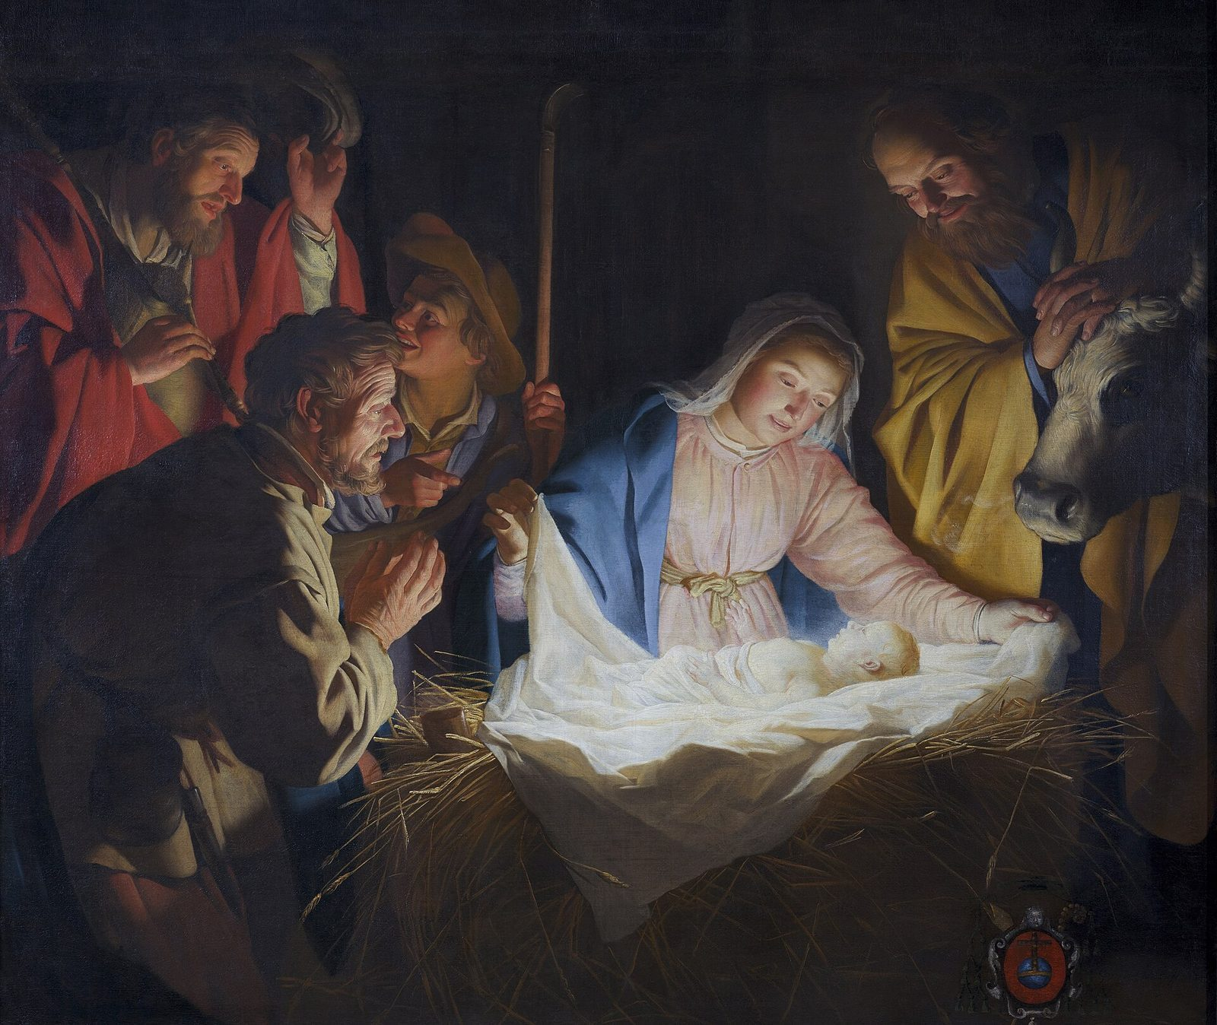
Let’s go to Bethlehem!
The shepherds hurried. They found Mary, Joseph, and the baby.
Notes:
The shepherds said to each other, Let’s go to Bethlehem now and see! They hurried and found Mary and Joseph, and the baby lying in the manger. Look at the light shining on their faces in this painting.

Slide 9

They told everyone!
The shepherds went back to their sheep, praising God.
Notes:
The shepherds told everyone what the angel had said. People were amazed. Mary kept all these things in her heart. The shepherds went back to their fields, praising God all the way.

Slide 10
Good news for everyone
God’s good news came first to shepherds. It is for you too!
Notes:
God sent the good news first to ordinary working people out in the dark. That tells us the good news is for everyone.

Slide 11
I wonder…
I wonder how the shepherds felt when the angel came.
Notes:
Wait for answers. Every answer is welcome.

Slide 12
I wonder…
I wonder who you would tell this good news to.
Notes:
Let the children name people. Every answer is welcome.

Slide 13
Question 1 of 7
What were the shepherds doing that night?
Watching their sheep
Baking bread
A
B
Fishing in a boat
Sleeping in a castle
C
D
Notes:
Read the question and the choices aloud, and let the children answer. Then show the answer: Watching their sheep. They were out in the fields, keeping watch over their flock.

Slide 14
Question 1 of 7
What were the shepherds doing that night?
Watching their sheep
Baking bread
A
B
Fishing in a boat
Sleeping in a castle
C
D
The answer is A. They were out in the fields, keeping watch over their flock.
Notes:
The answer is A: Watching their sheep. They were out in the fields, keeping watch over their flock.

Slide 15
Question 2 of 7
What did the angel say first?
Go back to sleep
Run away
A
B
Don’t be afraid
Count your sheep
C
D
Notes:
Read the question and the choices aloud, and let the children answer. Then show the answer: Don’t be afraid. The shepherds were scared, so the angel said, “Don’t be afraid.”

Slide 16
Question 2 of 7
What did the angel say first?
Go back to sleep
Run away
A
B
Don’t be afraid
Count your sheep
C
D
The answer is C. The shepherds were scared, so the angel said, “Don’t be afraid.”
Notes:
The answer is C: Don’t be afraid. The shepherds were scared, so the angel said, “Don’t be afraid.”

Slide 17
Question 3 of 7
Who is the good news for?
Only kings
Only angels
A
B
All the people
Only grown-ups
C
D
Notes:
Read the question and the choices aloud, and let the children answer. Then show the answer: All the people. The angel said the good news was for all the people. That means you too!

Slide 18
Question 3 of 7
Who is the good news for?
Only kings
Only angels
A
B
All the people
Only grown-ups
C
D
The answer is C. The angel said the good news was for all the people. That means you too!
Notes:
The answer is C: All the people. The angel said the good news was for all the people. That means you too!

Slide 19
Question 4 of 7
How would the shepherds know the baby?
He would be lying in a manger
He would wear a crown
A
B
He would be riding a camel
He would be in a palace
C
D
Notes:
Read the question and the choices aloud, and let the children answer. Then show the answer: He would be lying in a manger. The angel said they would find a baby wrapped in cloth, lying in a manger.

Slide 20
Question 4 of 7
How would the shepherds know the baby?
He would be lying in a manger
He would wear a crown
A
B
He would be riding a camel
He would be in a palace
C
D
The answer is A. The angel said they would find a baby wrapped in cloth, lying in a manger.
Notes:
The answer is A: He would be lying in a manger. The angel said they would find a baby wrapped in cloth, lying in a manger.

Slide 21
Question 5 of 7
What did the angels sing?
Happy birthday to you!
Glory to God in the highest!
A
B
Twinkle, twinkle, little star!
Row, row, row your boat!
C
D
Notes:
Read the question and the choices aloud, and let the children answer. Then show the answer: Glory to God in the highest!. The angels praised God: “Glory to God in the highest, on earth peace.”

Slide 22
Question 5 of 7
What did the angels sing?
Happy birthday to you!
Glory to God in the highest!
A
B
Twinkle, twinkle, little star!
Row, row, row your boat!
C
D
The answer is B. The angels praised God: “Glory to God in the highest, on earth peace.”
Notes:
The answer is B: Glory to God in the highest!. The angels praised God: “Glory to God in the highest, on earth peace.”

Slide 23
Question 6 of 7
What did the shepherds do after they saw Jesus?
They kept it a secret
They went to sleep
A
B
They told everyone and praised God
They got lost
C
D
Notes:
Read the question and the choices aloud, and let the children answer. Then show the answer: They told everyone and praised God. They shared the good news, and they went home praising God.

Slide 24
Question 6 of 7
What did the shepherds do after they saw Jesus?
They kept it a secret
They went to sleep
A
B
They told everyone and praised God
They got lost
C
D
The answer is C. They shared the good news, and they went home praising God.
Notes:
The answer is C: They told everyone and praised God. They shared the good news, and they went home praising God.

Slide 25
Question 7 of 7
Why do you think God told shepherds first?
Shepherds were the richest people
The angels were lost
A
B
Only shepherds can hear angels
God’s good news is for everyone
C
D
Notes:
Read the question and the choices aloud, and let the children answer. Then show the answer: God’s good news is for everyone. God chose ordinary working people to hear the news first. It is for everyone.

Slide 26
Question 7 of 7
Why do you think God told shepherds first?
Shepherds were the richest people
The angels were lost
A
B
Only shepherds can hear angels
God’s good news is for everyone
C
D
The answer is D. God chose ordinary working people to hear the news first. It is for everyone.
Notes:
The answer is D: God’s good news is for everyone. God chose ordinary working people to hear the news first. It is for everyone.

Slide 27

Great job!
You finished all 7 questions.
Notes:
Thank the children for listening so well.

Slide 28

Our memory verse
“I bring you good news of great joy which will be to all the people.”
Luke 2:10
Notes:
Say the verse with motions. “I bring you good news” (cup your hands around your mouth). “of great joy” (throw your arms up). “which will be to all the people” (sweep your arm around the circle). Say it like an angel, then like a sleepy shepherd, then all together.

Slide 29
Make a good-news angel
Roll half a paper plate into a cone.
Trace and cut out your two hands.
Glue the hands on as wings.
Add a face and a halo.
Write: Good news for all!
Notes:
Show a finished angel first. Help with rolling and taping the cone.

Slide 30
Pass the good news
Sit in a circle.
Whisper the message to your neighbor.
The last person stands up and tells everyone!
Notes:
Use short messages from the story. Laugh together if the message gets mixed up, then shout the real message all together.

Slide 31
Let’s pray
Dear God, thank you for the good news of Jesus. It is for all the people, and for me. Help me share it. Amen.
Notes:
Read the prayer one line at a time and let the children repeat each line after you.

