Slide 1
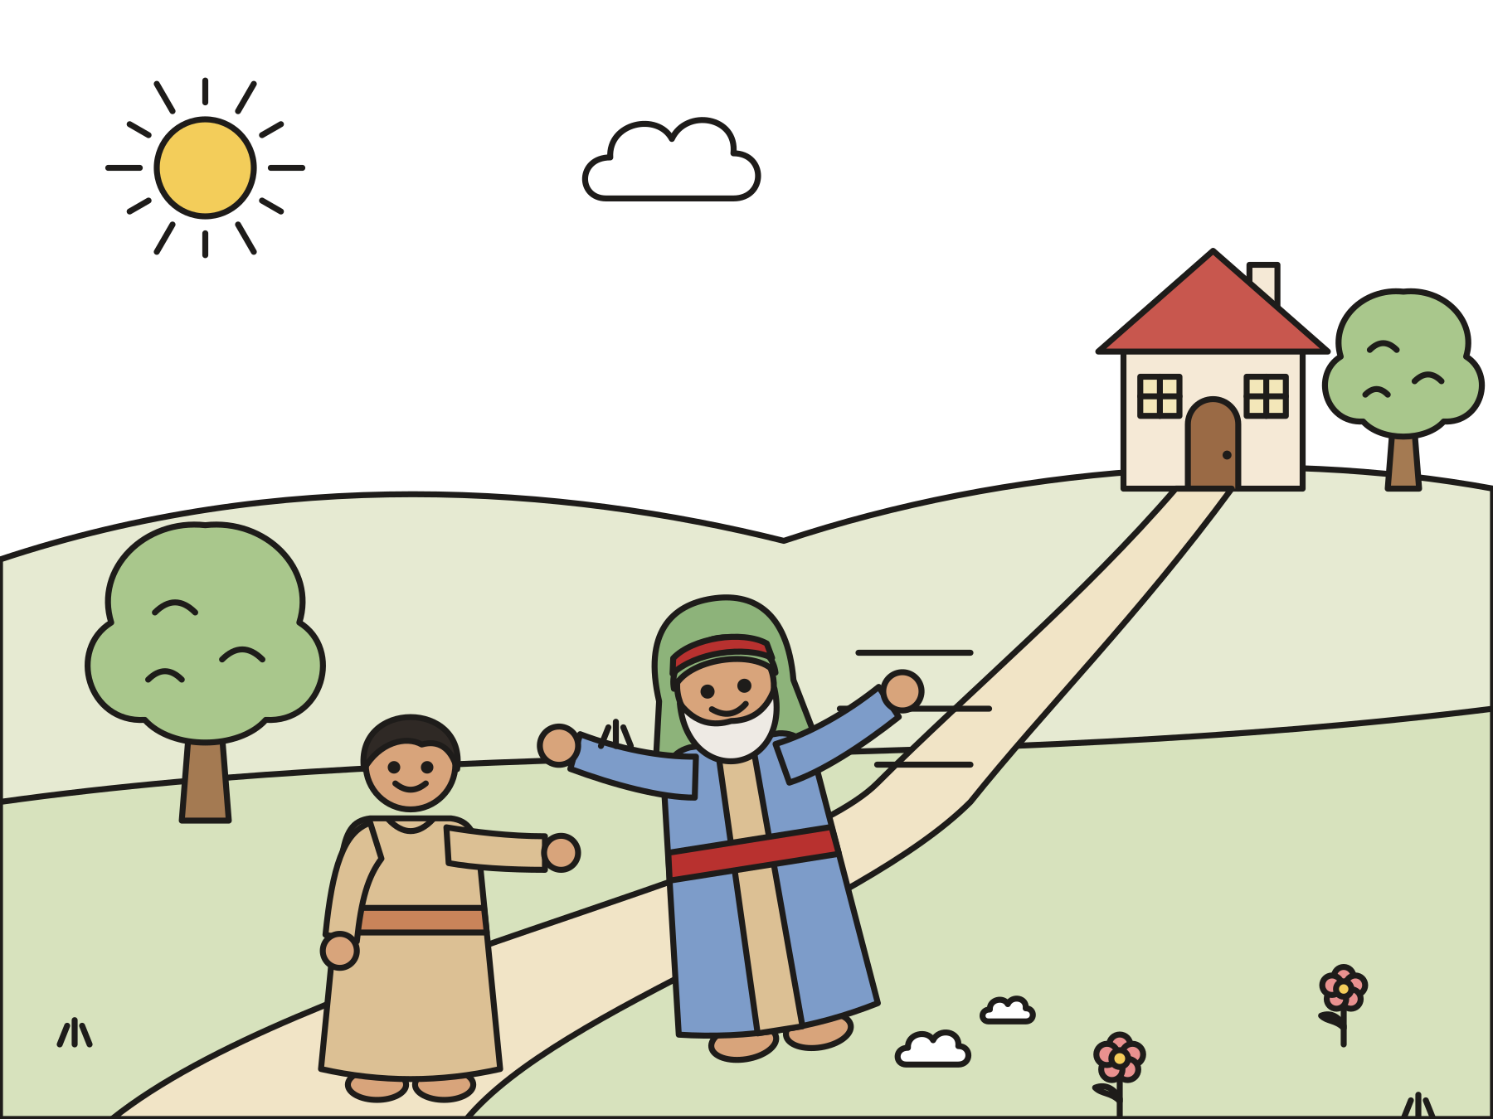
Sunday school · Ages 7–9
The prodigal son
Luke 15:11–32
Mainline Christian
Notes:
Welcome the children. Today’s story comes from Luke 15:11–32.

Slide 2

Welcome!
Have you ever lost something special? How did you feel when you found it?
Notes:
Welcome each child by name. Ask the question and let two or three children answer. Say: Today Jesus tells a story about something very special that was lost.

Slide 3

A father had two sons.
The younger son said, “Give me my share of the money now.”
Notes:
Jesus told this story. A father had two sons. One day the younger son said, “Father, give me my share of your money now.” The father was sad, but he gave it to him.

Slide 4

He went far away.
He spent all his money. Soon it was all gone.
Notes:
The son packed up and went far away. He spent his money on parties and fun things. He did not save any. Soon it was all gone.

Slide 5
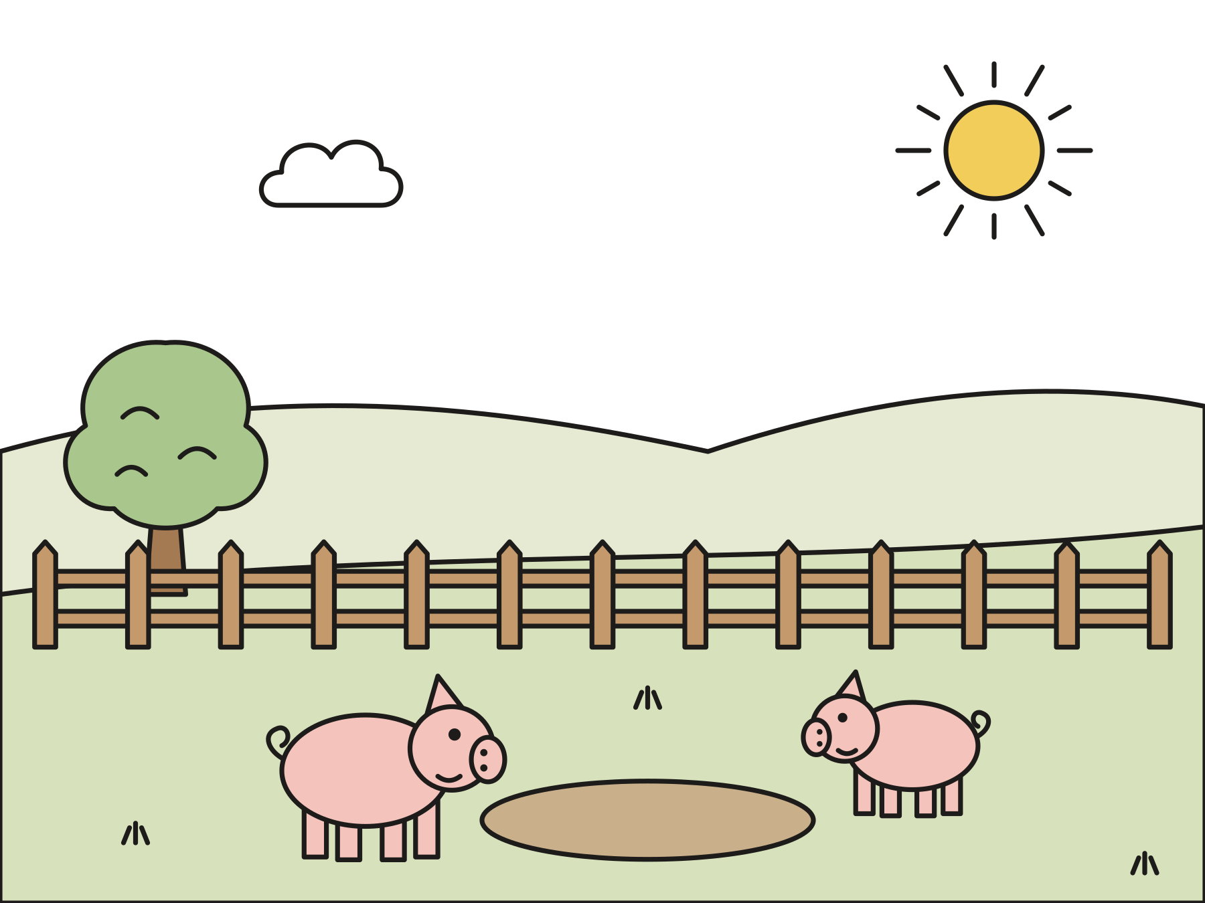
He fed the pigs.
There was no food in that land. He was very hungry.
Notes:
Then the food ran out in that land. The son got a job feeding pigs. He was so hungry that he wanted to eat the pigs’ food!

Slide 6
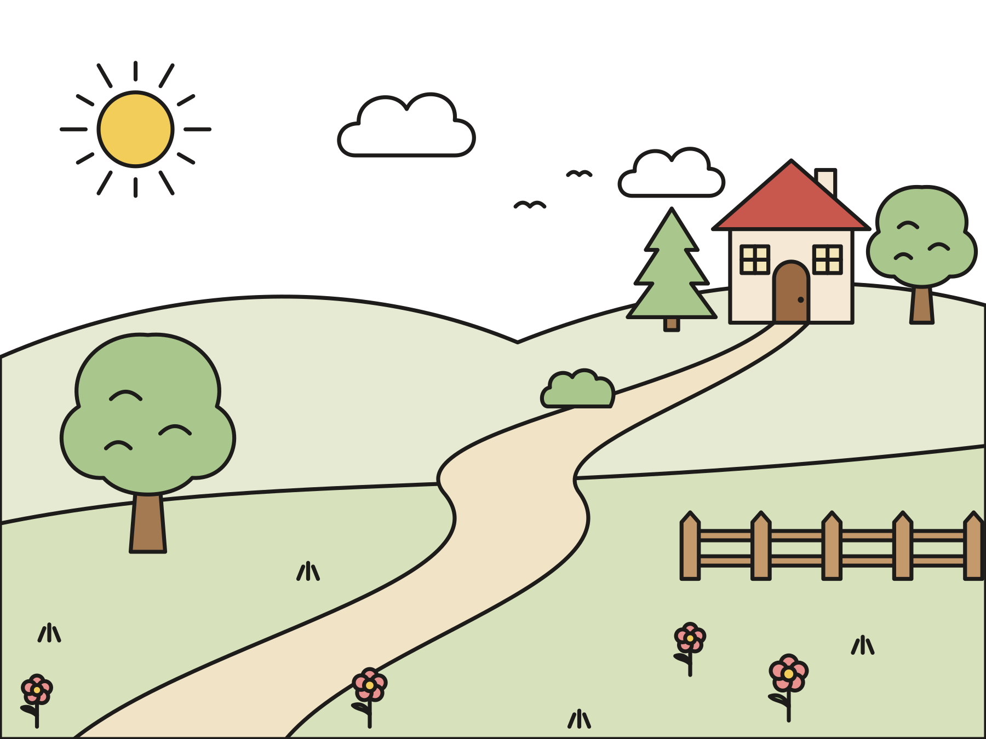
He had an idea.
“I will go home. I will say I am sorry.”
Notes:
The son thought about home. “My father’s helpers have lots of food. I will go home and say I am sorry. Maybe he will let me be a helper.” So he started walking.

Slide 7
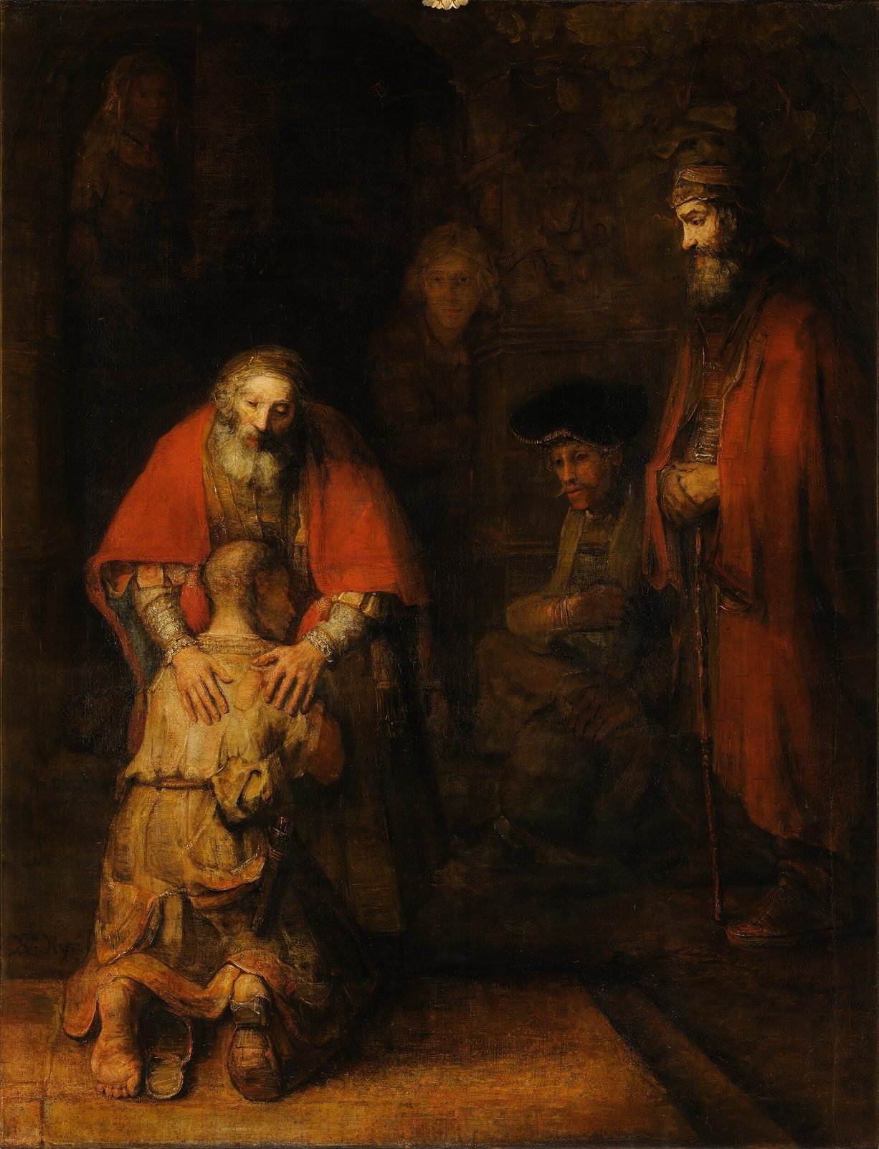
The father ran!
The father saw him far away. He ran and hugged him.
Notes:
The father saw his son while he was still far away. He ran down the road! He hugged him and kissed him. This painting by Rembrandt shows the father holding his son close.

Slide 8
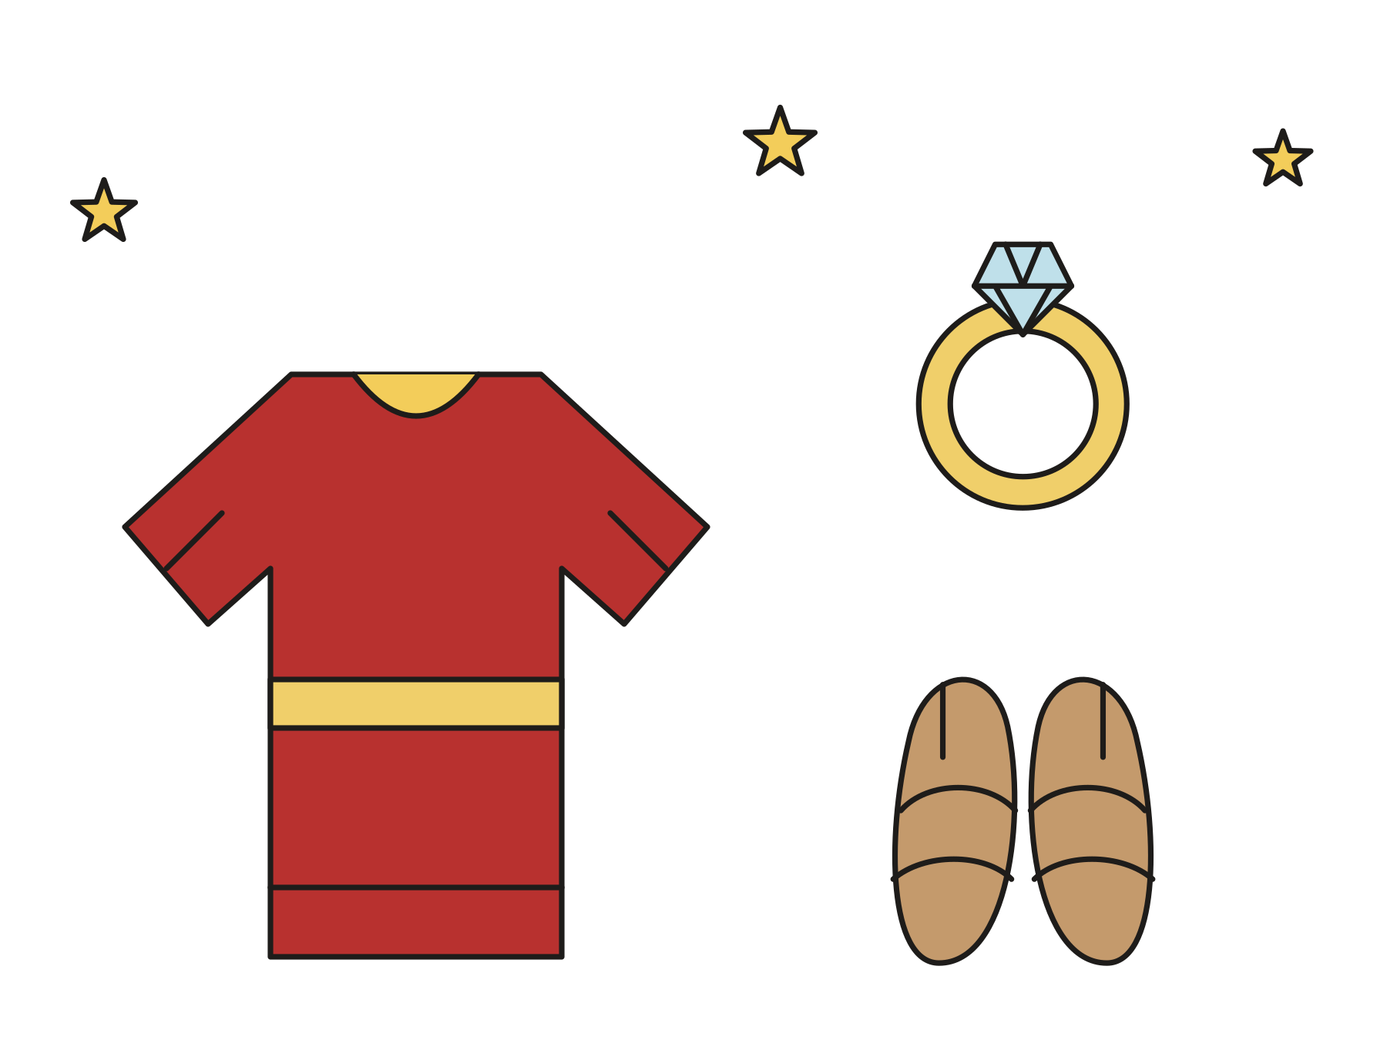
Bring the best robe!
The father gave him a robe, a ring, and sandals.
Notes:
The son said, “I am sorry. I am not good enough to be your son.” The father called his helpers: “Bring the best robe! Put a ring on his hand and shoes on his feet!” These gifts meant: You are my son. You belong here.

Slide 9
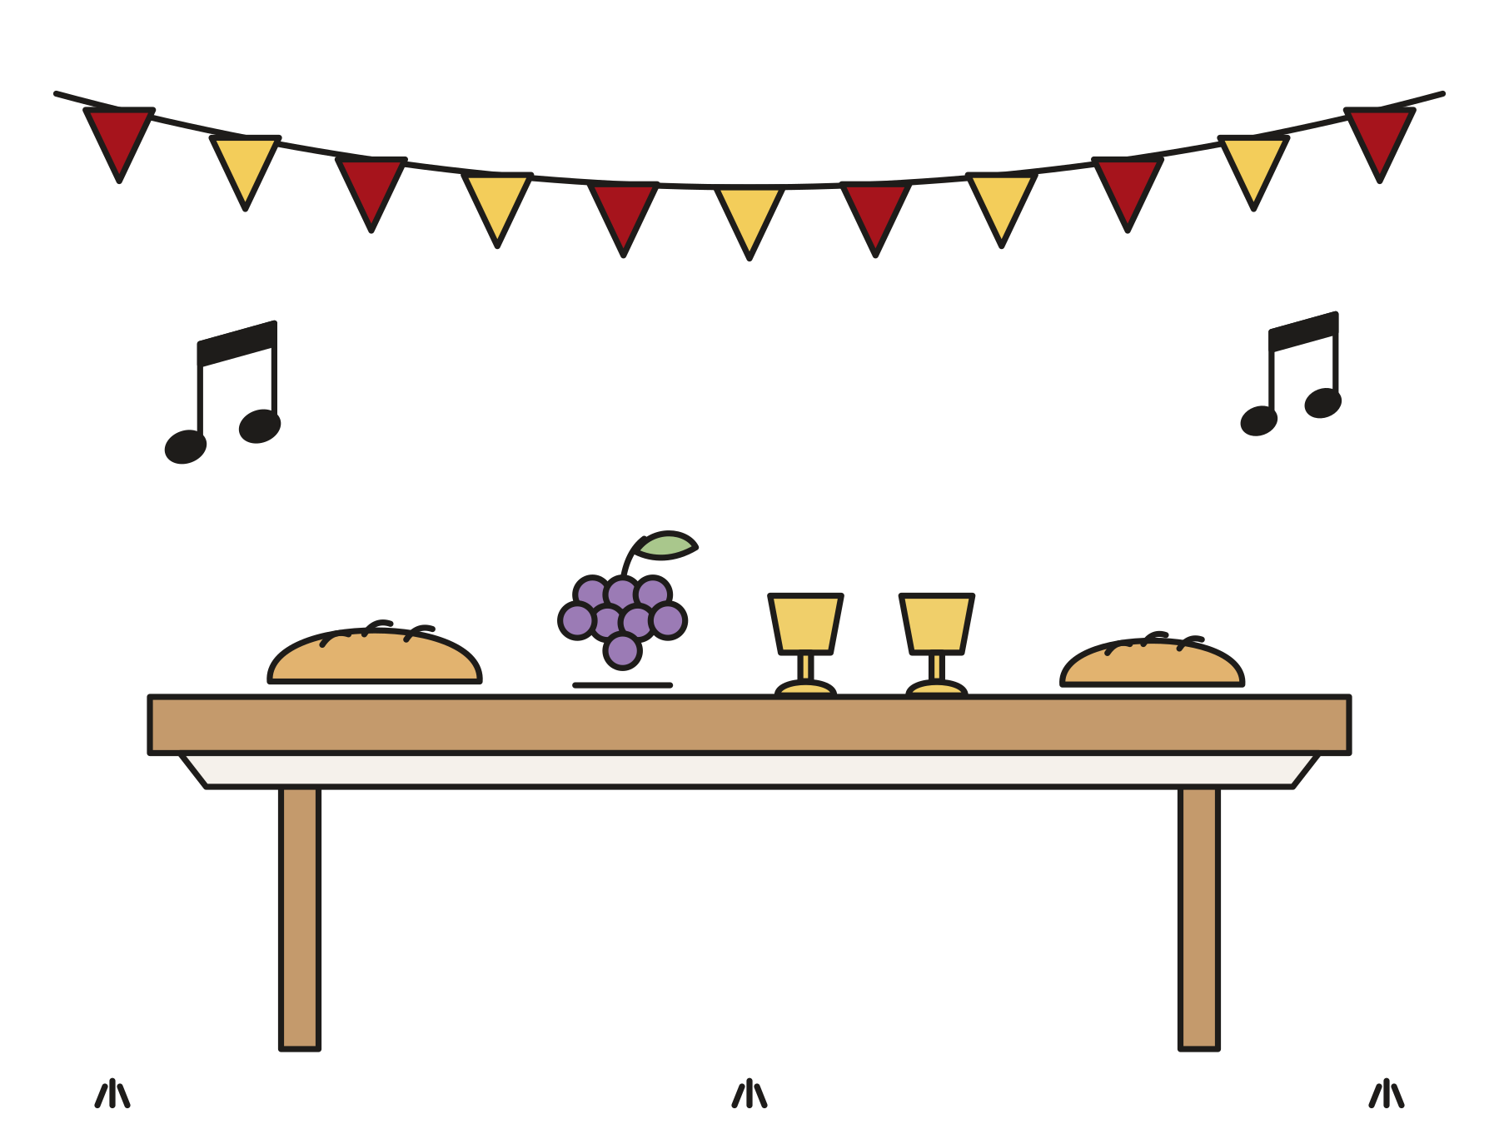
Let’s have a party!
“He was lost and is found.”
Luke 15:24
Notes:
The father said, “Let’s have a party! My son was lost, and now he is found!” Everyone ate and sang and danced.

Slide 10

The older brother was angry.
The father said, “Come in! Your brother is home!”
Notes:
The older brother came in from the field. He heard the music. When he found out why, he was angry and would not go in. The father came out to him too. “You are always with me. All I have is yours. Come and be glad with us!”

Slide 11
God is like the father.
God loves us. God is glad when we come home.
Notes:
Jesus told this story to show us what God is like. God loves us like that father. When we go the wrong way, God is glad when we come back.

Slide 12
I wonder…
I wonder how the son felt when his father ran to him.
Notes:
Wait quietly for answers. Every answer is welcome.

Slide 13
I wonder…
I wonder if the older brother went in to the party.
Notes:
Jesus does not tell us. Let the children imagine the ending.

Slide 14
Question 1 of 7
How many sons did the father have?
Two
One
A
B
Three
Ten
C
D
Notes:
Read the question and the choices aloud, and let the children answer. Then show the answer: Two. Jesus said, “A man had two sons.”

Slide 15
Question 1 of 7
How many sons did the father have?
Two
One
A
B
Three
Ten
C
D
The answer is A. Jesus said, “A man had two sons.”
Notes:
The answer is A: Two. Jesus said, “A man had two sons.”

Slide 16
Question 2 of 7
What job did the younger son get?
Catching fish
Building houses
A
B
Feeding pigs
Baking bread
C
D
Notes:
Read the question and the choices aloud, and let the children answer. Then show the answer: Feeding pigs. He fed pigs in a land far away, and he was very hungry.

Slide 17
Question 2 of 7
What job did the younger son get?
Catching fish
Building houses
A
B
Feeding pigs
Baking bread
C
D
The answer is C. He fed pigs in a land far away, and he was very hungry.
Notes:
The answer is C: Feeding pigs. He fed pigs in a land far away, and he was very hungry.

Slide 18
Question 3 of 7
Why did the son go home?
He wanted more money
His friends told him to
A
B
He was looking for a pig
He was hungry and sorry
C
D
Notes:
Read the question and the choices aloud, and let the children answer. Then show the answer: He was hungry and sorry. He had no food, and he wanted to tell his father he was sorry.

Slide 19
Question 3 of 7
Why did the son go home?
He wanted more money
His friends told him to
A
B
He was looking for a pig
He was hungry and sorry
C
D
The answer is D. He had no food, and he wanted to tell his father he was sorry.
Notes:
The answer is D: He was hungry and sorry. He had no food, and he wanted to tell his father he was sorry.

Slide 20
Question 4 of 7
What did the father do when he saw his son?
He shut the door
He ran and hugged him
A
B
He said, “Go away!”
He went back to sleep
C
D
Notes:
Read the question and the choices aloud, and let the children answer. Then show the answer: He ran and hugged him. The father saw him far away and ran to meet him.

Slide 21
Question 4 of 7
What did the father do when he saw his son?
He shut the door
He ran and hugged him
A
B
He said, “Go away!”
He went back to sleep
C
D
The answer is B. The father saw him far away and ran to meet him.
Notes:
The answer is B: He ran and hugged him. The father saw him far away and ran to meet him.

Slide 22
Question 5 of 7
What did the father give his son?
A bike
A pet pig
A
B
A new house
A robe, a ring, and sandals
C
D
Notes:
Read the question and the choices aloud, and let the children answer. Then show the answer: A robe, a ring, and sandals. These gifts showed that he was still the father’s son.

Slide 23
Question 5 of 7
What did the father give his son?
A bike
A pet pig
A
B
A new house
A robe, a ring, and sandals
C
D
The answer is D. These gifts showed that he was still the father’s son.
Notes:
The answer is D: A robe, a ring, and sandals. These gifts showed that he was still the father’s son.

Slide 24
Question 6 of 7
Why was the older brother angry?
He did not like the food
He was very tired
A
B
He lost his ring
He thought the party was not fair
C
D
Notes:
Read the question and the choices aloud, and let the children answer. Then show the answer: He thought the party was not fair. He had worked hard for a long time, and he felt left out.

Slide 25
Question 6 of 7
Why was the older brother angry?
He did not like the food
He was very tired
A
B
He lost his ring
He thought the party was not fair
C
D
The answer is D. He had worked hard for a long time, and he felt left out.
Notes:
The answer is D: He thought the party was not fair. He had worked hard for a long time, and he felt left out.

Slide 26
Question 7 of 7
What does this story teach us about God?
God loves us and welcomes us home
God wants us to stay far away
A
B
God loves only grown-ups
God is too busy for us
C
D
Notes:
Read the question and the choices aloud, and let the children answer. Then show the answer: God loves us and welcomes us home. Like the father in the story, God is glad when we come home.

Slide 27
Question 7 of 7
What does this story teach us about God?
God loves us and welcomes us home
God wants us to stay far away
A
B
God loves only grown-ups
God is too busy for us
C
D
The answer is A. Like the father in the story, God is glad when we come home.
Notes:
The answer is A: God loves us and welcomes us home. Like the father in the story, God is glad when we come home.

Slide 28

Great job!
You finished all 7 questions.
Notes:
Thank the children for listening so well.

Slide 29

Our memory verse
“He was lost and is found.”
Luke 15:24
Notes:
Say the verse with motions. “He was lost” (hands over your eyes, look around). “And is found” (arms open wide, big smile). Say it softly, then loudly, then in a whisper.

Slide 30
Make a welcome-home hug
Trace your two hands on paper.
Cut out the hands.
Fold a long strip back and forth like a fan.
Glue one hand to each end.
Write: God welcomes me home!
Notes:
Show a finished hug first. Help with cutting as needed. When the hugs are done, children can wrap them around a friend.

Slide 31
Welcome-home relay
Walk fast to the chair.
Put on the robe, the ring, and the sandals.
Take them off and walk fast back.
Cheer: Welcome home!
Notes:
Make two teams if you have eight or more children. Everyone cheers for every runner.

Slide 32
Let’s pray
Dear God, thank you for loving us like the father in Jesus’s story. Thank you for always welcoming us home. Amen.
Notes:
Read the prayer one line at a time and let the children repeat each line after you.

