Slide 1
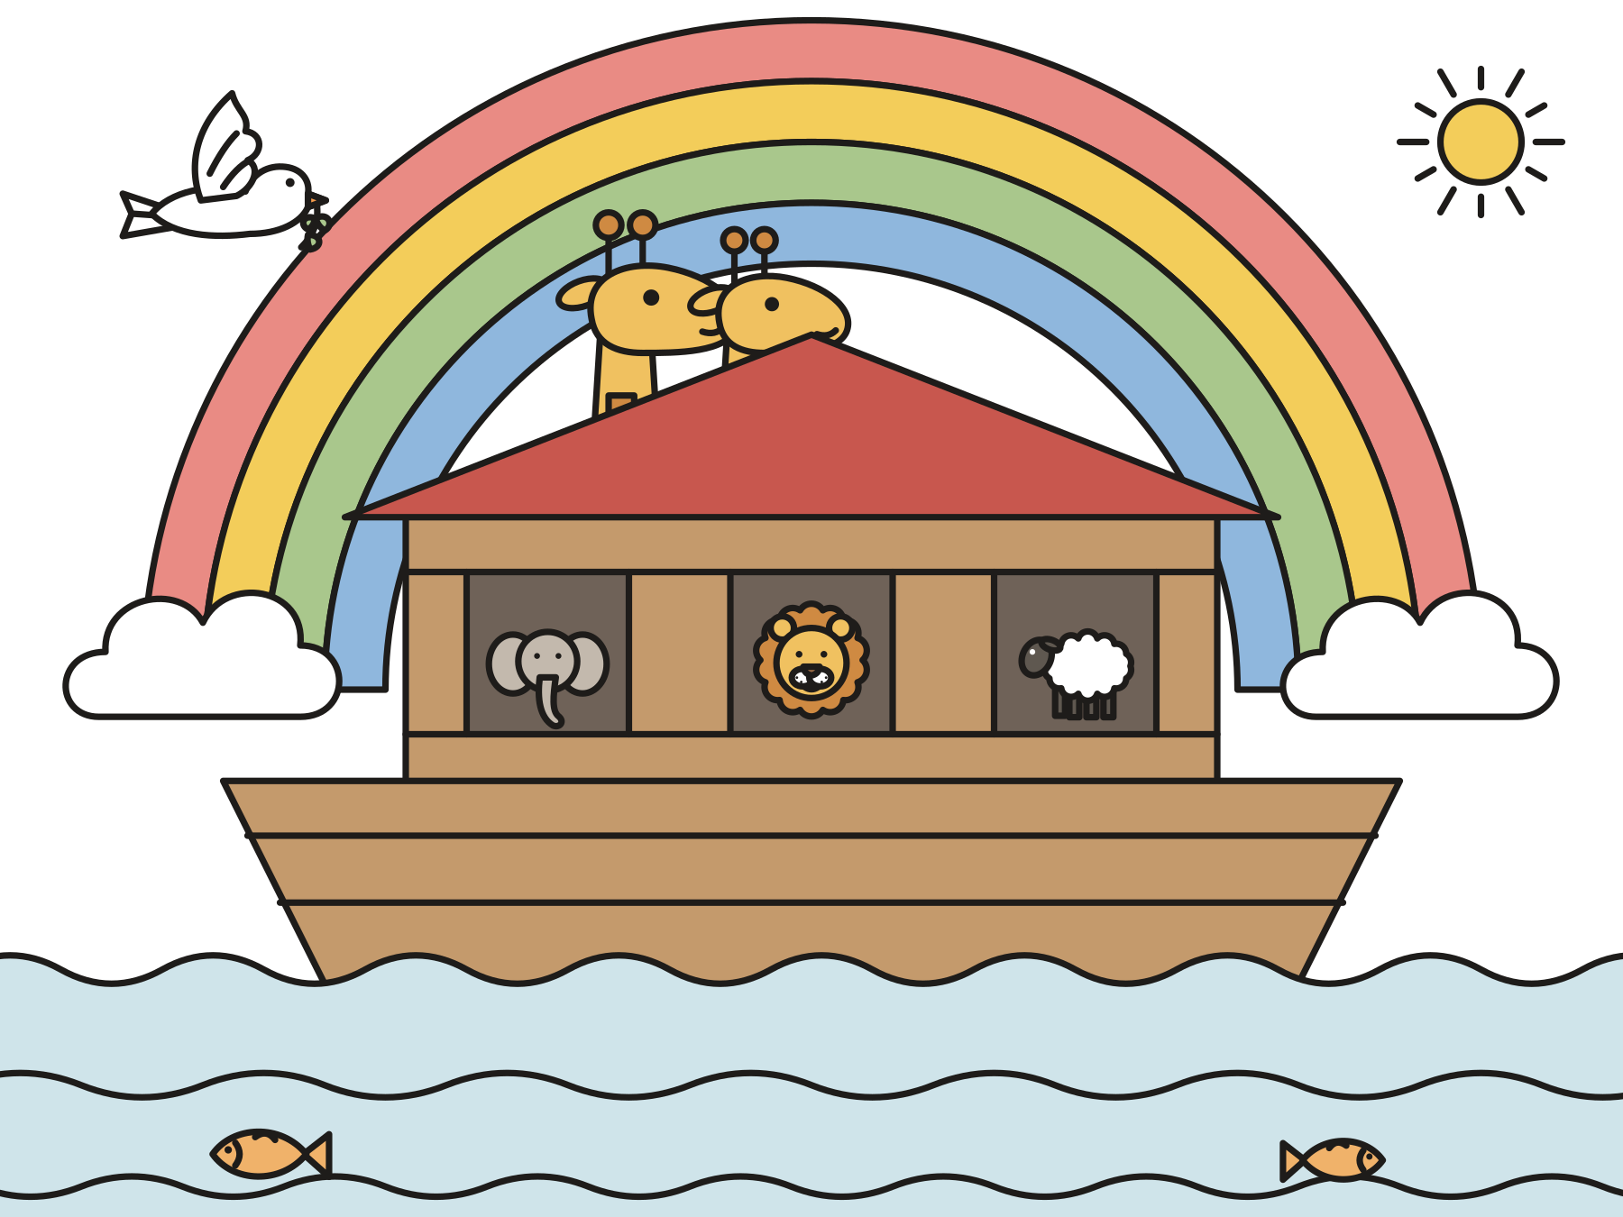
Sunday school · Ages 7–9
Noah builds the ark
Genesis 6:9–22
Mainline Christian
Notes:
Welcome the children. Today’s story comes from Genesis 6:9–22.

Slide 2

Welcome!
What is the biggest boat you have ever seen?
Notes:
Welcome each child by name. Ask the question and let two or three children answer. Say: Today’s story is about the biggest boat in the Bible.

Slide 3

God made a beautiful world.
But people were hurting each other. God was very sad.
Notes:
Long, long ago, God looked at the world God had made. It was full of trees and flowers and animals. But the people were fighting and hurting each other. God was very sad. The Bible says it grieved God’s heart.

Slide 4
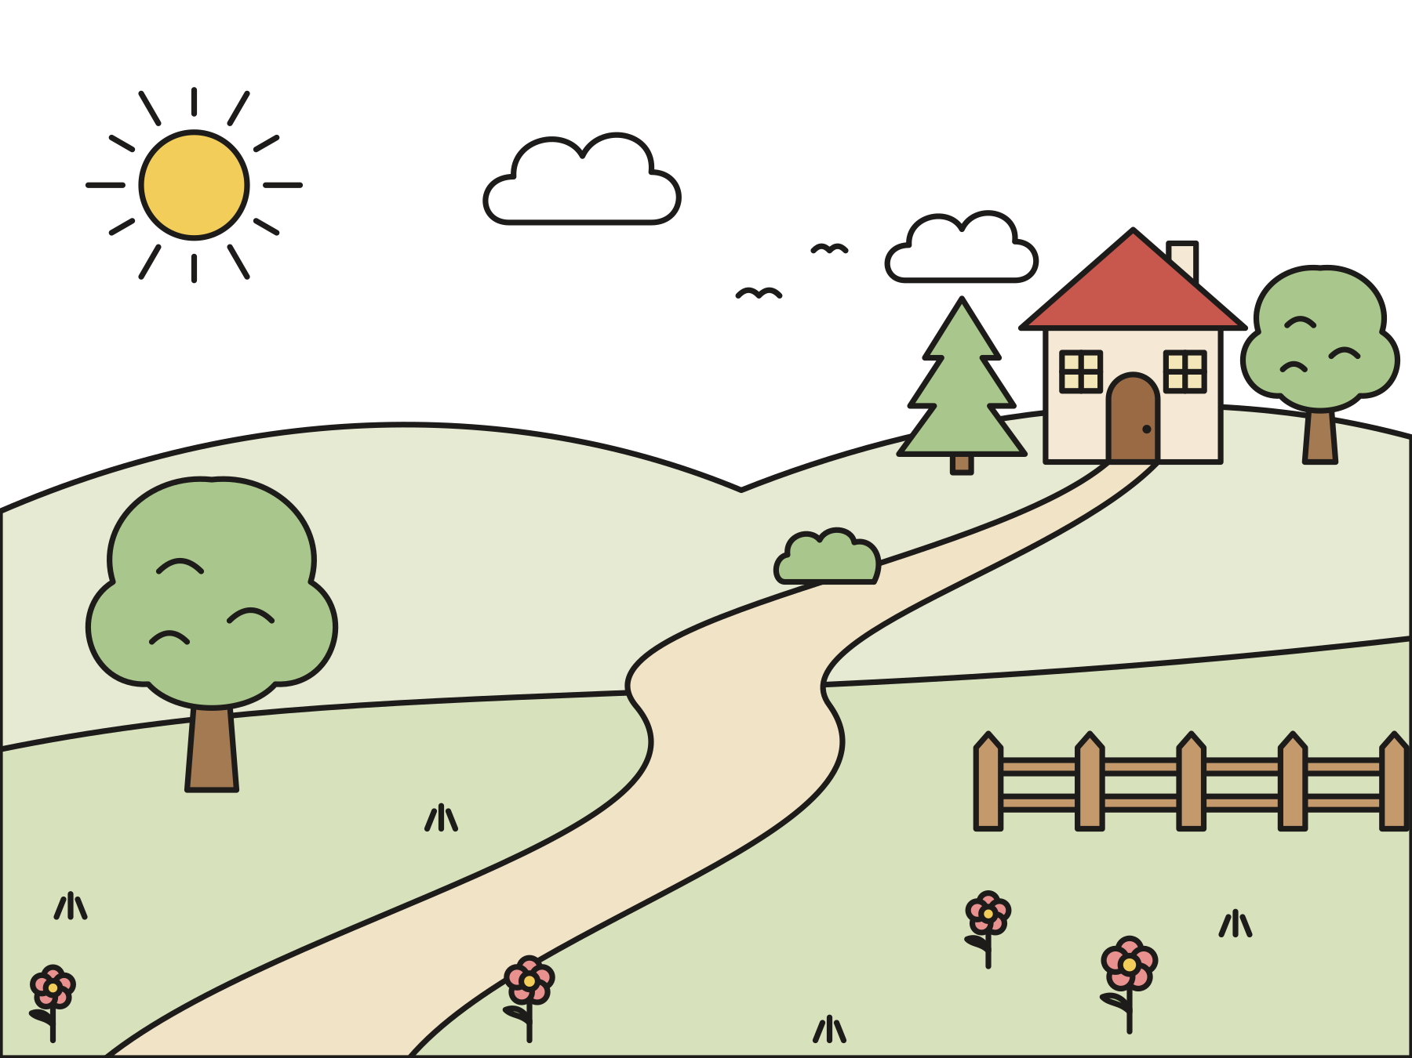
Noah walked with God.
Noah was God’s friend. He listened to God.
Notes:
But there was one man named Noah. The Bible says, “Noah walked with God.” Noah was God’s friend. He listened to God and tried to do what was right. Noah had a wife and three sons, Shem, Ham, and Japheth, and the sons had wives too.

Slide 5

Build an ark!
God asked Noah to build a very big boat out of wood.
Notes:
One day God said, “Noah, build an ark.” An ark is a big boat. God told Noah how to make it: out of wood, with rooms inside, three floors, a roof, and a door in the side. It had to be longer than a football field!

Slide 6

Noah got to work.
He sawed and hammered for a long, long time.
Notes:
That was a big job! But Noah trusted God. He cut down trees. He sawed the boards and hammered them together. He painted the ark with sticky tar so no water could get in. Saw, saw. Bang, bang!

Slide 7
Noah did all God asked.
“Thus Noah did. He did all that God commanded him.”
Genesis 6:22
Notes:
Read the verse together. Noah did everything God asked him to do.

Slide 8
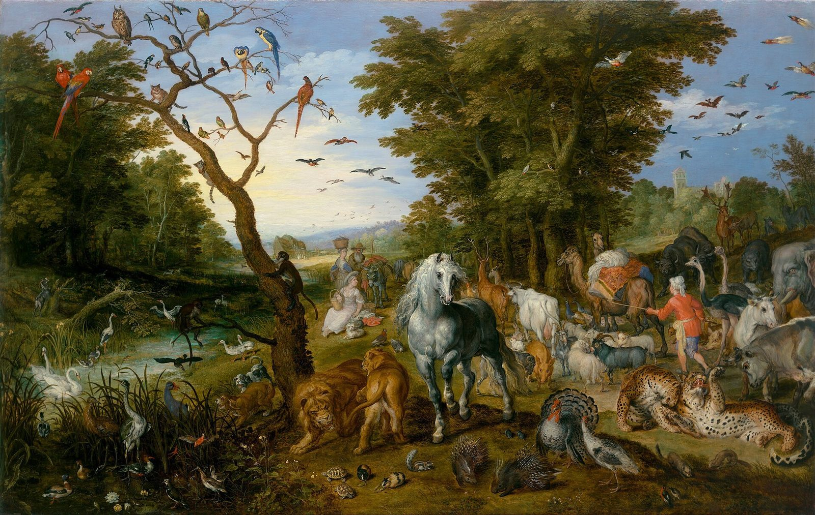
Two by two
The animals came into the ark, two of every kind.
Notes:
When the ark was ready, the animals came, two by two. Lions and lambs. Elephants and eagles. Bears and bees and butterflies! This painting by Jan Brueghel is more than four hundred years old. How many pairs of animals can you find?

Slide 9

The rain came.
It rained for forty days and forty nights.
Notes:
Noah’s family went into the ark, and God shut the door. Then the rain began. Drip, drop. Pitter, patter. Then a great big storm! It rained for forty days and forty nights.

Slide 10
Safe in the ark
Water covered the earth. The ark floated, and everyone inside was safe.
Notes:
Water covered the whole earth. But the ark floated on the water. Noah’s family and all the animals were safe inside.

Slide 11
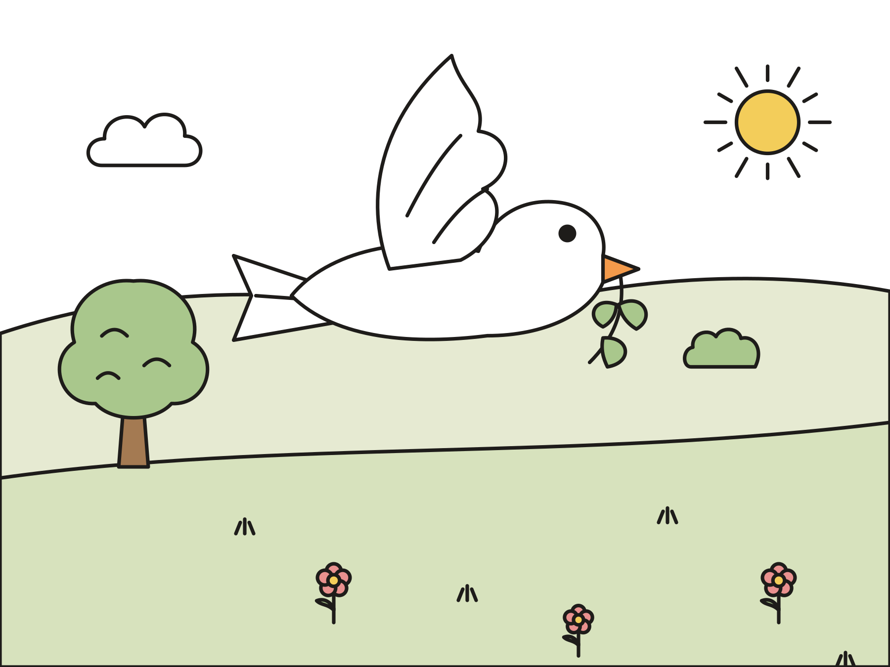
God remembered Noah.
The water went down. A dove brought back a green leaf.
Notes:
God did not forget them. God remembered Noah and every animal in the ark. Slowly the water went down. Noah sent out a dove, and she came back with a fresh green leaf in her beak. Dry land was coming back!

Slide 12
A rainbow promise
God promised never to flood the whole earth again.
Notes:
When the ground was dry, everyone came out of the ark, and Noah said thank you to God. God made a promise: never again would a flood cover the whole earth. God put a rainbow in the sky as a sign of the promise.

Slide 13

God cares for every creature.
God loves the whole world. God loves you, too!
Notes:
God cares for every creature, big and small. God kept Noah’s family and the animals safe. And God always keeps promises.

Slide 14
I wonder…
I wonder how Noah felt when God asked him to build the ark.
Notes:
Wait for answers. Every answer is welcome.

Slide 15
I wonder…
I wonder what it means to walk with God.
Notes:
Let the children think out loud. There are no wrong answers.

Slide 16
Question 1 of 8
What did God ask Noah to build?
A tower
A castle
A
B
A bridge
An ark
C
D
Notes:
Read the question and the choices aloud, and let the children answer. Then show the answer: An ark. God asked Noah to build an ark, a very big boat.

Slide 17
Question 1 of 8
What did God ask Noah to build?
A tower
A castle
A
B
A bridge
An ark
C
D
The answer is D. God asked Noah to build an ark, a very big boat.
Notes:
The answer is D: An ark. God asked Noah to build an ark, a very big boat.

Slide 18
Question 2 of 8
What does the Bible say about Noah?
Noah walked with God
Noah was a king
A
B
Noah was afraid of water
Noah never listened
C
D
Notes:
Read the question and the choices aloud, and let the children answer. Then show the answer: Noah walked with God. The Bible says, “Noah walked with God.” He was God’s friend.

Slide 19
Question 2 of 8
What does the Bible say about Noah?
Noah walked with God
Noah was a king
A
B
Noah was afraid of water
Noah never listened
C
D
The answer is A. The Bible says, “Noah walked with God.” He was God’s friend.
Notes:
The answer is A: Noah walked with God. The Bible says, “Noah walked with God.” He was God’s friend.

Slide 20
Question 3 of 8
What was the ark made of?
Wood
Ice
A
B
Paper
Bricks
C
D
Notes:
Read the question and the choices aloud, and let the children answer. Then show the answer: Wood. Noah built the ark out of wood and covered it with tar.

Slide 21
Question 3 of 8
What was the ark made of?
Wood
Ice
A
B
Paper
Bricks
C
D
The answer is A. Noah built the ark out of wood and covered it with tar.
Notes:
The answer is A: Wood. Noah built the ark out of wood and covered it with tar.

Slide 22
Question 4 of 8
Who went into the ark with Noah?
The whole town
Only his dog
A
B
Nobody
His family and the animals
C
D
Notes:
Read the question and the choices aloud, and let the children answer. Then show the answer: His family and the animals. Noah’s wife, his three sons, and their wives went in, with two of every kind of animal.

Slide 23
Question 4 of 8
Who went into the ark with Noah?
The whole town
Only his dog
A
B
Nobody
His family and the animals
C
D
The answer is D. Noah’s wife, his three sons, and their wives went in, with two of every kind of animal.
Notes:
The answer is D: His family and the animals. Noah’s wife, his three sons, and their wives went in, with two of every kind of animal.

Slide 24
Question 5 of 8
How did the animals come into the ark?
Two by two
One at a time
A
B
On a train
They stayed outside
C
D
Notes:
Read the question and the choices aloud, and let the children answer. Then show the answer: Two by two. The animals came in pairs, two of every kind.

Slide 25
Question 5 of 8
How did the animals come into the ark?
Two by two
One at a time
A
B
On a train
They stayed outside
C
D
The answer is A. The animals came in pairs, two of every kind.
Notes:
The answer is A: Two by two. The animals came in pairs, two of every kind.

Slide 26
Question 6 of 8
How long did it rain?
One hour
All summer
A
B
Forty days and forty nights
Just one night
C
D
Notes:
Read the question and the choices aloud, and let the children answer. Then show the answer: Forty days and forty nights. The Bible says it rained for forty days and forty nights.

Slide 27
Question 6 of 8
How long did it rain?
One hour
All summer
A
B
Forty days and forty nights
Just one night
C
D
The answer is C. The Bible says it rained for forty days and forty nights.
Notes:
The answer is C: Forty days and forty nights. The Bible says it rained for forty days and forty nights.

Slide 28
Question 7 of 8
What did God put in the sky as a sign of a promise?
A kite
A big moon
A
B
A rainbow
Fireworks
C
D
Notes:
Read the question and the choices aloud, and let the children answer. Then show the answer: A rainbow. The rainbow reminds us that God keeps promises.

Slide 29
Question 7 of 8
What did God put in the sky as a sign of a promise?
A kite
A big moon
A
B
A rainbow
Fireworks
C
D
The answer is C. The rainbow reminds us that God keeps promises.
Notes:
The answer is C: A rainbow. The rainbow reminds us that God keeps promises.

Slide 30
Question 8 of 8
What does this story teach us about God?
God cares for every creature
God forgets about us
A
B
God loves only people
God likes only big animals
C
D
Notes:
Read the question and the choices aloud, and let the children answer. Then show the answer: God cares for every creature. God kept Noah’s family and the animals safe. God cares for every creature, big and small.

Slide 31
Question 8 of 8
What does this story teach us about God?
God cares for every creature
God forgets about us
A
B
God loves only people
God likes only big animals
C
D
The answer is A. God kept Noah’s family and the animals safe. God cares for every creature, big and small.
Notes:
The answer is A: God cares for every creature. God kept Noah’s family and the animals safe. God cares for every creature, big and small.

Slide 32

Great job!
You finished all 8 questions.
Notes:
Thank the children for listening so well.

Slide 33

Our memory verse
“Noah walked with God.”
Genesis 6:9
Notes:
Say the verse with motions. “Noah” (pretend to hammer). “walked” (walk in place). “with God” (point up, then hold hands with the people next to you). Say it softly, then loudly, then in a whisper.

Slide 34
Make an ark with a door
Draw a big ark on brown paper.
Cut it out.
Cut a door that opens.
Glue the ark on blue paper.
Draw the family and animals behind the door.
Notes:
Show a finished ark first. Help with cutting the door. Remind the children not to put glue on the door.

Slide 35
Make a rainstorm
Rub your hands: wind.
Tap your fingers: raindrops.
Pat your knees: rain.
Stomp your feet: a storm!
Go backward until the rain stops.
Notes:
Lead the motions and let the children copy. End by drawing a rainbow in the air and saying together, “God keeps promises!”

Slide 36

Let’s pray
Dear God, thank you for caring for every creature. Help us walk with you every day. Amen.
Notes:
Read the prayer one line at a time and let the children repeat each line after you.

