Slide 1
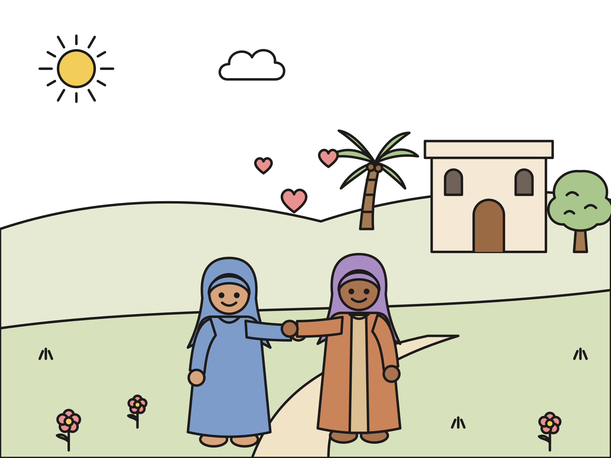
Sunday school · Ages 7–9
Mary visits Elizabeth
Luke 1:39–56
Mainline Christian
Notes:
Welcome the children. Today’s story comes from Luke 1:39–56.

Slide 2

Welcome!
What does a magnifying glass do? It makes small things look big!
Notes:
Welcome each child by name. Hold up a magnifying glass and ask what it does. Say: Today Mary sings a song that makes something look very big. Let’s find out what.

Slide 3
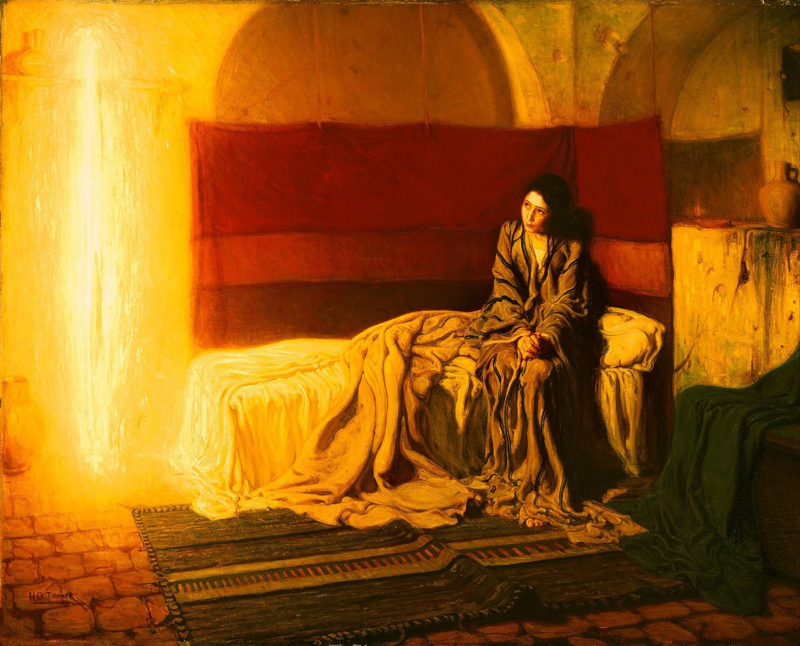
Mary had big news.
An angel told Mary, “You will have a baby. His name will be Jesus.”
Notes:
Mary lived in a small town called Nazareth. One day the angel Gabriel came to her with big news. She would have a baby boy, and she would name him Jesus. This painting by Henry Ossawa Tanner shows Mary looking up at the angel, who is a bright light.

Slide 4

Elizabeth had news too.
Elizabeth was old. Now she was going to have a baby!
Notes:
The angel had more news. Mary’s relative Elizabeth was going to have a baby too. Elizabeth and her husband, Zechariah, had waited many, many years for a baby. Now God was giving them one.

Slide 5
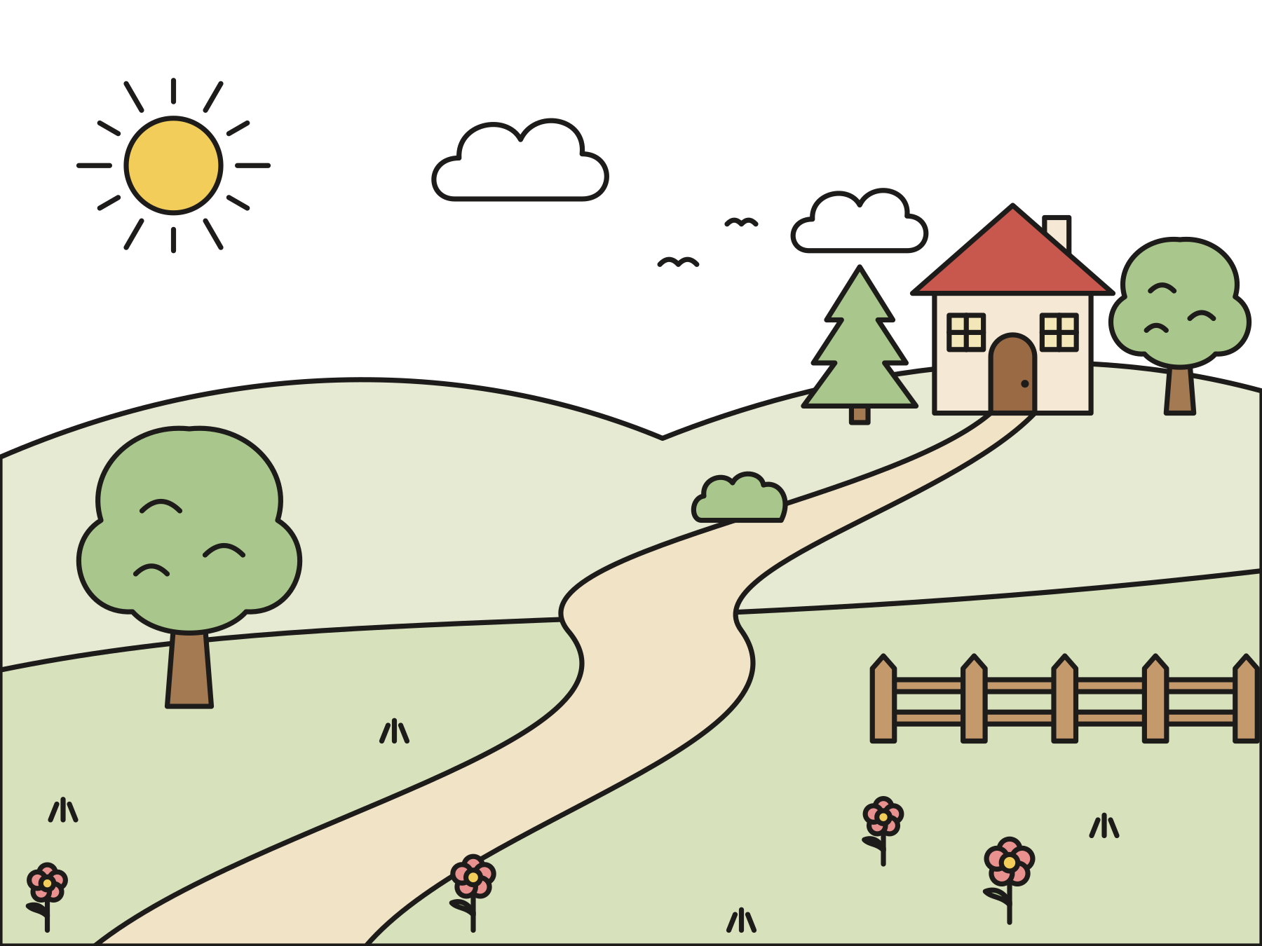
Mary hurried to the hills.
She walked up hills and down hills for days.
Notes:
Mary wanted to see Elizabeth right away. She hurried off to the hill country where Elizabeth lived. It was a long walk, up the hills and down the hills, for days and days.

Slide 6
“Hello, Elizabeth!”
At last Mary came to the house. She called hello.
Notes:
At last Mary came to Zechariah and Elizabeth’s house. Zechariah could not talk at all right then, but that is another story. Mary knocked on the door and called, “Hello, Elizabeth!”

Slide 7

The baby leaped for joy!
When Elizabeth heard Mary’s hello, her baby jumped inside her.
Notes:
When Elizabeth heard Mary’s hello, the baby inside her jumped! Let’s all jump once. Elizabeth was filled with God’s Holy Spirit and filled with joy.

Slide 8
Blessed are you!
Elizabeth said, “Blessed are you among women!”
Notes:
Elizabeth called out in a loud voice, “Blessed are you among women!” That means God has given you a very special gift. She said, “When I heard your hello, my baby jumped for joy!”

Slide 9

Mary sang a song.
“My soul magnifies the Lord. My spirit has rejoiced in God my Savior.”
Luke 1:46–47
Notes:
Mary was so happy that she sang a song to God. It begins, “My soul magnifies the Lord.” Magnify means to make something look bigger. Mary’s song made God’s goodness look big for everyone to see.

Slide 10

God lifts up the small.
Mary sang that God cares for people who are small.
Notes:
Mary was a young woman from a small town. Nobody thought she was important. But God chose her! She sang that God lifts up people who are small and left out.

Slide 11

God fills the hungry.
Mary sang that God fills hungry people with good things.
Notes:
Mary sang that God fills hungry people with good things. God cares about everyone who does not have enough to eat. When we share food, we help God’s good news come true.

Slide 12

Mary stayed three months.
Mary and Elizabeth helped each other and were glad together.
Notes:
Mary stayed with Elizabeth for about three months. Maybe they cooked and talked and laughed and prayed together. Then Mary went home. Soon Elizabeth’s baby was born. His name was John.

Slide 13
I wonder…
I wonder how Elizabeth felt when she saw Mary at the door.
Notes:
Wait in silence for answers. Every answer is welcome.

Slide 14
I wonder…
I wonder what song you would sing to God.
Notes:
Let children hum, sing, or say a line. There are no wrong answers.

Slide 15
Question 1 of 7
Who did Mary go to visit?
The king
A shepherd
A
B
Elizabeth
Her teacher
C
D
Notes:
Read the question and the choices aloud, and let the children answer. Then show the answer: Elizabeth. Mary hurried to see Elizabeth, who was part of her family.

Slide 16
Question 1 of 7
Who did Mary go to visit?
The king
A shepherd
A
B
Elizabeth
Her teacher
C
D
The answer is C. Mary hurried to see Elizabeth, who was part of her family.
Notes:
The answer is C: Elizabeth. Mary hurried to see Elizabeth, who was part of her family.

Slide 17
Question 2 of 7
Where did Elizabeth live?
On a boat
In a big palace
A
B
In the hill country
In a cave
C
D
Notes:
Read the question and the choices aloud, and let the children answer. Then show the answer: In the hill country. Mary walked up and down the hills to a town in Judea.

Slide 18
Question 2 of 7
Where did Elizabeth live?
On a boat
In a big palace
A
B
In the hill country
In a cave
C
D
The answer is C. Mary walked up and down the hills to a town in Judea.
Notes:
The answer is C: In the hill country. Mary walked up and down the hills to a town in Judea.

Slide 19
Question 3 of 7
What did Elizabeth’s baby do when Mary said hello?
He fell asleep
He sneezed
A
B
He leaped for joy
He sang a song
C
D
Notes:
Read the question and the choices aloud, and let the children answer. Then show the answer: He leaped for joy. Elizabeth said her baby jumped for joy when she heard Mary’s hello.

Slide 20
Question 3 of 7
What did Elizabeth’s baby do when Mary said hello?
He fell asleep
He sneezed
A
B
He leaped for joy
He sang a song
C
D
The answer is C. Elizabeth said her baby jumped for joy when she heard Mary’s hello.
Notes:
The answer is C: He leaped for joy. Elizabeth said her baby jumped for joy when she heard Mary’s hello.

Slide 21
Question 4 of 7
What did Elizabeth say to Mary?
“Go home!”
“I am too busy.”
A
B
“Blessed are you!”
“Who are you?”
C
D
Notes:
Read the question and the choices aloud, and let the children answer. Then show the answer: “Blessed are you!”. Elizabeth was glad to see Mary and blessed her and her baby.

Slide 22
Question 4 of 7
What did Elizabeth say to Mary?
“Go home!”
“I am too busy.”
A
B
“Blessed are you!”
“Who are you?”
C
D
The answer is C. Elizabeth was glad to see Mary and blessed her and her baby.
Notes:
The answer is C: “Blessed are you!”. Elizabeth was glad to see Mary and blessed her and her baby.

Slide 23
Question 5 of 7
What did Mary do next?
She sang a song to God
She took a nap
A
B
She went fishing
She baked a cake
C
D
Notes:
Read the question and the choices aloud, and let the children answer. Then show the answer: She sang a song to God. Mary’s song begins, “My soul magnifies the Lord.”

Slide 24
Question 5 of 7
What did Mary do next?
She sang a song to God
She took a nap
A
B
She went fishing
She baked a cake
C
D
The answer is A. Mary’s song begins, “My soul magnifies the Lord.”
Notes:
The answer is A: She sang a song to God. Mary’s song begins, “My soul magnifies the Lord.”

Slide 25
Question 6 of 7
What does “magnify” mean?
To make something look bigger
To make something disappear
A
B
To make something cold
To make something sleepy
C
D
Notes:
Read the question and the choices aloud, and let the children answer. Then show the answer: To make something look bigger. A magnifying glass makes things look bigger. Mary’s song made God’s goodness look big.

Slide 26
Question 6 of 7
What does “magnify” mean?
To make something look bigger
To make something disappear
A
B
To make something cold
To make something sleepy
C
D
The answer is A. A magnifying glass makes things look bigger. Mary’s song made God’s goodness look big.
Notes:
The answer is A: To make something look bigger. A magnifying glass makes things look bigger. Mary’s song made God’s goodness look big.

Slide 27
Question 7 of 7
Who does God fill with good things?
People who are hungry
Only kings
A
B
Only grown-ups
C
Notes:
Read the question and the choices aloud, and let the children answer. Then show the answer: People who are hungry. Mary sang that God fills the hungry with good things.

Slide 28
Question 7 of 7
Who does God fill with good things?
People who are hungry
Only kings
A
B
Only grown-ups
C
The answer is A. Mary sang that God fills the hungry with good things.
Notes:
The answer is A: People who are hungry. Mary sang that God fills the hungry with good things.

Slide 29
Great job!
You finished all 7 questions.
Notes:
Thank the children for listening so well.

Slide 30
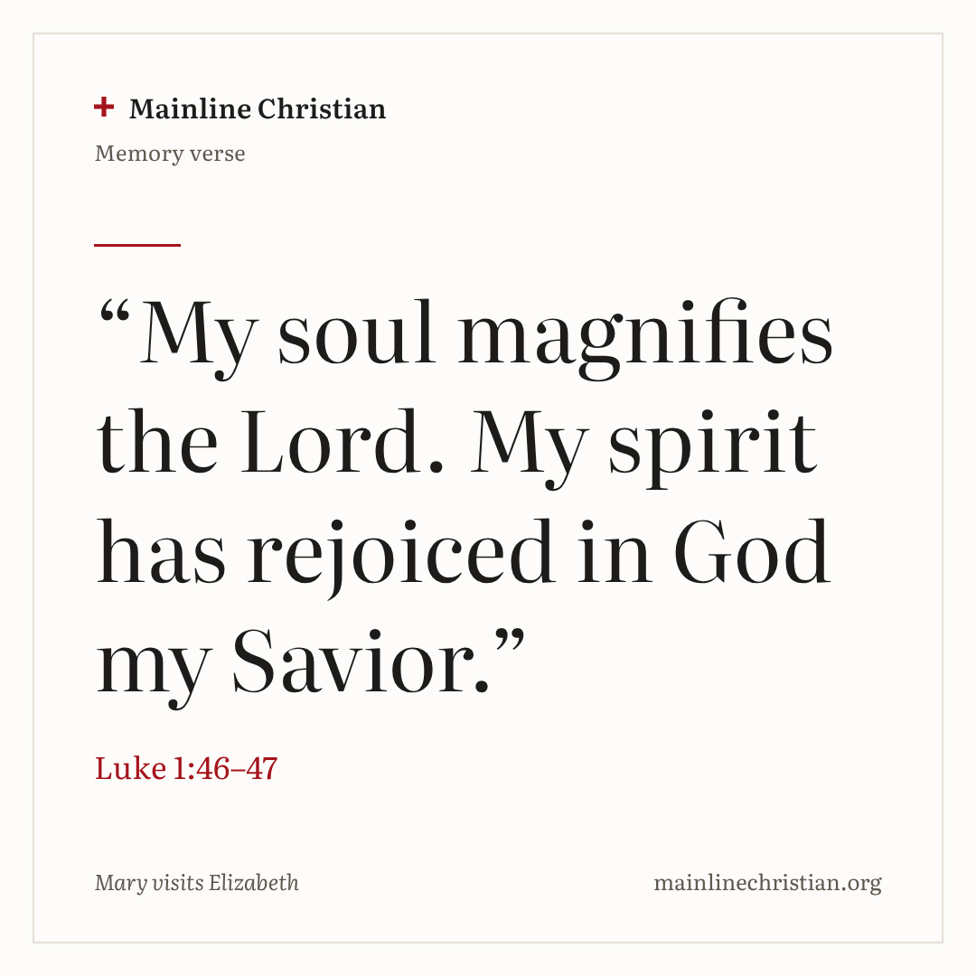
Our memory verse
“My soul magnifies the Lord. My spirit has rejoiced in God my Savior.”
Luke 1:46–47
Notes:
Say the verse with motions. “My soul magnifies the Lord” (hands close together, then spread wide apart). “My spirit has rejoiced” (wiggle fingers up high). “In God my Savior” (point up, then cross hands over your heart). Whisper it, say it, then sing it.

Slide 31
Make a magnifying glass
Color the rim of your paper plate.
Tape plastic wrap over the hole.
Tape on a craft stick handle.
Write: My soul magnifies the Lord!
Draw good things God gives.
Notes:
Show a finished magnifying glass first. Help with the plastic wrap and the tape. When everyone is done, hold them up and name one good thing God has done.

Slide 32
Hello, hop!
Walk around while the music plays.
When it stops, find a partner.
Say: Hello! God bless you!
Hop once together for joy.
Notes:
Keep the hops small. A child who cannot hop can clap or wave instead. Find a new partner each round. Everyone gets greeted.

Slide 33
Let’s pray
Dear God, thank you for Mary and Elizabeth. Help us share your joy and share with the hungry. Amen.
Notes:
Read the prayer one line at a time and let the children repeat each line after you.

