Slide 1
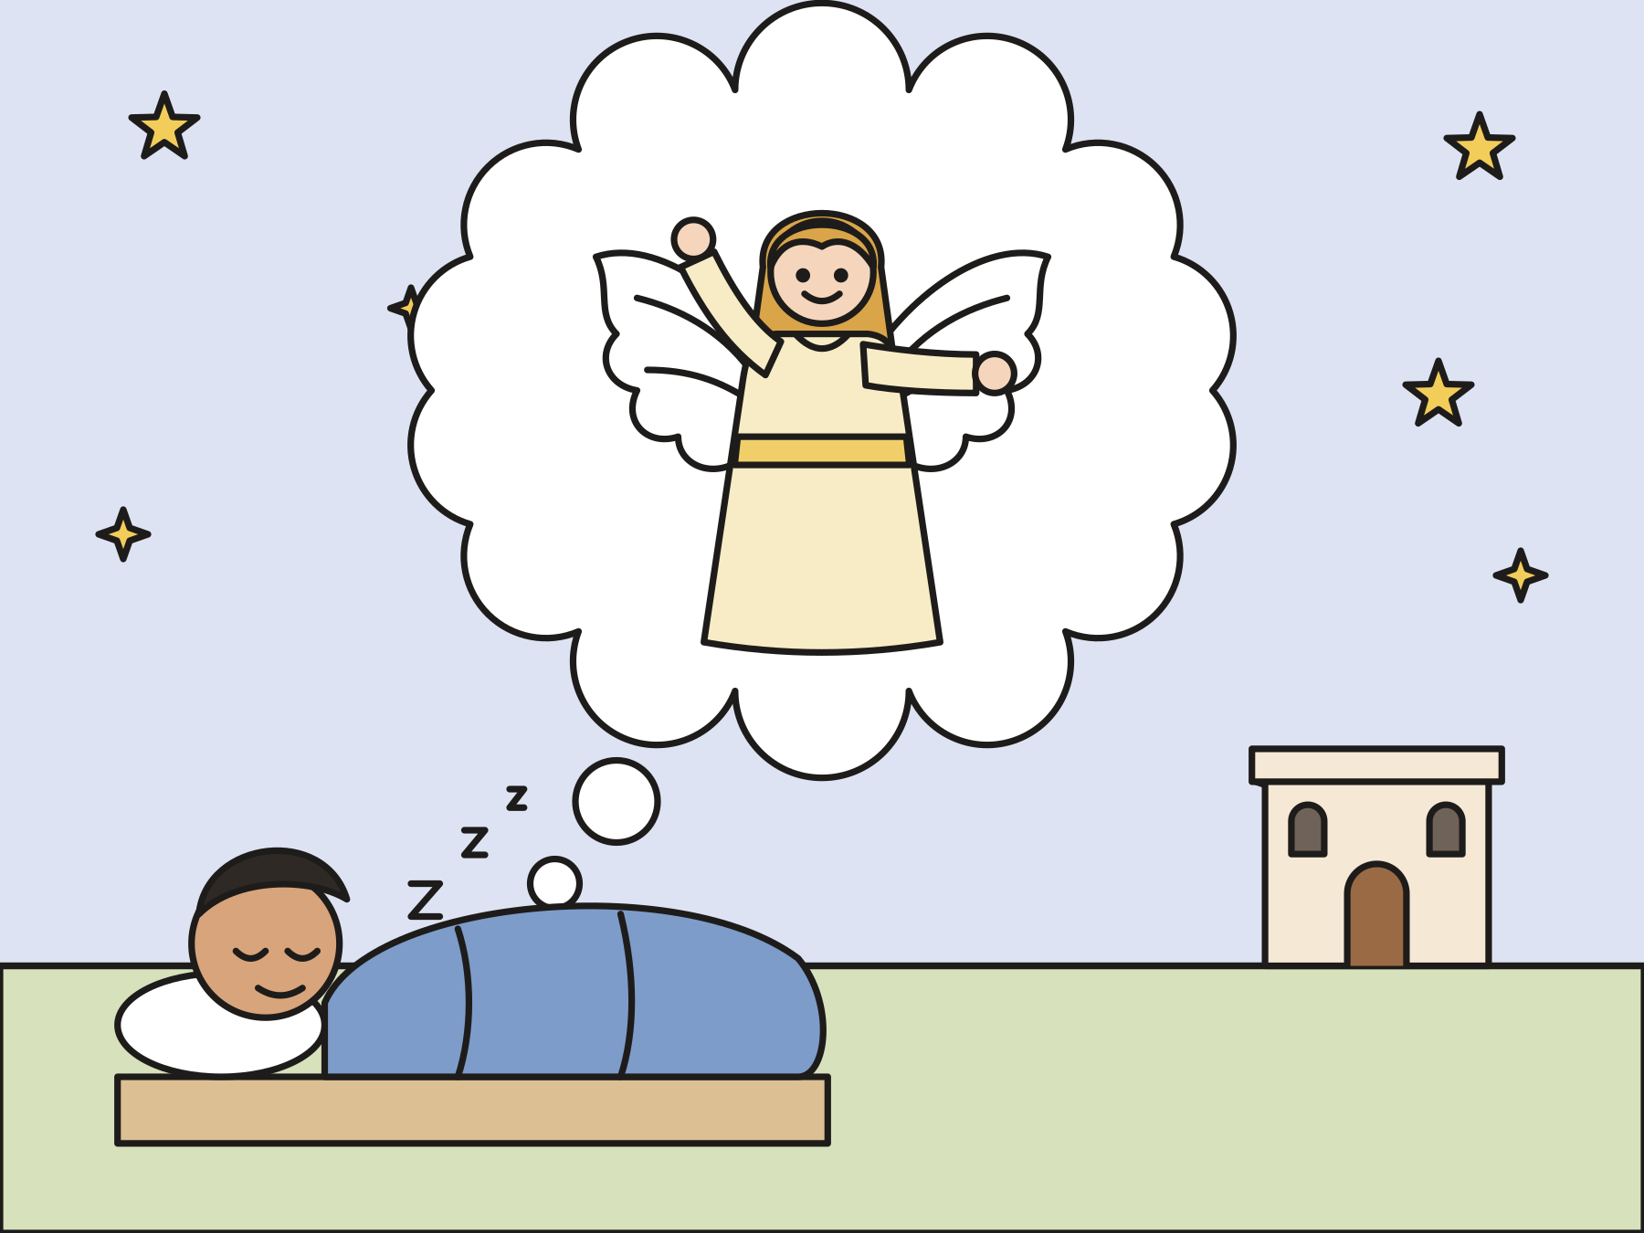
Sunday school · Ages 7–9
Joseph’s dream
Matthew 1:18–25
Mainline Christian
Notes:
Welcome the children. Today’s story comes from Matthew 1:18–25.

Slide 2

Welcome!
What is your name? Do you know who chose it for you?
Notes:
Welcome each child by name. Ask the question and let two or three children answer. Say: Today God tells a man named Joseph what to name a very special baby.

Slide 3

Joseph was a good man.
Joseph was going to marry Mary.
Notes:
Once there was a man named Joseph. He lived in Nazareth. Many people think he was a carpenter, a builder who worked with wood. Joseph loved God. He was going to marry a young woman named Mary.

Slide 4

Joseph had a hard problem.
Mary was going to have a baby. Joseph knew it was not his baby.
Notes:
One day Joseph found out that Mary was going to have a baby. Joseph knew he was not the baby’s father. He did not understand. He felt confused and sad.

Slide 5
Joseph made a kind plan.
He did not want anyone to be mean to Mary.
Notes:
Joseph decided not to marry Mary after all. But he was kind. He did not want anyone to say mean things about her. So he planned to end their promise without a fuss.

Slide 6
An angel came in a dream!
“Joseph, son of David, don’t be afraid.”
Notes:
That night Joseph went to sleep. In a dream, an angel from God came to him. The angel said, “Joseph, son of David, don’t be afraid. Take Mary home to be your wife. Her baby is from God’s Holy Spirit.”

Slide 7

Name him Jesus.
The angel said, “You shall name him Jesus.”
Notes:
The angel said, “She will have a son. You shall name him Jesus, because he will save his people.” The name Jesus means “God saves.”

Slide 8

Immanuel: God with us
“They shall call his name Immanuel, which is, being interpreted, “God with us.”
Matthew 1:23
Notes:
Matthew tells us that Jesus has another name too: Immanuel. Immanuel means “God with us.” Point up, then give yourself a hug.

Slide 9

Joseph woke up.
He did just what the angel said.
Notes:
Joseph woke up and remembered his dream. He was brave. He did just what the angel said. He took Mary home to be his wife.

Slide 10
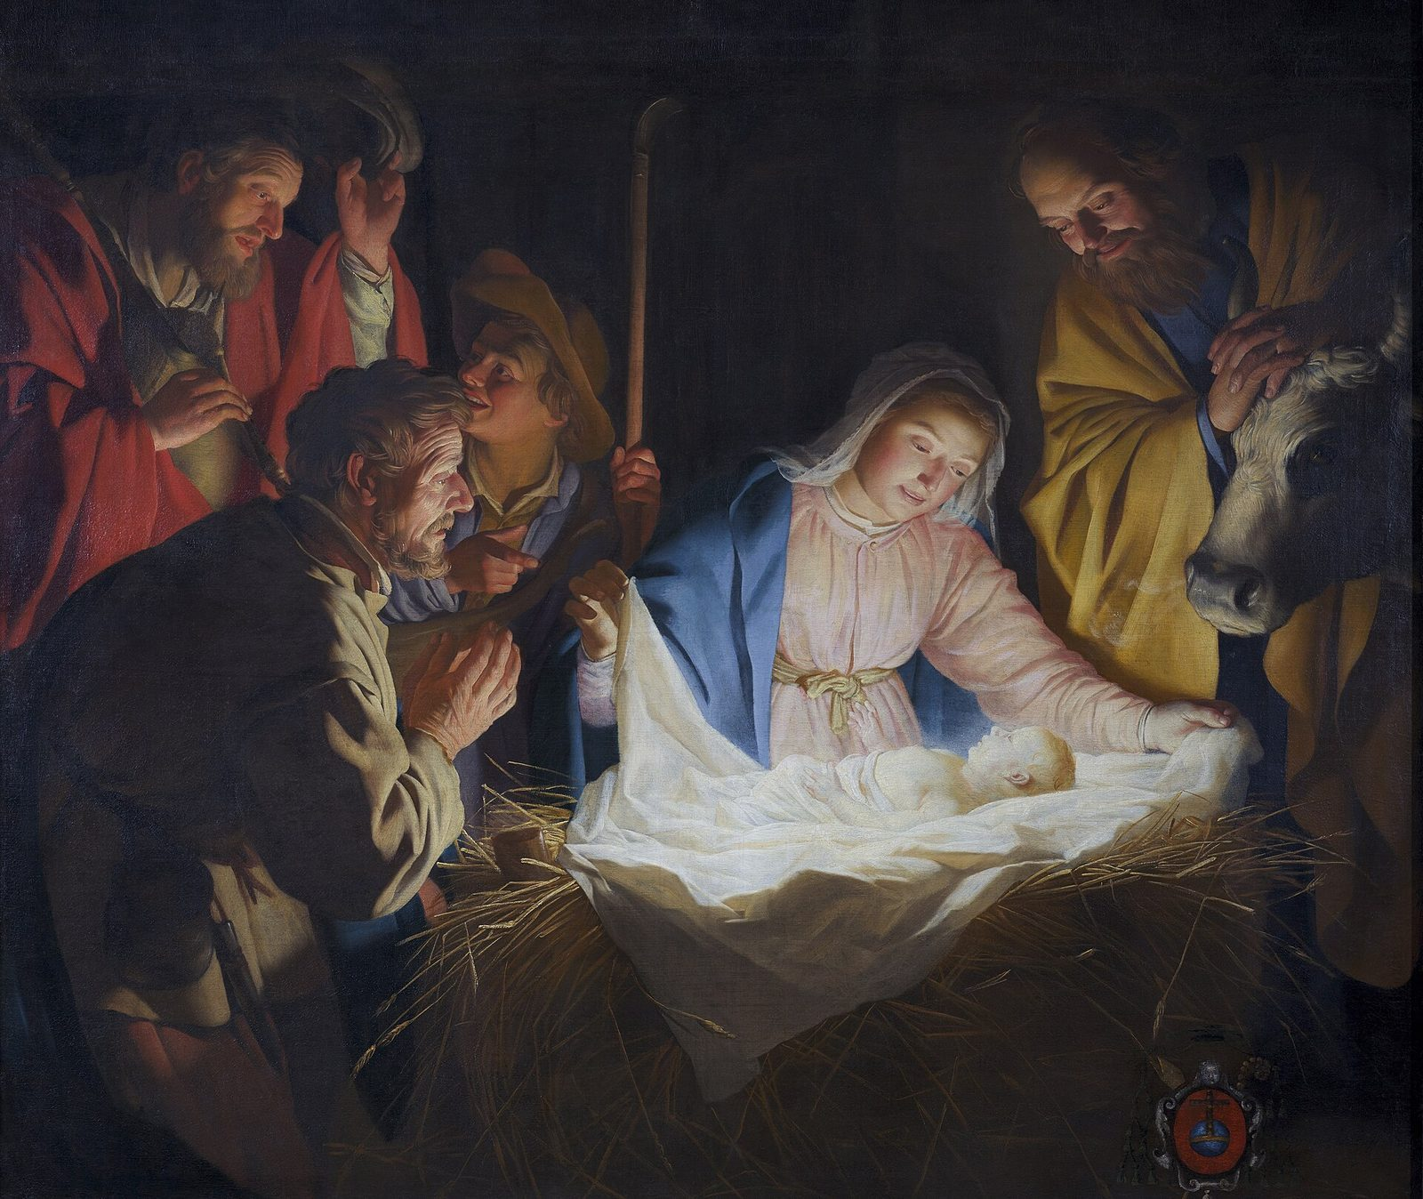
Joseph named the baby Jesus.
Joseph loved Jesus and took care of him.
Notes:
When the baby was born, Joseph named him Jesus. Giving the baby his name was like saying, “This is my son. I will love him and take care of him.” In this painting by Gerard van Honthorst, Joseph and the shepherds look at baby Jesus.

Slide 11

God is with us.
God was with Joseph and Mary. God is with us too.
Notes:
Joseph listened to God. He was kind and brave. God was with Joseph, with Mary, and with baby Jesus. God is with us too, every day and every night.

Slide 12
I wonder…
I wonder how Joseph felt when he woke up from his dream.
Notes:
Wait in silence for answers. Every answer is welcome.

Slide 13
I wonder…
I wonder when you need to remember that God is with you.
Notes:
Children may say at night, at school, or when they feel scared. Receive every answer gently.

Slide 14
Question 1 of 7
Who was Joseph going to marry?
Elizabeth
A queen
A
B
Mary
Sarah
C
D
Notes:
Read the question and the choices aloud, and let the children answer. Then show the answer: Mary. Joseph and Mary had promised to marry each other.

Slide 15
Question 1 of 7
Who was Joseph going to marry?
Elizabeth
A queen
A
B
Mary
Sarah
C
D
The answer is C. Joseph and Mary had promised to marry each other.
Notes:
The answer is C: Mary. Joseph and Mary had promised to marry each other.

Slide 16
Question 2 of 7
How did the angel talk to Joseph?
On the phone
In a dream
A
B
In a letter
At the market
C
D
Notes:
Read the question and the choices aloud, and let the children answer. Then show the answer: In a dream. An angel spoke to Joseph in a dream while he was asleep.

Slide 17
Question 2 of 7
How did the angel talk to Joseph?
On the phone
In a dream
A
B
In a letter
At the market
C
D
The answer is B. An angel spoke to Joseph in a dream while he was asleep.
Notes:
The answer is B: In a dream. An angel spoke to Joseph in a dream while he was asleep.

Slide 18
Question 3 of 7
What did the angel tell Joseph first?
“Run away!”
“Don’t be afraid.”
A
B
“Go back to sleep.”
“Build a boat.”
C
D
Notes:
Read the question and the choices aloud, and let the children answer. Then show the answer: “Don’t be afraid.”. The angel said, “Joseph, son of David, don’t be afraid.”

Slide 19
Question 3 of 7
What did the angel tell Joseph first?
“Run away!”
“Don’t be afraid.”
A
B
“Go back to sleep.”
“Build a boat.”
C
D
The answer is B. The angel said, “Joseph, son of David, don’t be afraid.”
Notes:
The answer is B: “Don’t be afraid.”. The angel said, “Joseph, son of David, don’t be afraid.”

Slide 20
Question 4 of 7
What name did Joseph give the baby?
John
Jesus
A
B
David
Joseph
C
D
Notes:
Read the question and the choices aloud, and let the children answer. Then show the answer: Jesus. The angel said to name him Jesus, and Joseph did.

Slide 21
Question 4 of 7
What name did Joseph give the baby?
John
Jesus
A
B
David
Joseph
C
D
The answer is B. The angel said to name him Jesus, and Joseph did.
Notes:
The answer is B: Jesus. The angel said to name him Jesus, and Joseph did.

Slide 22
Question 5 of 7
What does “Immanuel” mean?
Big and strong
God with us
A
B
Happy birthday
Good night
C
D
Notes:
Read the question and the choices aloud, and let the children answer. Then show the answer: God with us. Matthew tells us that Immanuel means “God with us.”

Slide 23
Question 5 of 7
What does “Immanuel” mean?
Big and strong
God with us
A
B
Happy birthday
Good night
C
D
The answer is B. Matthew tells us that Immanuel means “God with us.”
Notes:
The answer is B: God with us. Matthew tells us that Immanuel means “God with us.”

Slide 24
Question 6 of 7
What did Joseph do when he woke up?
He forgot his dream
He went fishing
A
B
He moved far away
He did what the angel said
C
D
Notes:
Read the question and the choices aloud, and let the children answer. Then show the answer: He did what the angel said. Joseph took Mary home to be his wife, just as the angel said.

Slide 25
Question 6 of 7
What did Joseph do when he woke up?
He forgot his dream
He went fishing
A
B
He moved far away
He did what the angel said
C
D
The answer is D. Joseph took Mary home to be his wife, just as the angel said.
Notes:
The answer is D: He did what the angel said. Joseph took Mary home to be his wife, just as the angel said.

Slide 26
Question 7 of 7
What does this story show us about God?
God is far away
God only loves grown-ups
A
B
God is with us
God is too busy for us
C
D
Notes:
Read the question and the choices aloud, and let the children answer. Then show the answer: God is with us. Jesus is Immanuel, God with us, every day and every night.

Slide 27
Question 7 of 7
What does this story show us about God?
God is far away
God only loves grown-ups
A
B
God is with us
God is too busy for us
C
D
The answer is C. Jesus is Immanuel, God with us, every day and every night.
Notes:
The answer is C: God is with us. Jesus is Immanuel, God with us, every day and every night.

Slide 28
Great job!
You finished all 7 questions.
Notes:
Thank the children for listening so well.

Slide 29
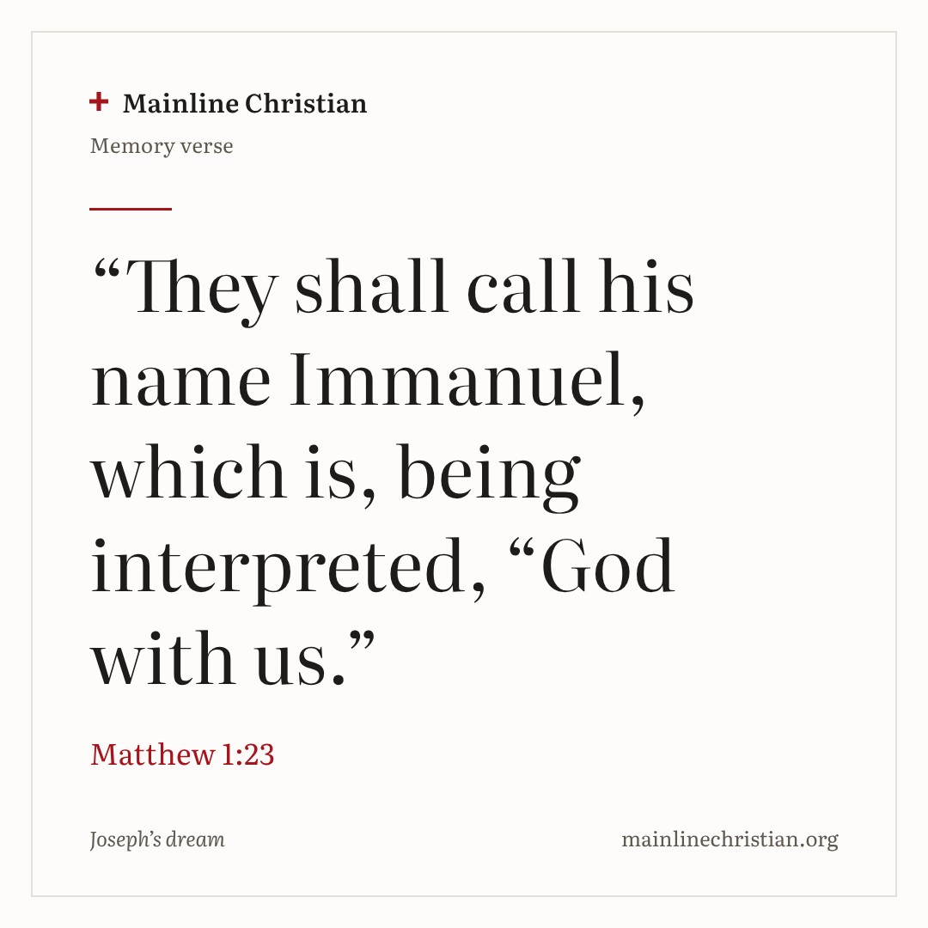
Our memory verse
“They shall call his name Immanuel, which is, being interpreted, “God with us.”
Matthew 1:23
Notes:
Say the verse with motions. “They shall call his name” (cup hands around your mouth). “Immanuel” (clap the four parts: Im-man-u-el). “Which is, being interpreted” (open your hands like a book). “God with us” (point up, hug yourself, then spread your arms wide).

Slide 30
Make a God-with-us door hanger
Write “God with us” on the front.
Draw yourself, your family, or your home.
On the back, write “Don’t be afraid.”
Draw a night sky with a moon and stars.
Hang it on your bedroom door.
Notes:
Show a finished door hanger first. Help with writing as needed. Say: When you go to bed, look at your door hanger and remember that God is with you.

Slide 31
Wake up, Joseph!
Everyone rests their head and closes their eyes.
The angel whispers a message to one sleeper.
Wake up, Joseph! Do what the angel said.
Everyone guesses the message.
Notes:
Use gentle, safe messages, such as “Hop three times” or “Wave to everyone.” Play until every child has had a turn as Joseph.

Slide 32
Let’s pray
Dear God, thank you for Joseph, who listened and was kind. Thank you for being with us, day and night. Amen.
Notes:
Read the prayer one line at a time and let the children repeat each line after you.

