Slide 1
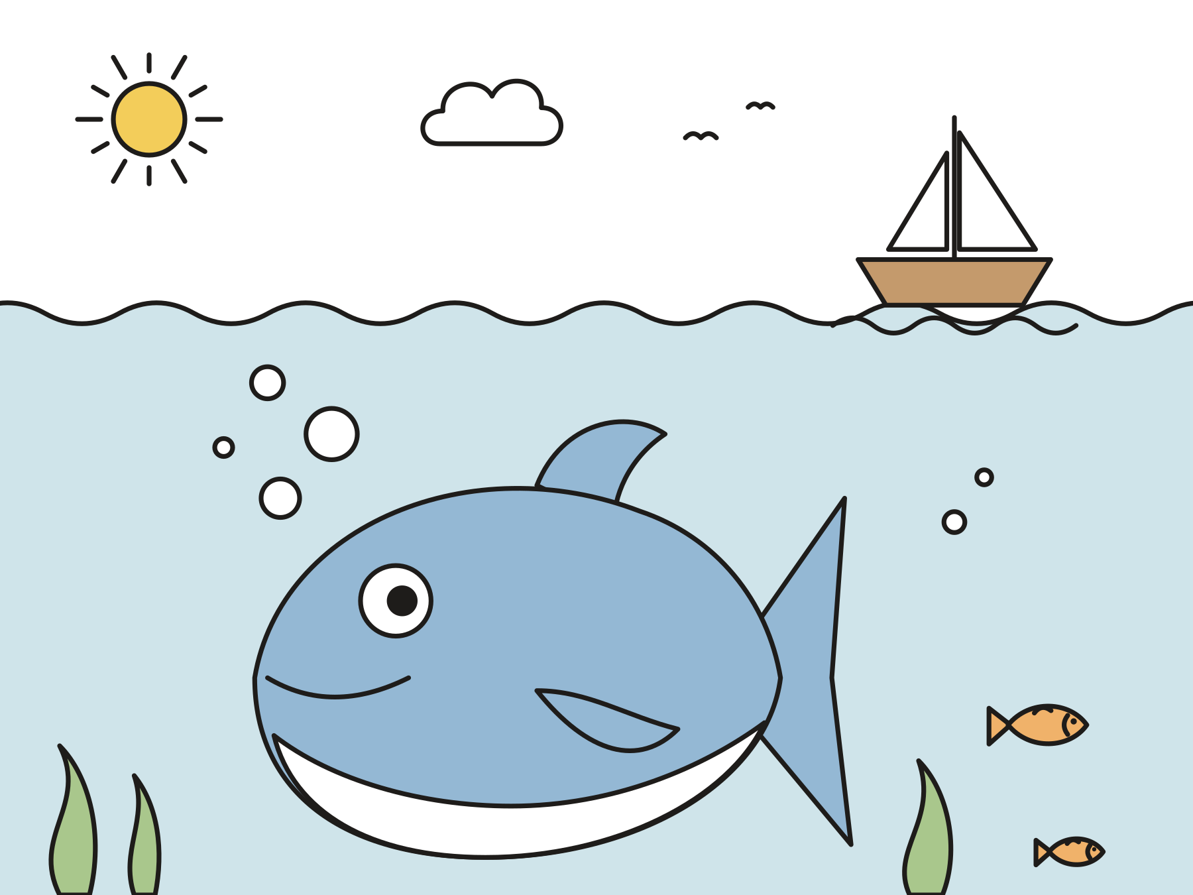
Sunday school · Ages 7–9
Jonah runs away
Jonah 1
Mainline Christian
Notes:
Welcome the children. Today’s story comes from Jonah 1.

Slide 2

Welcome!
Have you ever wanted to run the other way?
Notes:
Welcome each child by name. Ask the question and let two or three children answer. Say: Today we will hear about a man who ran the other way, and what God did next.

Slide 3

God spoke to Jonah.
“Go to Nineveh, that great big city.”
Notes:
Jonah was a prophet. A prophet listens to God and tells other people what God says. One day God said, “Jonah, get up! Go to Nineveh, that great city. The people there are doing cruel and wrong things. Tell them I see what they are doing.”

Slide 4

Jonah ran the other way!
He got on a ship going far, far away.
Notes:
Nineveh was a big city far to the east. The people there were enemies of Jonah’s people. Jonah did not want to go. So he went the other way! He found a ship going to Tarshish, far to the west, and he paid to ride on it.

Slide 5
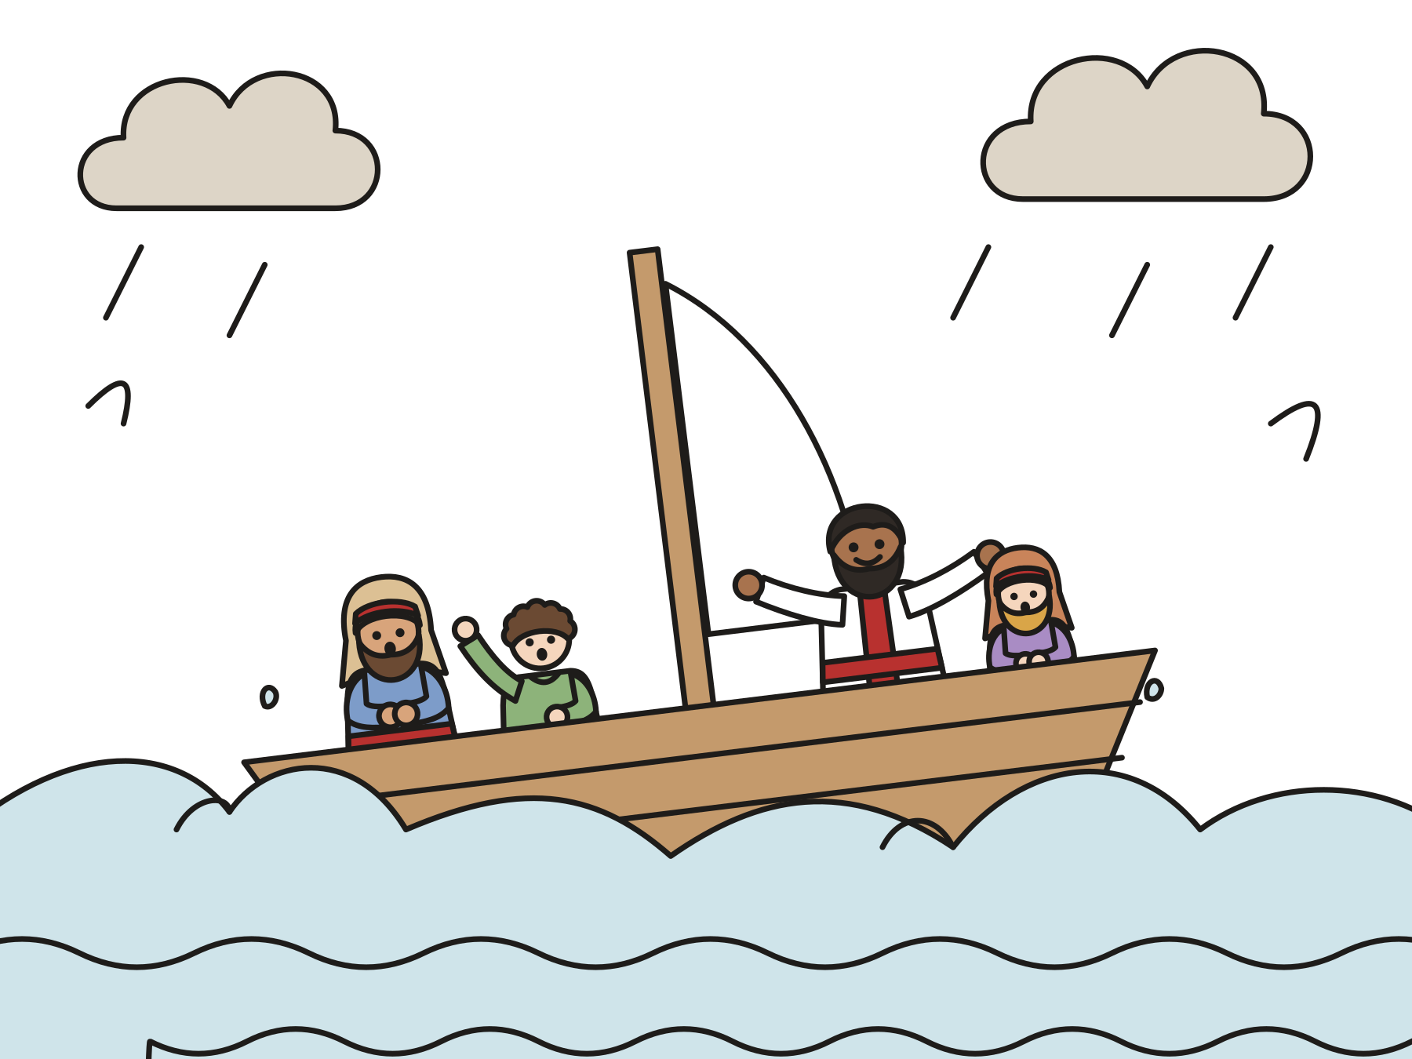
A great big storm
God sent a great wind. The waves crashed. The sailors were scared.
Notes:
The ship sailed out to sea. God sent a great wind. Whoosh! The waves grew bigger and bigger. The ship rocked up and down. The sailors were scared, and each one prayed to his own god.

Slide 6

Jonah was fast asleep!
The captain said, “Wake up! Pray to your God!”
Notes:
Where was Jonah? Down at the bottom of the ship, fast asleep! The captain woke him up. “How can you sleep? Wake up! Pray to your God! Maybe your God will help us.”

Slide 7
“This storm is because of me.”
Jonah said, “Throw me into the sea.” The sailors rowed hard to save him.
Notes:
Jonah told the sailors that he worshiped the God who made the sea and the dry land, and that he was running away from God. “Throw me into the sea,” he said. “Then the sea will be calm.” The sailors were kind. They did not want to hurt Jonah. They rowed and rowed to get back to land, but the waves only got bigger.

Slide 8

The sea was calm.
The sailors prayed to God. They put Jonah into the sea, and the storm stopped.
Notes:
So the sailors prayed to the LORD, Jonah’s God. Then they lifted Jonah up and put him into the sea. Right away, the wind stopped and the waves stopped. The sailors were amazed, and they worshiped God.

Slide 9
God sent a big fish.
Gulp! The fish swallowed Jonah. He was safe inside.
Notes:
Down, down, down went Jonah into the water. But God had a plan. God sent a big fish. Gulp! It swallowed Jonah whole. Jonah was inside the fish for three days and three nights. It was dark and wet and smelly, but Jonah was safe.

Slide 10

Jonah prayed.
Inside the fish, Jonah talked to God. God heard him.
Notes:
Inside the fish, Jonah did something important. He prayed. “God, I called to you, and you heard me. Thank you!”

Slide 11

Splat!
God told the fish to put Jonah on dry land. God gave Jonah a second chance.
Notes:
Then God spoke to the fish, and the fish spat Jonah out onto the dry beach. Splat! Jonah ran away, and God kept caring for him. God gave Jonah a second chance.

Slide 12
God is with us everywhere.
“Even there your hand will lead me, and your right hand will hold me.”
Psalm 139:10
Notes:
This verse comes from Psalm 139, a prayer that says God is with us everywhere: up in the sky, far across the sea, and even in the dark. “Even there” means even in the deepest sea, even inside a fish!

Slide 13
I wonder…
I wonder why Jonah didn’t want to go to Nineveh.
Notes:
Wait in silence for answers. Every answer is welcome.

Slide 14
I wonder…
I wonder what it was like to pray inside a fish.
Notes:
Let the children imagine. Some may say it was dark, smelly, or lonely. Some may say God felt close.

Slide 15
Question 1 of 8
Where did God ask Jonah to go?
The North Pole
The moon
A
B
Nineveh
Bethlehem
C
D
Notes:
Read the question and the choices aloud, and let the children answer. Then show the answer: Nineveh. God said, “Arise, go to Nineveh, that great city.”

Slide 16
Question 1 of 8
Where did God ask Jonah to go?
The North Pole
The moon
A
B
Nineveh
Bethlehem
C
D
The answer is C. God said, “Arise, go to Nineveh, that great city.”
Notes:
The answer is C: Nineveh. God said, “Arise, go to Nineveh, that great city.”

Slide 17
Question 2 of 8
What did Jonah do instead?
He got on a ship going the other way
He stayed in bed
A
B
He climbed a tree
He baked a cake
C
D
Notes:
Read the question and the choices aloud, and let the children answer. Then show the answer: He got on a ship going the other way. Jonah ran away. He sailed off toward Tarshish.

Slide 18
Question 2 of 8
What did Jonah do instead?
He got on a ship going the other way
He stayed in bed
A
B
He climbed a tree
He baked a cake
C
D
The answer is A. Jonah ran away. He sailed off toward Tarshish.
Notes:
The answer is A: He got on a ship going the other way. Jonah ran away. He sailed off toward Tarshish.

Slide 19
Question 3 of 8
What did God send while Jonah was on the ship?
A rainbow
A big storm
A
B
A snowman
A birthday party
C
D
Notes:
Read the question and the choices aloud, and let the children answer. Then show the answer: A big storm. God sent a great wind, and the waves grew big.

Slide 20
Question 3 of 8
What did God send while Jonah was on the ship?
A rainbow
A big storm
A
B
A snowman
A birthday party
C
D
The answer is B. God sent a great wind, and the waves grew big.
Notes:
The answer is B: A big storm. God sent a great wind, and the waves grew big.

Slide 21
Question 4 of 8
What was Jonah doing during the storm?
Swimming
Singing
A
B
Fishing
Sleeping
C
D
Notes:
Read the question and the choices aloud, and let the children answer. Then show the answer: Sleeping. Jonah was fast asleep down inside the ship.

Slide 22
Question 4 of 8
What was Jonah doing during the storm?
Swimming
Singing
A
B
Fishing
Sleeping
C
D
The answer is D. Jonah was fast asleep down inside the ship.
Notes:
The answer is D: Sleeping. Jonah was fast asleep down inside the ship.

Slide 23
Question 5 of 8
How did the sailors try to help Jonah?
They laughed at him
They went to sleep
A
B
They rowed hard to get back to land
They ate his lunch
C
D
Notes:
Read the question and the choices aloud, and let the children answer. Then show the answer: They rowed hard to get back to land. The sailors were kind. They tried hard to bring the ship to land.

Slide 24
Question 5 of 8
How did the sailors try to help Jonah?
They laughed at him
They went to sleep
A
B
They rowed hard to get back to land
They ate his lunch
C
D
The answer is C. The sailors were kind. They tried hard to bring the ship to land.
Notes:
The answer is C: They rowed hard to get back to land. The sailors were kind. They tried hard to bring the ship to land.

Slide 25
Question 6 of 8
What did God send to take care of Jonah in the sea?
A golden boat
A big fish
A
B
A flying horse
C
Notes:
Read the question and the choices aloud, and let the children answer. Then show the answer: A big fish. God sent a huge fish. Jonah was inside it for three days and three nights.

Slide 26
Question 6 of 8
What did God send to take care of Jonah in the sea?
A golden boat
A big fish
A
B
A flying horse
C
The answer is B. God sent a huge fish. Jonah was inside it for three days and three nights.
Notes:
The answer is B: A big fish. God sent a huge fish. Jonah was inside it for three days and three nights.

Slide 27
Question 7 of 8
What did Jonah do inside the fish?
He watched TV
He built a house
A
B
He went shopping
He prayed to God
C
D
Notes:
Read the question and the choices aloud, and let the children answer. Then show the answer: He prayed to God. Jonah prayed, and God heard him.

Slide 28
Question 7 of 8
What did Jonah do inside the fish?
He watched TV
He built a house
A
B
He went shopping
He prayed to God
C
D
The answer is D. Jonah prayed, and God heard him.
Notes:
The answer is D: He prayed to God. Jonah prayed, and God heard him.

Slide 29
Question 8 of 8
What does this story teach us about God?
God is with us wherever we go
God only loves people who never run away
A
B
God gives up on people
God lives only at church
C
D
Notes:
Read the question and the choices aloud, and let the children answer. Then show the answer: God is with us wherever we go. Even when Jonah ran away, God took care of him and gave him a second chance.

Slide 30
Question 8 of 8
What does this story teach us about God?
God is with us wherever we go
God only loves people who never run away
A
B
God gives up on people
God lives only at church
C
D
The answer is A. Even when Jonah ran away, God took care of him and gave him a second chance.
Notes:
The answer is A: God is with us wherever we go. Even when Jonah ran away, God took care of him and gave him a second chance.

Slide 31

Great job!
You finished all 8 questions.
Notes:
Thank the children for listening so well.

Slide 32
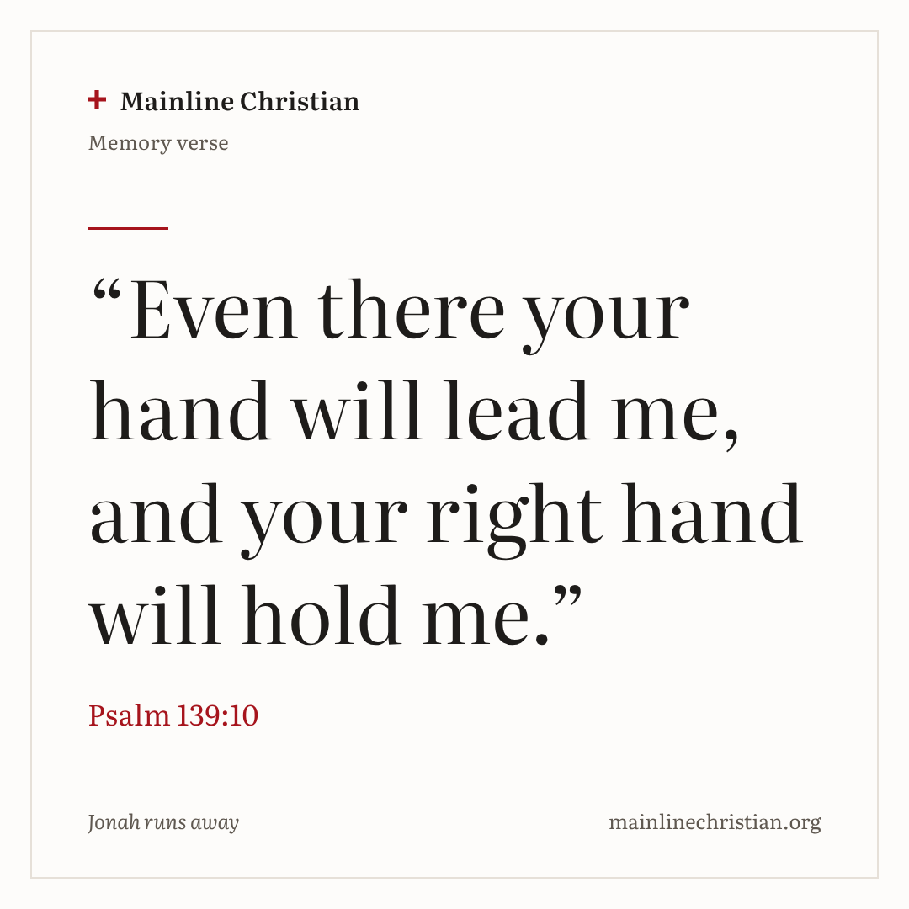
Our memory verse
“Even there your hand will lead me, and your right hand will hold me.”
Psalm 139:10
Notes:
Say the verse with motions. “Even there” (point far away). “your hand will lead me” (hold out your hand as if someone is leading you). “and your right hand will hold me” (hug yourself). Say it softly, then loudly, then in a whisper.

Slide 33
Make a big fish
Cut a pie-slice mouth out of a paper plate.
Glue the slice on the other side for a tail.
Draw an eye and scales.
Draw Jonah praying inside the fish.
Write: God is with me everywhere!
Notes:
Show a finished fish first. Help with cutting as needed. Children can glue blue paper waves along the bottom if there is time.

Slide 34
Stormy sea
Hold the edge of the sheet.
Little wind: make small waves.
Big storm: make big waves.
God made the sea calm: hold still!
Notes:
Keep your feet in place and your hands on the sheet. Everyone plays, and no one wins or loses.

Slide 35
Let’s pray
Dear God, thank you for being with us wherever we go. When we want to run away, help us turn around. Amen.
Notes:
Read the prayer one line at a time and let the children repeat each line after you.

