Slide 1

Children’s sermon
Follow the star: a children’s sermon for Epiphany
Matthew 2:1–12
Mainline Christian
Notes:
Welcome the children. Today’s story comes from Matthew 2:1–12.

Slide 2
What is this?
A star! Stars help people find their way.
Notes:
Bring the star out from behind your back. Ask: What is this? Have you ever looked at the stars at night? Let the children answer.

Slide 3
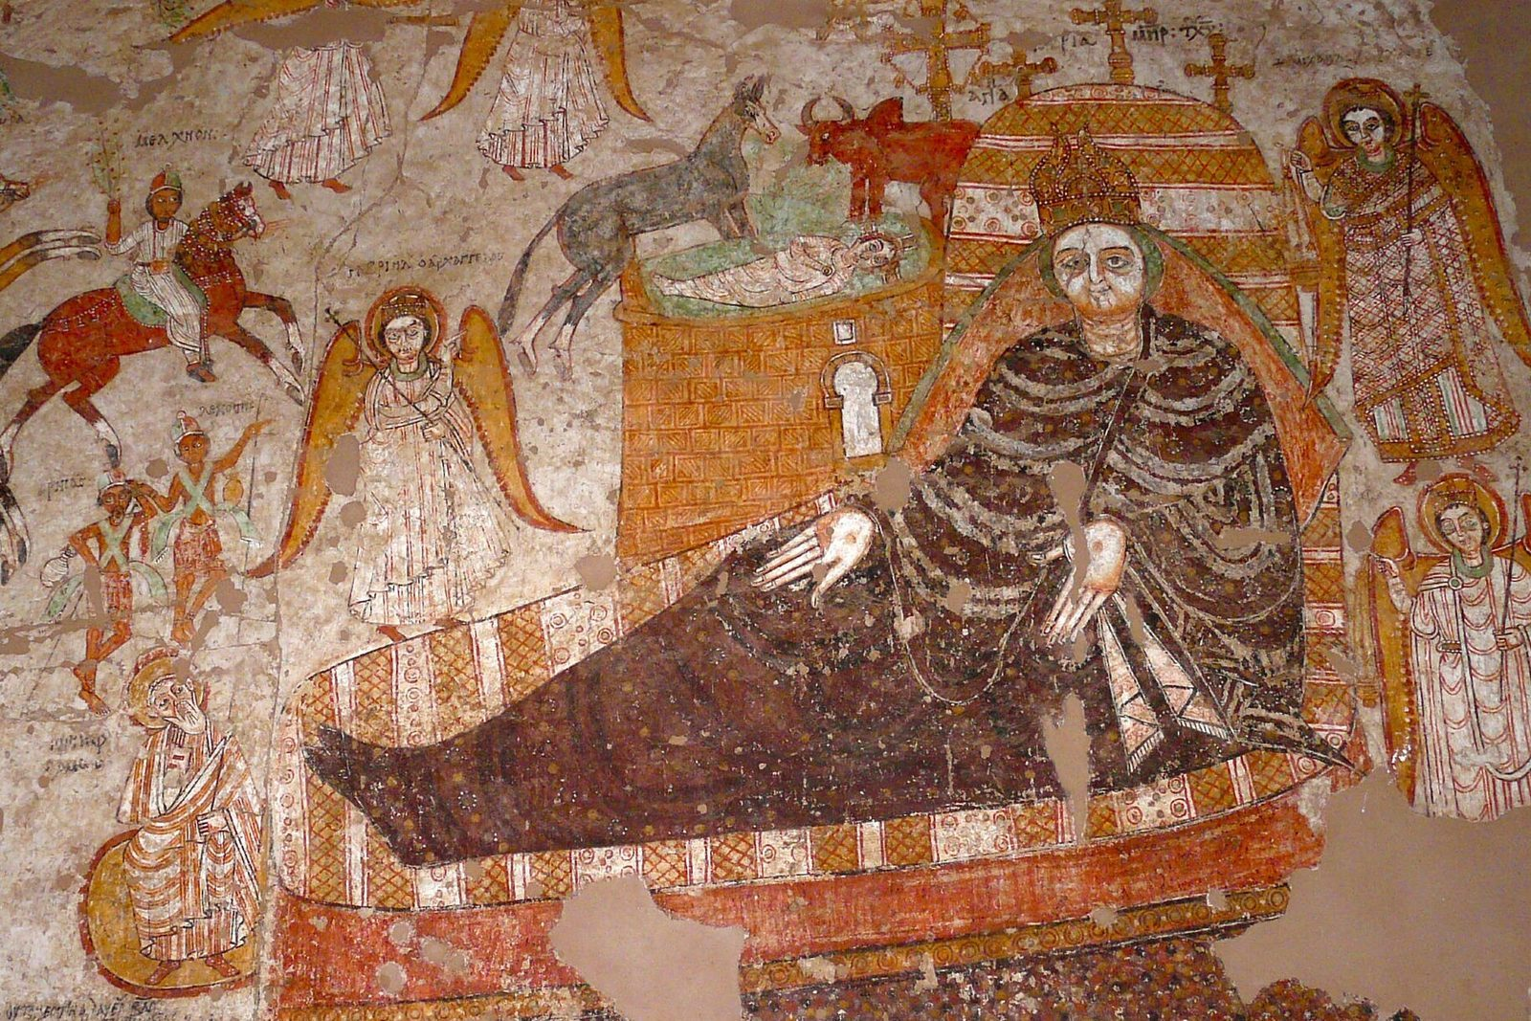
Wise men saw a new star.
They followed it a long, long way to find the new king.
Notes:
Wise men from a country far away saw a new star. They followed it all the way to Jerusalem and then to Bethlehem. In this painting from Africa, they ride in on horses.

Slide 4
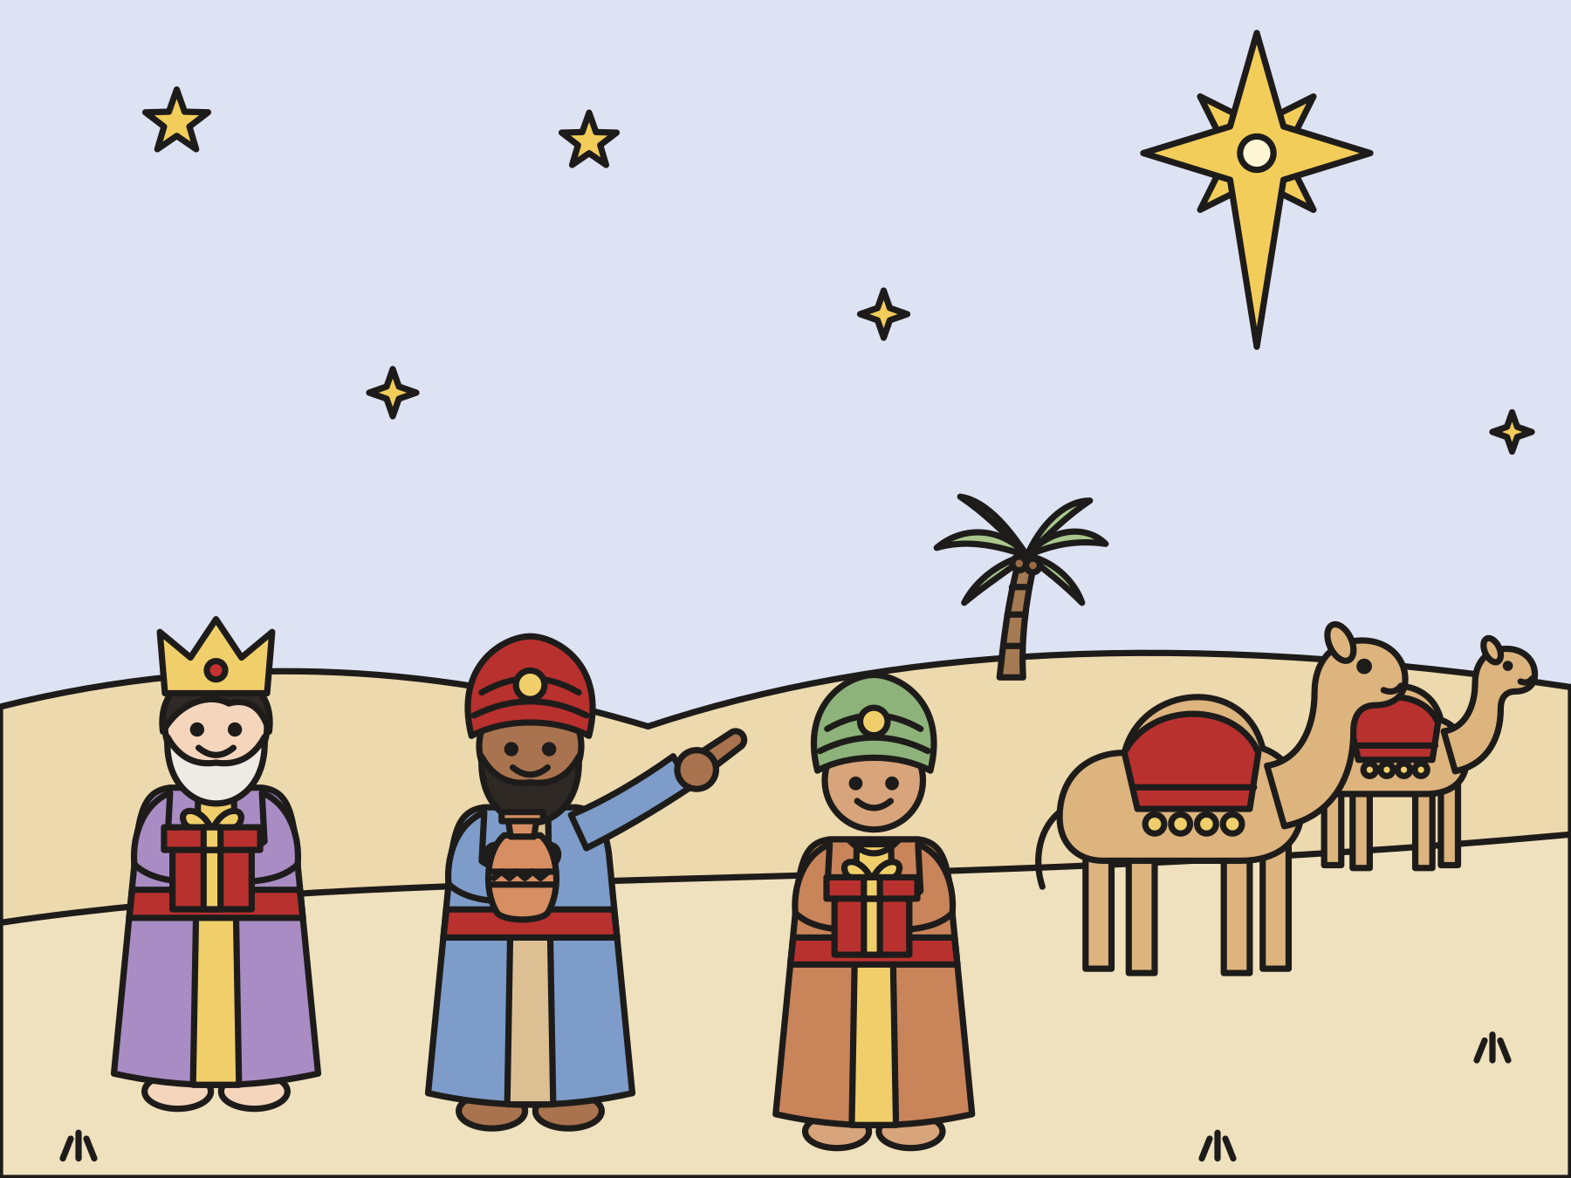
“The star, which they saw in the east, went before them until it came and stood over where the young child was.”
Matthew 2:9
Notes:
Read the verse slowly. The star went ahead of them and then it stopped!

Slide 5
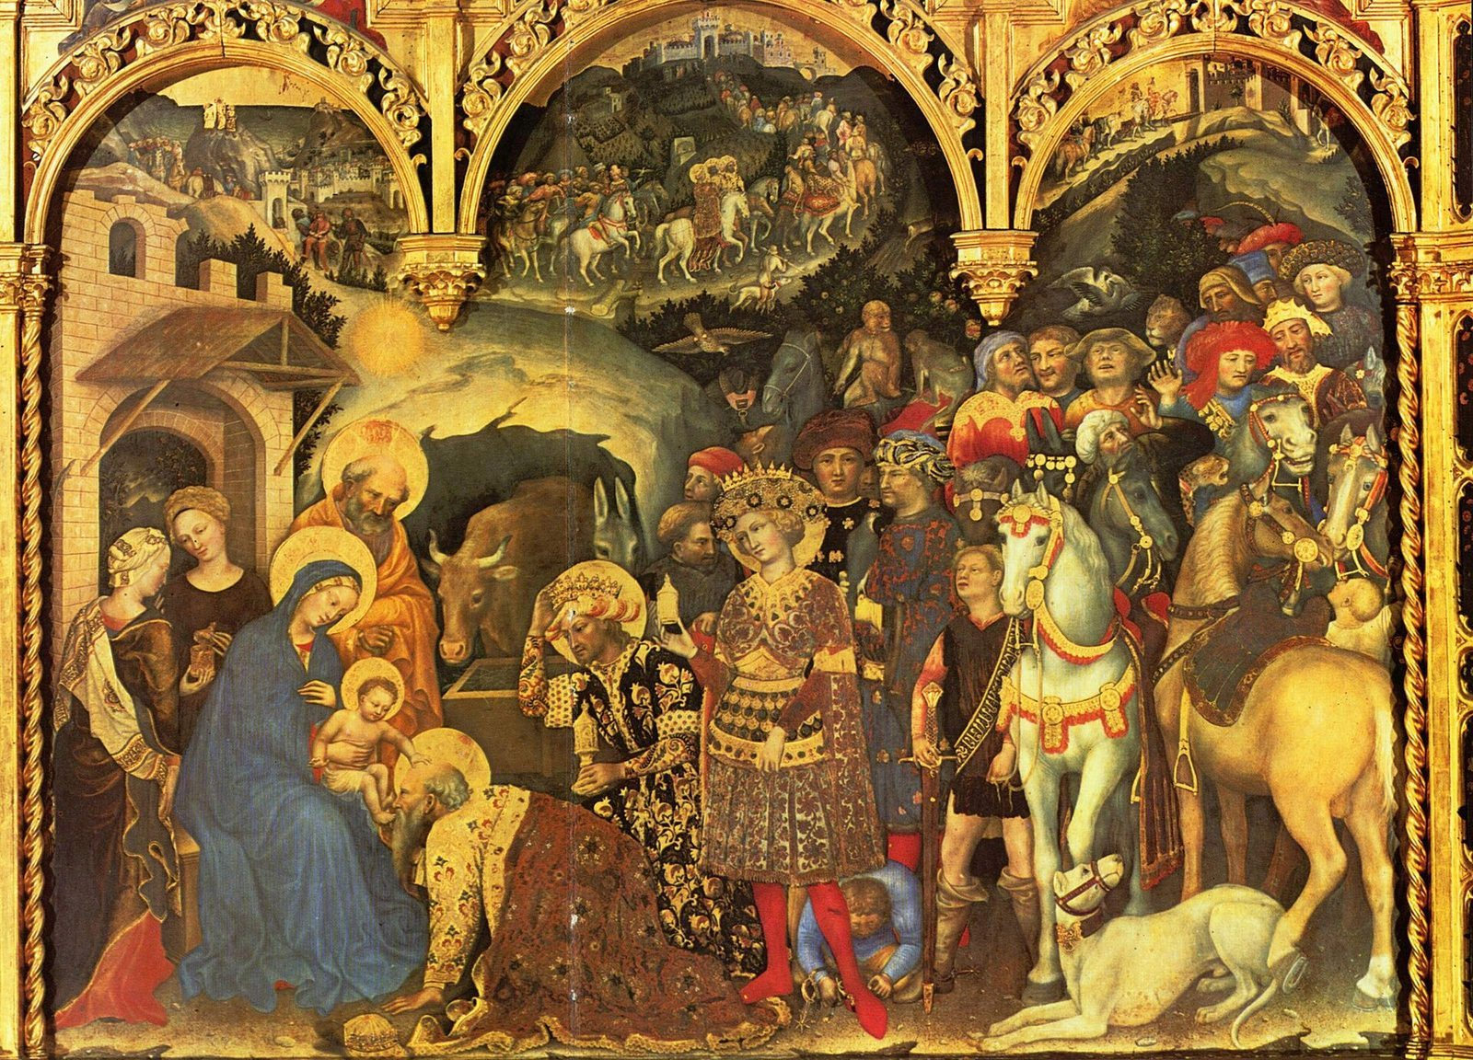
They found Jesus.
They were full of joy. They knelt down and gave him gifts.
Notes:
The wise men found Jesus with his mother, Mary. They worshiped him and gave him gold, frankincense, and myrrh.

Slide 6

God’s love is for everyone.
God led people from far away to meet Jesus.
Notes:
Epiphany means showing. God showed Jesus to people from every land. God’s love is for people near and far, and for you.

Slide 7
Question 1 of 3
What did the wise men follow?
A rainbow
A puppy
A
B
A star
C
Notes:
Read the question and the choices aloud, and let the children answer. Then show the answer: A star. The star went ahead of them all the way to Bethlehem.

Slide 8
Question 1 of 3
What did the wise men follow?
A rainbow
A puppy
A
B
A star
C
The answer is C. The star went ahead of them all the way to Bethlehem.
Notes:
The answer is C: A star. The star went ahead of them all the way to Bethlehem.

Slide 9
Question 2 of 3
How did the wise men feel when the star stopped?
Grumpy
Sleepy
A
B
Very happy
C
Notes:
Read the question and the choices aloud, and let the children answer. Then show the answer: Very happy. The Bible says they rejoiced with exceedingly great joy.

Slide 10
Question 2 of 3
How did the wise men feel when the star stopped?
Grumpy
Sleepy
A
B
Very happy
C
The answer is C. The Bible says they rejoiced with exceedingly great joy.
Notes:
The answer is C: Very happy. The Bible says they rejoiced with exceedingly great joy.

Slide 11
Question 3 of 3
Who is God’s love for?
Everyone, everywhere
Only kings
A
B
Only grown-ups
C
Notes:
Read the question and the choices aloud, and let the children answer. Then show the answer: Everyone, everywhere. God led the wise men from far away to meet Jesus.

Slide 12
Question 3 of 3
Who is God’s love for?
Everyone, everywhere
Only kings
A
B
Only grown-ups
C
The answer is A. God led the wise men from far away to meet Jesus.
Notes:
The answer is A: Everyone, everywhere. God led the wise men from far away to meet Jesus.

Slide 13
Great job!
You finished all 3 questions.
Notes:
Thank the children for listening so well.

Slide 14
Let’s pray
Dear God, thank you for the star that led the wise men to Jesus. Help us shine your light for everyone. Amen.
Notes:
Ask the children to repeat each line after you.

