Slide 1
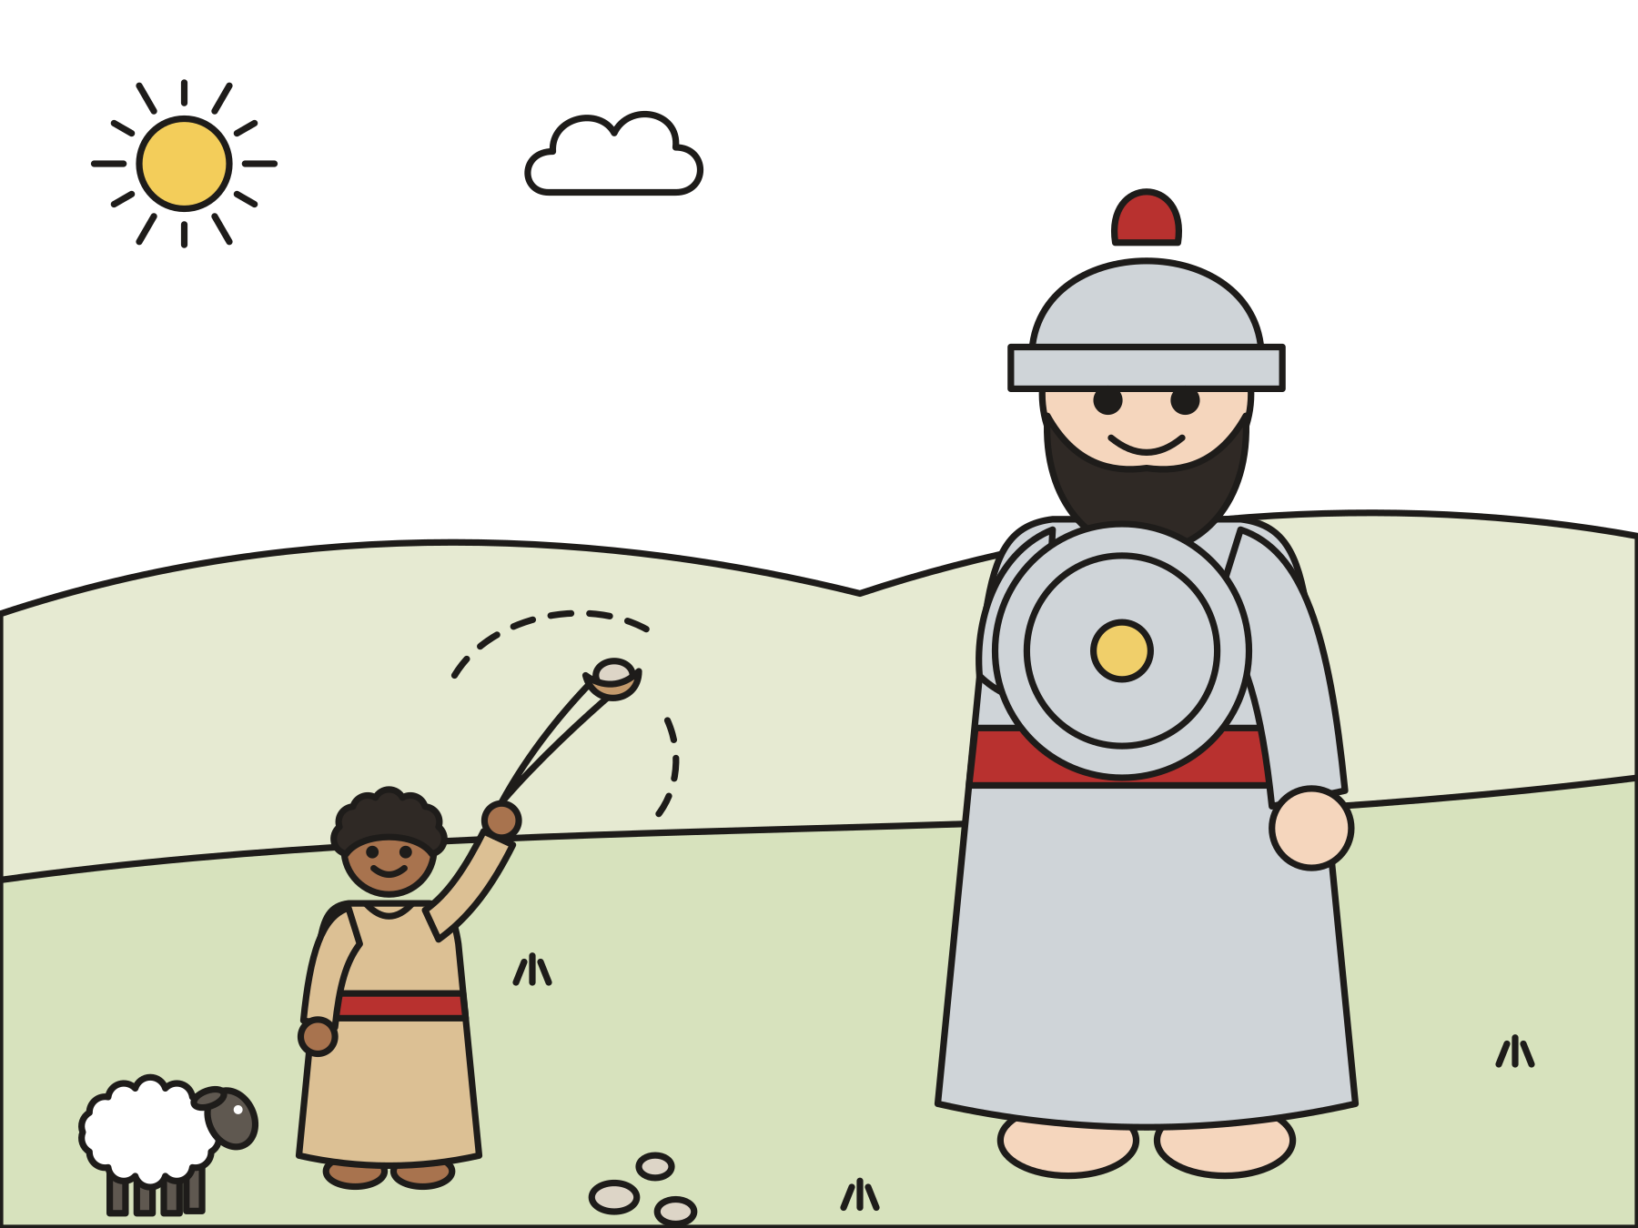
Sunday school · Ages 7–9
David and Goliath
1 Samuel 17:1–50
Mainline Christian
Notes:
Welcome the children. Today’s story comes from 1 Samuel 17:1–50.

Slide 2
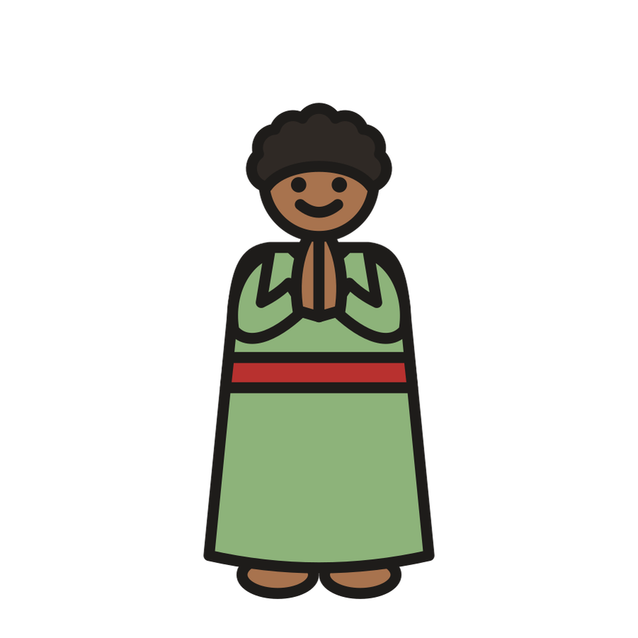
Welcome!
Have you ever felt too small for something big?
Notes:
Welcome each child by name. Ask the question and let two or three children answer. Say: Today’s story is about a boy who felt small next to a giant.

Slide 3
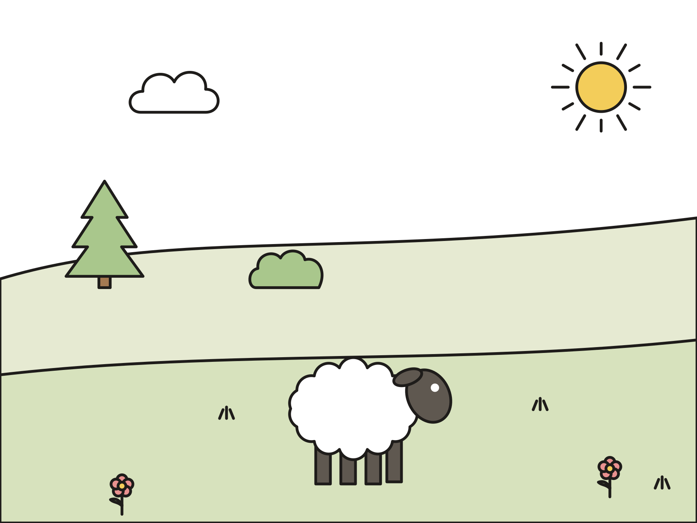
David was a shepherd.
He was the youngest of eight brothers. He took care of his father’s sheep.
Notes:
Long ago in Bethlehem lived a boy named David. He was the youngest of eight brothers. His job was to take care of his father’s sheep. He led them to grass and water, and he kept them safe.

Slide 4

Food for his brothers
David’s father sent him to the army camp with bread and cheese.
Notes:
David’s three oldest brothers were in King Saul’s army. One day David’s father, Jesse, said, “Take this grain and this bread to your brothers. Take these ten cheeses to their captain. See how your brothers are doing.”

Slide 5
A giant named Goliath
Goliath was very tall. Every day he shouted, “Send someone to fight me!”
Notes:
The army of the Philistines was on one hill, and King Saul’s army was on the other hill. Every morning and evening, a giant named Goliath came into the valley and shouted. He was almost as tall as a basketball hoop! For forty days, everyone was too scared to answer him.

Slide 6

“I will go!”
David said, “God kept me safe from a lion and a bear. God will be with me now.”
Notes:
David asked, “Why is everyone so scared? God is with us!” King Saul sent for him. Saul said, “You are just a boy.” David said, “When a lion or a bear came after my sheep, God kept me safe. God will keep me safe now.”

Slide 7

King Saul said:
“Go! The LORD will be with you.”
1 Samuel 17:37
Notes:
King Saul thought for a moment. Then he said, “Go! The LORD will be with you.” This is our memory verse today.

Slide 8
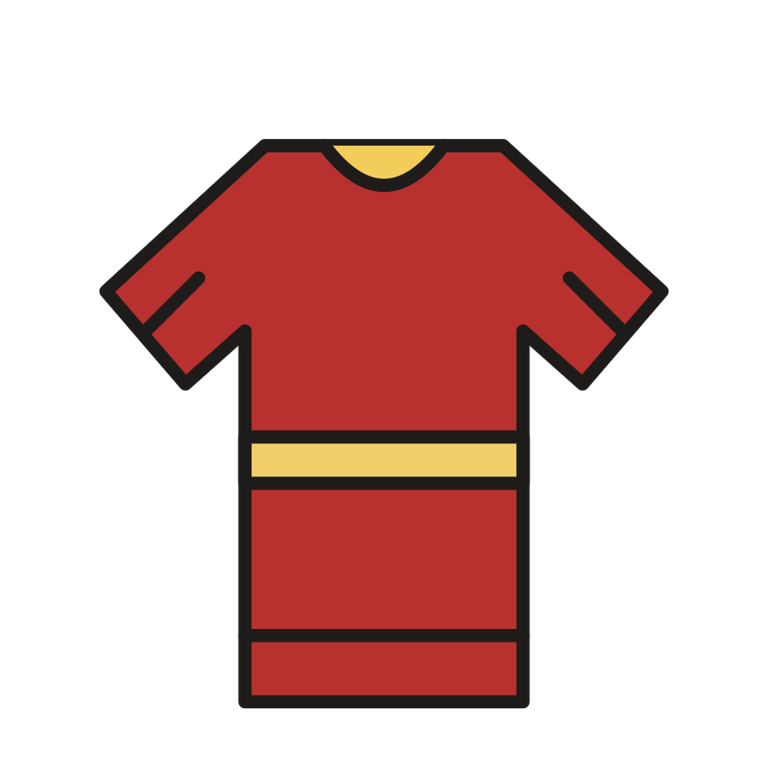
Too big!
King Saul gave David his armor. David could hardly walk, so he took it off.
Notes:
The king put his own armor on David: a bronze helmet, a heavy coat, and a sword. David took a step. Clank! Another step. Clunk! “I can’t walk in this,” he said. So he took it all off and went just as he was.

Slide 9
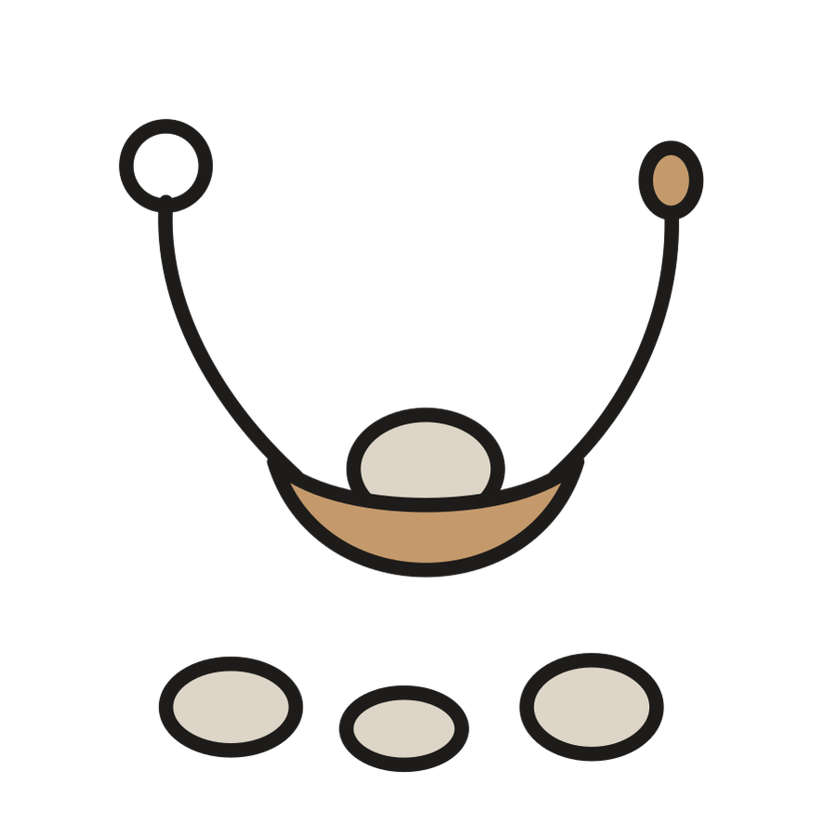
Five smooth stones
David chose five smooth stones from the brook. He took his sling.
Notes:
David took his shepherd’s staff. He went to the brook and chose five smooth stones. He put them in his shepherd’s bag. He held his sling in his hand. Then he walked down into the valley.

Slide 10
David trusted God.
“The LORD doesn’t save with sword and spear.”
1 Samuel 17:47
Notes:
Goliath laughed at David. David called back, “You come with a sword and a spear. I come in the name of the LORD. God doesn’t need swords and spears to save people!”

Slide 11
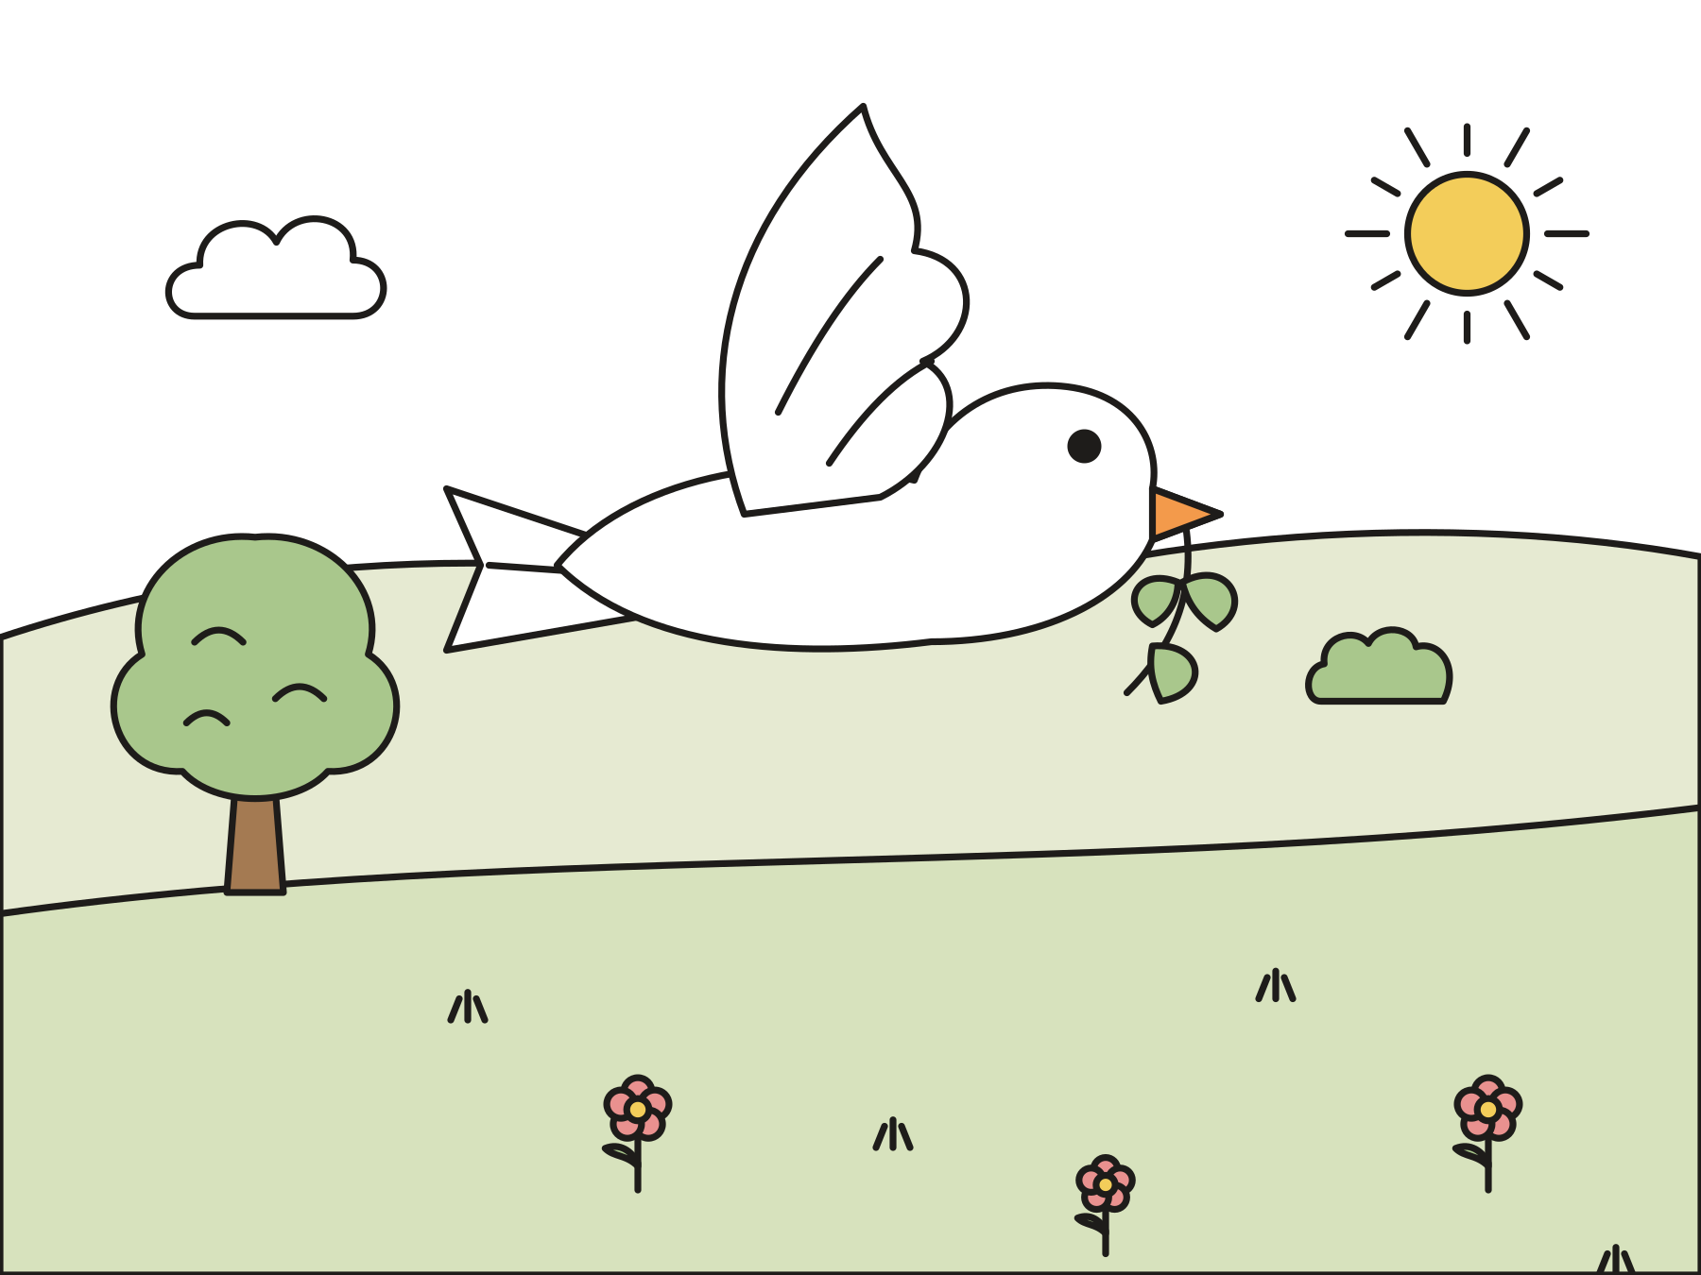
Down went the giant!
David’s stone hit Goliath on the forehead. Down he fell! The other army ran away.
Notes:
David put one stone in his sling and swung it around. Whoosh! The stone hit Goliath right on the forehead, and down he fell. THUD! The Philistine soldiers ran away. The fighting was over, and God’s people were safe.

Slide 12

God is with us too.
When we feel small or scared, God is with us.
Notes:
David was the youngest in his family, and he had no armor at all. He trusted God, and God was with him. When you feel small or scared, remember David. God is with you too.

Slide 13
I wonder…
I wonder how David felt as he walked toward the giant.
Notes:
Wait in silence for answers. Every answer is welcome.

Slide 14
I wonder…
I wonder what helps you feel brave.
Notes:
Let the children share. Some may name a person, a prayer, or a favorite toy. All of these are good answers.

Slide 15
Question 1 of 7
What was David’s job?
He took care of sheep
He caught fish
A
B
He baked bread
He was the king
C
D
Notes:
Read the question and the choices aloud, and let the children answer. Then show the answer: He took care of sheep. David was a shepherd. He took care of his father’s sheep.

Slide 16
Question 1 of 7
What was David’s job?
He took care of sheep
He caught fish
A
B
He baked bread
He was the king
C
D
The answer is A. David was a shepherd. He took care of his father’s sheep.
Notes:
The answer is A: He took care of sheep. David was a shepherd. He took care of his father’s sheep.

Slide 17
Question 2 of 7
What did David bring to his brothers?
Pizza
Bread and cheese
A
B
A puppy
New shoes
C
D
Notes:
Read the question and the choices aloud, and let the children answer. Then show the answer: Bread and cheese. His father sent him with grain, bread, and cheese for his brothers.

Slide 18
Question 2 of 7
What did David bring to his brothers?
Pizza
Bread and cheese
A
B
A puppy
New shoes
C
D
The answer is B. His father sent him with grain, bread, and cheese for his brothers.
Notes:
The answer is B: Bread and cheese. His father sent him with grain, bread, and cheese for his brothers.

Slide 19
Question 3 of 7
Why was everyone in the army scared?
It was raining
A giant shouted at them every day
A
B
They were lost
They had no lunch
C
D
Notes:
Read the question and the choices aloud, and let the children answer. Then show the answer: A giant shouted at them every day. Goliath was very tall, and he shouted at them for forty days.

Slide 20
Question 3 of 7
Why was everyone in the army scared?
It was raining
A giant shouted at them every day
A
B
They were lost
They had no lunch
C
D
The answer is B. Goliath was very tall, and he shouted at them for forty days.
Notes:
The answer is B: A giant shouted at them every day. Goliath was very tall, and he shouted at them for forty days.

Slide 21
Question 4 of 7
Why was David brave?
He was the biggest boy
He trusted that God was with him
A
B
He had the best armor
He wasn’t listening
C
D
Notes:
Read the question and the choices aloud, and let the children answer. Then show the answer: He trusted that God was with him. David remembered how God had kept him safe with his sheep.

Slide 22
Question 4 of 7
Why was David brave?
He was the biggest boy
He trusted that God was with him
A
B
He had the best armor
He wasn’t listening
C
D
The answer is B. David remembered how God had kept him safe with his sheep.
Notes:
The answer is B: He trusted that God was with him. David remembered how God had kept him safe with his sheep.

Slide 23
Question 5 of 7
Why did David take off King Saul’s armor?
It was too big and heavy
It was too pretty
A
B
It was wet
He wanted a crown instead
C
D
Notes:
Read the question and the choices aloud, and let the children answer. Then show the answer: It was too big and heavy. David could hardly walk in it, so he went just as he was.

Slide 24
Question 5 of 7
Why did David take off King Saul’s armor?
It was too big and heavy
It was too pretty
A
B
It was wet
He wanted a crown instead
C
D
The answer is A. David could hardly walk in it, so he went just as he was.
Notes:
The answer is A: It was too big and heavy. David could hardly walk in it, so he went just as he was.

Slide 25
Question 6 of 7
How many smooth stones did David choose?
One
Five
A
B
Ten
One hundred
C
D
Notes:
Read the question and the choices aloud, and let the children answer. Then show the answer: Five. David chose five smooth stones from the brook.

Slide 26
Question 6 of 7
How many smooth stones did David choose?
One
Five
A
B
Ten
One hundred
C
D
The answer is B. David chose five smooth stones from the brook.
Notes:
The answer is B: Five. David chose five smooth stones from the brook.

Slide 27
Question 7 of 7
What does this story teach us about God?
God is with us when we feel small or scared
God only helps grown-ups
A
B
God likes giants best
God is too far away to help
C
D
Notes:
Read the question and the choices aloud, and let the children answer. Then show the answer: God is with us when we feel small or scared. God was with David, and God is with us too.

Slide 28
Question 7 of 7
What does this story teach us about God?
God is with us when we feel small or scared
God only helps grown-ups
A
B
God likes giants best
God is too far away to help
C
D
The answer is A. God was with David, and God is with us too.
Notes:
The answer is A: God is with us when we feel small or scared. God was with David, and God is with us too.

Slide 29

Great job!
You finished all 7 questions.
Notes:
Thank the children for listening so well.

Slide 30
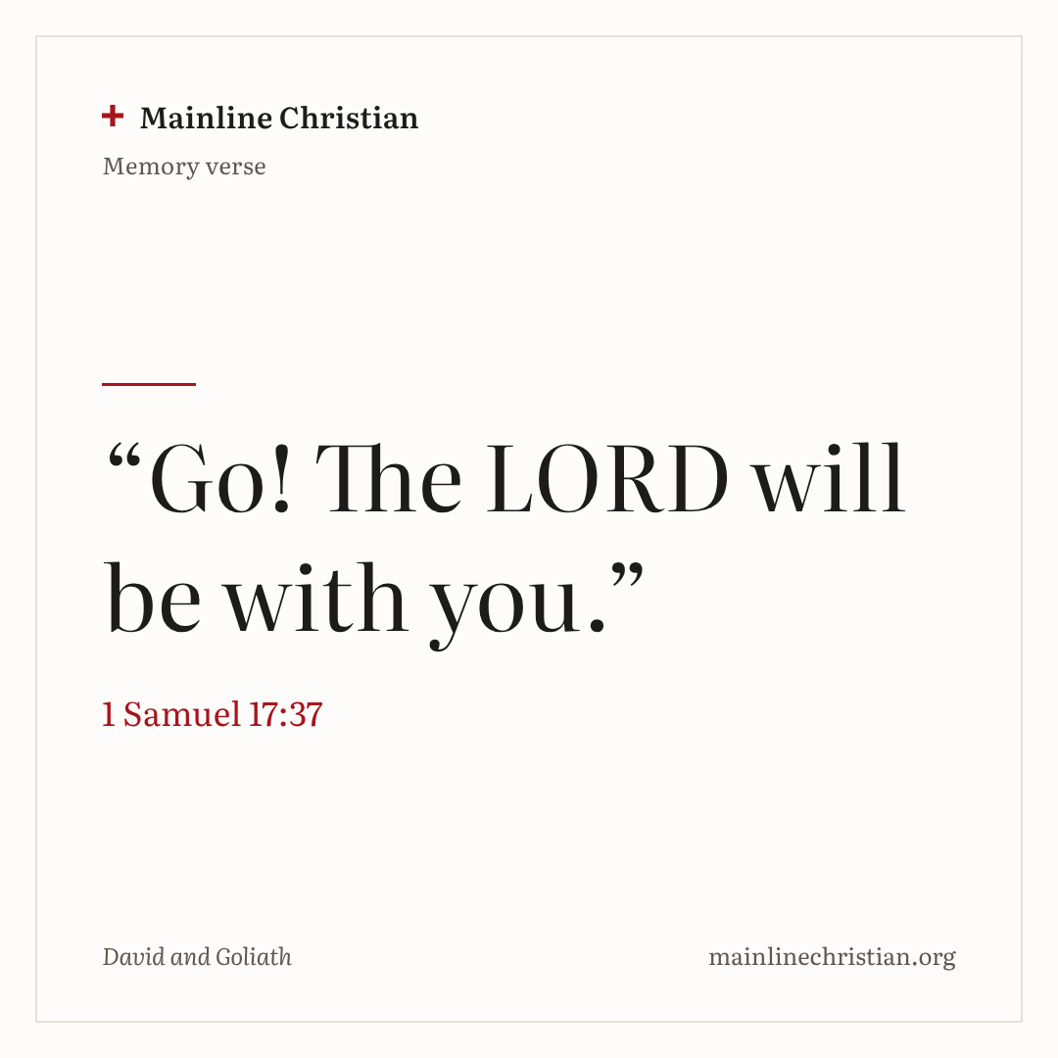
Our memory verse
“Go! The LORD will be with you.”
1 Samuel 17:37
Notes:
Say the verse with motions. “Go!” (take one big step forward). “The LORD” (point up). “will be with you” (hug yourself). Say it in a tiny voice, then a big giant voice, then your own voice.

Slide 31

Make a shepherd’s bag
Fold down the top of a paper bag.
Draw sheep, grass, and a sun on it.
Cut out five paper stones.
Write a brave word on each stone.
Put the stones in your bag.
Notes:
Show a finished bag first. Help with cutting and writing as needed. Suggested words: God is with me. Trust God. Be brave. God loves me. Pray.

Slide 32
Giant steps, shepherd steps
Listen for the kind of step.
Giant steps: big and slow.
Shepherd steps: small and quick.
“God is with me!”: stand tall and brave.
Notes:
Everyone walks together toward the brook line. No one is out, and everyone reaches the brook.

Slide 33
Let’s pray
Dear God, thank you for being with us when we feel small or scared. Help us trust you like David did. Amen.
Notes:
Read the prayer one line at a time and let the children repeat each line after you.

