Slide 1
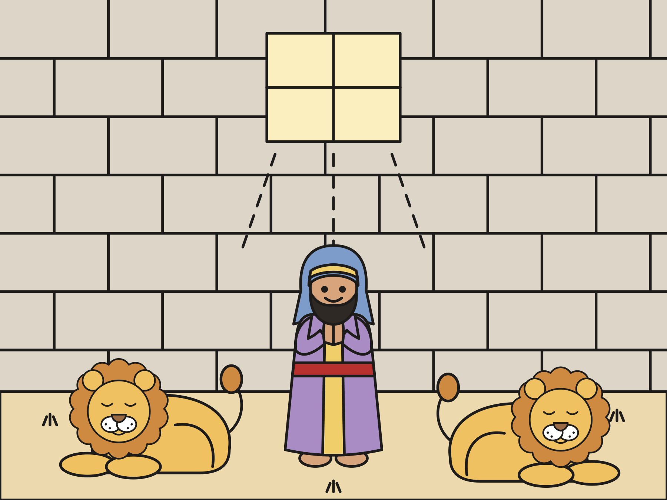
Sunday school · Ages 7–9
Daniel in the lions’ den
Daniel 6
Mainline Christian
Notes:
Welcome the children. Today’s story comes from Daniel 6.

Slide 2

Welcome!
What is something you do every single day?
Notes:
Welcome each child by name. Ask the question and let two or three children answer. Say: Today we will meet a man named Daniel. He did something special three times every day.

Slide 3

Daniel loved God.
Daniel lived far from home. He worked for King Darius.
Notes:
Long ago, a man named Daniel lived far from his home in Jerusalem. He lived in a big kingdom with a king named Darius. Daniel loved God. Every day he knelt down and talked to God.

Slide 4

Daniel was a good helper.
The king wanted to put Daniel in charge of the whole kingdom!
Notes:
Daniel worked for the king. He told the truth and did his work well. King Darius liked him so much that he wanted to put Daniel in charge of everything.

Slide 5

Some leaders were jealous.
They made a sneaky plan to trick the king.
Notes:
Some other leaders were jealous. They looked for something wrong with Daniel, and they could not find anything! So they made a sneaky plan. “Daniel always prays to God. Let’s use that!”

Slide 6

A new law
“For thirty days, pray only to the king!”
Notes:
They told the king, “Make a new law. For thirty days, people may pray only to you. Anyone who prays to God will be put in the lions’ den.” The king signed the law. In that land, nobody could change a law once the king signed it. Not even the king!

Slide 7
Daniel prayed, just like always.
“He kneeled on his knees three times a day, and prayed, and gave thanks before his God, as he did before.”
Daniel 6:10
Notes:
Daniel heard about the law. He went home, opened his window, and knelt down to pray. He said thank you to God, just like always. Read the verse together.

Slide 8

The king was sad.
The king said, “Daniel, your God will save you.”
Notes:
The jealous leaders saw Daniel praying and told the king. The king liked Daniel! He tried all day to help him, but the law could not be changed. So at sundown Daniel was put in the lions’ den. A den is a home for lions, like a cave. The king said, “Your God will save you.”

Slide 9

The king could not sleep.
All night long, he worried about his friend Daniel.
Notes:
A big stone was rolled over the door of the den. The king went home. He did not eat his supper. He did not want any music. He lay in bed and worried all night long.

Slide 10
Early in the morning…
The king ran to the den. “Daniel! Did your God save you?”
Notes:
As soon as the sun came up, the king jumped out of bed and ran all the way to the den. He called out in a worried voice, “Daniel! Did your God save you from the lions?”

Slide 11
God shut the lions’ mouths!
Daniel said, “God sent an angel. The lions did not hurt me!”
Notes:
A voice came from inside the den. “O king, live forever! My God sent his angel and shut the lions’ mouths. They did not hurt me!” The lions were sleepy and calm. God had been with Daniel all night long.

Slide 12

The living God
The king told everyone, “Daniel’s God is the living God!”
Notes:
The king was so happy! Daniel came out of the den without one scratch. Then the king wrote a letter to everyone in his kingdom: “Daniel’s God is the living God! God helps and saves!”

Slide 13
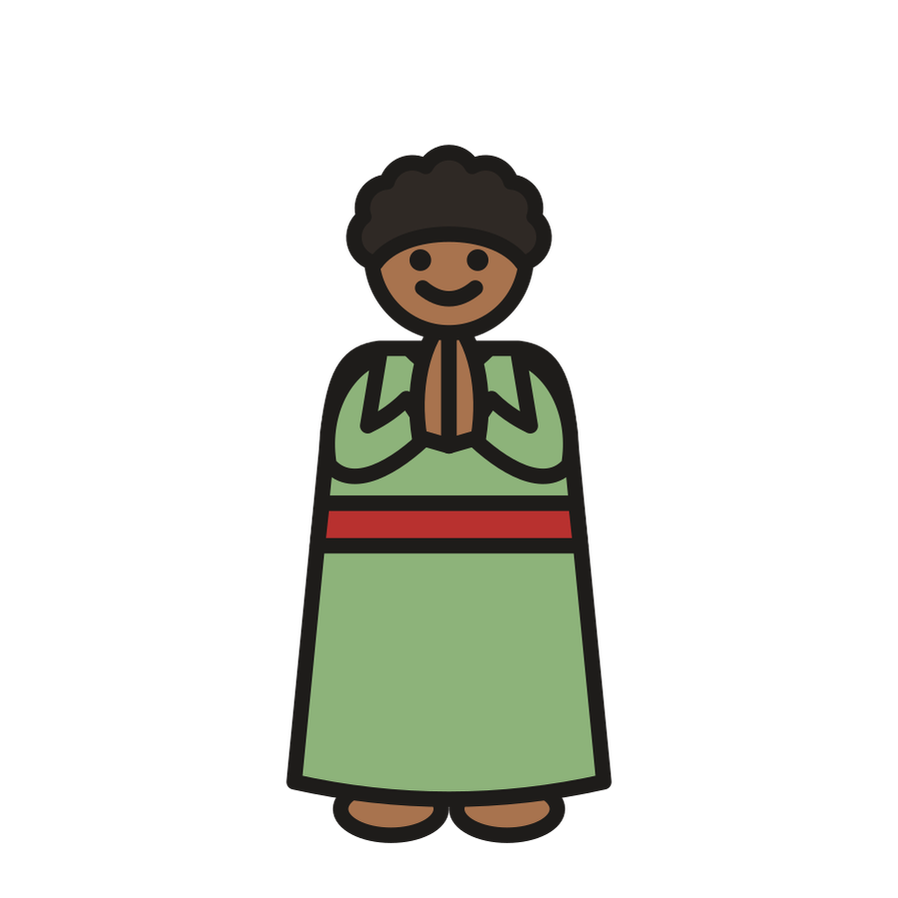
God is with us.
We can talk to God anytime. God is with us, even when we are afraid.
Notes:
Daniel trusted God when things were hard. We can talk to God anytime too: in the morning, at noon, at night, and whenever we feel afraid. God hears us, and God is always with us.

Slide 14
I wonder…
I wonder what Daniel said to God when he prayed.
Notes:
Wait quietly for answers. Every answer is welcome.

Slide 15
I wonder…
I wonder how Daniel felt in the den all night.
Notes:
Let the children think out loud. There are no wrong answers.

Slide 16
Question 1 of 7
Who did Daniel pray to?
God
King Darius
A
B
The lions
C
Notes:
Read the question and the choices aloud, and let the children answer. Then show the answer: God. Daniel loved God and prayed to God every day.

Slide 17
Question 1 of 7
Who did Daniel pray to?
God
King Darius
A
B
The lions
C
The answer is A. Daniel loved God and prayed to God every day.
Notes:
The answer is A: God. Daniel loved God and prayed to God every day.

Slide 18
Question 2 of 7
What did the new law say?
Eat more vegetables
Pray only to the king
A
B
Be kind to lions
Go to bed early
C
D
Notes:
Read the question and the choices aloud, and let the children answer. Then show the answer: Pray only to the king. For thirty days, people could pray only to King Darius.

Slide 19
Question 2 of 7
What did the new law say?
Eat more vegetables
Pray only to the king
A
B
Be kind to lions
Go to bed early
C
D
The answer is B. For thirty days, people could pray only to King Darius.
Notes:
The answer is B: Pray only to the king. For thirty days, people could pray only to King Darius.

Slide 20
Question 3 of 7
How many times a day did Daniel pray?
Three
One
A
B
Ten
Never
C
D
Notes:
Read the question and the choices aloud, and let the children answer. Then show the answer: Three. Daniel knelt and prayed three times a day, just like always.

Slide 21
Question 3 of 7
How many times a day did Daniel pray?
Three
One
A
B
Ten
Never
C
D
The answer is A. Daniel knelt and prayed three times a day, just like always.
Notes:
The answer is A: Three. Daniel knelt and prayed three times a day, just like always.

Slide 22
Question 4 of 7
Why did the jealous leaders want the new law?
To get Daniel in trouble
To help Daniel
A
B
To feed the lions
To make the king laugh
C
D
Notes:
Read the question and the choices aloud, and let the children answer. Then show the answer: To get Daniel in trouble. They knew Daniel would keep praying to God.

Slide 23
Question 4 of 7
Why did the jealous leaders want the new law?
To get Daniel in trouble
To help Daniel
A
B
To feed the lions
To make the king laugh
C
D
The answer is A. They knew Daniel would keep praying to God.
Notes:
The answer is A: To get Daniel in trouble. They knew Daniel would keep praying to God.

Slide 24
Question 5 of 7
How did the king feel that night?
Sad and worried
Happy and silly
A
B
Very hungry
C
Notes:
Read the question and the choices aloud, and let the children answer. Then show the answer: Sad and worried. The king liked Daniel. He could not eat or sleep all night.

Slide 25
Question 5 of 7
How did the king feel that night?
Sad and worried
Happy and silly
A
B
Very hungry
C
The answer is A. The king liked Daniel. He could not eat or sleep all night.
Notes:
The answer is A: Sad and worried. The king liked Daniel. He could not eat or sleep all night.

Slide 26
Question 6 of 7
How did God keep Daniel safe?
God sent an angel to shut the lions’ mouths
God gave Daniel a ladder
A
B
God made the lions fly away
God turned the lions into kittens
C
D
Notes:
Read the question and the choices aloud, and let the children answer. Then show the answer: God sent an angel to shut the lions’ mouths. Daniel said, “My God has sent his angel, and has shut the lions’ mouths.”

Slide 27
Question 6 of 7
How did God keep Daniel safe?
God sent an angel to shut the lions’ mouths
God gave Daniel a ladder
A
B
God made the lions fly away
God turned the lions into kittens
C
D
The answer is A. Daniel said, “My God has sent his angel, and has shut the lions’ mouths.”
Notes:
The answer is A: God sent an angel to shut the lions’ mouths. Daniel said, “My God has sent his angel, and has shut the lions’ mouths.”

Slide 28
Question 7 of 7
What does this story teach us about God?
God is with us, even when we are afraid
God only listens on Sundays
A
B
God is too busy to hear us
God likes lions more than people
C
D
Notes:
Read the question and the choices aloud, and let the children answer. Then show the answer: God is with us, even when we are afraid. Like Daniel, we can talk to God anytime, and God is always with us.

Slide 29
Question 7 of 7
What does this story teach us about God?
God is with us, even when we are afraid
God only listens on Sundays
A
B
God is too busy to hear us
God likes lions more than people
C
D
The answer is A. Like Daniel, we can talk to God anytime, and God is always with us.
Notes:
The answer is A: God is with us, even when we are afraid. Like Daniel, we can talk to God anytime, and God is always with us.

Slide 30
Great job!
You finished all 7 questions.
Notes:
Thank the children for listening so well.

Slide 31
Our memory verse
“He had trusted in his God.”
Daniel 6:23
Notes:
Say the verse with motions. “He had trusted” (hand on your heart). “in his God” (point up). Say it in a big lion voice, then in a sleepy lion whisper.

Slide 32
Make a sleepy lion
Color a paper plate for the lion’s face.
Draw sleepy eyes and a closed, smiling mouth.
Cut paper strips for the mane.
Glue the strips around the plate.
Write on the back: God was with Daniel!
Notes:
Show a finished lion first. Help with cutting as needed. Curl the strips around a pencil to make a bouncy mane.

Slide 33
Sleepy lions
Be a lion. Crawl and give a soft roar.
God shut the lions’ mouths! Lie down and sleep.
Daniel walks to the middle and kneels to pray.
The king calls, “Daniel!” Daniel answers.
Wake up and cheer!
Notes:
Choose a new Daniel each round. If a lion giggles or snores, that is fine. Nobody is out.

Slide 34
Let’s pray
Dear God, thank you for being with Daniel. Help us talk to you every day and trust you when we are afraid. Amen.
Notes:
Read the prayer one line at a time and let the children repeat each line after you.

