Slide 1
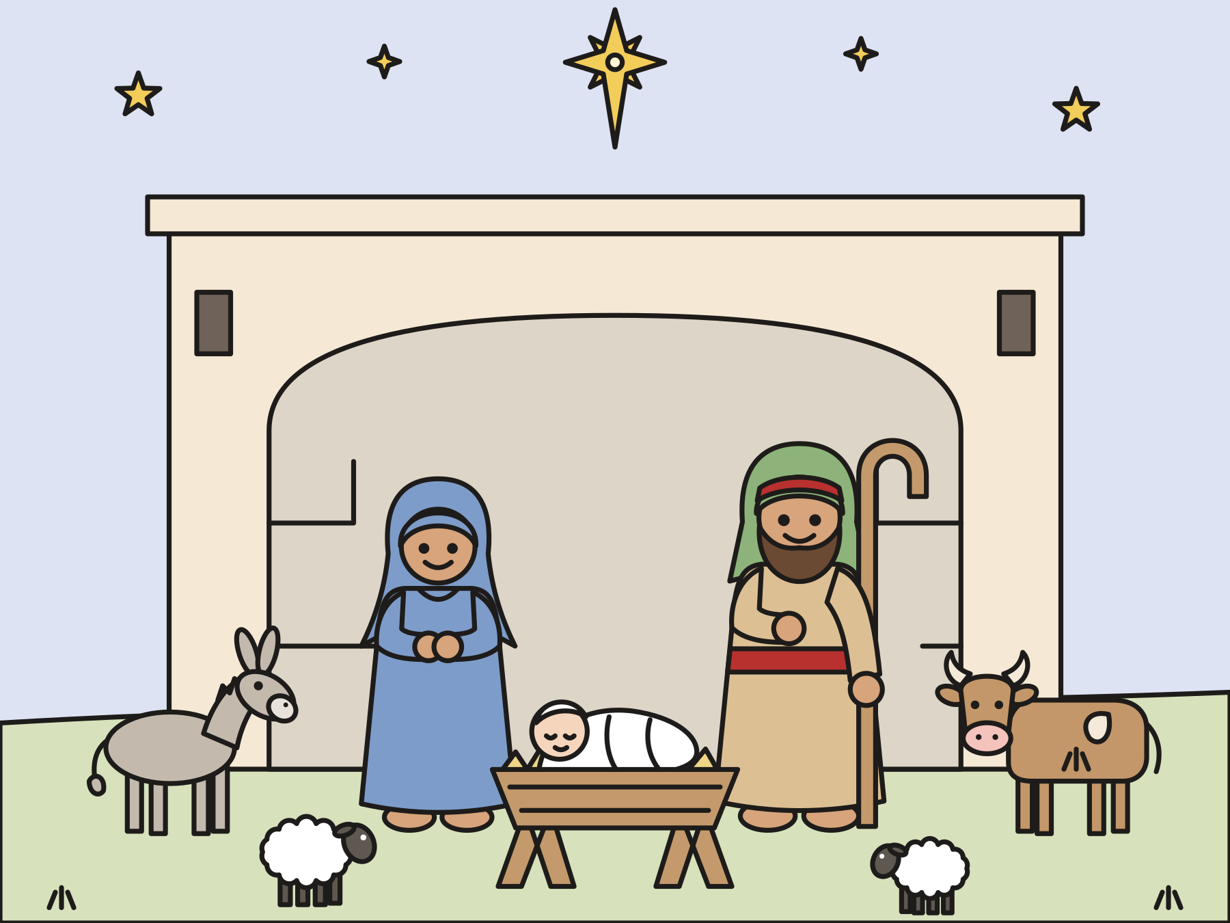
Sunday school · Ages 7–9
Jesus is born in Bethlehem
Luke 2:1–7
Mainline Christian
Notes:
Welcome the children. Today’s story comes from Luke 2:1–7.

Slide 2

Welcome!
What would you pack for a long trip?
Notes:
Welcome each child by name. Ask the question and let two or three children answer. Say: Today’s story is about a long trip that Mary and Joseph took.

Slide 3

Mary and Joseph lived in Nazareth.
Mary was going to have a baby. Her baby would be God’s Son.
Notes:
Long ago, a young woman named Mary lived in a town called Nazareth. She was going to marry Joseph, a carpenter. Mary was going to have a baby. An angel had told her that her baby would be God’s own Son.

Slide 4

Everyone must be counted!
The emperor made a rule. Everyone had to go to their family’s town.
Notes:
Far away in Rome lived the emperor, Caesar Augustus. His face was on the coins! One day he made a rule: everyone must be counted. Each person had to go to their family’s hometown and sign the list.

Slide 5
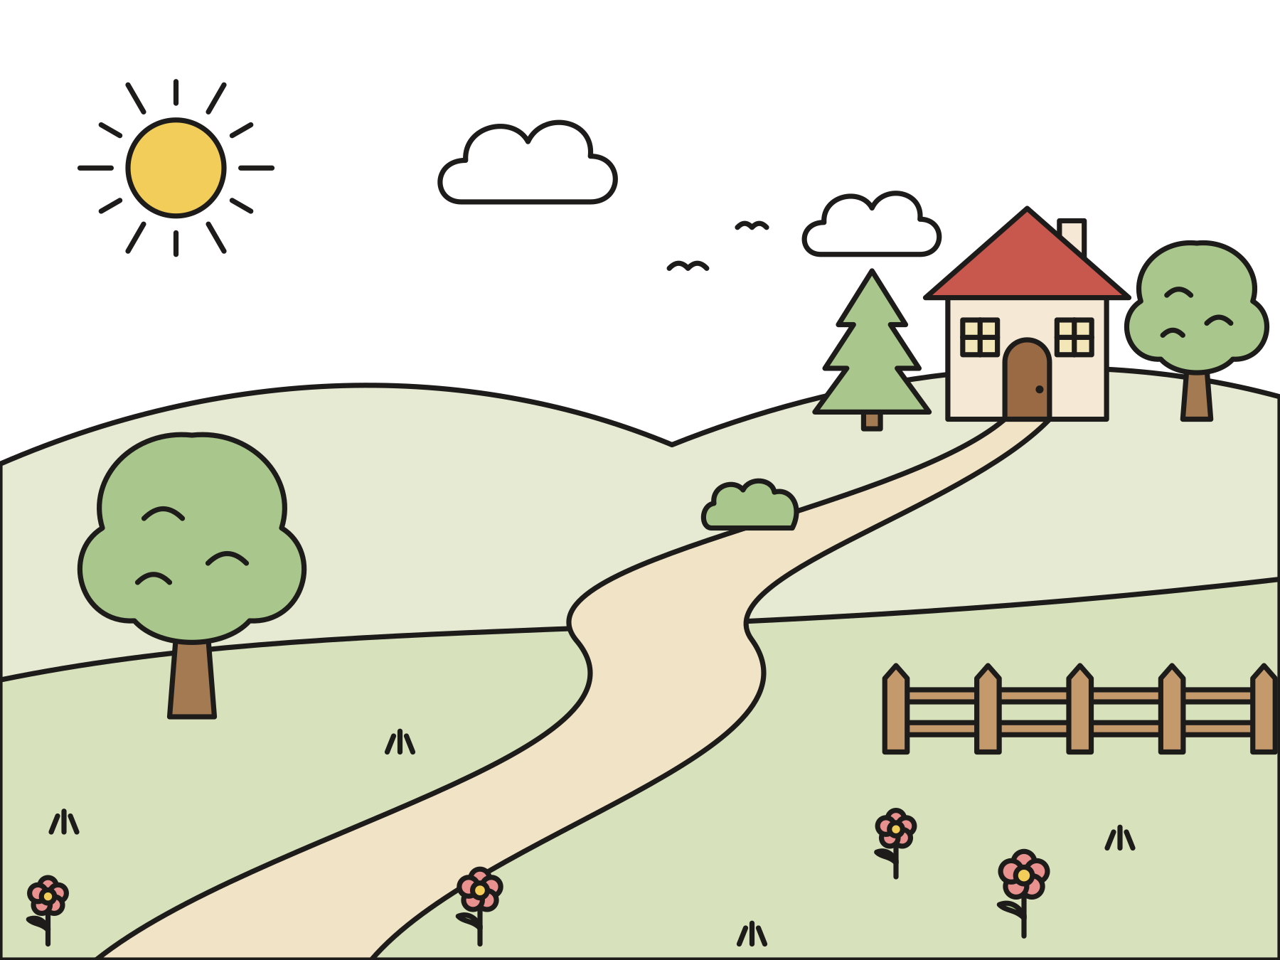
A long walk to Bethlehem
They walked for many days. Mary was tired.
Notes:
Joseph’s family came from Bethlehem, the town of King David. So Mary and Joseph set out. They walked up hills and down hills for many days. Maybe Mary rode a donkey part of the way. The Bible does not say.

Slide 6
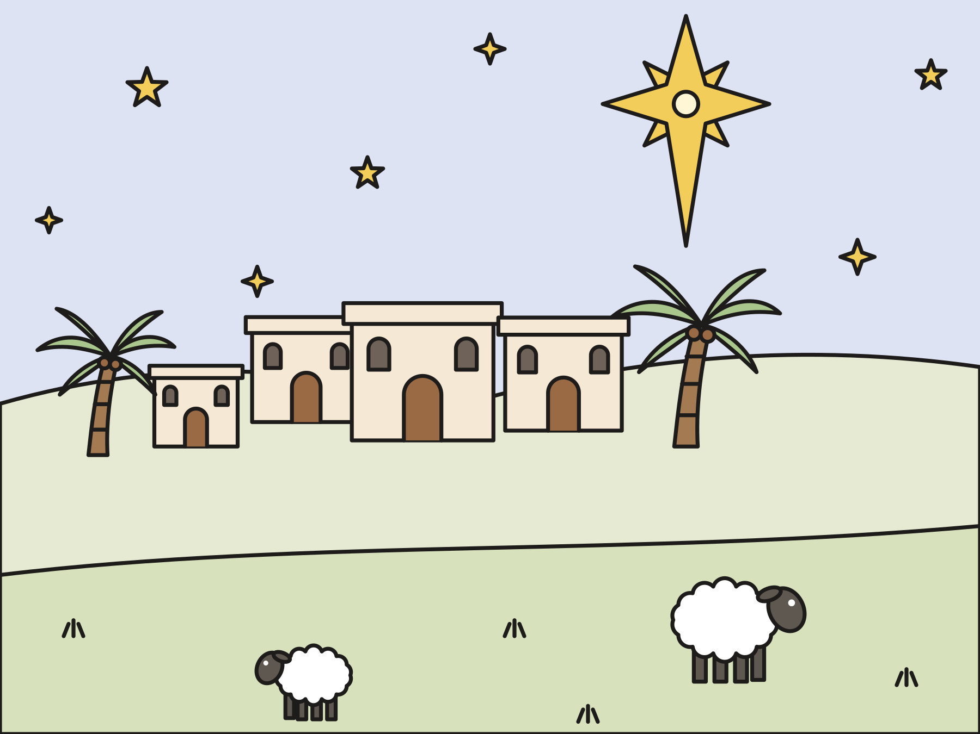
No room!
Bethlehem was full of people. The guest room was full.
Notes:
At last they came to Bethlehem. The town was crowded. Everyone had come to be counted! There was no room for them in the guest room. So they stayed in the place where the animals slept at night.

Slide 7
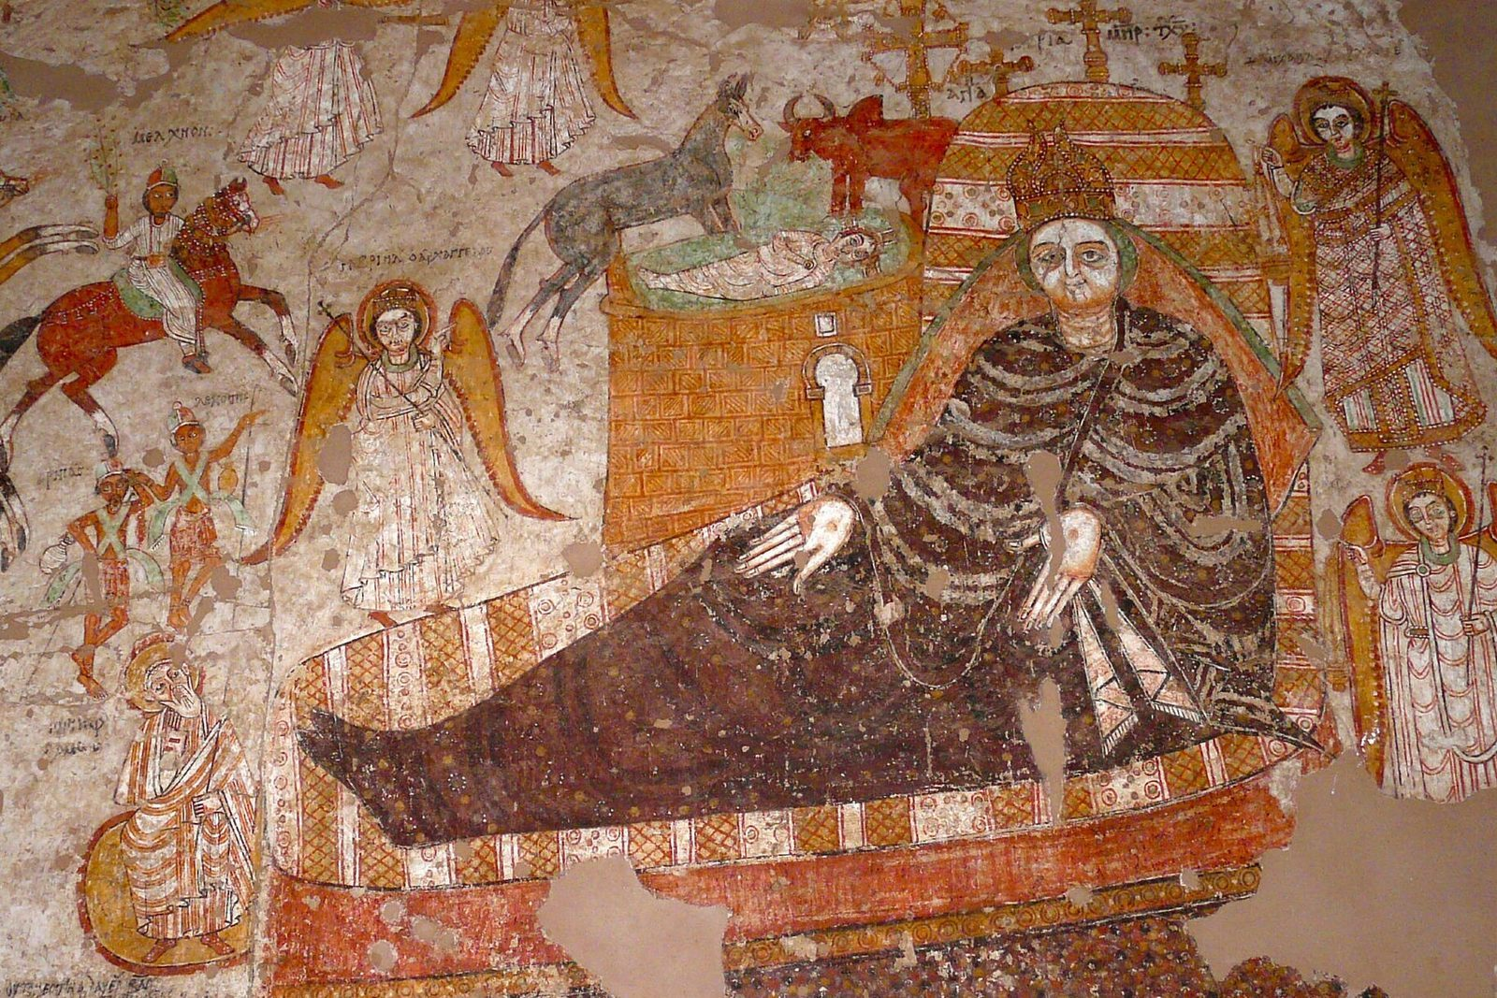
Jesus is born!
Mary wrapped him in cloth. She laid him in a manger.
Notes:
That night Mary’s baby was born. She wrapped him snugly in strips of cloth and laid him in a manger. They named him Jesus. This painting is about a thousand years old. It comes from a church in Nubia, in Africa. Can you find the baby, the ox, and the donkey?

Slide 8

What is a manger?
A manger is a feeding box for animals. It was baby Jesus’ first bed!
Notes:
Animals ate their dinner from a manger. It was full of hay. Mary filled it with soft hay and made it into a bed for her baby.

Slide 9

Room for everyone
God came close to us in Jesus. With Jesus, there is room for you!
Notes:
God’s own Son was born in a crowded little town. His first bed was a feeding box. Jesus came to be close to everyone. With Jesus, there is always room.

Slide 10
I wonder…
I wonder how Mary and Joseph felt on the long walk.
Notes:
Wait for answers. Every answer is welcome.

Slide 11
I wonder…
I wonder how you could make room for someone this Christmas.
Notes:
Let the children dream up ideas. There are no wrong answers.

Slide 12
Question 1 of 7
In what town did Mary and Joseph live?
Rome
The North Pole
A
B
Egypt
Nazareth
C
D
Notes:
Read the question and the choices aloud, and let the children answer. Then show the answer: Nazareth. Mary and Joseph lived in Nazareth, a long walk from Bethlehem.

Slide 13
Question 1 of 7
In what town did Mary and Joseph live?
Rome
The North Pole
A
B
Egypt
Nazareth
C
D
The answer is D. Mary and Joseph lived in Nazareth, a long walk from Bethlehem.
Notes:
The answer is D: Nazareth. Mary and Joseph lived in Nazareth, a long walk from Bethlehem.

Slide 14
Question 2 of 7
Why did Mary and Joseph go to Bethlehem?
To go to the beach
To buy a donkey
A
B
To see a parade
To be counted
C
D
Notes:
Read the question and the choices aloud, and let the children answer. Then show the answer: To be counted. The emperor wanted everyone counted in their family’s town.

Slide 15
Question 2 of 7
Why did Mary and Joseph go to Bethlehem?
To go to the beach
To buy a donkey
A
B
To see a parade
To be counted
C
D
The answer is D. The emperor wanted everyone counted in their family’s town.
Notes:
The answer is D: To be counted. The emperor wanted everyone counted in their family’s town.

Slide 16
Question 3 of 7
Why did they stay where the animals slept?
They liked the smell
There was no room in the guest room
A
B
The cows invited them
They were playing hide-and-seek
C
D
Notes:
Read the question and the choices aloud, and let the children answer. Then show the answer: There was no room in the guest room. Bethlehem was full of people, and there was no room for them.

Slide 17
Question 3 of 7
Why did they stay where the animals slept?
They liked the smell
There was no room in the guest room
A
B
The cows invited them
They were playing hide-and-seek
C
D
The answer is B. Bethlehem was full of people, and there was no room for them.
Notes:
The answer is B: There was no room in the guest room. Bethlehem was full of people, and there was no room for them.

Slide 18
Question 4 of 7
What did Mary wrap her baby in?
Bands of cloth
A paper bag
A
B
Leaves
A fishing net
C
D
Notes:
Read the question and the choices aloud, and let the children answer. Then show the answer: Bands of cloth. Mary wrapped him snugly in strips of cloth to keep him warm.

Slide 19
Question 4 of 7
What did Mary wrap her baby in?
Bands of cloth
A paper bag
A
B
Leaves
A fishing net
C
D
The answer is A. Mary wrapped him snugly in strips of cloth to keep him warm.
Notes:
The answer is A: Bands of cloth. Mary wrapped him snugly in strips of cloth to keep him warm.

Slide 20
Question 5 of 7
Where did Mary lay baby Jesus?
In a boat
In a manger
A
B
In a castle
In a tree
C
D
Notes:
Read the question and the choices aloud, and let the children answer. Then show the answer: In a manger. A manger is a feeding box for animals. It was Jesus’ first bed.

Slide 21
Question 5 of 7
Where did Mary lay baby Jesus?
In a boat
In a manger
A
B
In a castle
In a tree
C
D
The answer is B. A manger is a feeding box for animals. It was Jesus’ first bed.
Notes:
The answer is B: In a manger. A manger is a feeding box for animals. It was Jesus’ first bed.

Slide 22
Question 6 of 7
What did the family name the baby?
Jesus
David
A
B
Augustus
Joseph
C
D
Notes:
Read the question and the choices aloud, and let the children answer. Then show the answer: Jesus. The baby’s name was Jesus.

Slide 23
Question 6 of 7
What did the family name the baby?
Jesus
David
A
B
Augustus
Joseph
C
D
The answer is A. The baby’s name was Jesus.
Notes:
The answer is A: Jesus. The baby’s name was Jesus.

Slide 24
Question 7 of 7
What does this story show us about God?
God stays far away
God loves only kings
A
B
God came close to be with us
God is too busy for us
C
D
Notes:
Read the question and the choices aloud, and let the children answer. Then show the answer: God came close to be with us. God came to us in Jesus, a tiny baby in a crowded town.

Slide 25
Question 7 of 7
What does this story show us about God?
God stays far away
God loves only kings
A
B
God came close to be with us
God is too busy for us
C
D
The answer is C. God came to us in Jesus, a tiny baby in a crowded town.
Notes:
The answer is C: God came close to be with us. God came to us in Jesus, a tiny baby in a crowded town.

Slide 26

Great job!
You finished all 7 questions.
Notes:
Thank the children for listening so well.

Slide 27
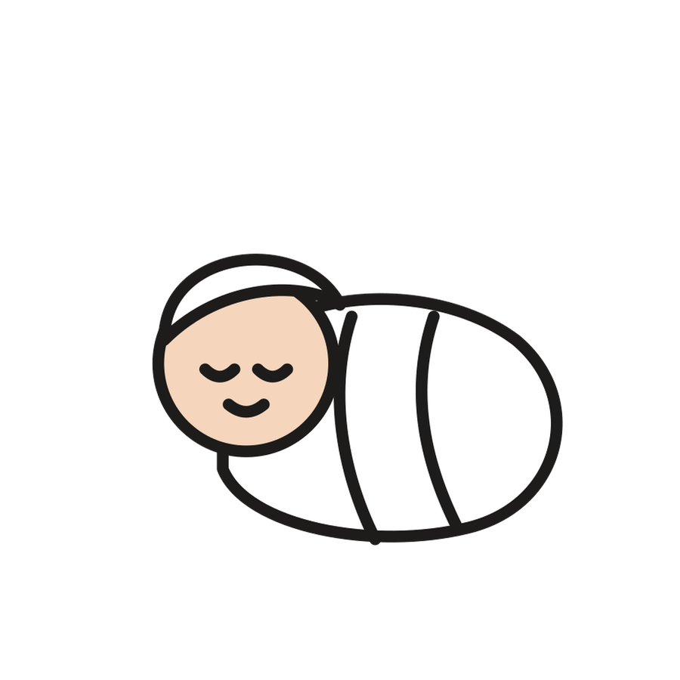
Our memory verse
“For a child is born to us. A son is given to us.”
Isaiah 9:6
Notes:
Say the verse with motions. “For a child is born” (rock a baby in your arms). “to us” (point around the circle). “A son is given” (hold out your hands like a gift). “to us” (hug yourself). Say it softly, then loudly, then in a whisper.

Slide 28
Make a baby Jesus in a manger
Draw a face on the clothespin.
Wrap the cloth around it.
Tape or glue the end.
Fill a cup with paper hay.
Lay the baby on the hay.
Notes:
Show a finished manger first. Help with wrapping and taping as needed.

Slide 29
Room for everyone
Walk around while the music plays.
When it stops, everyone gets on the sheet.
A toe or a hand counts!
Cheer: There’s room for everyone!
Notes:
Fold the sheet smaller each round. Remind the children to be gentle. No one is ever out.

Slide 30
Let’s pray
Dear God, thank you for sending Jesus to be close to us. Help us make room for Jesus and for each other. Amen.
Notes:
Read the prayer one line at a time and let the children repeat each line after you.

