Slide 1
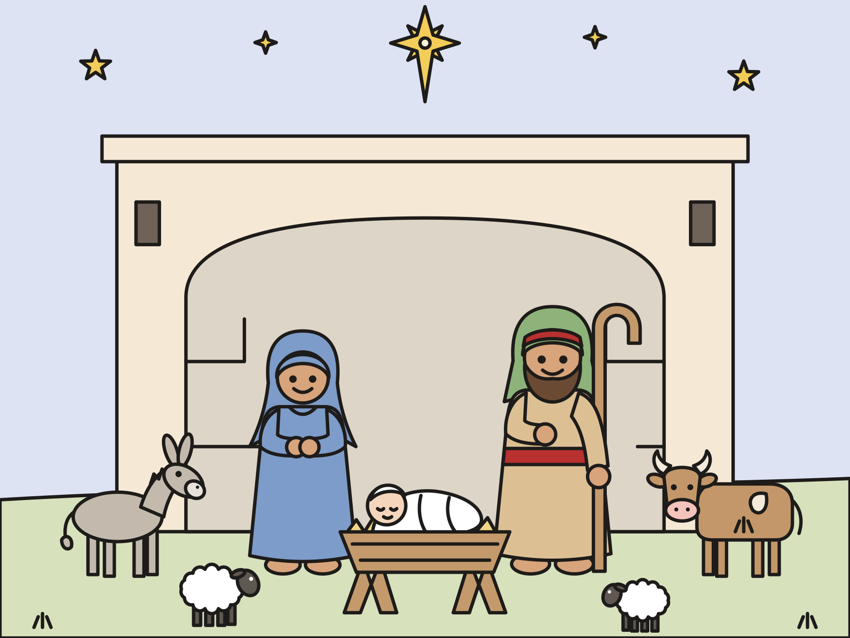
Sunday school · Ages 4–12
A no-rehearsal Christmas pageant
Luke 2:1–20; Matthew 2:1–12
Mainline Christian
Notes:
Welcome the children. Today’s story comes from Luke 2:1–20; Matthew 2:1–12.

Slide 2

Welcome to our Christmas pageant!
Everyone has a part today, and that includes you!
Notes:
Show this slide as people arrive. Narrator 1 says: Welcome! Today our children tell the story of Jesus’ birth. You have a part too. Please sing the carols, make the animal sounds, and say the angels’ song with us.

Slide 3
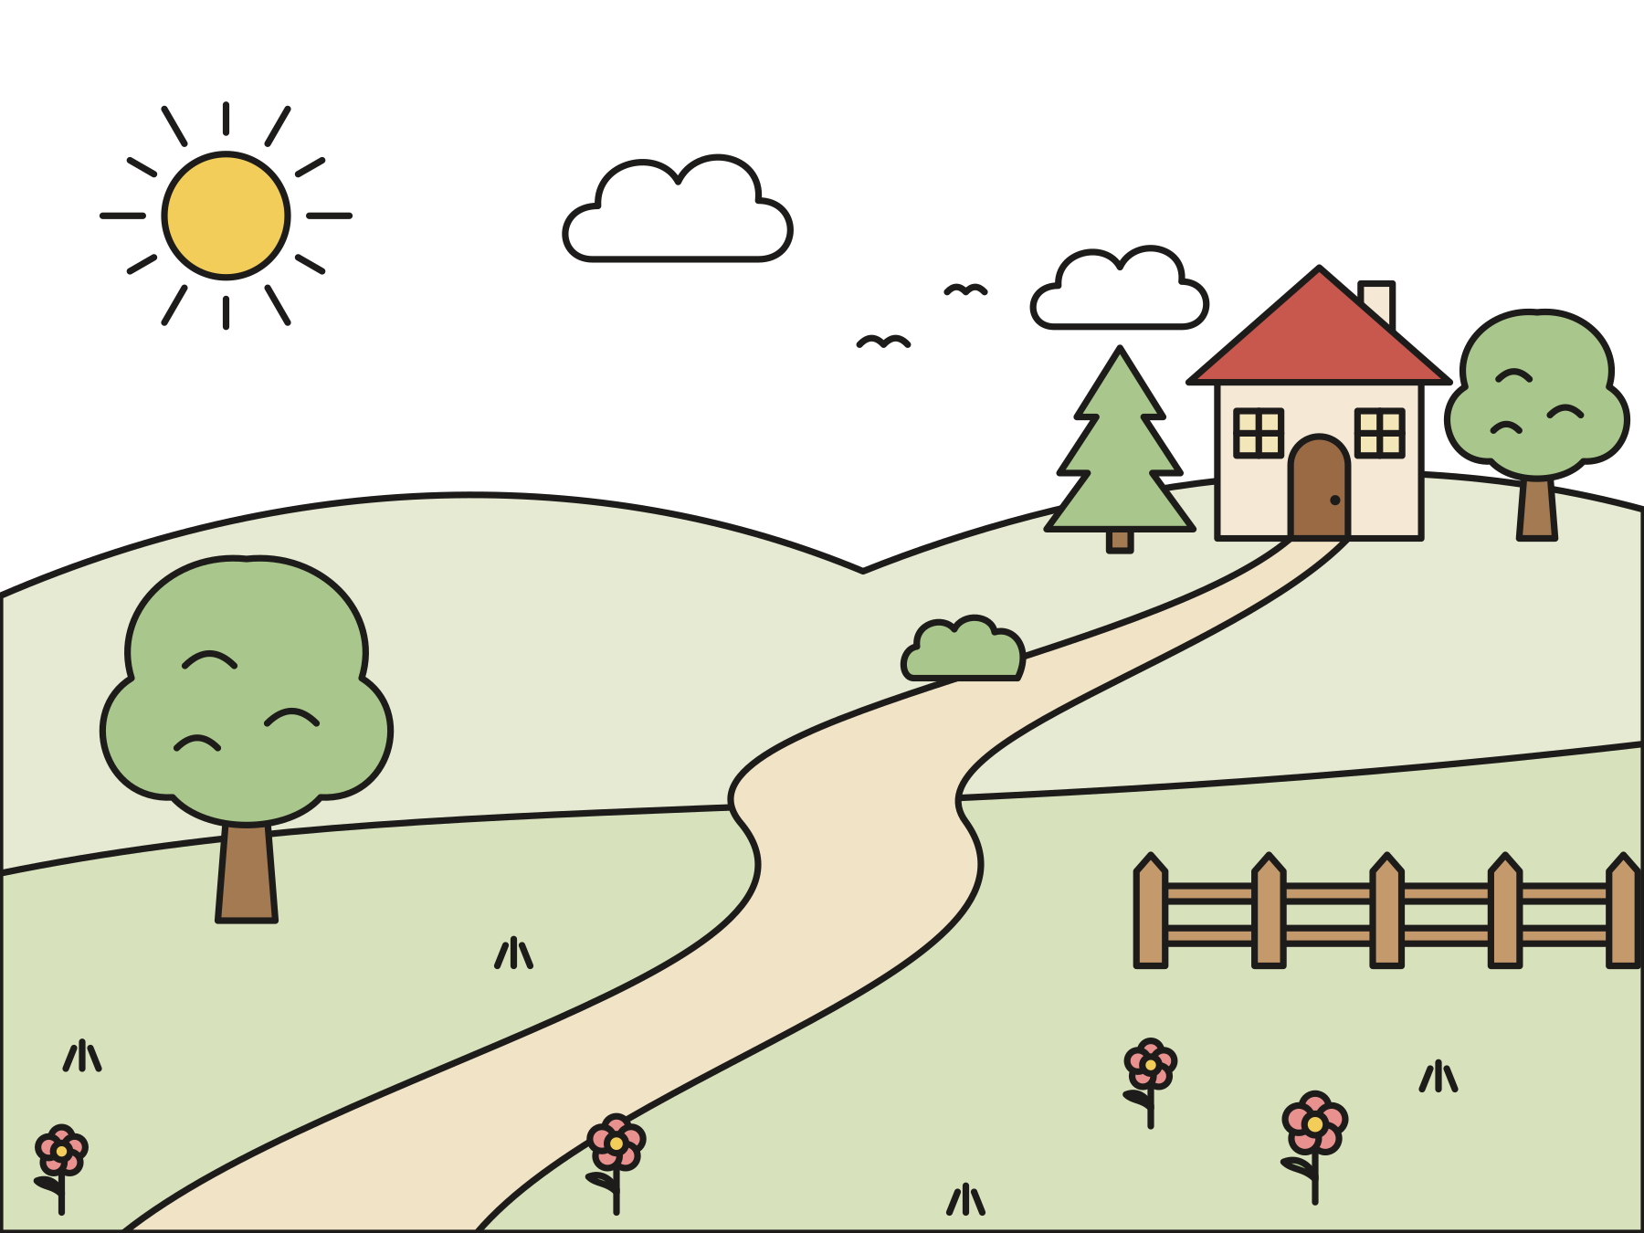
The long walk to Bethlehem
Mary and Joseph walked from Nazareth to Bethlehem.
Notes:
Narrator 1 reads Scene 1. The emperor makes a rule that everyone must be counted, and Mary and Joseph set out for Bethlehem.

Slide 4
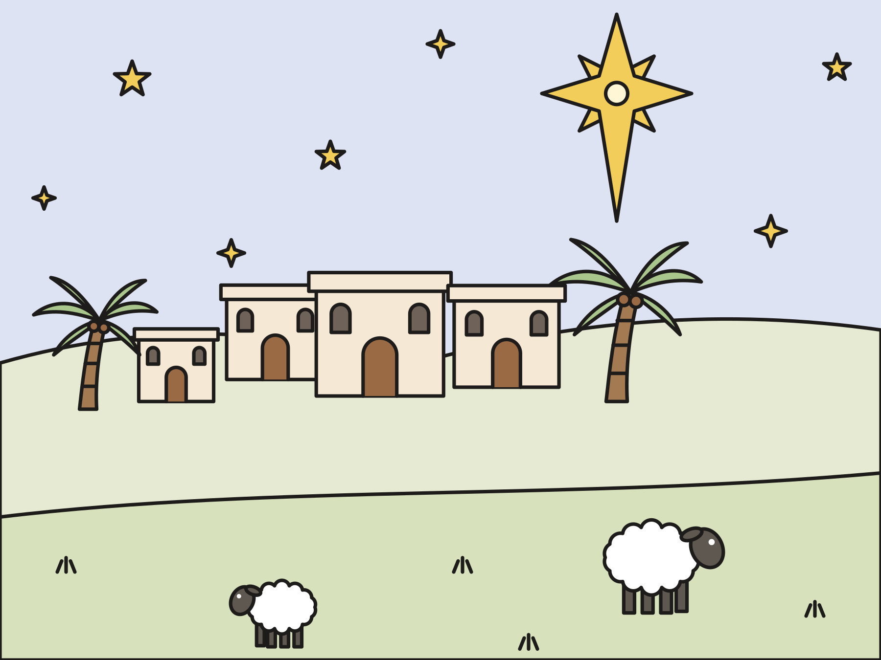
Sing: O Little Town of Bethlehem
Notes:
Everyone sings while Mary, Joseph, and the travelers walk slowly up the aisle.

Slide 5
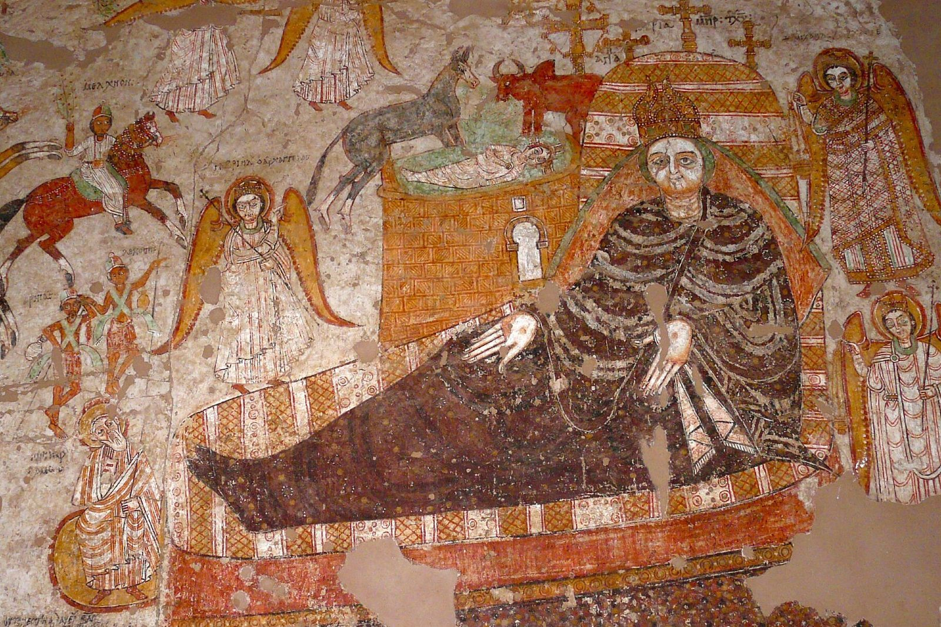
No room
Mary laid baby Jesus in a manger, a feeding box for animals.
Notes:
Narrator 2 reads Scene 2. Mary lays the baby in the manger, and the animals gather around. This painting comes from a church in Nubia, in Africa, about a thousand years ago.

Slide 6

Sing: Away in a Manger
Notes:
Everyone sings. The animals lie down near the manger.

Slide 7
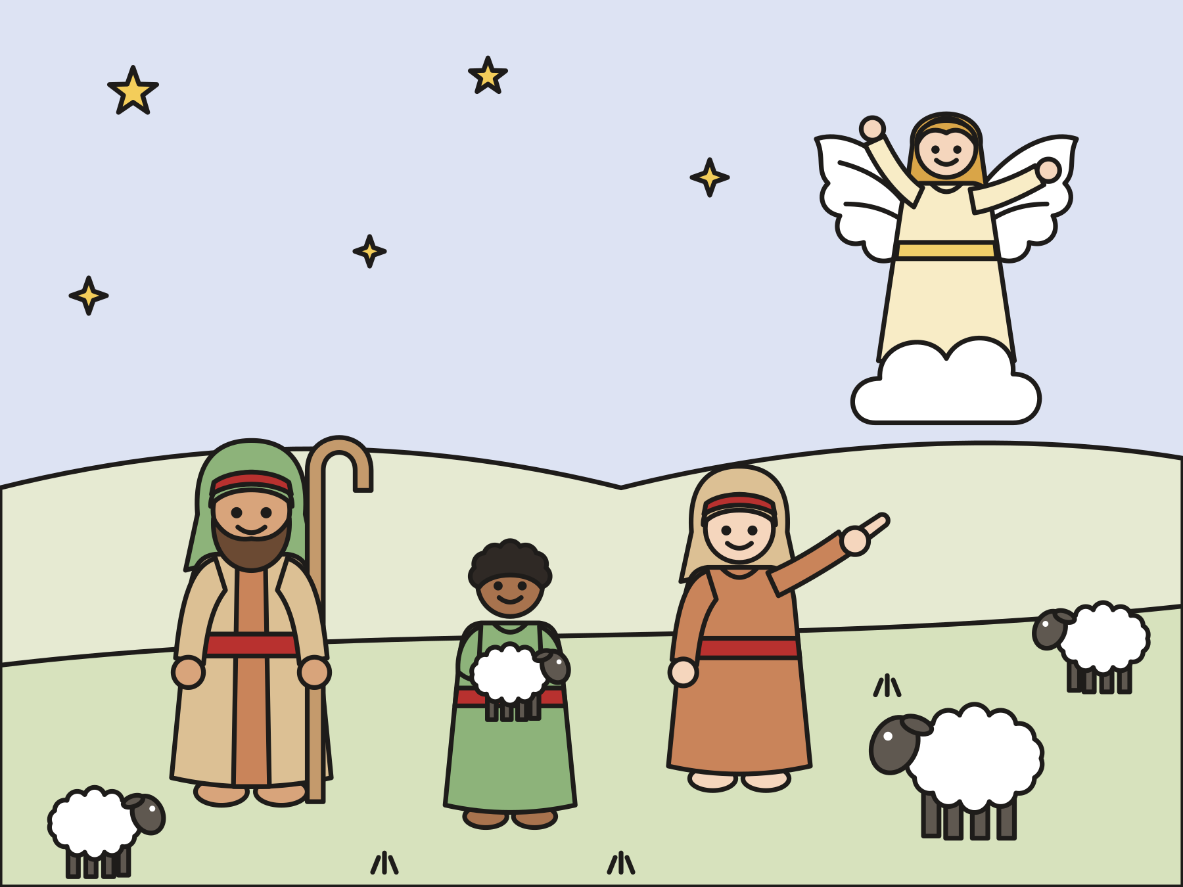
Shepherds in the fields
It was night. The shepherds were watching their sheep.
Notes:
Narrator 3 reads Scene 3. The bell ringers ring when the angel appears.

Slide 8
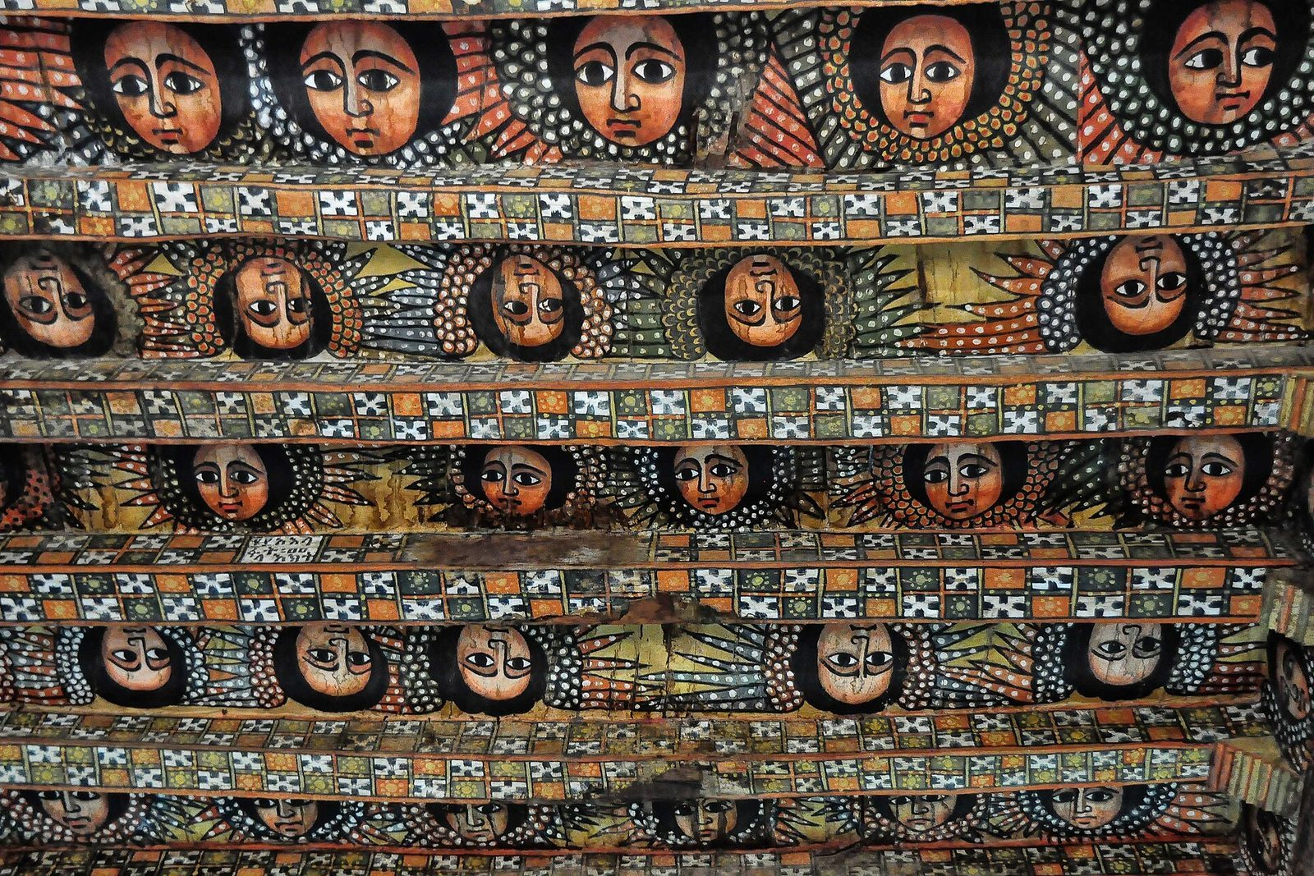
Don’t be afraid!
“Don’t be afraid, for behold, I bring you good news of great joy which will be to all the people.”
Luke 2:10
Notes:
The messenger angel echoes the helper, one line at a time. These angels are painted on the ceiling of a church in Ethiopia.

Slide 9
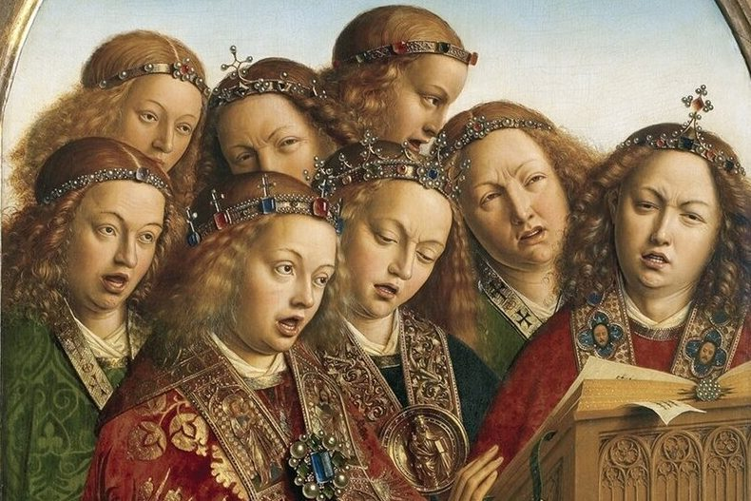
Glory to God!
“Glory to God in the highest, on earth peace”
Luke 2:14
Notes:
Narrator 4 reads Scene 4. The angel choir echoes the helper, and then everyone says the angels’ song together.

Slide 10
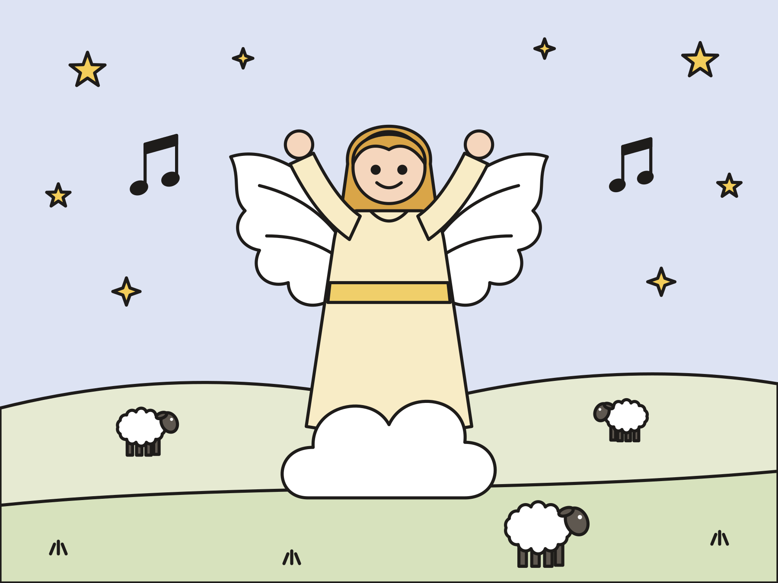
Sing: Angels We Have Heard on High
Notes:
Everyone sings. The angels move to stand behind the manger.

Slide 11
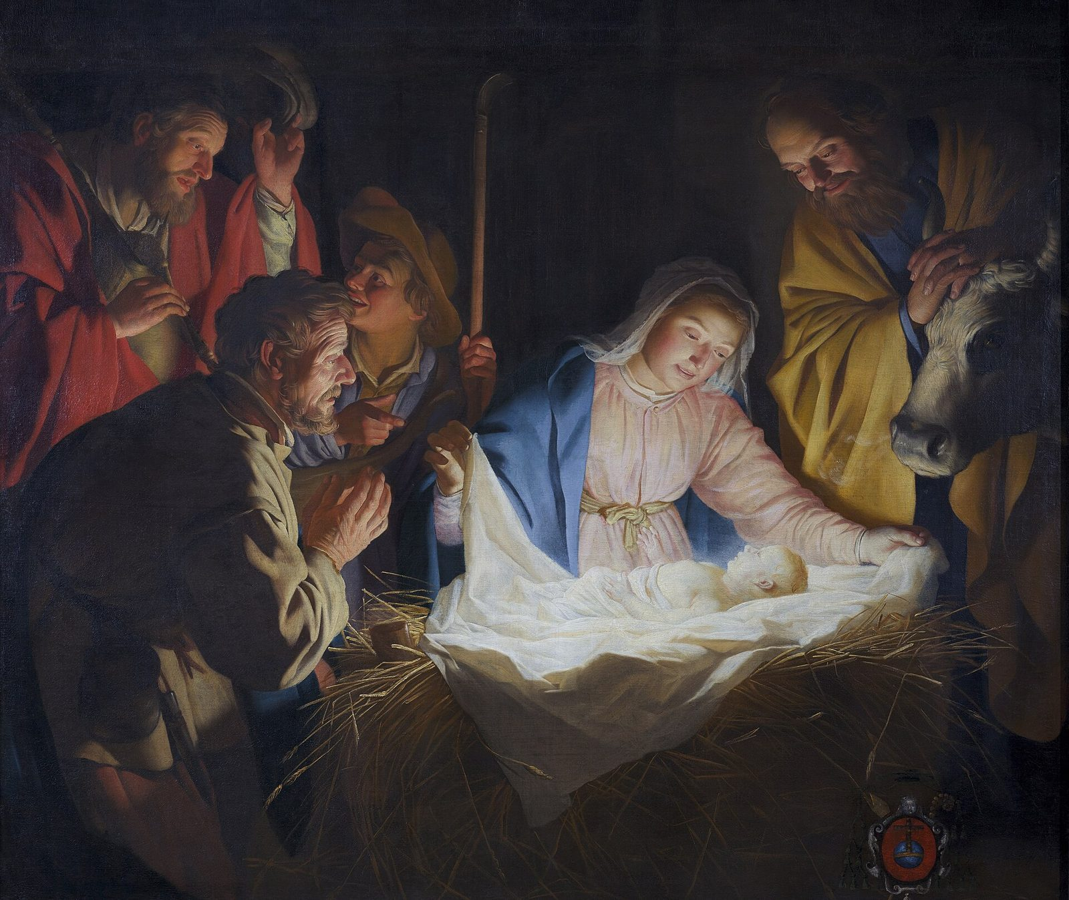
Let’s go to Bethlehem!
The shepherds found the baby, just as the angel said.
Notes:
Narrator 5 reads Scene 5. The shepherds and sheep hurry to the manger, walking fast with no running.

Slide 12

Sing: Go, Tell It on the Mountain
Notes:
Everyone sings. The shepherds and sheep stay near the manger.

Slide 13
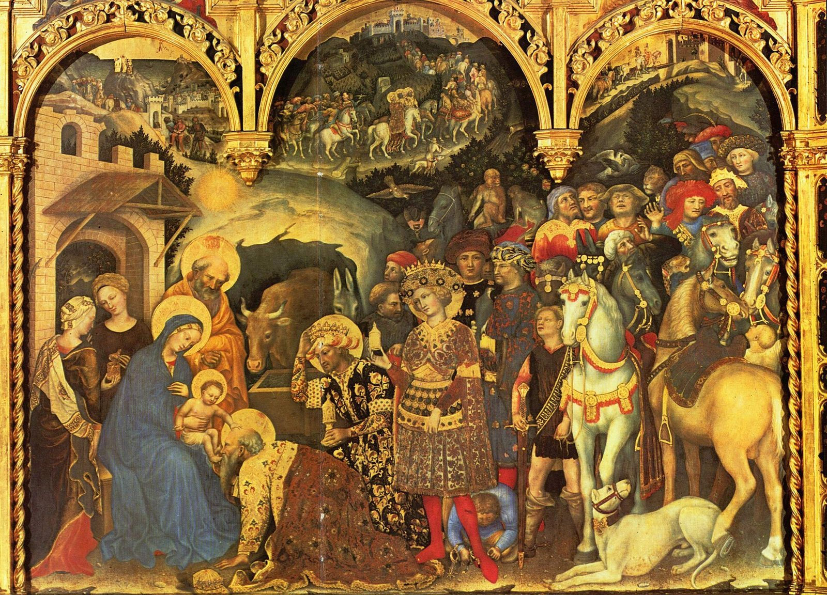
The wise men follow the star
A star led them to Jesus. They brought gold, frankincense, and myrrh.
Notes:
Narrator 5 reads Scene 6. The star leads the wise men up the aisle to the manger.

Slide 14
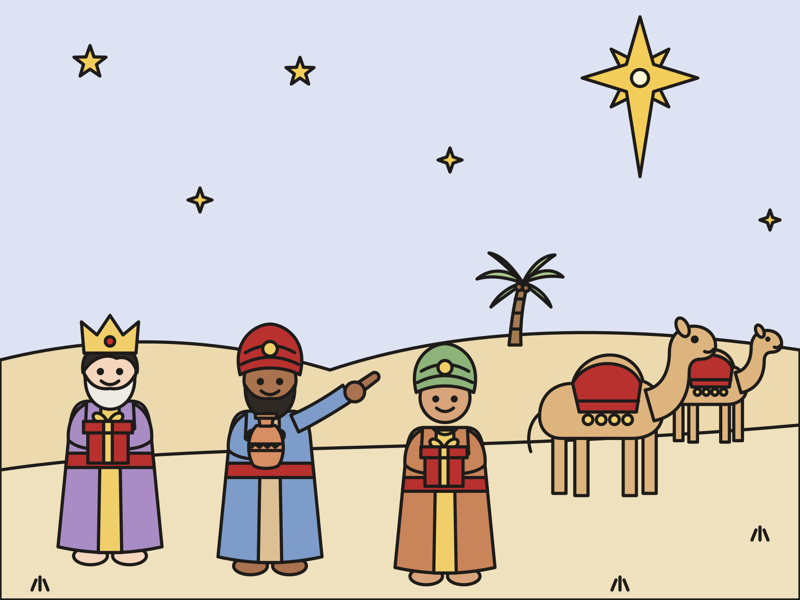
Sing: We Three Kings
Notes:
Everyone sings while the wise men kneel and set their gifts by the manger.

Slide 15

Good news for all the people
Jesus came for everyone. That means you!
Notes:
Narrator 1 reads Scene 7. Then everyone says the angels’ song one more time: Glory to God in the highest, on earth peace!

Slide 16
Sing: Joy to the World
Notes:
Everyone sings. The cast can stay by the manger or walk back down the aisle during the last verse.

Slide 17
I wonder…
I wonder which part of the pageant you liked best.
Notes:
Use this slide afterward, in the classroom. Wait for answers. Every answer is welcome.

Slide 18
Question 1 of 7
In what town was Jesus born?
The North Pole
Rome
A
B
Nazareth
Bethlehem
C
D
Notes:
Read the question and the choices aloud, and let the children answer. Then show the answer: Bethlehem. Mary and Joseph went to Bethlehem, and Jesus was born there.

Slide 19
Question 1 of 7
In what town was Jesus born?
The North Pole
Rome
A
B
Nazareth
Bethlehem
C
D
The answer is D. Mary and Joseph went to Bethlehem, and Jesus was born there.
Notes:
The answer is D: Bethlehem. Mary and Joseph went to Bethlehem, and Jesus was born there.

Slide 20
Question 2 of 7
Why did Mary lay the baby in a manger?
The manger was a toy box
There was no room for them
A
B
The cows asked her to
It was a game
C
D
Notes:
Read the question and the choices aloud, and let the children answer. Then show the answer: There was no room for them. Luke says there was no room for them, so Jesus slept in a feeding box for animals.

Slide 21
Question 2 of 7
Why did Mary lay the baby in a manger?
The manger was a toy box
There was no room for them
A
B
The cows asked her to
It was a game
C
D
The answer is B. Luke says there was no room for them, so Jesus slept in a feeding box for animals.
Notes:
The answer is B: There was no room for them. Luke says there was no room for them, so Jesus slept in a feeding box for animals.

Slide 22
Question 3 of 7
Who heard the good news out in the fields?
Kings
Fishermen
A
B
Shepherds
Soldiers
C
D
Notes:
Read the question and the choices aloud, and let the children answer. Then show the answer: Shepherds. An angel brought the good news to shepherds watching their sheep at night.

Slide 23
Question 3 of 7
Who heard the good news out in the fields?
Kings
Fishermen
A
B
Shepherds
Soldiers
C
D
The answer is C. An angel brought the good news to shepherds watching their sheep at night.
Notes:
The answer is C: Shepherds. An angel brought the good news to shepherds watching their sheep at night.

Slide 24
Question 4 of 7
What did the angels sing?
Happy birthday!
Glory to God in the highest!
A
B
Jingle bells!
Twinkle, twinkle, little star!
C
D
Notes:
Read the question and the choices aloud, and let the children answer. Then show the answer: Glory to God in the highest!. The angels praised God: “Glory to God in the highest, on earth peace.”

Slide 25
Question 4 of 7
What did the angels sing?
Happy birthday!
Glory to God in the highest!
A
B
Jingle bells!
Twinkle, twinkle, little star!
C
D
The answer is B. The angels praised God: “Glory to God in the highest, on earth peace.”
Notes:
The answer is B: Glory to God in the highest!. The angels praised God: “Glory to God in the highest, on earth peace.”

Slide 26
Question 5 of 7
What led the wise men to Jesus?
A map
A rainbow
A
B
A camel
A star
C
D
Notes:
Read the question and the choices aloud, and let the children answer. Then show the answer: A star. The wise men followed a star until it stopped over the place where Jesus was.

Slide 27
Question 5 of 7
What led the wise men to Jesus?
A map
A rainbow
A
B
A camel
A star
C
D
The answer is D. The wise men followed a star until it stopped over the place where Jesus was.
Notes:
The answer is D: A star. The wise men followed a star until it stopped over the place where Jesus was.

Slide 28
Question 6 of 7
What gifts did the wise men bring?
Toys and candy
Bread and fish
A
B
A robe and a ring
Gold, frankincense, and myrrh
C
D
Notes:
Read the question and the choices aloud, and let the children answer. Then show the answer: Gold, frankincense, and myrrh. Matthew tells us they gave Jesus gold, frankincense, and myrrh.

Slide 29
Question 6 of 7
What gifts did the wise men bring?
Toys and candy
Bread and fish
A
B
A robe and a ring
Gold, frankincense, and myrrh
C
D
The answer is D. Matthew tells us they gave Jesus gold, frankincense, and myrrh.
Notes:
The answer is D: Gold, frankincense, and myrrh. Matthew tells us they gave Jesus gold, frankincense, and myrrh.

Slide 30
Question 7 of 7
Who is the good news of Christmas for?
Only the actors
All the people
A
B
Only kings
Only grown-ups
C
D
Notes:
Read the question and the choices aloud, and let the children answer. Then show the answer: All the people. The angel said the good news is for all the people. That means you!

Slide 31
Question 7 of 7
Who is the good news of Christmas for?
Only the actors
All the people
A
B
Only kings
Only grown-ups
C
D
The answer is B. The angel said the good news is for all the people. That means you!
Notes:
The answer is B: All the people. The angel said the good news is for all the people. That means you!

Slide 32

Great job!
You finished all 7 questions.
Notes:
Thank the children for listening so well.

Slide 33
Let’s pray
Dear God, thank you for baby Jesus. Thank you that your good news is for all the people. Help us share it. Amen.
Notes:
Read the prayer one line at a time and let the children repeat each line after you.

