Slide 1

Children’s sermon
Good news for everyone: a children’s sermon for Christmas Eve
Luke 2:1–20
Mainline Christian
Notes:
Welcome the children. Today’s story comes from Luke 2:1–20.

Slide 2
What’s inside?
A present! Who likes presents?
Notes:
Hold up the wrapped box and give it a gentle shake. Ask: What could be inside? Let the children guess.

Slide 3
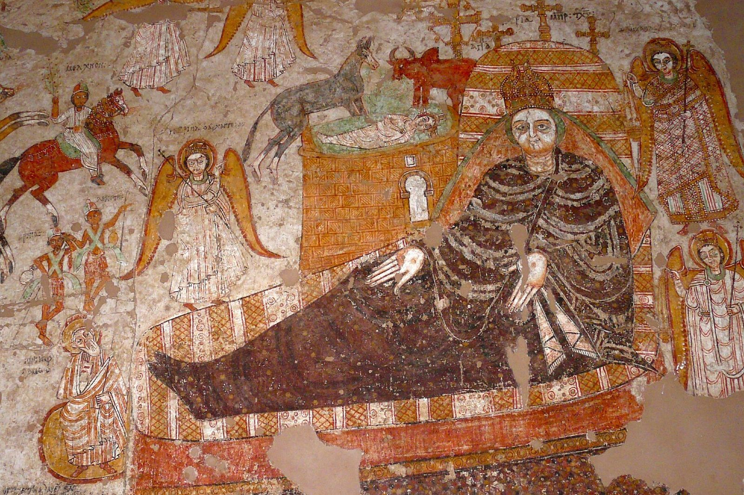
A baby in Bethlehem
Mary laid baby Jesus in a manger, a feeding box for animals.
Notes:
Mary and Joseph went to Bethlehem. There was no room in the guest room. When Mary’s baby was born, she wrapped him in cloth and laid him in a manger.

Slide 4
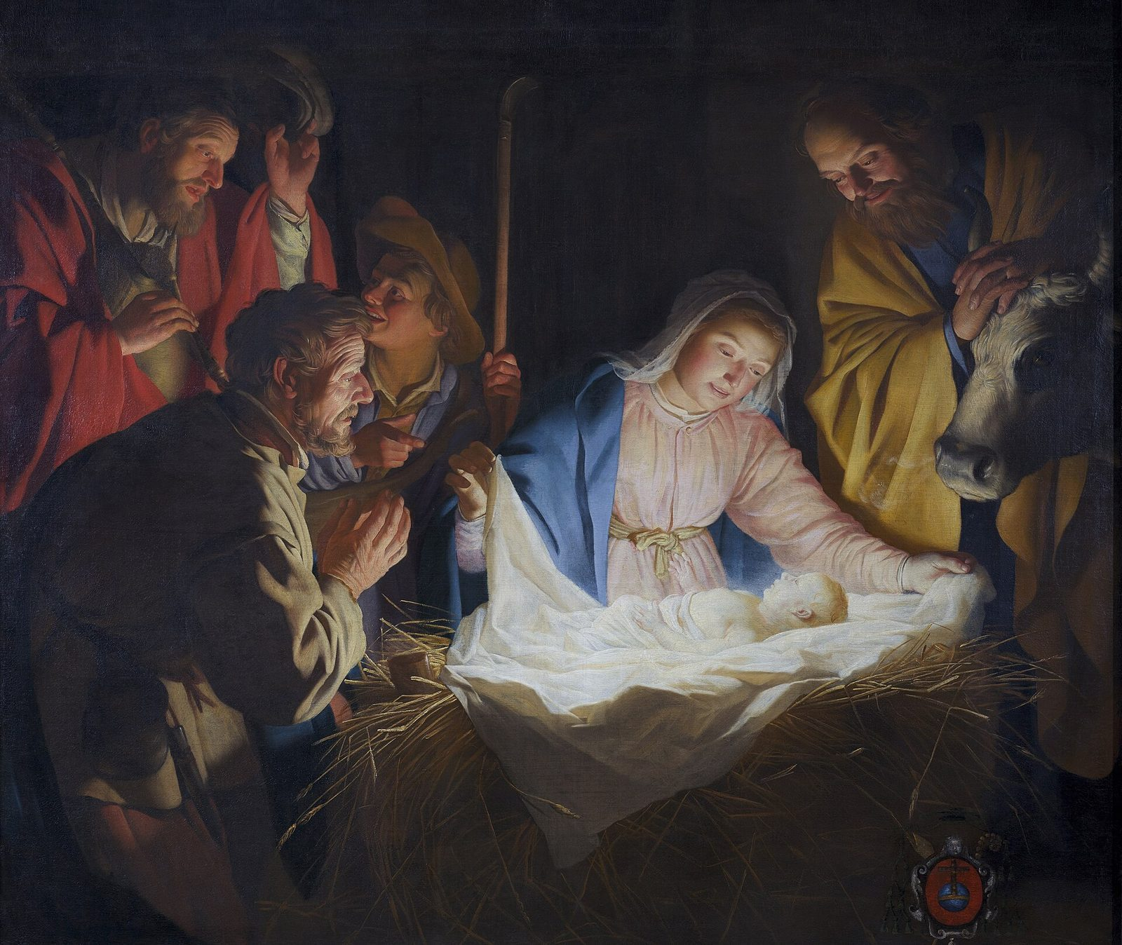
“Don’t be afraid, for behold, I bring you good news of great joy which will be to all the people.”
Luke 2:10
Notes:
Read the verse slowly. The angel brought this good news to shepherds working in the fields at night.

Slide 5

Good news for everyone!
Grown-ups and kids. Happy and sad. Near and far. And you!
Notes:
Ask: Who are all the people? Let the children answer yes to each one. God’s gift of Jesus is for everyone.

Slide 6
Question 1 of 3
Where did Mary lay baby Jesus?
In a toy box
In a manger
A
B
In a car
C
Notes:
Read the question and the choices aloud, and let the children answer. Then show the answer: In a manger. A manger is a feeding box for animals. It was Jesus’ first bed.

Slide 7
Question 1 of 3
Where did Mary lay baby Jesus?
In a toy box
In a manger
A
B
In a car
C
The answer is B. A manger is a feeding box for animals. It was Jesus’ first bed.
Notes:
The answer is B: In a manger. A manger is a feeding box for animals. It was Jesus’ first bed.

Slide 8
Question 2 of 3
Who heard the good news first, out in the fields?
Kings
Soldiers
A
B
Shepherds
C
Notes:
Read the question and the choices aloud, and let the children answer. Then show the answer: Shepherds. An angel brought the good news to shepherds watching their sheep at night.

Slide 9
Question 2 of 3
Who heard the good news first, out in the fields?
Kings
Soldiers
A
B
Shepherds
C
The answer is C. An angel brought the good news to shepherds watching their sheep at night.
Notes:
The answer is C: Shepherds. An angel brought the good news to shepherds watching their sheep at night.

Slide 10
Question 3 of 3
Who is the good news for?
Only grown-ups
All the people
A
B
Only kings
C
Notes:
Read the question and the choices aloud, and let the children answer. Then show the answer: All the people. The angel said the good news is for all the people. That means you!

Slide 11
Question 3 of 3
Who is the good news for?
Only grown-ups
All the people
A
B
Only kings
C
The answer is B. The angel said the good news is for all the people. That means you!
Notes:
The answer is B: All the people. The angel said the good news is for all the people. That means you!

Slide 12

Great job!
You finished all 3 questions.
Notes:
Thank the children for listening so well.

Slide 13
Let’s pray
Dear God, thank you for the gift of Jesus. Thank you that your good news is for all the people. Help us share it. Amen.
Notes:
Ask the children to repeat each line after you.

