Slide 1

Children’s sermon
Simeon and Anna waited: a children’s sermon for the Sunday after Christmas
Luke 2:22–40
Mainline Christian
Notes:
Welcome the children. Today’s story comes from Luke 2:22–40.

Slide 2
Waiting is hard!
What is hard for you to wait for?
Notes:
Hold up the timer. Ask: What do we use timers for? Then set it for thirty seconds and wait together until it rings.

Slide 3
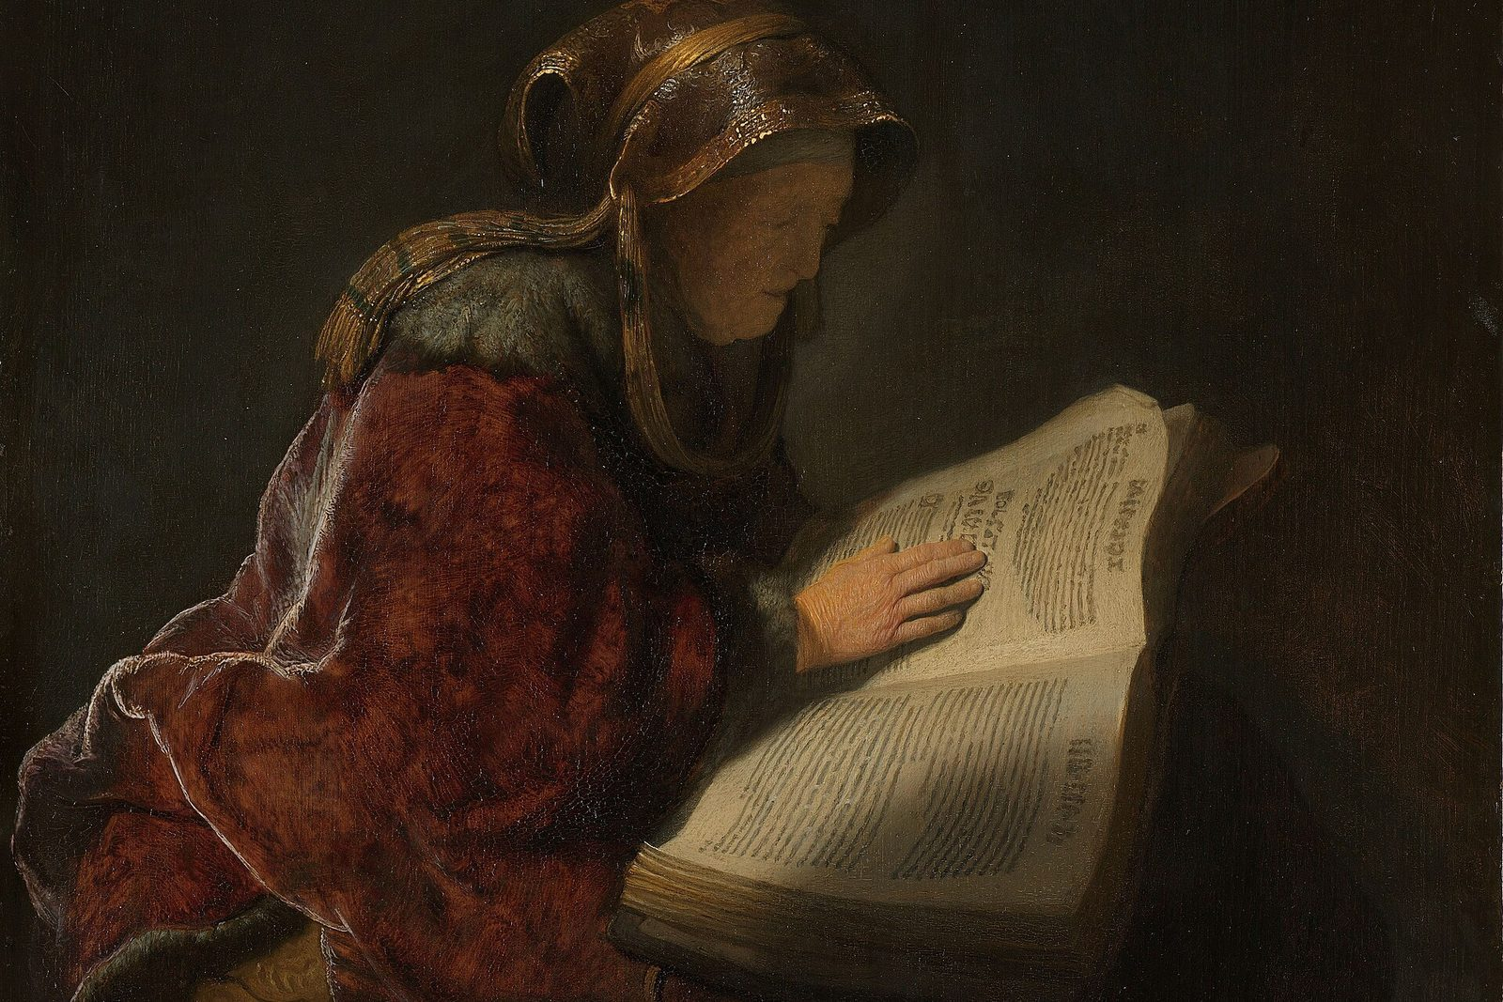
Simeon and Anna waited.
They waited many years for the one God promised.
Notes:
Simeon and Anna loved God. They waited and prayed for years. Rembrandt painted this old woman reading, and the museum that owns it thinks she is Anna.

Slide 4
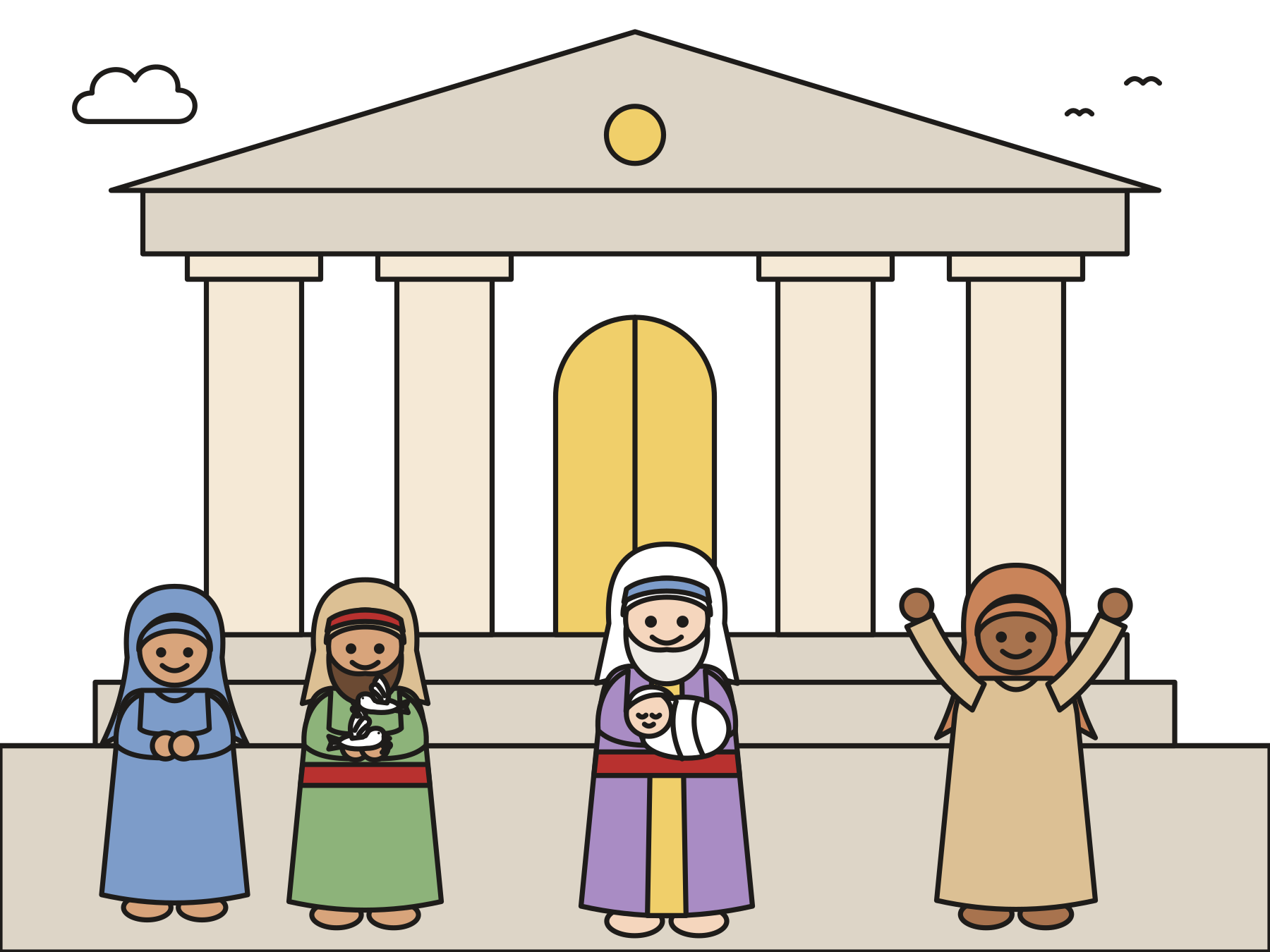
Ding! Baby Jesus came.
Mary and Joseph brought him to the temple.
Notes:
One day Mary and Joseph brought baby Jesus to the temple. Simeon held him and praised God. The waiting was over!

Slide 5

“Coming up at that very hour, she gave thanks to the Lord, and spoke of him to all those who were looking for redemption in Jerusalem.”
Luke 2:38
Notes:
Read the verse slowly. At that very hour, right on time, Anna thanked God and told everyone about Jesus.

Slide 6

God is with us while we wait.
When the good thing comes, we can say thank you!
Notes:
God keeps promises. God is with us while we wait, and we can thank God and tell others the good news, just like Anna.

Slide 7
Question 1 of 3
Who waited a long time to see baby Jesus?
Simeon and Anna
A fisherman
A
B
A big lion
C
Notes:
Read the question and the choices aloud, and let the children answer. Then show the answer: Simeon and Anna. Simeon and Anna waited many years for the one God promised.

Slide 8
Question 1 of 3
Who waited a long time to see baby Jesus?
Simeon and Anna
A fisherman
A
B
A big lion
C
The answer is A. Simeon and Anna waited many years for the one God promised.
Notes:
The answer is A: Simeon and Anna. Simeon and Anna waited many years for the one God promised.

Slide 9
Question 2 of 3
Where did Simeon and Anna meet baby Jesus?
At the temple
On a boat
A
B
At the beach
C
Notes:
Read the question and the choices aloud, and let the children answer. Then show the answer: At the temple. Mary and Joseph brought Jesus to the temple, God’s house in Jerusalem.

Slide 10
Question 2 of 3
Where did Simeon and Anna meet baby Jesus?
At the temple
On a boat
A
B
At the beach
C
The answer is A. Mary and Joseph brought Jesus to the temple, God’s house in Jerusalem.
Notes:
The answer is A: At the temple. Mary and Joseph brought Jesus to the temple, God’s house in Jerusalem.

Slide 11
Question 3 of 3
What did Anna do when she saw Jesus?
She went to sleep
She thanked God and told everyone
A
B
She hid
C
Notes:
Read the question and the choices aloud, and let the children answer. Then show the answer: She thanked God and told everyone. Anna gave thanks to God and told everyone about Jesus.

Slide 12
Question 3 of 3
What did Anna do when she saw Jesus?
She went to sleep
She thanked God and told everyone
A
B
She hid
C
The answer is B. Anna gave thanks to God and told everyone about Jesus.
Notes:
The answer is B: She thanked God and told everyone. Anna gave thanks to God and told everyone about Jesus.

Slide 13

Great job!
You finished all 3 questions.
Notes:
Thank the children for listening so well.

Slide 14
Let’s pray
Dear God, thank you for keeping your promises. Be with us while we wait, and help us tell others about Jesus. Amen.
Notes:
Ask the children to repeat each line after you.

