Slide 1
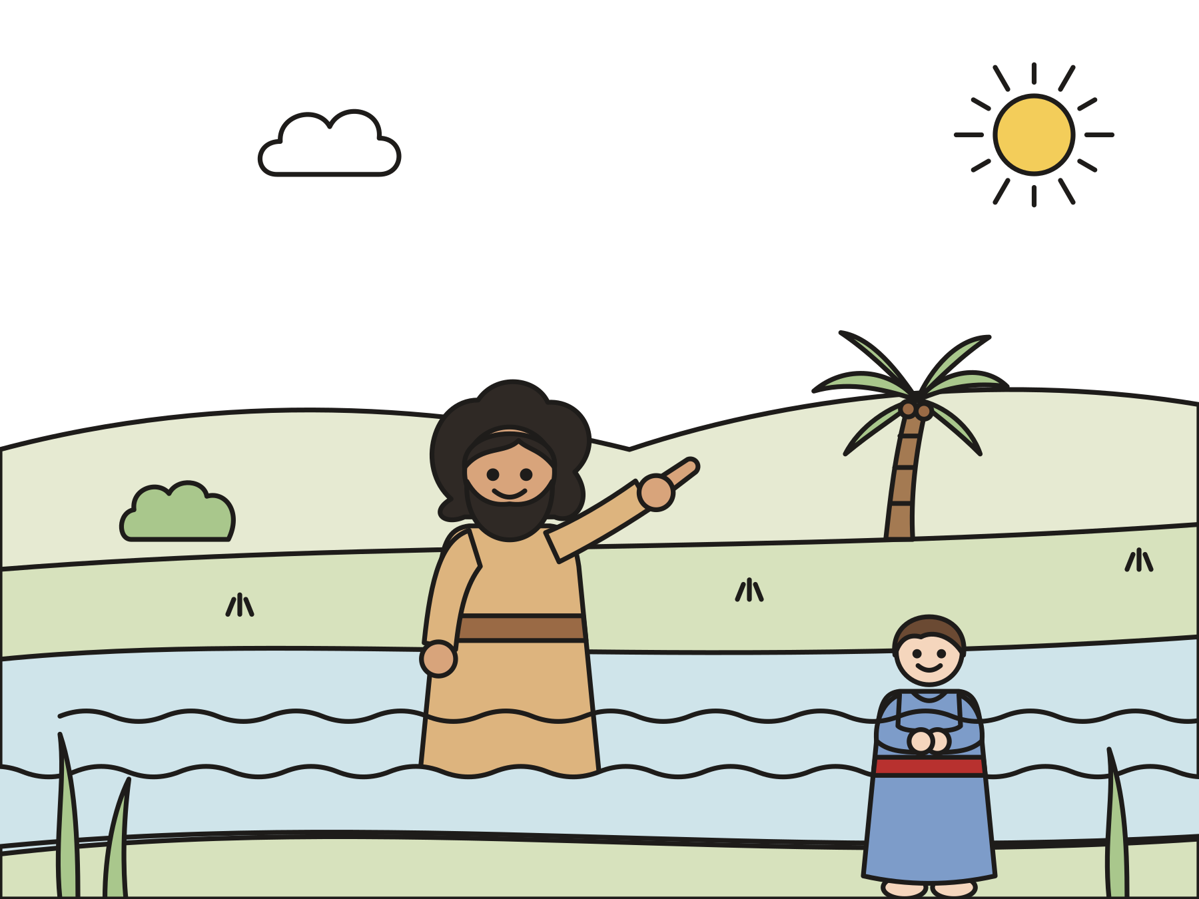
Sunday school · Ages 7–9
Peace: John the Baptist prepares the way
Isaiah 40:1–11; Mark 1:1–8
Mainline Christian
Notes:
Welcome the children. Today’s story comes from Isaiah 40:1–11; Mark 1:1–8.

Slide 2

Welcome!
What does your family do to get ready when a special guest is coming?
Notes:
Welcome each child by name. Let two or three children answer. Say: Today we meet a man named John. His job was to help people get ready for Jesus.

Slide 3

Two candles today
Last week we lit the candle of hope. Today we light the candle of peace.
Notes:
Light the first candle, then the second, or switch them on. Peace is when things are made right between us and God, and between us and each other.

Slide 4
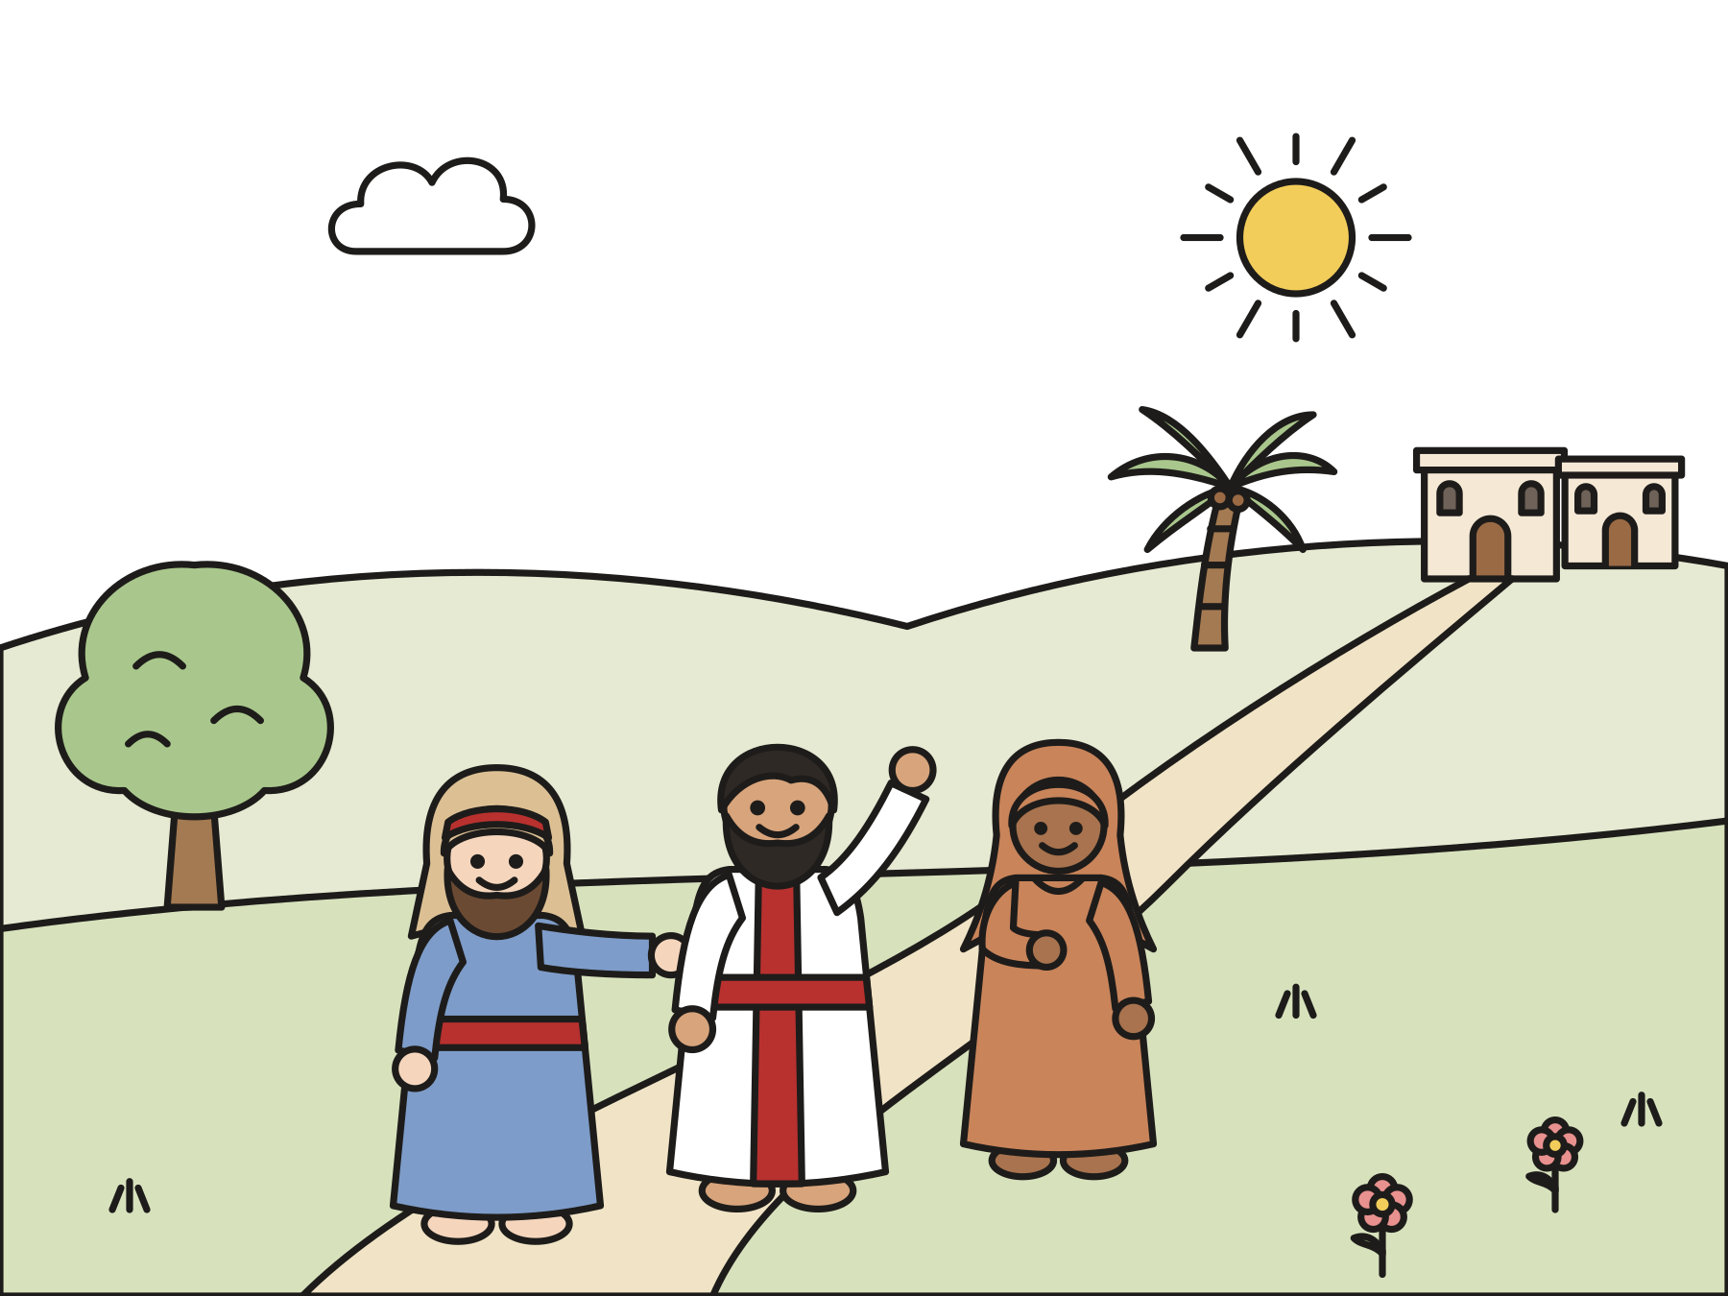
God’s people were far from home.
They were tired and sad. They missed Jerusalem.
Notes:
Long ago, God’s people were taken far away to a land called Babylon. They were tired and sad, and they missed their homes.

Slide 5

Comfort, comfort!
“Comfort, comfort my people,” says your God.”
Isaiah 40:1
Notes:
God gave a prophet a message for the sad people. Comfort is like a big, warm hug for your heart. Hug yourself!

Slide 6
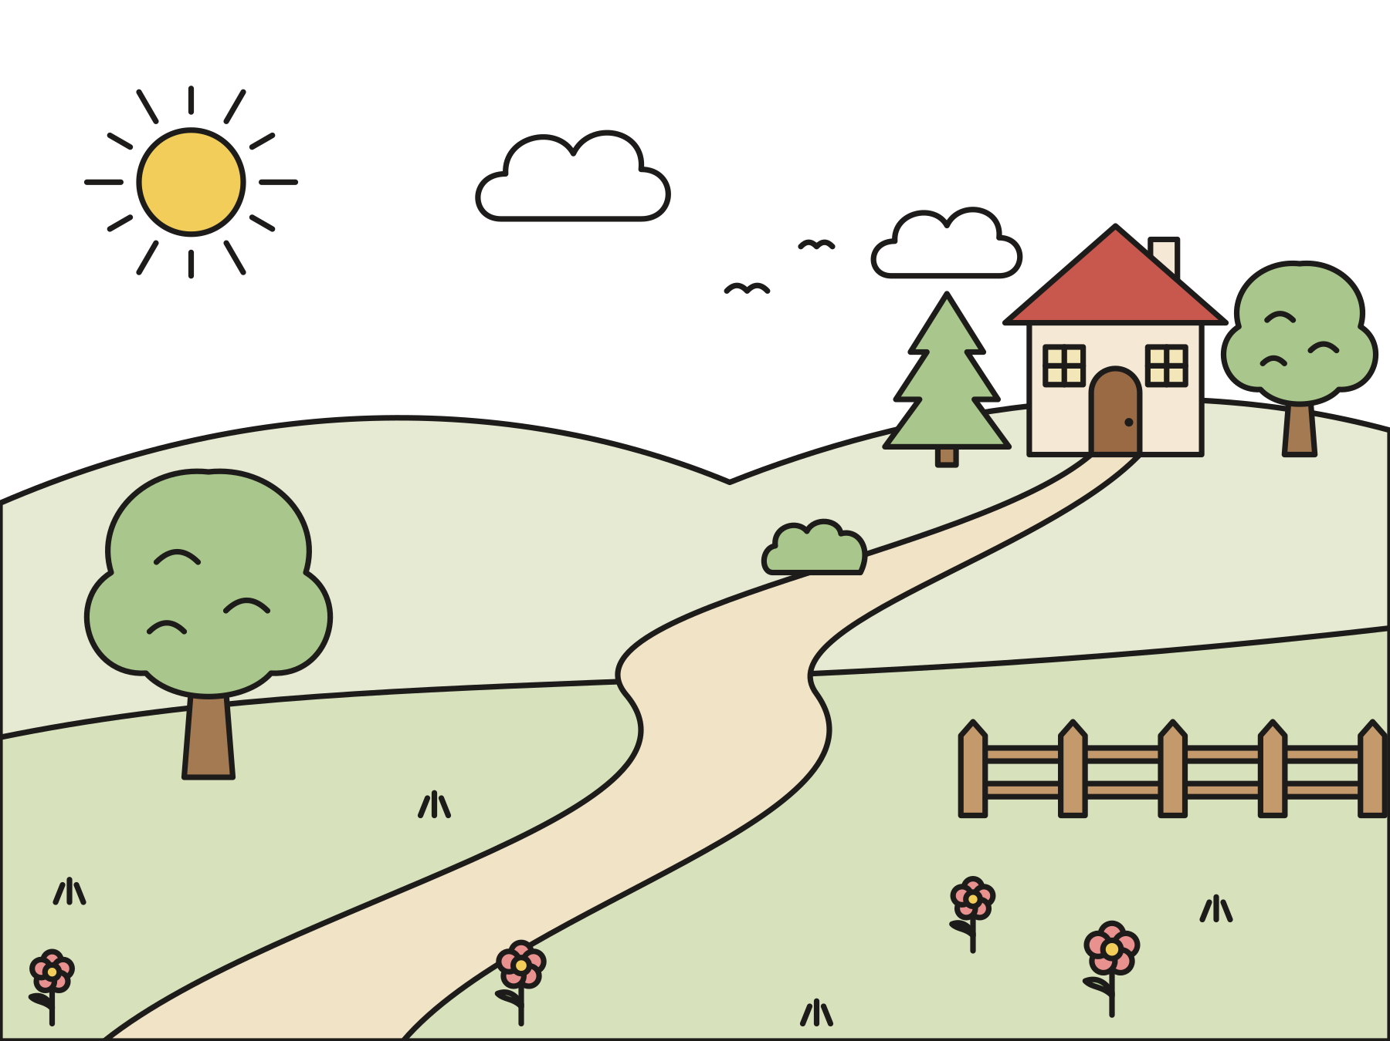
Get the road ready!
Fill in the valleys. Make the mountains low. Smooth out the bumpy places.
Notes:
Do the motions: crouch low and pop up for the valleys, reach high and bend down for the mountains, sweep your hand flat for the bumpy places. God is coming to bring the people home!

Slide 7
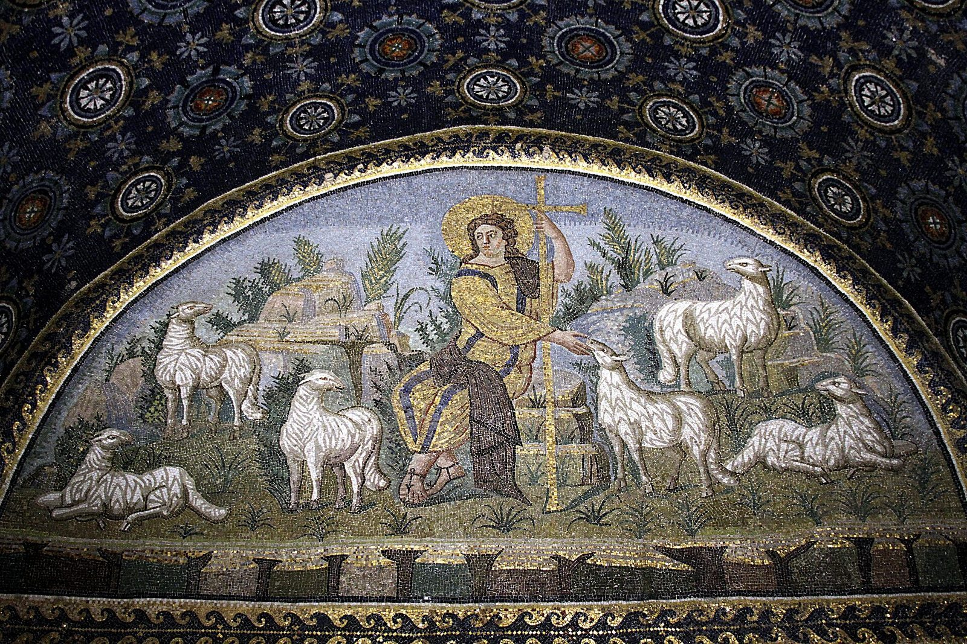
God comes like a shepherd.
God gathers the little lambs and carries them close.
Notes:
Isaiah said, “He will gather the lambs in his arm, and carry them in his bosom.” That means God holds the little lambs close to God’s heart. This old mosaic shows Jesus as a shepherd with his sheep.

Slide 8
John lived in the wilderness.
He wore camel’s hair. He ate locusts and wild honey!
Notes:
Many years later, a man named John lived in the wilderness, a wild, dry place. Locusts are big grasshoppers. Crunchy!

Slide 9
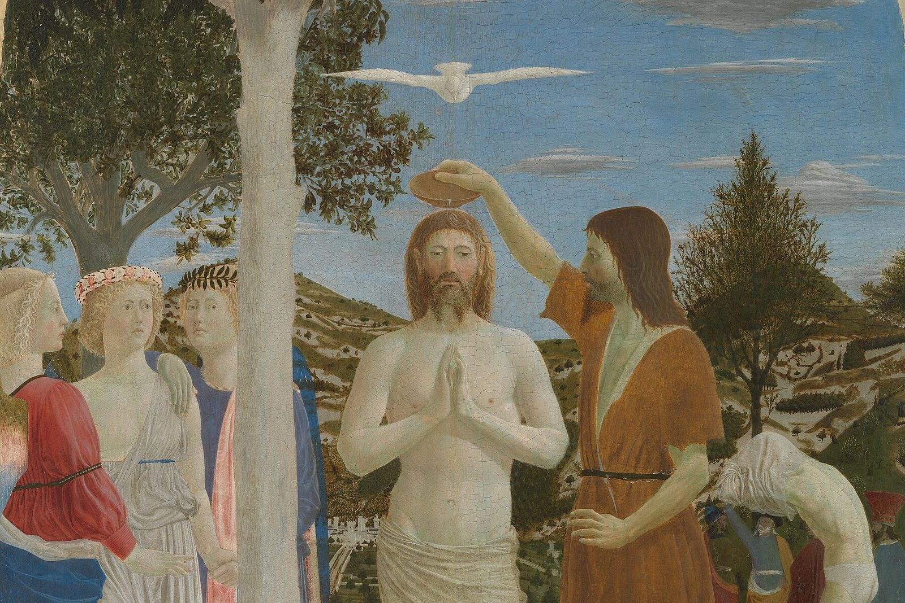
People came to the river.
They told God they were sorry. John baptized them in the Jordan River.
Notes:
People came from the towns and from Jerusalem. John baptized them as a sign of a fresh start. This painting shows John at the river. Later, Jesus came to be baptized too. We will hear that story in January.

Slide 10

Someone greater is coming!
John said, “After me comes he who is mightier than I.”
Notes:
John said he was not even worthy to untie the straps of this person’s sandals. John was talking about Jesus.

Slide 11
Make ready the way!
“Make ready the way of the Lord! Make his paths straight!”
Mark 1:3
Notes:
Mark says John was the voice Isaiah heard, calling in the wilderness. John was getting the road ready for Jesus.

Slide 12

A smooth road for peace
When we say sorry and forgive, we make the road smooth for peace.
Notes:
Getting ready for Jesus is still our job in Advent. Saying sorry fills in a valley. Forgiving makes a mountain of grumpy feelings low.

Slide 13
I wonder…
I wonder what it was like to meet John by the river.
Notes:
Wait for answers. Every answer is welcome.

Slide 14
I wonder…
I wonder how you could bring peace to someone this week.
Notes:
Let the children dream up their own ideas.

Slide 15
Question 1 of 7
Where did John preach?
In a castle
On a boat
A
B
In the wilderness
At the mall
C
D
Notes:
Read the question and the choices aloud, and let the children answer. Then show the answer: In the wilderness. John lived and preached in the wilderness, a wild, dry place.

Slide 16
Question 1 of 7
Where did John preach?
In a castle
On a boat
A
B
In the wilderness
At the mall
C
D
The answer is C. John lived and preached in the wilderness, a wild, dry place.
Notes:
The answer is C: In the wilderness. John lived and preached in the wilderness, a wild, dry place.

Slide 17
Question 2 of 7
What did John eat?
Pizza and pie
Pancakes and syrup
A
B
Locusts and wild honey
Fish and chips
C
D
Notes:
Read the question and the choices aloud, and let the children answer. Then show the answer: Locusts and wild honey. Locusts are big grasshoppers. The honey made them sweet!

Slide 18
Question 2 of 7
What did John eat?
Pizza and pie
Pancakes and syrup
A
B
Locusts and wild honey
Fish and chips
C
D
The answer is C. Locusts are big grasshoppers. The honey made them sweet!
Notes:
The answer is C: Locusts and wild honey. Locusts are big grasshoppers. The honey made them sweet!

Slide 19
Question 3 of 7
Where did John baptize people?
In a bathtub
In the ocean
A
B
In a swimming pool
In the Jordan River
C
D
Notes:
Read the question and the choices aloud, and let the children answer. Then show the answer: In the Jordan River. People came from all around to be baptized by John in the Jordan River.

Slide 20
Question 3 of 7
Where did John baptize people?
In a bathtub
In the ocean
A
B
In a swimming pool
In the Jordan River
C
D
The answer is D. People came from all around to be baptized by John in the Jordan River.
Notes:
The answer is D: In the Jordan River. People came from all around to be baptized by John in the Jordan River.

Slide 21
Question 4 of 7
Who did John say was coming after him?
A king with an army
Jesus
A
B
A big storm
C
Notes:
Read the question and the choices aloud, and let the children answer. Then show the answer: Jesus. John said someone mightier was coming. He was talking about Jesus.

Slide 22
Question 4 of 7
Who did John say was coming after him?
A king with an army
Jesus
A
B
A big storm
C
The answer is B. John said someone mightier was coming. He was talking about Jesus.
Notes:
The answer is B: Jesus. John said someone mightier was coming. He was talking about Jesus.

Slide 23
Question 5 of 7
How does God carry the little lambs?
In a big truck
On a long rope
A
B
Close in his arms
C
Notes:
Read the question and the choices aloud, and let the children answer. Then show the answer: Close in his arms. Isaiah said, “He will gather the lambs in his arm.”

Slide 24
Question 5 of 7
How does God carry the little lambs?
In a big truck
On a long rope
A
B
Close in his arms
C
The answer is C. Isaiah said, “He will gather the lambs in his arm.”
Notes:
The answer is C: Close in his arms. Isaiah said, “He will gather the lambs in his arm.”

Slide 25
Question 6 of 7
What do many churches call the second Advent candle?
Noise
Snow
A
B
Peace
C
Notes:
Read the question and the choices aloud, and let the children answer. Then show the answer: Peace. Many churches light the candle of peace on the second Sunday of Advent.

Slide 26
Question 6 of 7
What do many churches call the second Advent candle?
Noise
Snow
A
B
Peace
C
The answer is C. Many churches light the candle of peace on the second Sunday of Advent.
Notes:
The answer is C: Peace. Many churches light the candle of peace on the second Sunday of Advent.

Slide 27
Question 7 of 7
How can we make the road smooth for peace?
Stay grumpy
Push to the front
A
B
Say sorry and forgive
C
Notes:
Read the question and the choices aloud, and let the children answer. Then show the answer: Say sorry and forgive. Saying sorry and forgiving each other helps peace grow.

Slide 28
Question 7 of 7
How can we make the road smooth for peace?
Stay grumpy
Push to the front
A
B
Say sorry and forgive
C
The answer is C. Saying sorry and forgiving each other helps peace grow.
Notes:
The answer is C: Say sorry and forgive. Saying sorry and forgiving each other helps peace grow.

Slide 29

Great job!
You finished all 7 questions.
Notes:
Thank the children for listening so well.

Slide 30
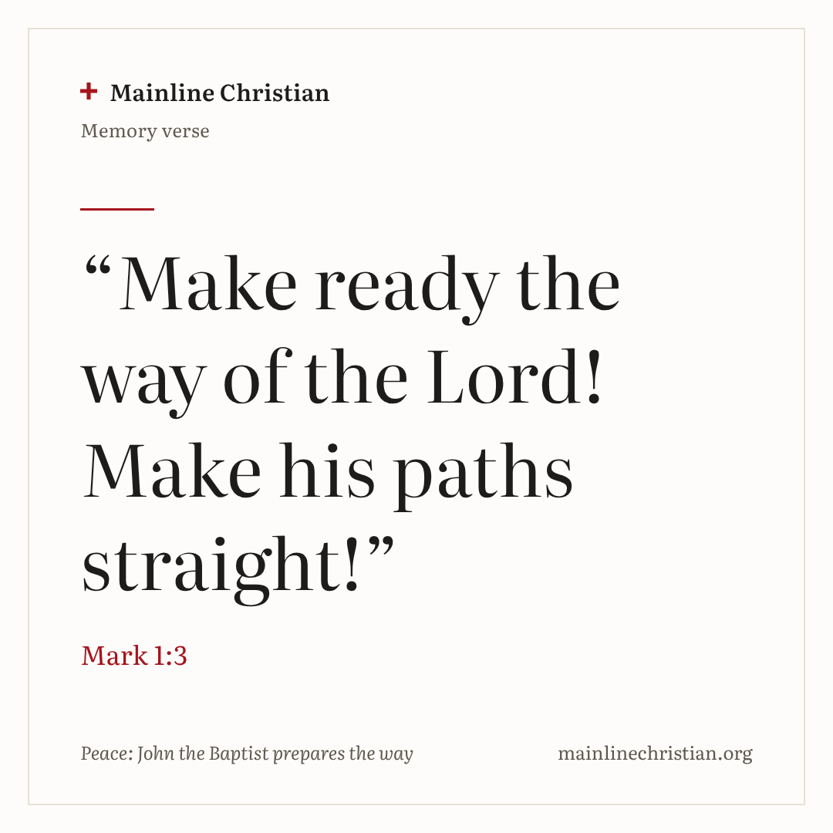
Our memory verse
“Make ready the way of the Lord! Make his paths straight!”
Mark 1:3
Notes:
Say the verse with motions. “Make ready” (rub your hands together, ready to work). “The way of the Lord” (point down a long road). “Make his paths straight!” (both arms straight out in front of you). Shout it like John, then say it soft like an echo.

Slide 31
Make a John the Baptist vest
Crumple your paper bag vest, then smooth it out.
Draw lots of hairy lines.
Cut fringe along the bottom.
Write on the back: Prepare the way!
Put it on and tie on a belt.
Notes:
Show a finished vest first. Help with cutting. Tie belts loosely around the waist.

Slide 32
John says
Fill the valley! (Crouch, then pop up.)
Make the mountain low! (Reach high, then touch your toes.)
Make the path straight! (Arms straight out.)
Turn around!
Share the peace! (Wave and say, “Peace be with you!”)
Notes:
Play like Simon Says, but nobody is ever out. End with: John says, get ready, Jesus is coming! Everyone cheers.

Slide 33
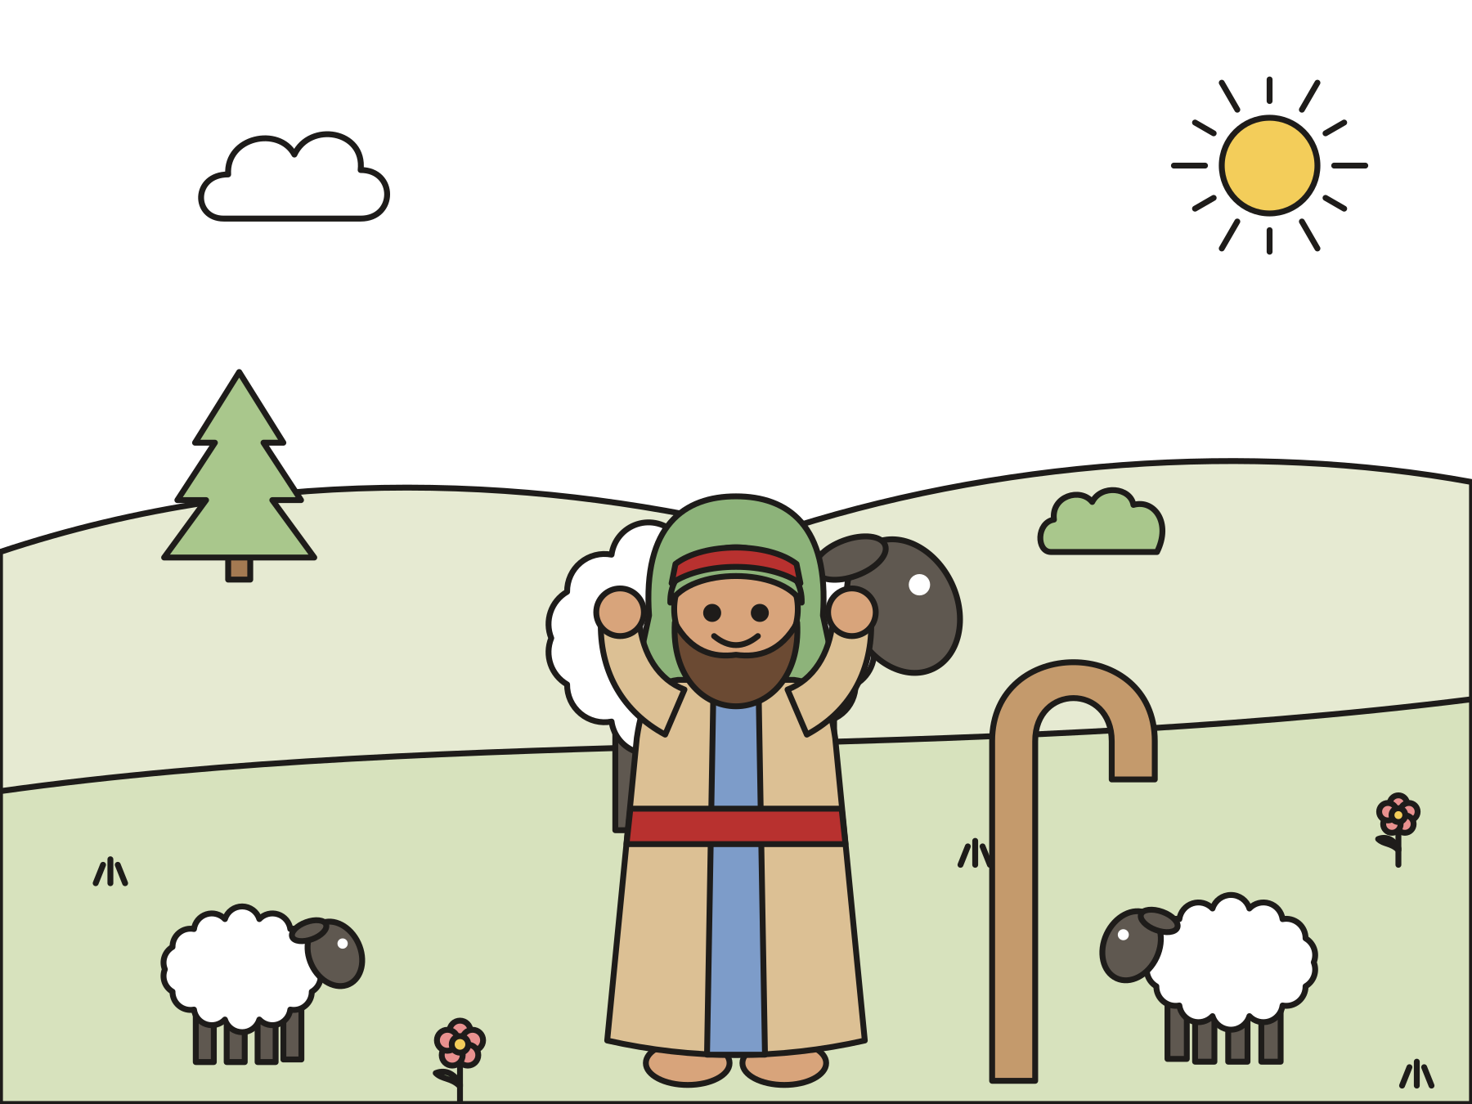
Let’s pray
Dear God, help us make a smooth road for peace. Hold us close like a shepherd holds the lambs. Amen.
Notes:
Read the prayer one line at a time and let the children repeat each line after you. Then share the peace.

