Slide 1
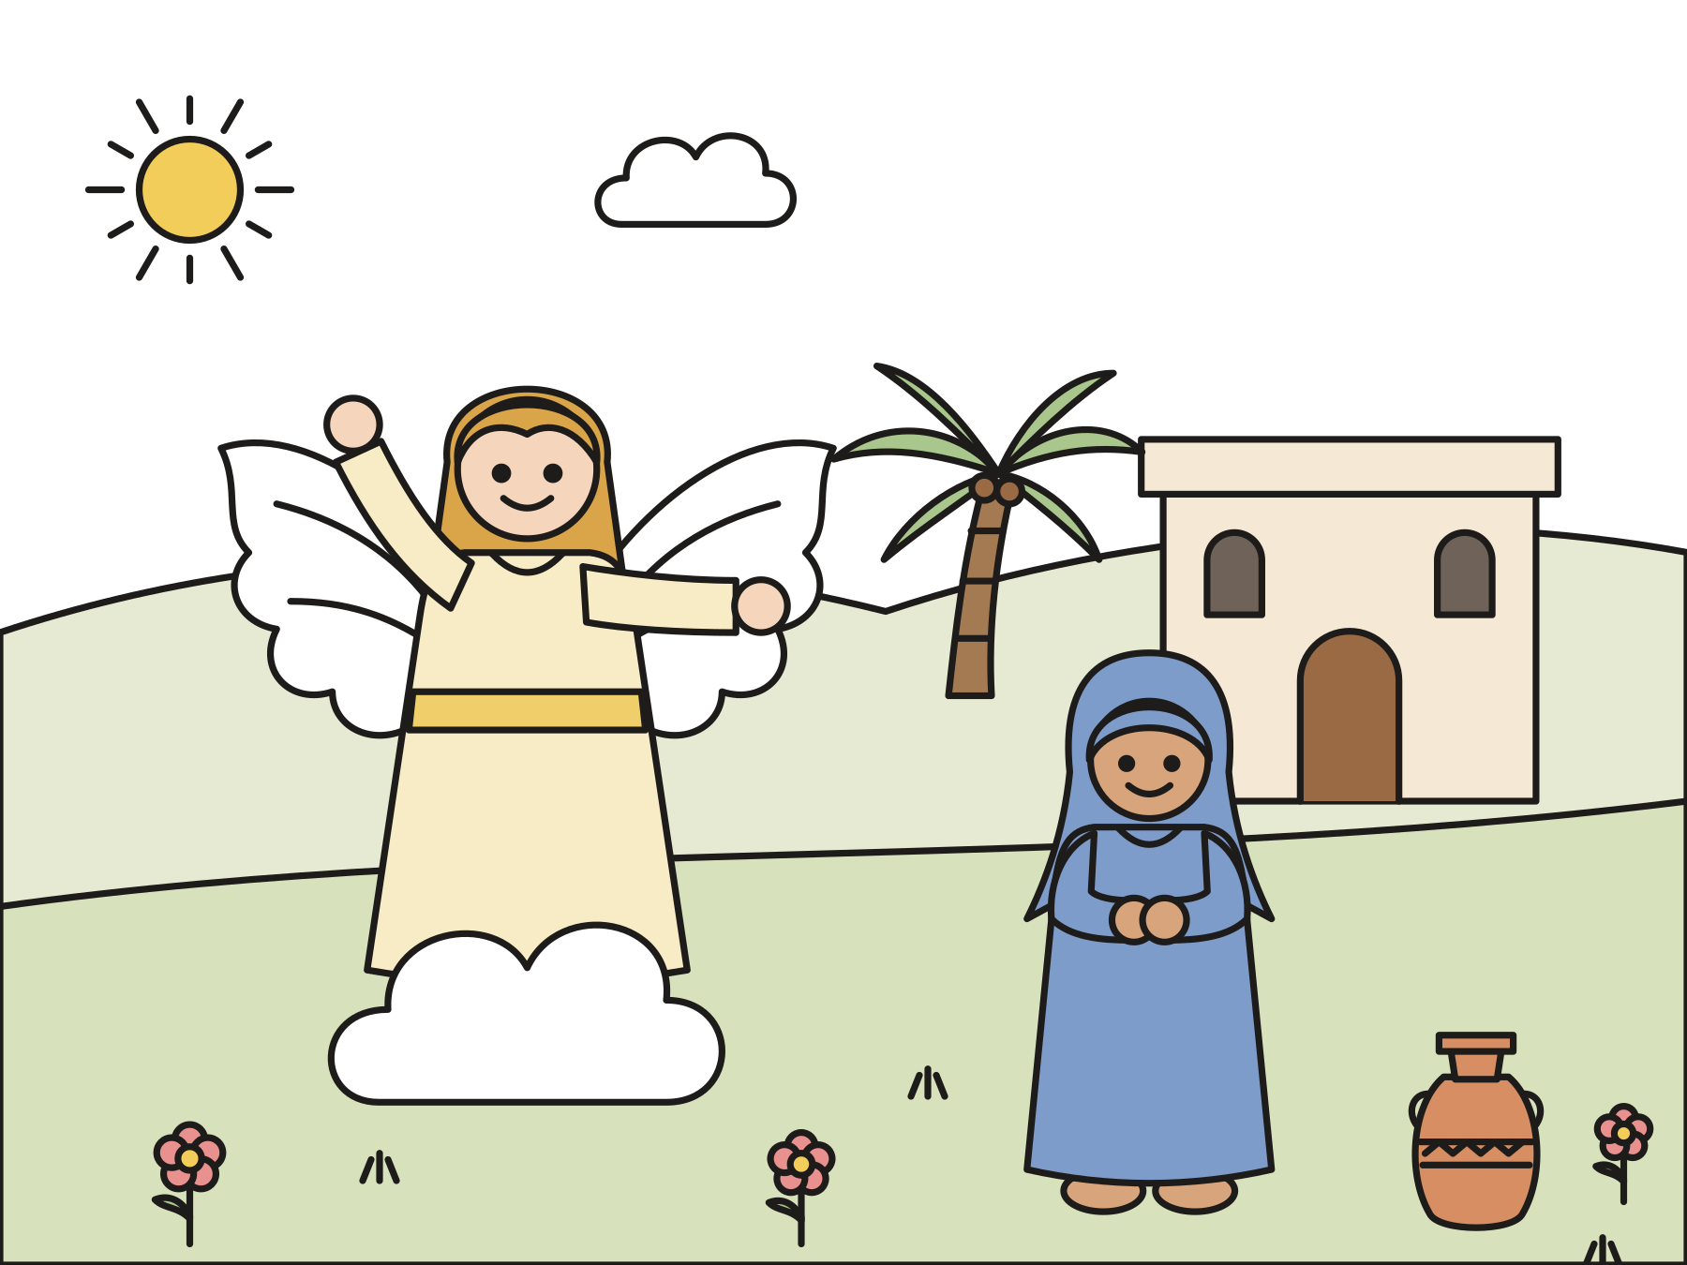
Sunday school · Ages 7–9
Love: Mary says yes
Luke 1:26–38
Mainline Christian
Notes:
Welcome the children. Today’s story comes from Luke 1:26–38.

Slide 2

Welcome!
Do you like getting mail? What is the best message you ever got?
Notes:
Welcome each child by name. Ask the question and let two or three children answer. Say: Today God sends a very special message.

Slide 3

The candle of love
Today many churches light the fourth Advent candle. It is the candle of love.
Notes:
Point to the Advent wreath. Many churches name the candles hope, peace, joy, and love. Today we light the last one, the candle of love. Christmas is almost here!

Slide 4

A young woman named Mary
Mary lived in Nazareth, a small town. She was going to marry Joseph.
Notes:
Long ago, a young woman named Mary lived in Nazareth. It was a little town with dusty roads and small houses. Mary was going to marry a man named Joseph. Joseph came from the family of King David.

Slide 5
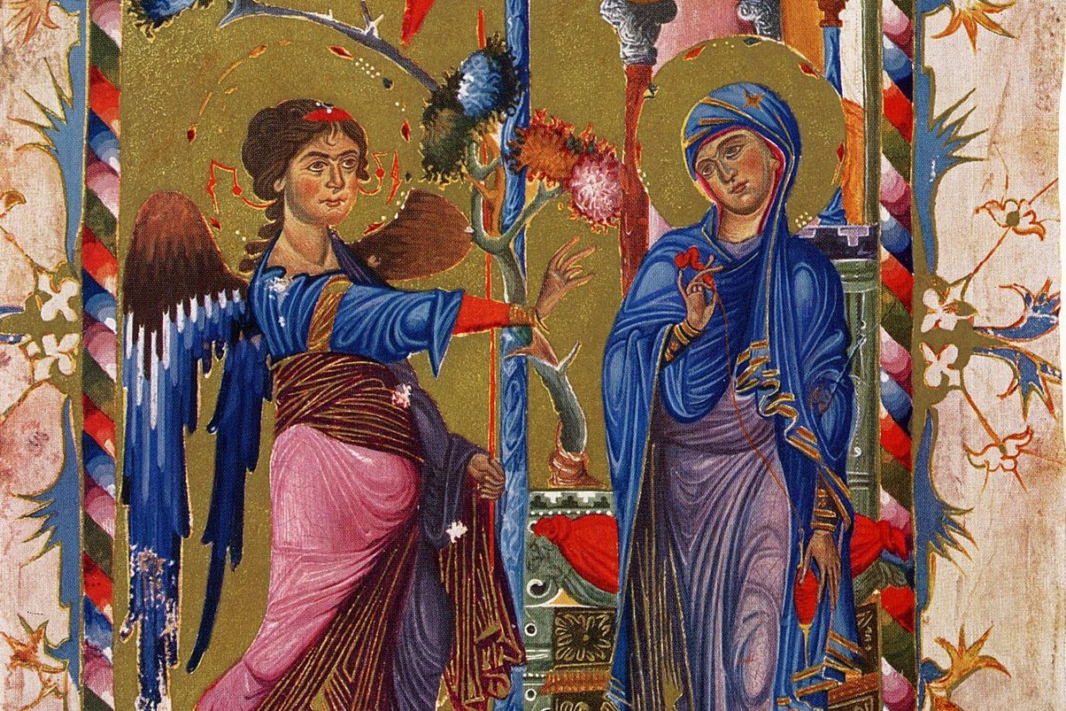
God sent an angel.
God sent the angel Gabriel to Mary with a message.
Notes:
One day God sent a messenger to Mary: the angel Gabriel. This picture comes from an Armenian Gospel book made about 750 years ago. Can you see the red yarn in Mary’s hands?

Slide 6
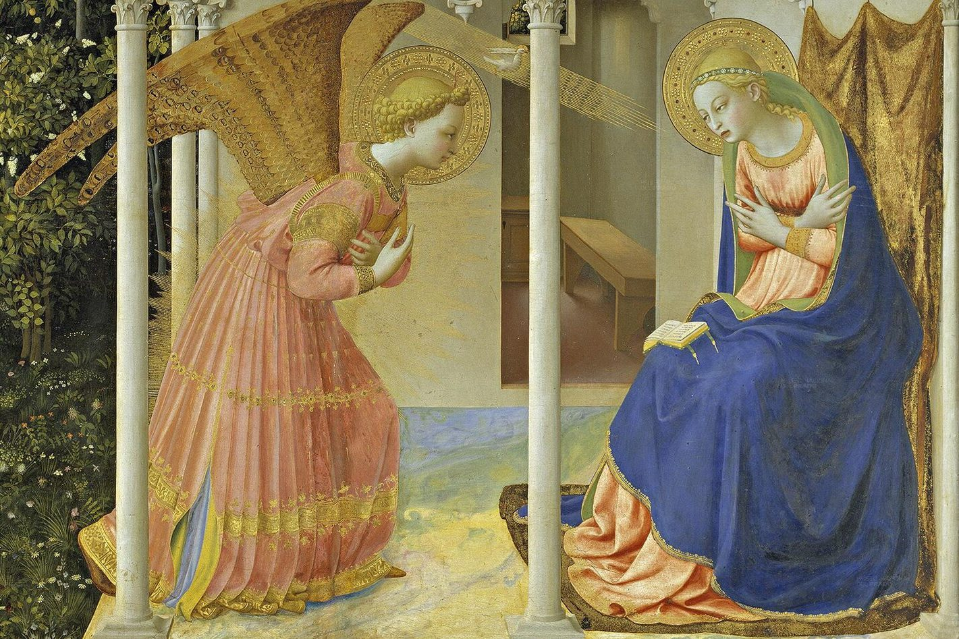
“The Lord is with you!”
Gabriel said, “Rejoice, you highly favored one! The Lord is with you.”
Notes:
Gabriel said hello in a wonderful way. “Rejoice, you highly favored one! The Lord is with you.” That means: Be glad, Mary! God loves you, and God is with you.

Slide 7

Mary was troubled.
Mary wondered what this message could mean.
Notes:
Mary was surprised. She was troubled, too. Why would an angel come to her? What could this message mean?

Slide 8

“Don’t be afraid, Mary!”
“Don’t be afraid, Mary, for you have found favor with God.”
Luke 1:30
Notes:
Gabriel said, “Don’t be afraid, Mary, for you have found favor with God.” Favor means that God is pleased with you and loves you.

Slide 9
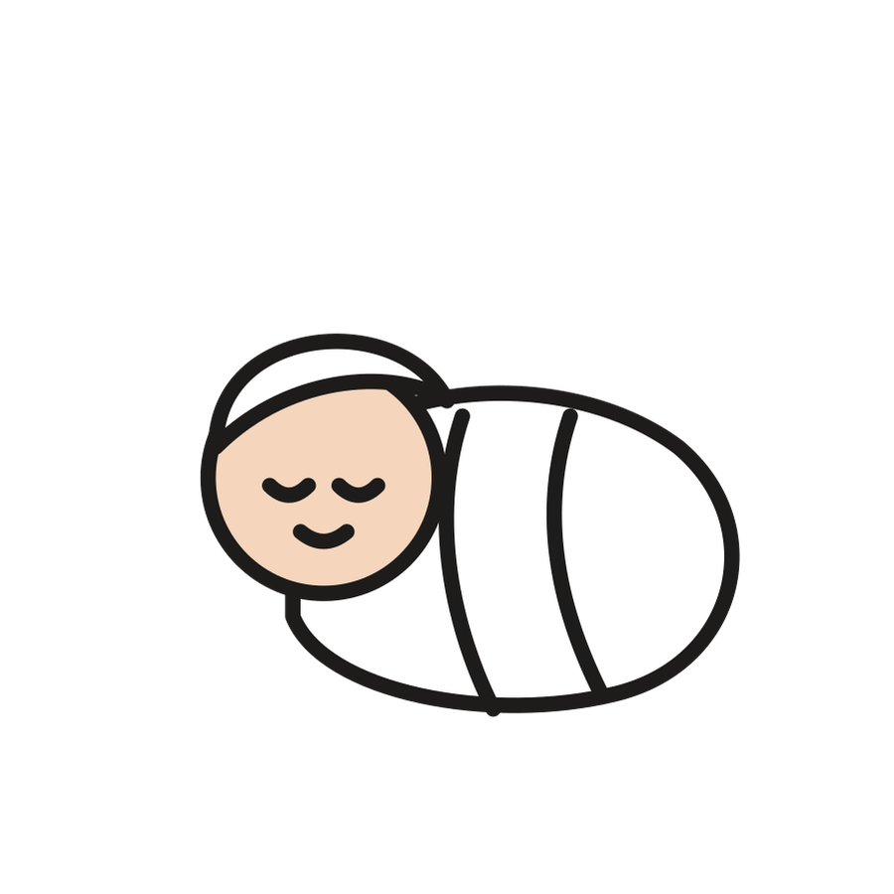
You will have a baby.
“Name him Jesus.” He will be God’s Son, and his kingdom will never end.
Notes:
Gabriel said Mary would have a baby boy. She would name him Jesus. He would be called the Son of God. He would be a king like David, and his kingdom would never end.

Slide 10

“How can this be?”
Gabriel said, “Nothing spoken by God is impossible.”
Notes:
Mary asked, “How can this be?” Gabriel said God’s Holy Spirit would make it happen. Then he told her more good news. Her relative Elizabeth was going to have a baby too, even though everyone thought she was too old.

Slide 11
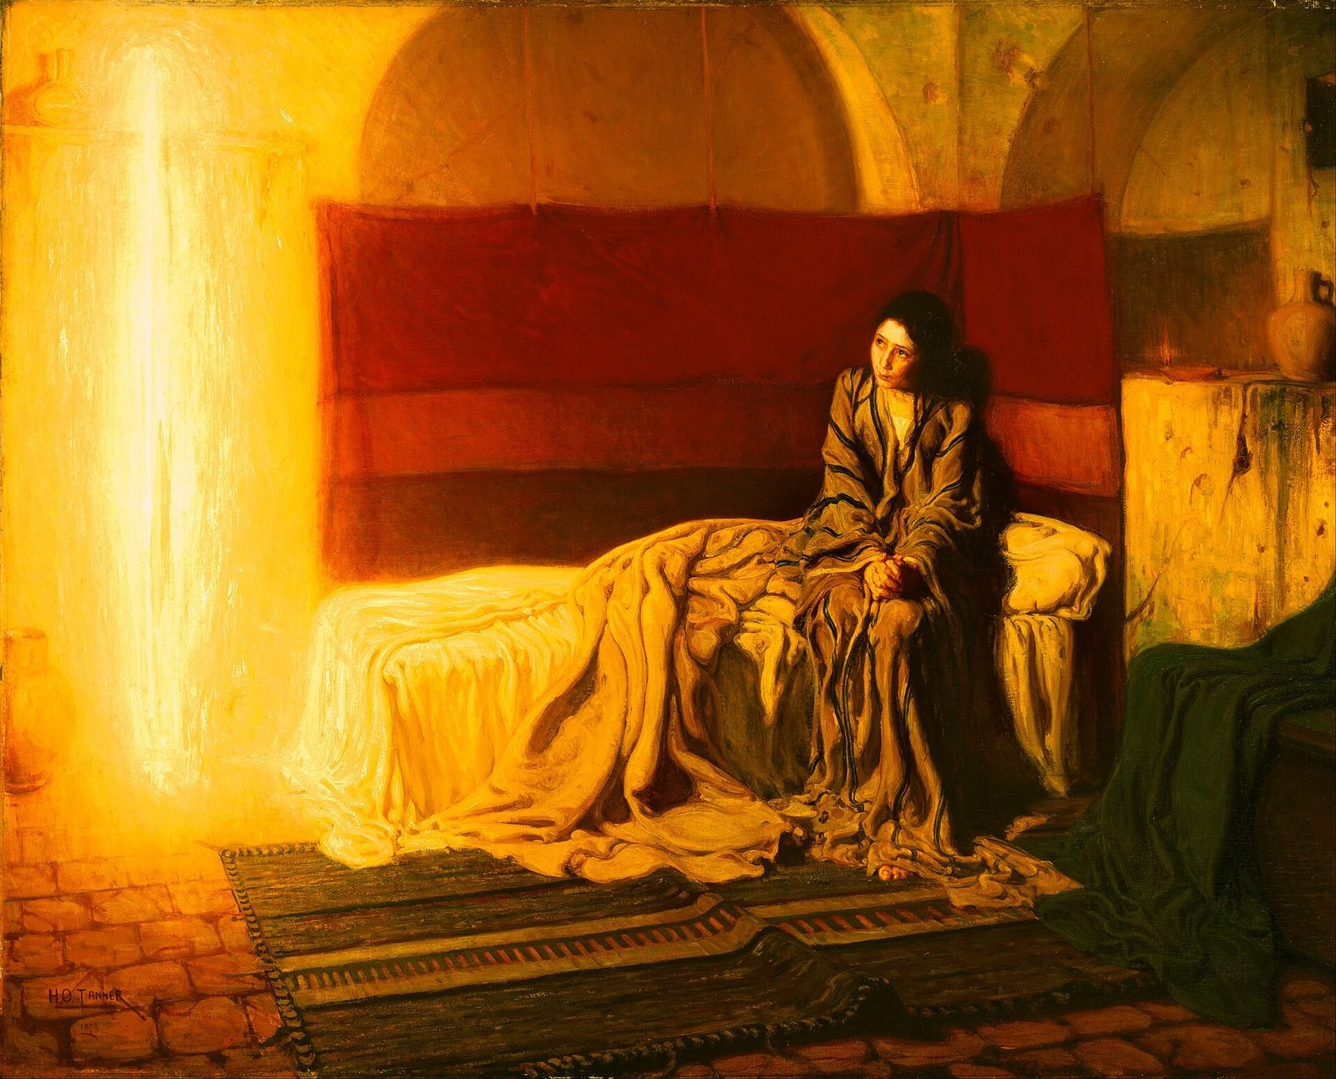
Mary said yes!
“Behold, the servant of the Lord; let it be done to me according to your word.”
Luke 1:38
Notes:
Mary thought about everything the angel said. Then she said yes. Henry Ossawa Tanner painted this picture in 1898. He painted the angel as a column of golden light. Mary looks up, ready to listen.

Slide 12

God’s love came close.
Jesus is God’s gift of love for everyone. God’s love is for you too.
Notes:
God chose an ordinary young woman in a small town. God’s love comes to ordinary people and ordinary places. It comes to you too.

Slide 13
I wonder…
I wonder how Mary felt when the angel came.
Notes:
Wait for answers. Every answer is welcome.

Slide 14
I wonder…
I wonder what message of love God has for you.
Notes:
Give the children time to think. Some may want to answer, and some may want to keep their answer in their hearts.

Slide 15
Question 1 of 7
What was the angel’s name?
Gabriel
Goliath
A
B
Zacchaeus
Noah
C
D
Notes:
Read the question and the choices aloud, and let the children answer. Then show the answer: Gabriel. God sent the angel Gabriel to Mary in Nazareth.

Slide 16
Question 1 of 7
What was the angel’s name?
Gabriel
Goliath
A
B
Zacchaeus
Noah
C
D
The answer is A. God sent the angel Gabriel to Mary in Nazareth.
Notes:
The answer is A: Gabriel. God sent the angel Gabriel to Mary in Nazareth.

Slide 17
Question 2 of 7
Where did Mary live?
In Egypt
Under the sea
A
B
On the moon
In Nazareth
C
D
Notes:
Read the question and the choices aloud, and let the children answer. Then show the answer: In Nazareth. Mary lived in Nazareth, a small town in Galilee.

Slide 18
Question 2 of 7
Where did Mary live?
In Egypt
Under the sea
A
B
On the moon
In Nazareth
C
D
The answer is D. Mary lived in Nazareth, a small town in Galilee.
Notes:
The answer is D: In Nazareth. Mary lived in Nazareth, a small town in Galilee.

Slide 19
Question 3 of 7
What did the angel say to Mary first?
“Go to your room!”
“Pack your bags!”
A
B
“The Lord is with you!”
C
Notes:
Read the question and the choices aloud, and let the children answer. Then show the answer: “The Lord is with you!”. Gabriel said, “Rejoice, you highly favored one! The Lord is with you.”

Slide 20
Question 3 of 7
What did the angel say to Mary first?
“Go to your room!”
“Pack your bags!”
A
B
“The Lord is with you!”
C
The answer is C. Gabriel said, “Rejoice, you highly favored one! The Lord is with you.”
Notes:
The answer is C: “The Lord is with you!”. Gabriel said, “Rejoice, you highly favored one! The Lord is with you.”

Slide 21
Question 4 of 7
How did Mary feel when the angel came?
Surprised and troubled
Sleepy
A
B
Hungry for pizza
C
Notes:
Read the question and the choices aloud, and let the children answer. Then show the answer: Surprised and troubled. Mary wondered what the message meant, so Gabriel said, “Don’t be afraid.”

Slide 22
Question 4 of 7
How did Mary feel when the angel came?
Surprised and troubled
Sleepy
A
B
Hungry for pizza
C
The answer is A. Mary wondered what the message meant, so Gabriel said, “Don’t be afraid.”
Notes:
The answer is A: Surprised and troubled. Mary wondered what the message meant, so Gabriel said, “Don’t be afraid.”

Slide 23
Question 5 of 7
What name did the angel give for Mary’s baby?
John
Jesus
A
B
David
Gabriel
C
D
Notes:
Read the question and the choices aloud, and let the children answer. Then show the answer: Jesus. Gabriel told Mary to name her baby Jesus.

Slide 24
Question 5 of 7
What name did the angel give for Mary’s baby?
John
Jesus
A
B
David
Gabriel
C
D
The answer is B. Gabriel told Mary to name her baby Jesus.
Notes:
The answer is B: Jesus. Gabriel told Mary to name her baby Jesus.

Slide 25
Question 6 of 7
What did Mary say to God?
No way
Yes
A
B
Maybe later
C
Notes:
Read the question and the choices aloud, and let the children answer. Then show the answer: Yes. Mary said she was ready to do what God asked.

Slide 26
Question 6 of 7
What did Mary say to God?
No way
Yes
A
B
Maybe later
C
The answer is B. Mary said she was ready to do what God asked.
Notes:
The answer is B: Yes. Mary said she was ready to do what God asked.

Slide 27
Question 7 of 7
What does this story show us about God?
God only visits kings
God is far away
A
B
God’s love comes close to everyone
God loves only grown-ups
C
D
Notes:
Read the question and the choices aloud, and let the children answer. Then show the answer: God’s love comes close to everyone. God sent a message of love to Mary in a small town, and Jesus came for everyone.

Slide 28
Question 7 of 7
What does this story show us about God?
God only visits kings
God is far away
A
B
God’s love comes close to everyone
God loves only grown-ups
C
D
The answer is C. God sent a message of love to Mary in a small town, and Jesus came for everyone.
Notes:
The answer is C: God’s love comes close to everyone. God sent a message of love to Mary in a small town, and Jesus came for everyone.

Slide 29

Great job!
You finished all 7 questions.
Notes:
Thank the children for listening so well.

Slide 30
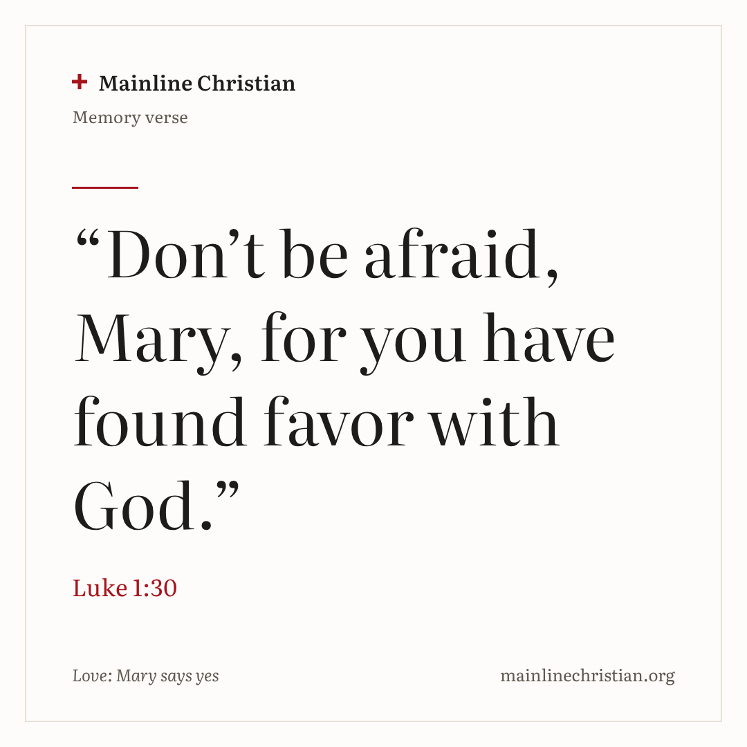
Our memory verse
“Don’t be afraid, Mary, for you have found favor with God.”
Luke 1:30
Notes:
Say the verse with motions. “Don’t be afraid” (open your hands and shake your head gently). “Mary” (wave hello). “For you have found favor” (hug yourself). “With God” (point up). Say it in a whisper, then in a normal voice, then with a big smile.

Slide 31
Make a message angel
Cut the paper plate in half.
Roll one half into a cone and tape it.
Cut the other half into two wings.
Tape on the wings and glue on a head.
Add the message: The Lord is with you.
Notes:
Show a finished angel first. Help with cutting and taping as needed. Angels in Bible art look many different ways, so children may draw their angel however they imagine.

Slide 32
Good-news messenger
Gabriel carries the envelope to the chair.
Gabriel says, “Good news! God loves you!”
Open it, hold up the heart, and say, “Yes!”
Switch places and play again.
Notes:
Call out a new way to move each turn: tiptoe, hop, or walk like a penguin. Everyone gets a turn to be Gabriel and a turn in the chair.

Slide 33
Let’s pray
Dear God, thank you for Mary, who said yes. Thank you for Jesus, your gift of love. Amen.
Notes:
Read the prayer one line at a time and let the children repeat each line after you.

