Slide 1
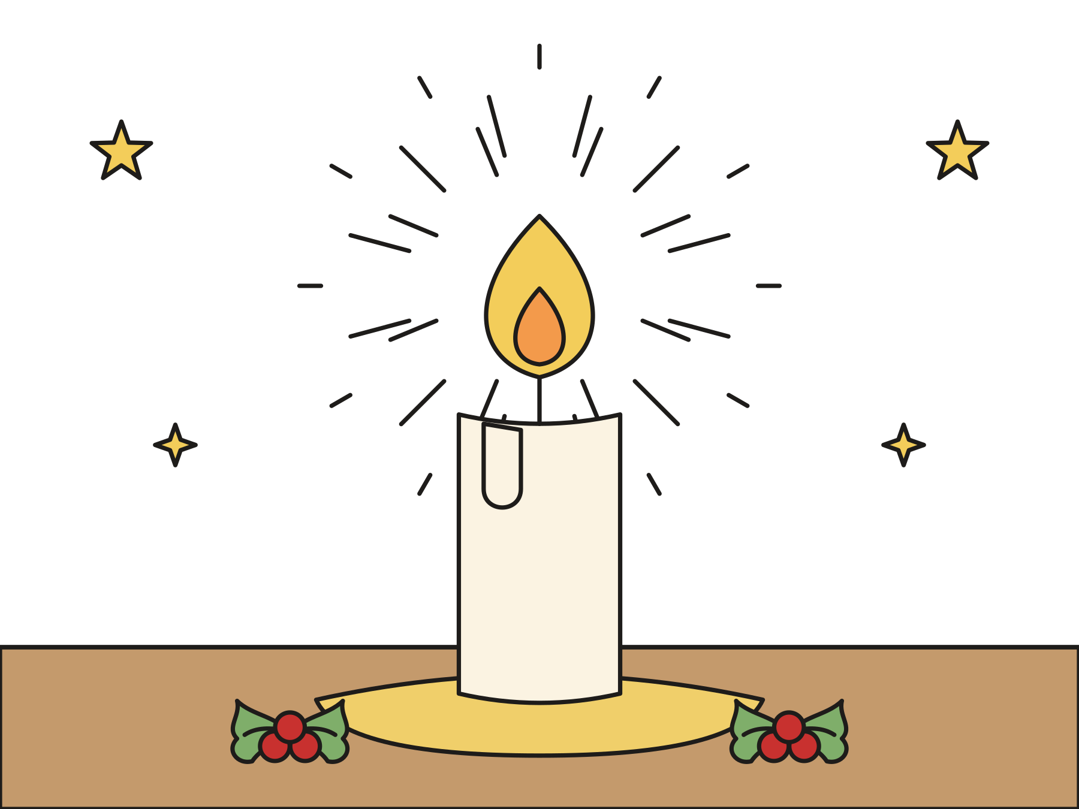
Sunday school · Ages 7–9
Joy: John points to the light
Isaiah 61:1–4, 8–11; Psalm 126; John 1:6–8, 19–28
Mainline Christian
Notes:
Welcome the children. Today’s story comes from Isaiah 61:1–4, 8–11; Psalm 126; John 1:6–8, 19–28.

Slide 2

Welcome!
What good news makes you so happy that you want to tell everyone?
Notes:
Welcome each child by name. Ask the question and let two or three children answer. Say: Today we will meet a man who had the best news of all.

Slide 3

The candle of joy
Today many churches light the pink candle. It is the candle of joy.
Notes:
Point to the Advent wreath. Many churches name the candles hope, peace, joy, and love. Today is the third Sunday of Advent, so we light the third candle. It is pink, and it stands for joy. Christmas is getting close!

Slide 4
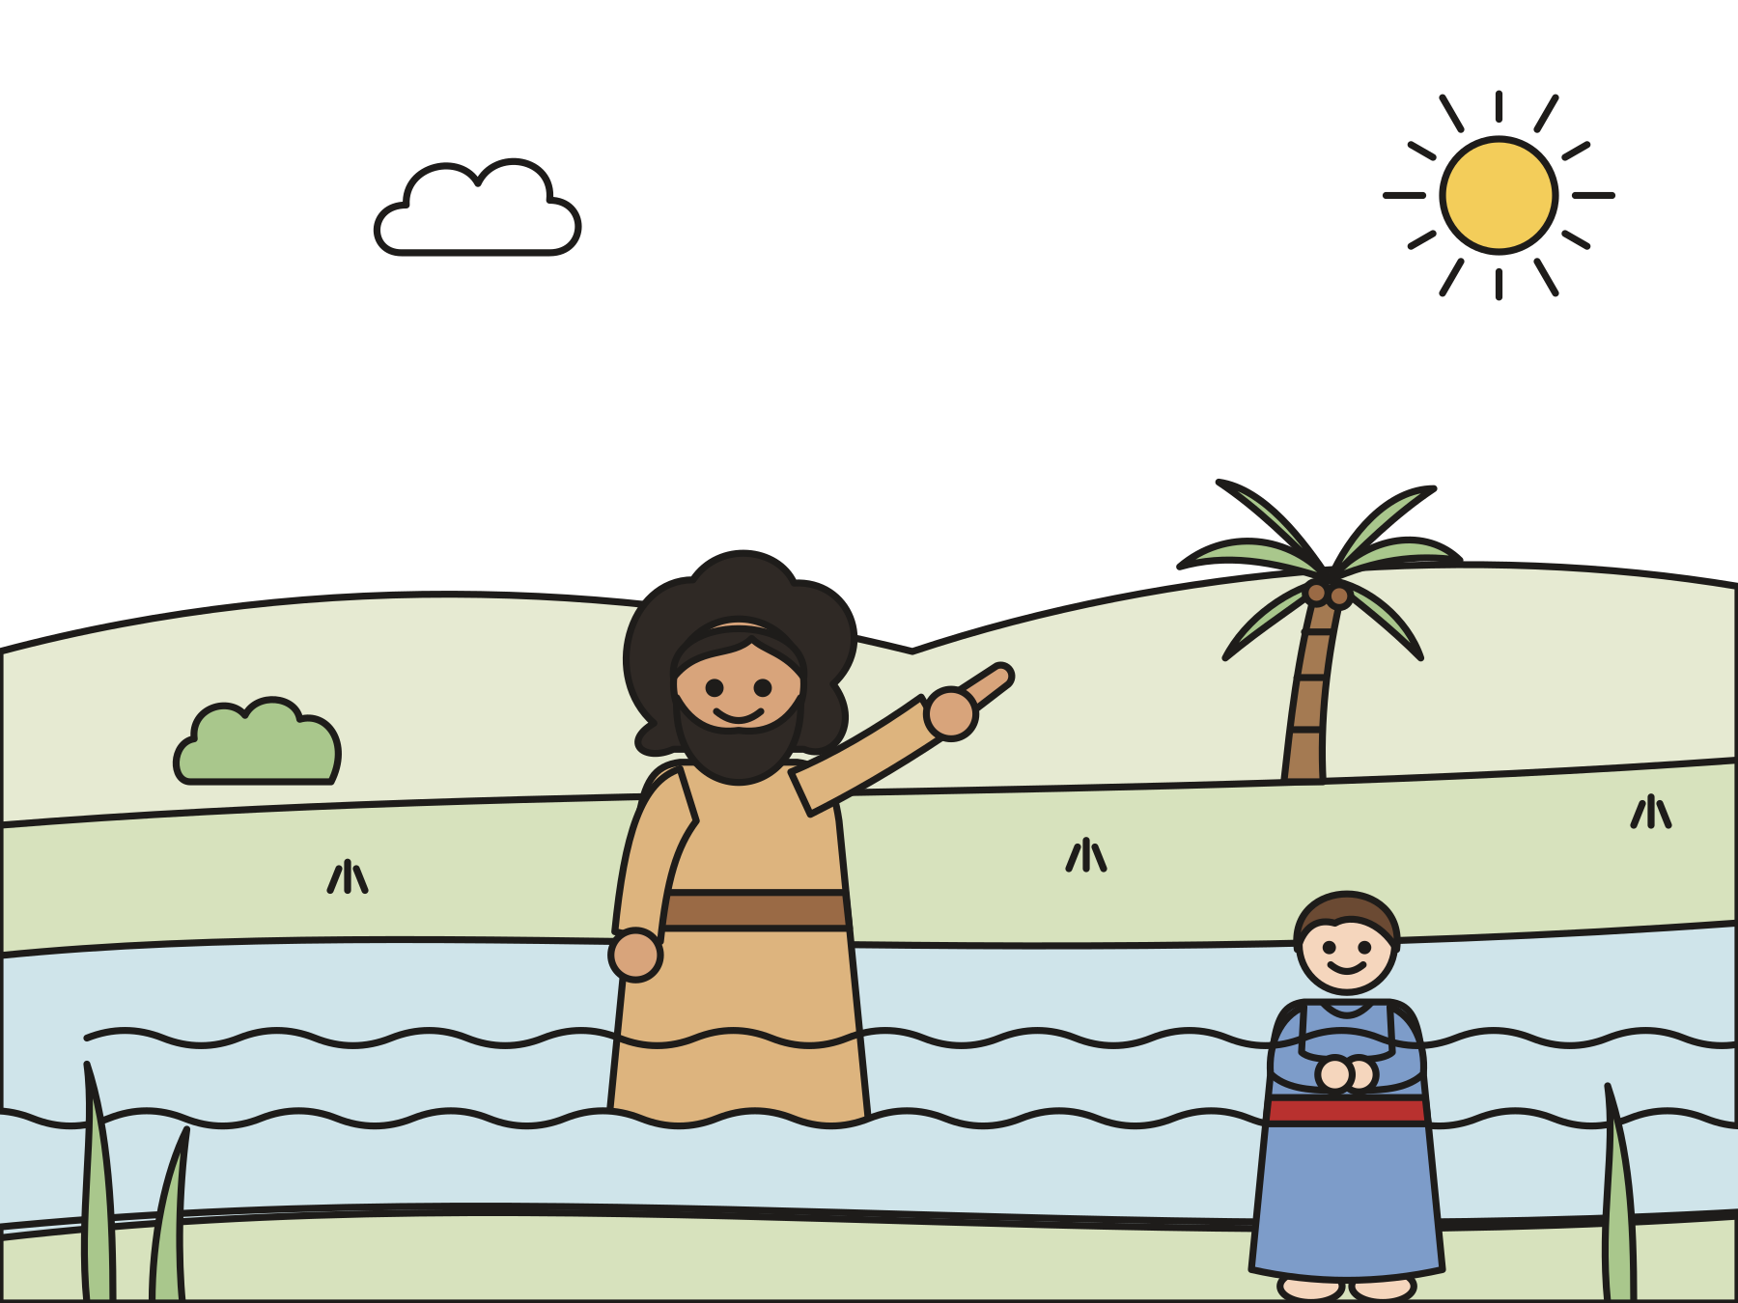
God sent a man named John.
John lived in the wilderness. He baptized people in the Jordan River.
Notes:
Long ago, God sent a man named John. He lived out in the wilderness, a wild, dry place. He wore rough clothes made of camel hair, and he ate locusts and wild honey! Crowds came to the river to hear him.

Slide 5

“Who are you?”
Leaders in Jerusalem sent helpers to ask John who he was.
Notes:
Everyone was talking about John. So leaders in the big city of Jerusalem sent priests and temple helpers to find him. They walked all the way to the river and asked, “Who are you?”

Slide 6
No, no, no!
“Are you Elijah?” “Are you the prophet?” John said, “No.”
Notes:
Let the children shout “No!” with John. First John told them, “I am not the Christ.” The Christ was the special king God promised. He said no when they asked if he was Elijah, and no again when they asked if he was the prophet.

Slide 7
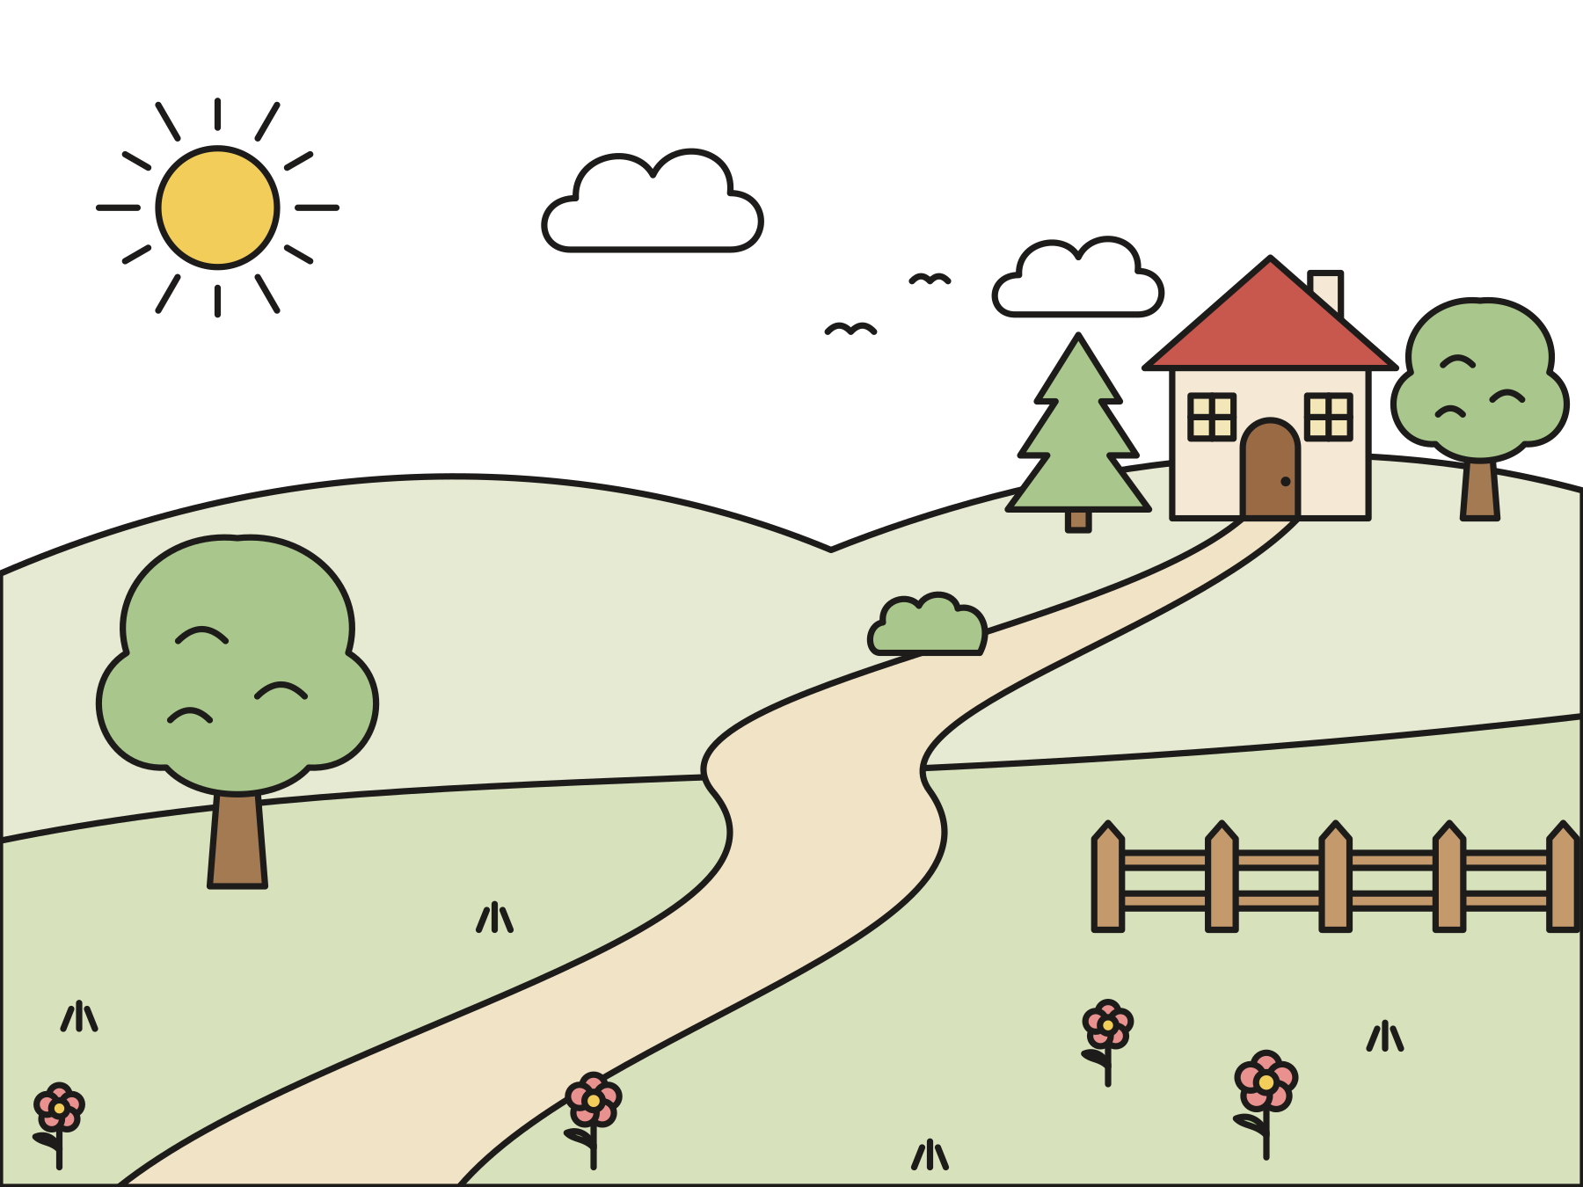
A voice in the wilderness
John said, “Make straight the way of the Lord!”
Notes:
John said, “I am the voice of one crying in the wilderness, ‘Make straight the way of the Lord.’” He meant: Get ready! God is coming. It is like fixing the road for a very special visitor.

Slide 8

Someone is coming!
Someone greater was already among them. John was not worthy to untie his sandals.
Notes:
The helpers asked why John baptized people. John said, “I baptize with water. Someone is standing among you right now, and you do not know him yet. I am not even worthy to untie his sandals.” John was talking about Jesus!

Slide 9
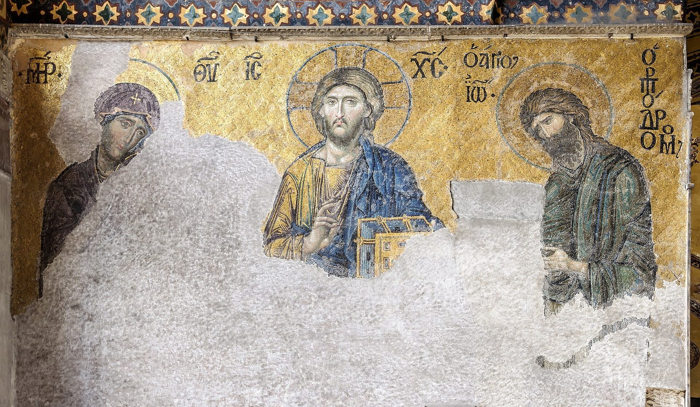
John pointed to the light.
“He was not the light, but was sent that he might testify about the light.”
John 1:8
Notes:
Read the verse slowly. John’s job was to point to the light, and the light is Jesus. In this old mosaic from a great church in Istanbul, John turns toward Jesus. Mary is on the other side.

Slide 10
John was full of joy!
John was glad to point to Jesus. Jesus brings God’s love to everyone.
Notes:
Was John sad that everyone would look at Jesus? No! He was full of joy. Even before he was born, baby John leaped for joy when Mary came to visit his mother, Elizabeth. Jesus is like a light in the dark, and his light is for everyone.

Slide 11
We are glad!
“The LORD has done great things for us, and we are glad.”
Psalm 126:3
Notes:
This verse comes from Psalm 126, one of today’s readings. God’s people sang it when God brought them home. Say: God has done great things for us too. That gives us joy!

Slide 12
I wonder…
I wonder why John was so happy to point to someone else.
Notes:
Wait for answers. Every answer is welcome.

Slide 13
I wonder…
I wonder how you could point someone to God’s light this week.
Notes:
Let the children dream up ideas. Kindness, sharing, and inviting a friend are all ways of shining God’s light.

Slide 14
Question 1 of 7
Where did John baptize people?
In a swimming pool
In a big castle
A
B
On a ship at sea
In the Jordan River
C
D
Notes:
Read the question and the choices aloud, and let the children answer. Then show the answer: In the Jordan River. John lived in the wilderness and baptized people in the Jordan River.

Slide 15
Question 1 of 7
Where did John baptize people?
In a swimming pool
In a big castle
A
B
On a ship at sea
In the Jordan River
C
D
The answer is D. John lived in the wilderness and baptized people in the Jordan River.
Notes:
The answer is D: In the Jordan River. John lived in the wilderness and baptized people in the Jordan River.

Slide 16
Question 2 of 7
What did the helpers from Jerusalem ask John?
“What is for lunch?”
“Where is your dog?”
A
B
“Who are you?”
C
Notes:
Read the question and the choices aloud, and let the children answer. Then show the answer: “Who are you?”. They wanted to know who John was and why he baptized people.

Slide 17
Question 2 of 7
What did the helpers from Jerusalem ask John?
“What is for lunch?”
“Where is your dog?”
A
B
“Who are you?”
C
The answer is C. They wanted to know who John was and why he baptized people.
Notes:
The answer is C: “Who are you?”. They wanted to know who John was and why he baptized people.

Slide 18
Question 3 of 7
Was John the light?
Yes, he glowed in the dark
Yes, he was a lamp
A
B
No, he told people about the light
C
Notes:
Read the question and the choices aloud, and let the children answer. Then show the answer: No, he told people about the light. God sent John to tell everyone about the light.

Slide 19
Question 3 of 7
Was John the light?
Yes, he glowed in the dark
Yes, he was a lamp
A
B
No, he told people about the light
C
The answer is C. God sent John to tell everyone about the light.
Notes:
The answer is C: No, he told people about the light. God sent John to tell everyone about the light.

Slide 20
Question 4 of 7
Who is the light that John pointed to?
The moon
Jesus
A
B
A campfire
A birthday candle
C
D
Notes:
Read the question and the choices aloud, and let the children answer. Then show the answer: Jesus. John pointed to Jesus, who brings God’s light and love to everyone.

Slide 21
Question 4 of 7
Who is the light that John pointed to?
The moon
Jesus
A
B
A campfire
A birthday candle
C
D
The answer is B. John pointed to Jesus, who brings God’s light and love to everyone.
Notes:
The answer is B: Jesus. John pointed to Jesus, who brings God’s light and love to everyone.

Slide 22
Question 5 of 7
What did John say about the one coming after him?
He was always late
He had a pet camel
A
B
He was not worthy to untie his sandals
C
Notes:
Read the question and the choices aloud, and let the children answer. Then show the answer: He was not worthy to untie his sandals. John knew that Jesus was greater than he was, and that made him glad.

Slide 23
Question 5 of 7
What did John say about the one coming after him?
He was always late
He had a pet camel
A
B
He was not worthy to untie his sandals
C
The answer is C. John knew that Jesus was greater than he was, and that made him glad.
Notes:
The answer is C: He was not worthy to untie his sandals. John knew that Jesus was greater than he was, and that made him glad.

Slide 24
Question 6 of 7
Why do many churches light a pink candle today?
Pink is the only color left
It is the candle of joy
A
B
To make the room smell nice
C
Notes:
Read the question and the choices aloud, and let the children answer. Then show the answer: It is the candle of joy. The third Sunday of Advent is a Sunday of joy, because Christmas is getting close.

Slide 25
Question 6 of 7
Why do many churches light a pink candle today?
Pink is the only color left
It is the candle of joy
A
B
To make the room smell nice
C
The answer is B. The third Sunday of Advent is a Sunday of joy, because Christmas is getting close.
Notes:
The answer is B: It is the candle of joy. The third Sunday of Advent is a Sunday of joy, because Christmas is getting close.

Slide 26
Question 7 of 7
Who is God’s good news for?
Only grown-ups
Everyone
A
B
Only kings
Only people who are never sad
C
D
Notes:
Read the question and the choices aloud, and let the children answer. Then show the answer: Everyone. John came so that all people could hear about the light.

Slide 27
Question 7 of 7
Who is God’s good news for?
Only grown-ups
Everyone
A
B
Only kings
Only people who are never sad
C
D
The answer is B. John came so that all people could hear about the light.
Notes:
The answer is B: Everyone. John came so that all people could hear about the light.

Slide 28

Great job!
You finished all 7 questions.
Notes:
Thank the children for listening so well.

Slide 29
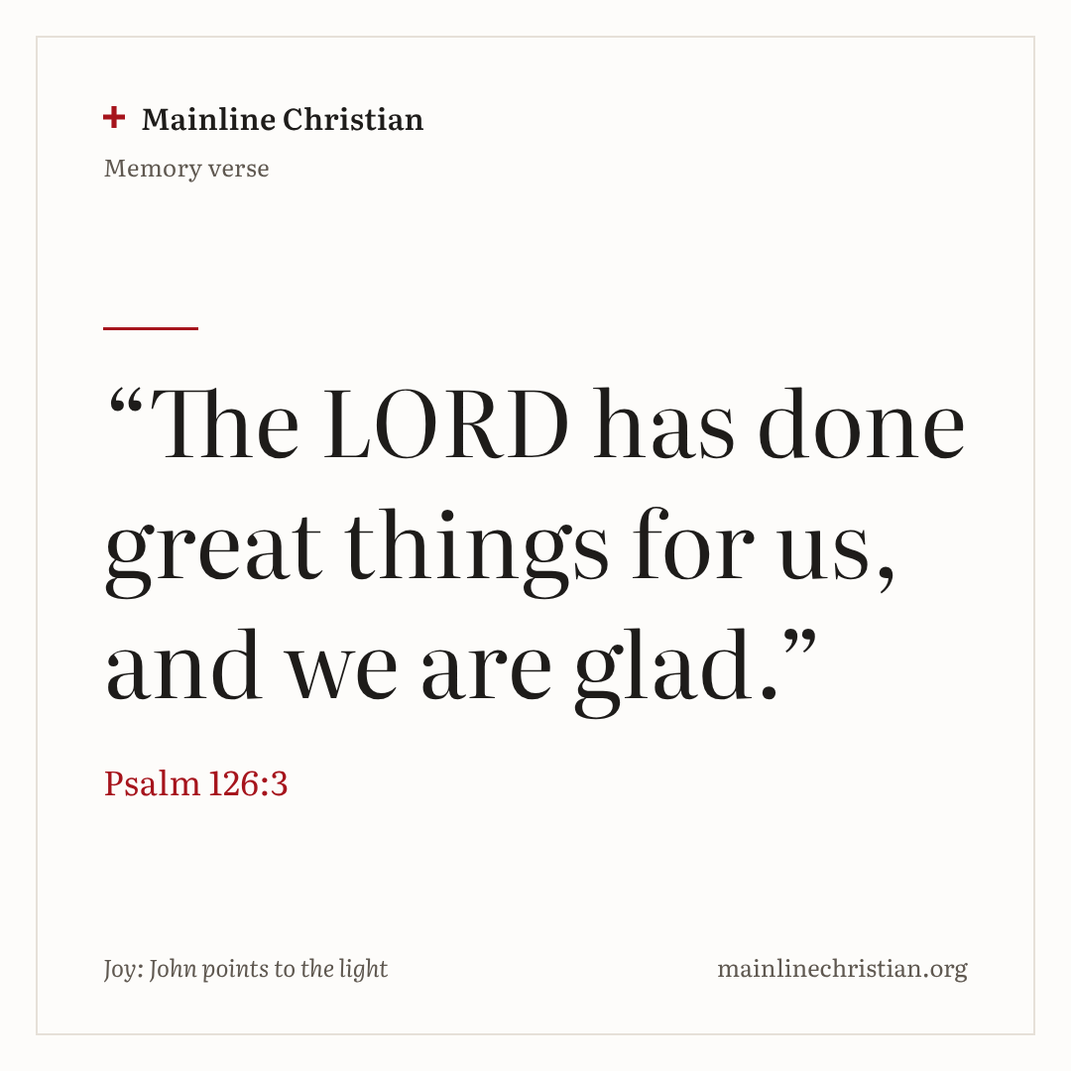
Our memory verse
“The LORD has done great things for us, and we are glad.”
Psalm 126:3
Notes:
Say the verse with motions. “The LORD” (point up). “Has done great things” (spread your arms wide). “For us” (hug yourself). “And we are glad” (big smile and jazz hands). Say it softly, then louder, then with your biggest smile.

Slide 30
Make a joy lantern
Decorate one side of your paper.
Fold it in half the long way, colored side out.
Cut slits from the fold to the line.
Unfold, roll it into a tube, and tape it.
Tape on a paper handle.
Notes:
Show a finished lantern first. Draw the cutting line for children who need help. Remind them to stop cutting at the line.

Slide 31
Shine the light
Shine the flashlight on a star.
Everyone points and says, “Get ready!”
Pass the flashlight to the next friend.
Find the Jesus star? Shout, “Jesus is the light!”
Notes:
Keep the flashlight pointed at the walls and the stars, never at anyone’s eyes. Everyone stays seated, and everyone gets a turn.

Slide 32

Let’s pray
Dear God, thank you for John, who pointed to the light. Fill us with joy, and help us share it. Amen.
Notes:
Read the prayer one line at a time and let the children repeat each line after you.

