Slide 1
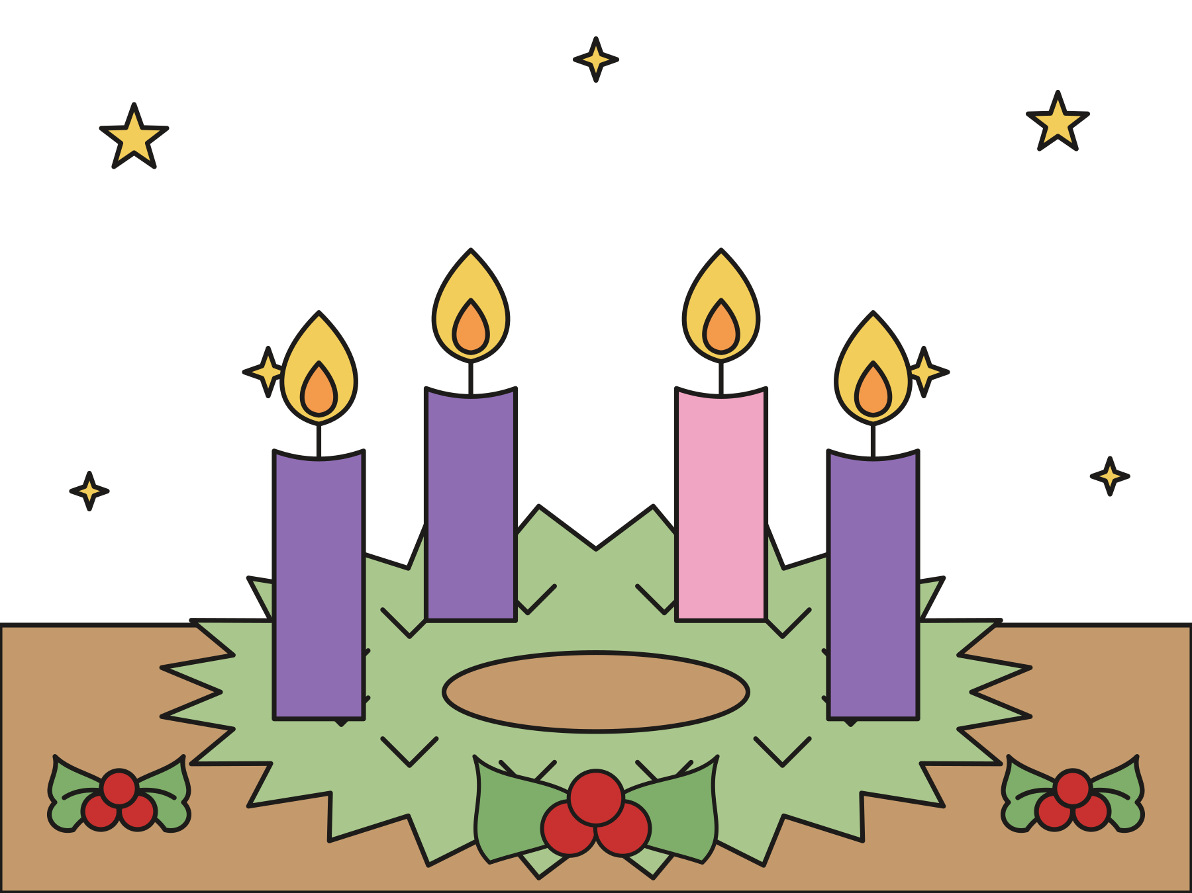
Sunday school · Ages 7–9
Hope: stay awake for God’s light
Mark 13:24–37; Isaiah 64:1–9
Mainline Christian
Notes:
Welcome the children. Today’s story comes from Mark 13:24–37; Isaiah 64:1–9.

Slide 2

Welcome!
What is the hardest thing you ever had to wait for?
Notes:
Welcome each child by name. Ask the question and let two or three children answer. Say: Today we start a season of waiting. It is called Advent.

Slide 3

It’s Advent!
Advent is four Sundays of waiting. We get ready for Christmas.
Notes:
The word Advent means coming. For four Sundays, the church gets ready to remember that Jesus was born. We also wait with hope for the day God makes the whole world right.

Slide 4

The candle of hope
Hope means something good is coming, even before we can see it.
Notes:
Point to the Advent wreath. The circle has no end, like God’s love. Many churches call the first candle the candle of hope. Light it, or switch it on.

Slide 5

Jesus talked with his friends.
They asked, “When will these things be?”
Notes:
Jesus and four friends sat on a hill called the Mount of Olives. They could see the big temple in Jerusalem. His friends had a question: When will God make everything new?

Slide 6

God’s light will shine.
Even on the darkest day, God will gather God’s people from near and far.
Notes:
Jesus used big picture words. The sun and moon might go dark. The stars might seem to fall. But then Jesus would come with God’s great glory, and angels would gather God’s people from every corner of the earth.

Slide 7

Who knows when?
No one knows the day or the hour. Only God knows.
Notes:
Jesus said to look at the fig tree. When it grows new leaves, you know summer is near. But no one knows the exact day. Not even the angels know!

Slide 8

A man went on a trip.
He gave each helper a job. The doorkeeper had to watch the door.
Notes:
So Jesus told a little story. A man went away on a long trip. He gave each helper a job to do. And he told the doorkeeper to keep watch.

Slide 9

When will he come home?
In the evening? At midnight? When the rooster crows? In the morning?
Notes:
Nobody knew when the man would come home. Do the motions together: yawn for evening, rest your head for midnight, crow for the rooster, stretch up high for morning.

Slide 10

Jesus said, “Watch!”
“What I tell you, I tell all: Watch!”
Mark 13:37
Notes:
Jesus said this to his four friends. He says it to everyone, and that means you too!

Slide 11
God’s people waited long ago.
A prophet prayed, “Oh that you would tear the heavens, that you would come down.”
Notes:
Long before Jesus, God’s people had a very hard time. Their city was broken, and they were sad. A prophet prayed: God, open up the sky and come help us!

Slide 12

We are the clay.
“We are the clay and you our potter. We all are the work of your hand.”
Isaiah 64:8
Notes:
Pretend to shape clay in your hands. A potter keeps working the clay until it is just right. God made each one of us, and God keeps working with us.

Slide 13
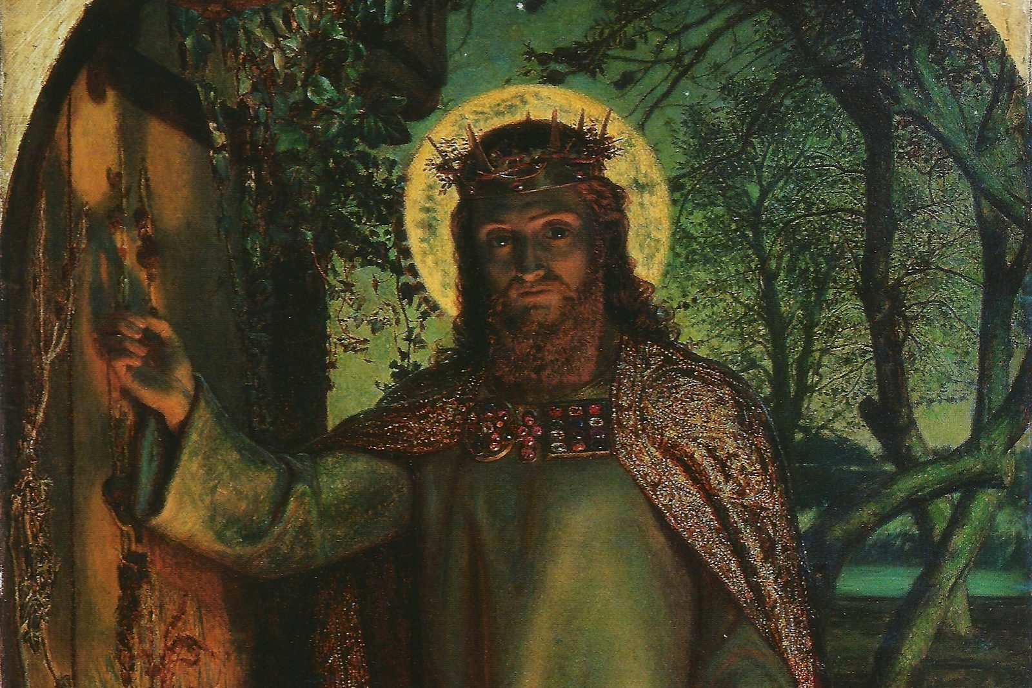
Jesus brings God’s light.
We wait for Christmas, when we remember that Jesus was born.
Notes:
This painting by William Holman Hunt shows Jesus holding a lamp and knocking at a door. Jesus said, “I am the light of the world.” In Advent we stay awake for God’s light. We can see it in kind words and helping hands.

Slide 14
I wonder…
I wonder what the doorkeeper did all night long.
Notes:
Wait for answers. Every answer is welcome.

Slide 15
I wonder…
I wonder what you are hoping for this Advent.
Notes:
Some hopes are tender, like hoping a sick grandparent gets well. Thank each child for sharing.

Slide 16
Question 1 of 7
What does the word Advent mean?
Sleeping
Shopping
A
B
Snowing
Coming
C
D
Notes:
Read the question and the choices aloud, and let the children answer. Then show the answer: Coming. Advent means coming. We get ready to remember that Jesus came.

Slide 17
Question 1 of 7
What does the word Advent mean?
Sleeping
Shopping
A
B
Snowing
Coming
C
D
The answer is D. Advent means coming. We get ready to remember that Jesus came.
Notes:
The answer is D: Coming. Advent means coming. We get ready to remember that Jesus came.

Slide 18
Question 2 of 7
What job did the doorkeeper have?
To bake bread
To catch fish
A
B
To go to sleep
To keep watch
C
D
Notes:
Read the question and the choices aloud, and let the children answer. Then show the answer: To keep watch. The man told the doorkeeper to watch for him to come home.

Slide 19
Question 2 of 7
What job did the doorkeeper have?
To bake bread
To catch fish
A
B
To go to sleep
To keep watch
C
D
The answer is D. The man told the doorkeeper to watch for him to come home.
Notes:
The answer is D: To keep watch. The man told the doorkeeper to watch for him to come home.

Slide 20
Question 3 of 7
When would the man come home?
At lunchtime
Nobody knew
A
B
On his birthday
C
Notes:
Read the question and the choices aloud, and let the children answer. Then show the answer: Nobody knew. He might come in the evening, at midnight, when the rooster crows, or in the morning.

Slide 21
Question 3 of 7
When would the man come home?
At lunchtime
Nobody knew
A
B
On his birthday
C
The answer is B. He might come in the evening, at midnight, when the rooster crows, or in the morning.
Notes:
The answer is B: Nobody knew. He might come in the evening, at midnight, when the rooster crows, or in the morning.

Slide 22
Question 4 of 7
What one word did Jesus say to everyone?
Watch!
Hurry!
A
B
Sleep!
Hide!
C
D
Notes:
Read the question and the choices aloud, and let the children answer. Then show the answer: Watch!. Jesus said, “What I tell you, I tell all: Watch!”

Slide 23
Question 4 of 7
What one word did Jesus say to everyone?
Watch!
Hurry!
A
B
Sleep!
Hide!
C
D
The answer is A. Jesus said, “What I tell you, I tell all: Watch!”
Notes:
The answer is A: Watch!. Jesus said, “What I tell you, I tell all: Watch!”

Slide 24
Question 5 of 7
Isaiah said we are like clay. Who is the potter?
God
A king
A
B
The doorkeeper
C
Notes:
Read the question and the choices aloud, and let the children answer. Then show the answer: God. Isaiah prayed, “We are the clay and you our potter.”

Slide 25
Question 5 of 7
Isaiah said we are like clay. Who is the potter?
God
A king
A
B
The doorkeeper
C
The answer is A. Isaiah prayed, “We are the clay and you our potter.”
Notes:
The answer is A: God. Isaiah prayed, “We are the clay and you our potter.”

Slide 26
Question 6 of 7
What do many churches call the first Advent candle?
Sleep
Hope
A
B
Snow
Presents
C
D
Notes:
Read the question and the choices aloud, and let the children answer. Then show the answer: Hope. Hope means we know something good is coming.

Slide 27
Question 6 of 7
What do many churches call the first Advent candle?
Sleep
Hope
A
B
Snow
Presents
C
D
The answer is B. Hope means we know something good is coming.
Notes:
The answer is B: Hope. Hope means we know something good is coming.

Slide 28
Question 7 of 7
Why do we wait with hope in Advent?
God’s light is coming to us
We want to stay up late
A
B
We like being bored
C
Notes:
Read the question and the choices aloud, and let the children answer. Then show the answer: God’s light is coming to us. Jesus brings God’s light and love to everyone. Good news is worth the wait!

Slide 29
Question 7 of 7
Why do we wait with hope in Advent?
God’s light is coming to us
We want to stay up late
A
B
We like being bored
C
The answer is A. Jesus brings God’s light and love to everyone. Good news is worth the wait!
Notes:
The answer is A: God’s light is coming to us. Jesus brings God’s light and love to everyone. Good news is worth the wait!

Slide 30
Great job!
You finished all 7 questions.
Notes:
Thank the children for listening so well.

Slide 31
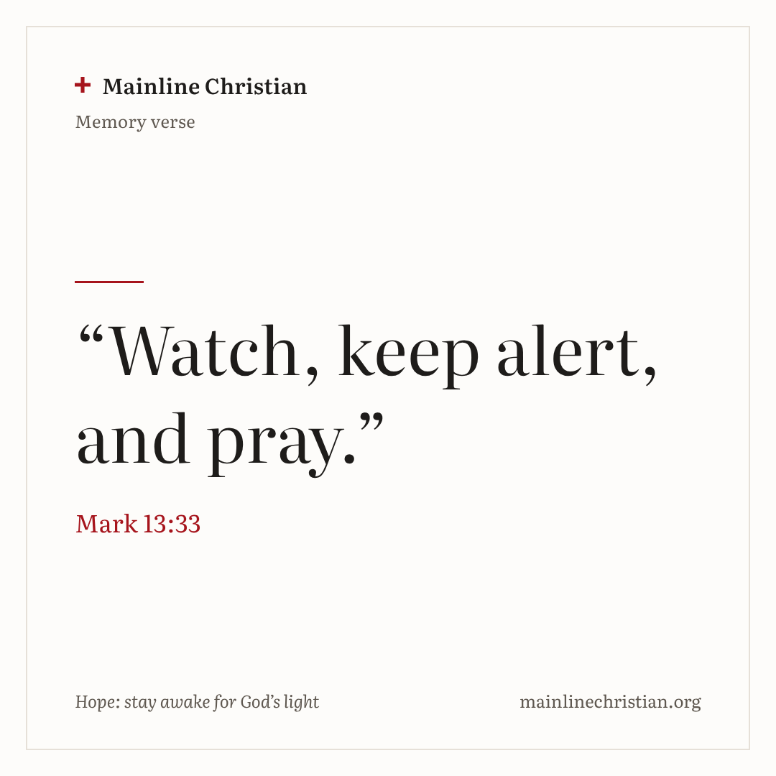
Our memory verse
“Watch, keep alert, and pray.”
Mark 13:33
Notes:
Say the verse with motions. “Watch” (hand above your eyes, look far away). “Keep alert” (sit up tall, eyes wide open). “And pray” (fold your hands). Say it like a sleepy person, then a little more awake, then wide awake!

Slide 32
Make an Advent wreath
Tear green paper into leaves.
Glue the leaves all around your paper ring.
Glue on four paper candles.
Write HOPE, PEACE, JOY, and LOVE on the candles.
Glue a yellow flame on the HOPE candle.
Notes:
Show a finished wreath first. Put the other three flames in an envelope so children can add one at home each Sunday.

Slide 33
Keep awake!
Evening: yawn and stretch.
Midnight: rest your head on your hands.
Rooster: flap your arms and crow.
Morning: reach up for the sun.
Knock, knock! Jump up and shout, “Welcome home!”
Notes:
Call out the times in any order, faster and faster. Every so often, knock on the door. Nobody is ever out.

Slide 34
Let’s pray
Dear God, help us wait with hope. Help us stay awake for your light. Come, Lord Jesus! Amen.
Notes:
Read the prayer one line at a time and let the children repeat each line after you.

