Slide 1

Children’s sermon
Mary says yes: a children’s sermon for the fourth Sunday of Advent
Luke 1:26–38
Mainline Christian
Notes:
Welcome the children. Today’s story comes from Luke 1:26–38.

Slide 2
You’ve got mail!
What could be inside this envelope?
Notes:
Hold up the sealed envelope. Ask: Who likes getting mail? What do you think is inside? Let the children guess.

Slide 3
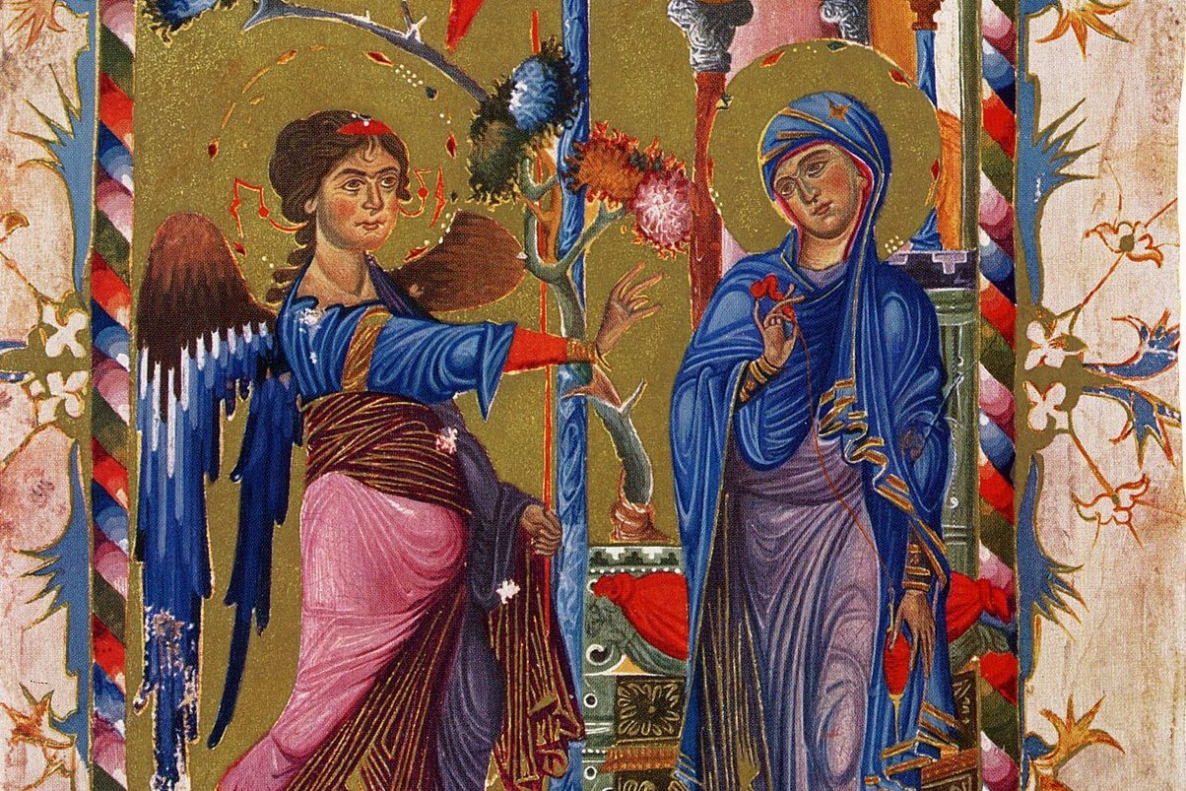
God sent a message.
God sent the angel Gabriel to Mary in Nazareth.
Notes:
Long ago, God had a message for a young woman named Mary. God sent the angel Gabriel to bring it. This picture comes from an Armenian Gospel book made about 750 years ago.

Slide 4
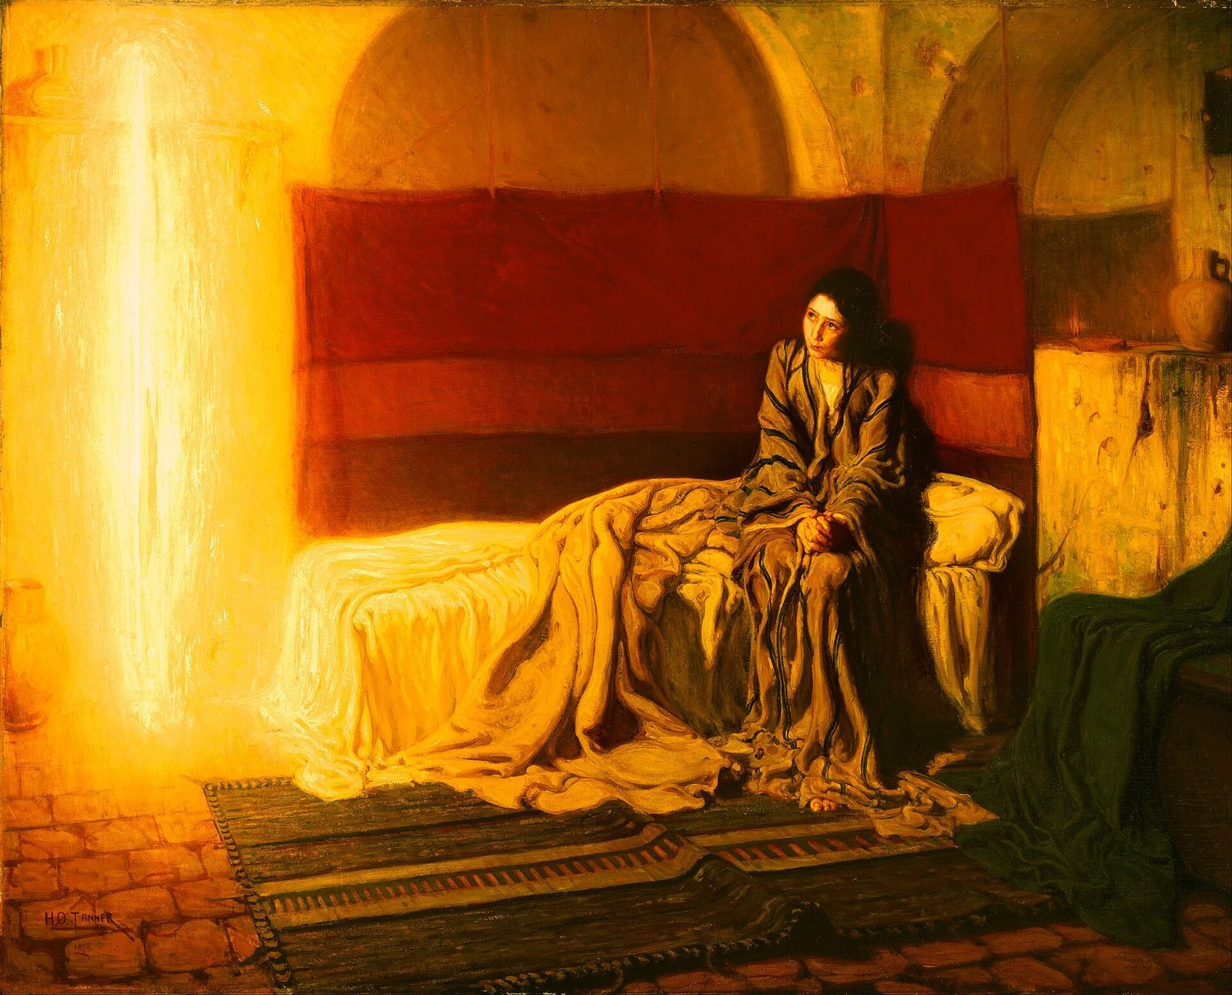
“Rejoice, you highly favored one! The Lord is with you.”
Luke 1:28
Notes:
Read the verse slowly. Gabriel’s message meant: Be glad, Mary! God loves you, and God is with you. Henry Ossawa Tanner painted the angel as a column of golden light.

Slide 5
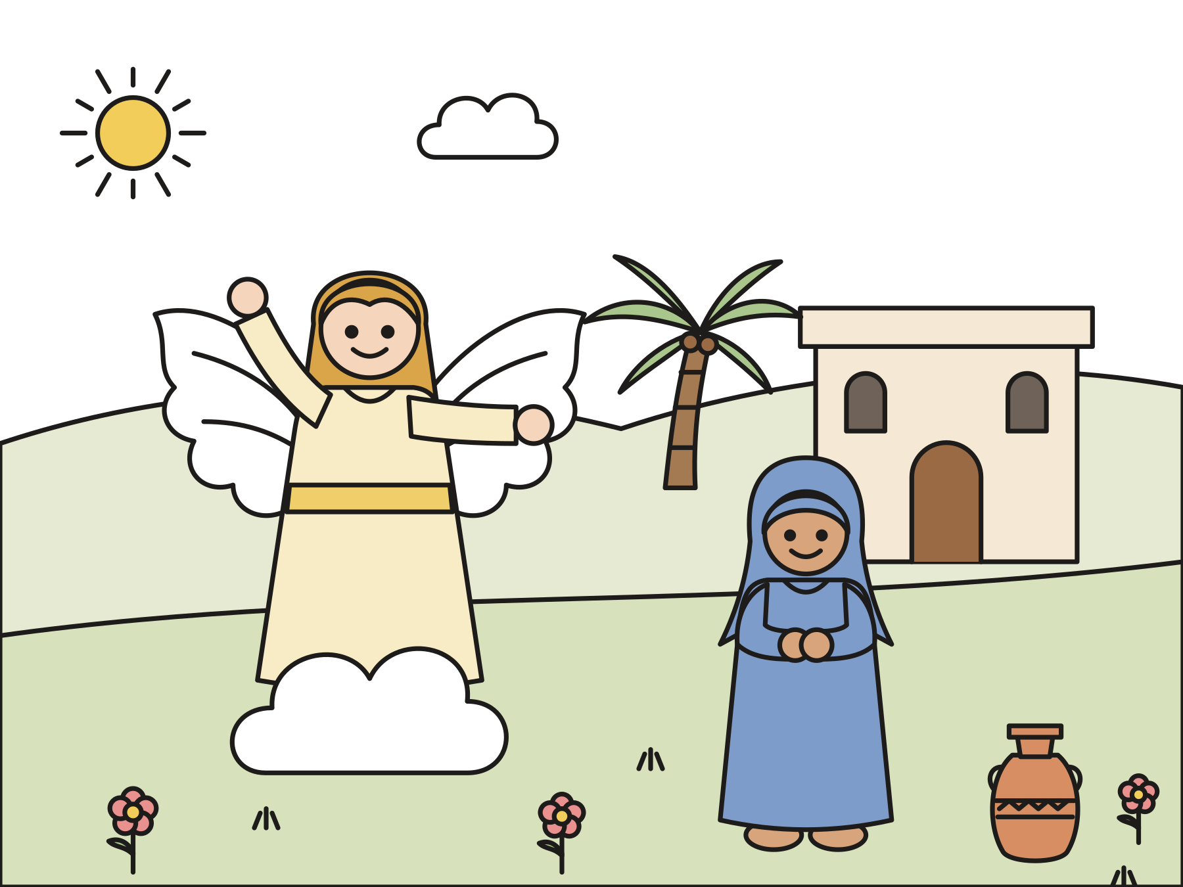
Mary said yes!
“Behold, the servant of the Lord; let it be done to me according to your word.”
Notes:
Gabriel told Mary she would have a baby named Jesus. Mary had a question. Then she gave her answer. She said yes to God.

Slide 6

God’s message for you
God loves you, and God is with you.
Notes:
Open the envelope and read the card. Today many churches light the fourth Advent candle, the candle of love. Jesus is God’s gift of love for everyone.

Slide 7
Question 1 of 3
Who brought God’s message to Mary?
A mail carrier
A shepherd
A
B
The angel Gabriel
C
Notes:
Read the question and the choices aloud, and let the children answer. Then show the answer: The angel Gabriel. God sent the angel Gabriel to Mary in Nazareth.

Slide 8
Question 1 of 3
Who brought God’s message to Mary?
A mail carrier
A shepherd
A
B
The angel Gabriel
C
The answer is C. God sent the angel Gabriel to Mary in Nazareth.
Notes:
The answer is C: The angel Gabriel. God sent the angel Gabriel to Mary in Nazareth.

Slide 9
Question 2 of 3
What did Mary say to God?
No way
Yes
A
B
Ask me later
C
Notes:
Read the question and the choices aloud, and let the children answer. Then show the answer: Yes. Mary said, “Let it be done to me according to your word.” That means yes!

Slide 10
Question 2 of 3
What did Mary say to God?
No way
Yes
A
B
Ask me later
C
The answer is B. Mary said, “Let it be done to me according to your word.” That means yes!
Notes:
The answer is B: Yes. Mary said, “Let it be done to me according to your word.” That means yes!

Slide 11
Question 3 of 3
What do many churches call the fourth Advent candle?
The candle of bedtime
The candle of love
A
B
The candle of snow
C
Notes:
Read the question and the choices aloud, and let the children answer. Then show the answer: The candle of love. On the fourth Sunday of Advent, many churches light the candle of love.

Slide 12
Question 3 of 3
What do many churches call the fourth Advent candle?
The candle of bedtime
The candle of love
A
B
The candle of snow
C
The answer is B. On the fourth Sunday of Advent, many churches light the candle of love.
Notes:
The answer is B: The candle of love. On the fourth Sunday of Advent, many churches light the candle of love.

Slide 13

Great job!
You finished all 3 questions.
Notes:
Thank the children for listening so well.

Slide 14
Let’s pray
Dear God, thank you for your message of love. Help us say yes to you and share your love. Amen.
Notes:
Ask the children to repeat each line after you.

