Slide 1

Children’s sermon
A witness to the light: a children’s sermon for the third Sunday of Advent
John 1:6–8, 19–28
Mainline Christian
Notes:
Welcome the children. Today’s story comes from John 1:6–8, 19–28.

Slide 2
What is this?
A flashlight! It shows us where to look.
Notes:
Hold up the flashlight and switch it on. Ask: What do we use a flashlight for? Let the children answer.

Slide 3
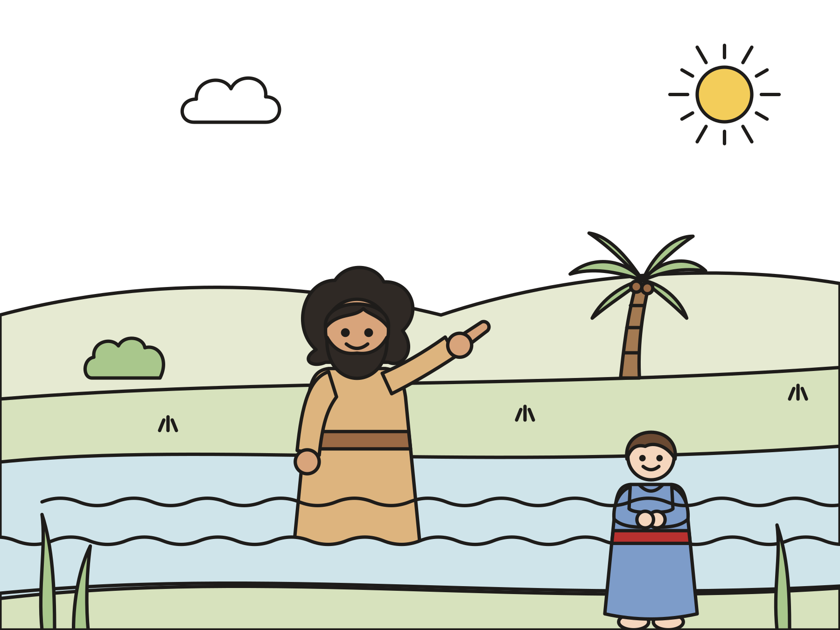
God sent a man named John.
John told everyone, “Get ready! Someone is coming!”
Notes:
John lived in the wilderness by the Jordan River. Some leaders asked him, “Who are you?” John said, “I am not the Christ.” He was getting people ready for someone else.

Slide 4
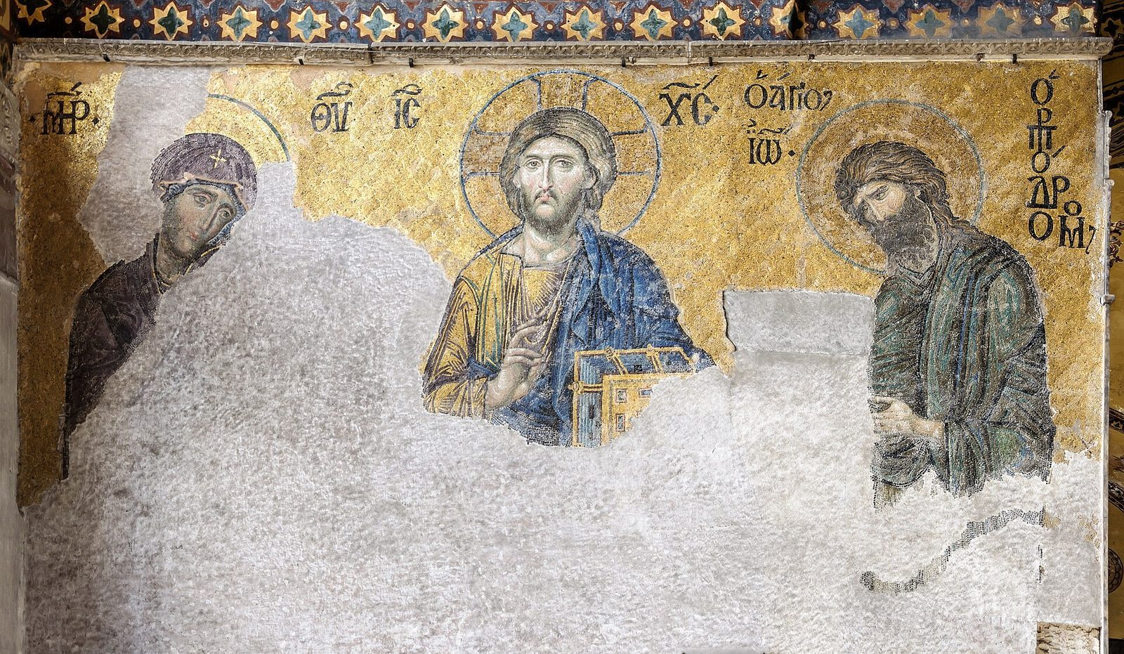
“He was not the light, but was sent that he might testify about the light.”
John 1:8
Notes:
Read the verse slowly. Then shine the flashlight on the picture of baby Jesus. John was like a flashlight. He pointed to Jesus.

Slide 5
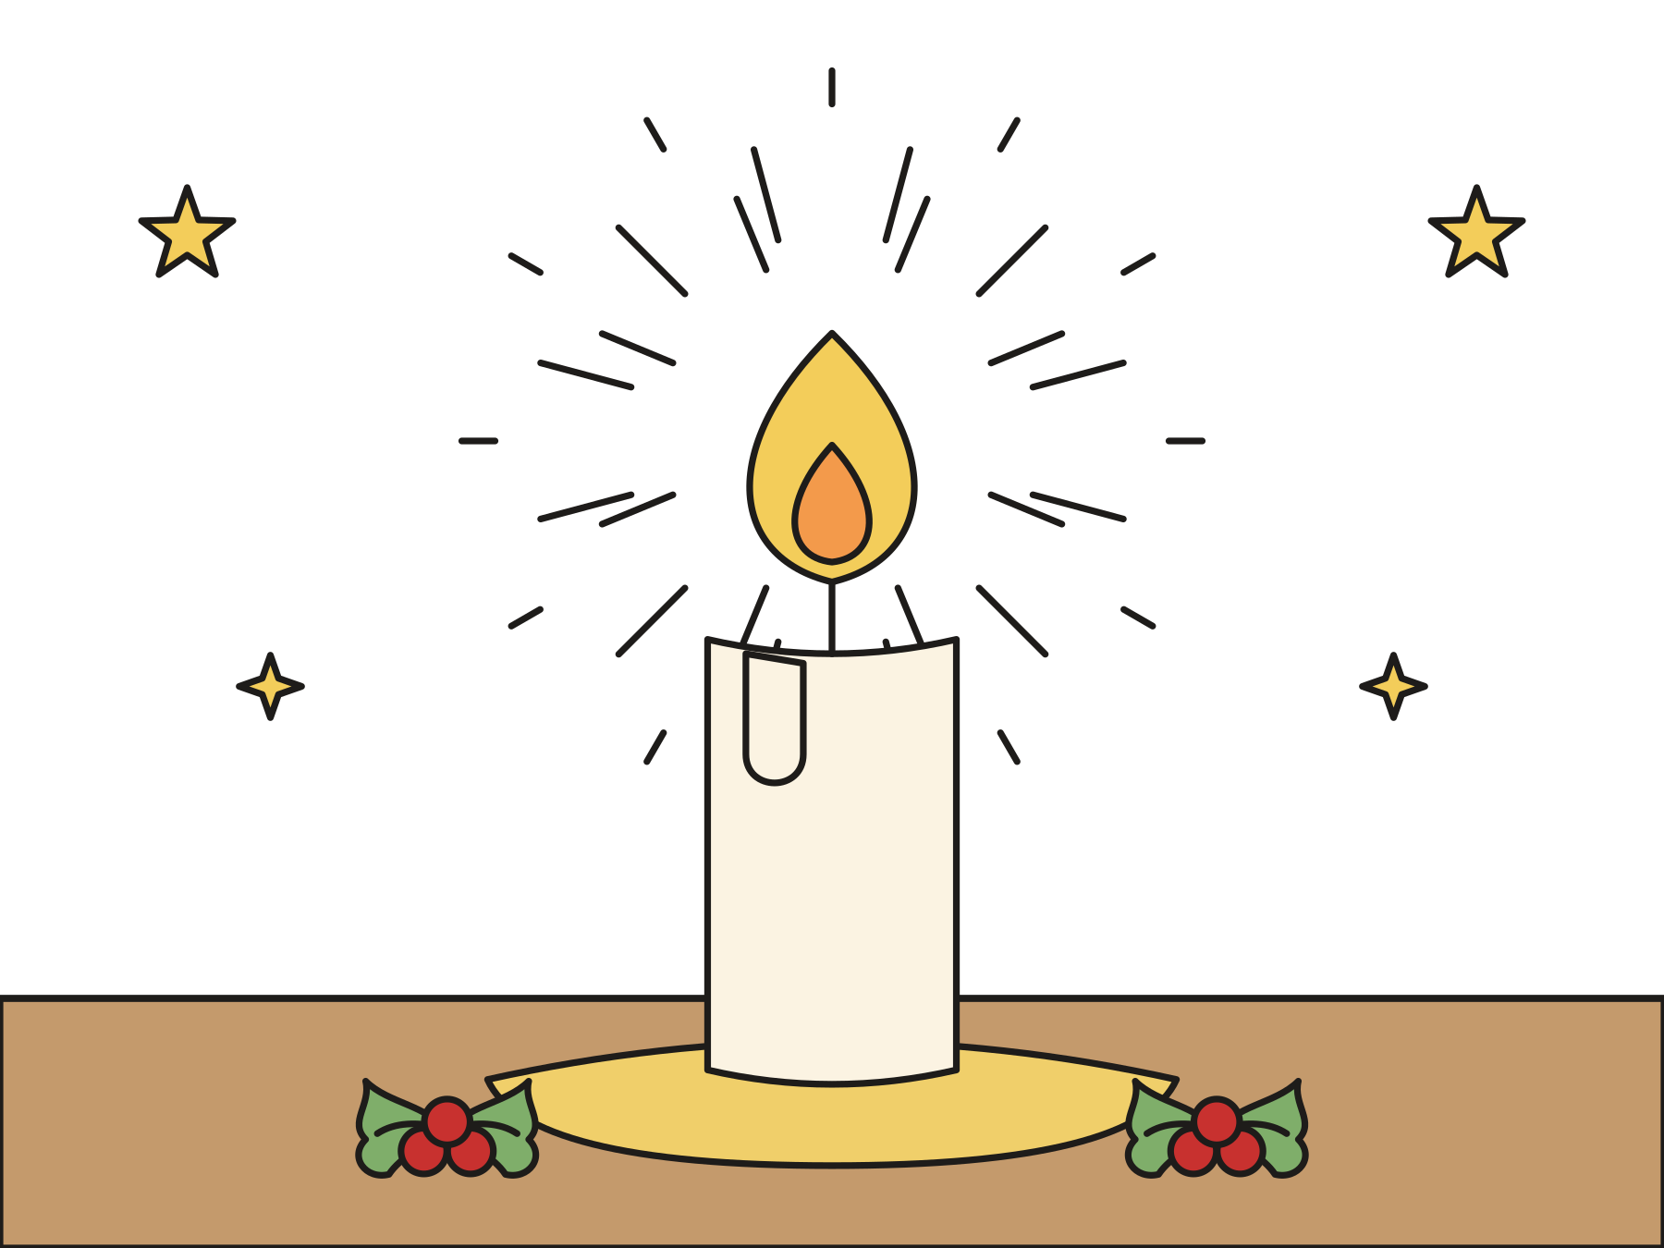
Jesus is the light.
John pointed everyone to Jesus, and it filled him with joy.
Notes:
Jesus shows us how much God loves us. John was so glad to point to Jesus. Later he said that Jesus made his joy full.

Slide 6

Always rejoice!
“Always rejoice.”
1 Thessalonians 5:16
Notes:
Many churches light the pink candle today, the candle of joy. One of today’s readings says, “Always rejoice.” That means be glad, because God’s light is coming.

Slide 7
Question 1 of 3
What was John’s job?
To point people to Jesus
To fix flashlights
A
B
To catch fish
C
Notes:
Read the question and the choices aloud, and let the children answer. Then show the answer: To point people to Jesus. God sent John to tell everyone about the light, and the light is Jesus.

Slide 8
Question 1 of 3
What was John’s job?
To point people to Jesus
To fix flashlights
A
B
To catch fish
C
The answer is A. God sent John to tell everyone about the light, and the light is Jesus.
Notes:
The answer is A: To point people to Jesus. God sent John to tell everyone about the light, and the light is Jesus.

Slide 9
Question 2 of 3
Who is the light John talked about?
The sun
Jesus
A
B
A birthday candle
C
Notes:
Read the question and the choices aloud, and let the children answer. Then show the answer: Jesus. John pointed to Jesus, who brings God’s love to everyone.

Slide 10
Question 2 of 3
Who is the light John talked about?
The sun
Jesus
A
B
A birthday candle
C
The answer is B. John pointed to Jesus, who brings God’s love to everyone.
Notes:
The answer is B: Jesus. John pointed to Jesus, who brings God’s love to everyone.

Slide 11
Question 3 of 3
What do many churches call the pink Advent candle?
The candle of bedtime
The candle of snow
A
B
The candle of joy
C
Notes:
Read the question and the choices aloud, and let the children answer. Then show the answer: The candle of joy. On the third Sunday of Advent, many churches light the pink candle of joy.

Slide 12
Question 3 of 3
What do many churches call the pink Advent candle?
The candle of bedtime
The candle of snow
A
B
The candle of joy
C
The answer is C. On the third Sunday of Advent, many churches light the pink candle of joy.
Notes:
The answer is C: The candle of joy. On the third Sunday of Advent, many churches light the pink candle of joy.

Slide 13

Great job!
You finished all 3 questions.
Notes:
Thank the children for listening so well.

Slide 14
Let’s pray
Dear God, thank you for John, who pointed to Jesus. Help us shine your light and share your joy. Amen.
Notes:
Ask the children to repeat each line after you.

