Slide 1

Children’s sermon
Prepare the way: a children’s sermon for the second Sunday of Advent
Mark 1:1–8; Isaiah 40:1–11
Mainline Christian
Notes:
Welcome the children. Today’s story comes from Mark 1:1–8; Isaiah 40:1–11.

Slide 2
What is a broom for?
Sweeping! Cleaning up! Getting ready for someone special!
Notes:
Hold up the broom. Ask: What is this for? When does your family clean up? Let the children answer.

Slide 3
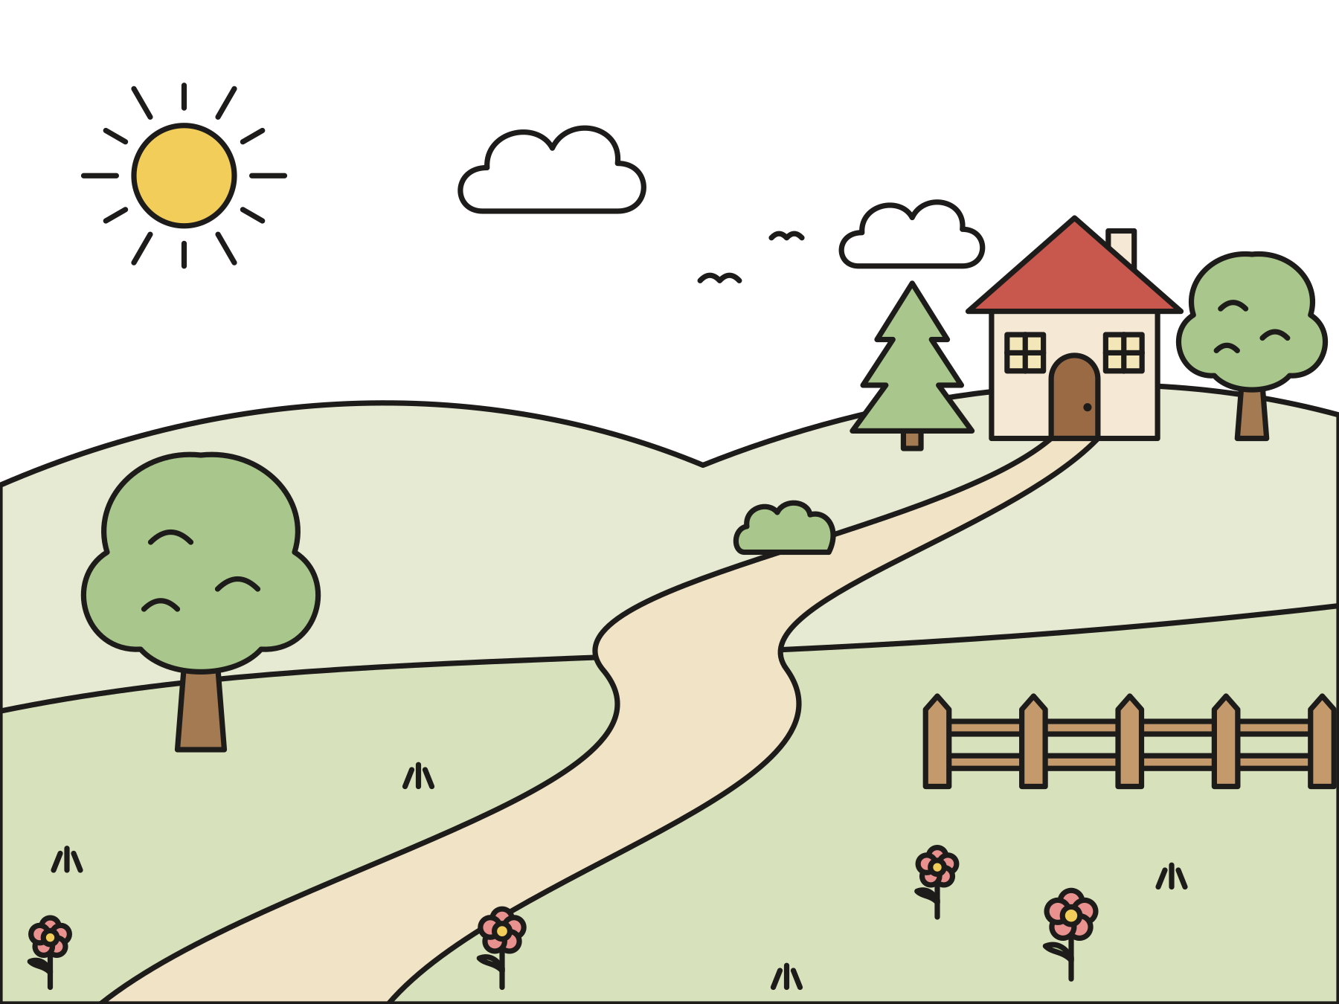
Get the road ready!
Fill in the valleys. Make the mountains low. God is coming!
Notes:
Long ago, God’s people were far from home and sad. A prophet told them to get a road ready for God, with no bumps and no holes.

Slide 4
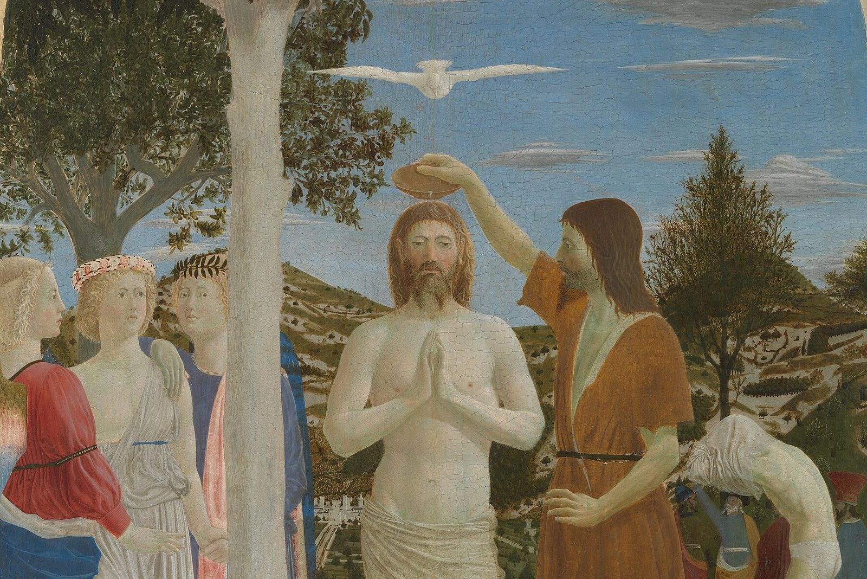
“Make ready the way of the Lord! Make his paths straight!”
Mark 1:3
Notes:
Many years later, John lived in the wilderness and baptized people in the Jordan River. The Bible says John was the voice calling these words. This painting shows John at the river.

Slide 5

A smooth road for peace
Say sorry. Forgive. Make peace!
Notes:
John helped people get their hearts ready for Jesus. When we say sorry and forgive, we sweep the road smooth for peace. Many churches light the candle of peace today.

Slide 6
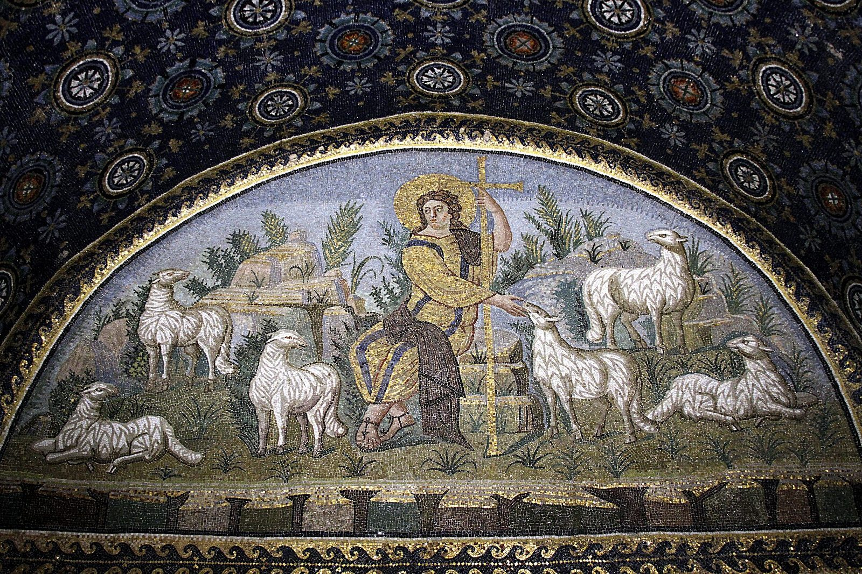
“He will feed his flock like a shepherd. He will gather the lambs in his arm, and carry them in his bosom.”
Isaiah 40:11
Notes:
When God comes, God comes gently, like a shepherd who holds the little lambs close to his heart. God holds you close like that too.

Slide 7
Question 1 of 3
Who was John getting people ready for?
Jesus
A snowstorm
A
B
A birthday party
C
Notes:
Read the question and the choices aloud, and let the children answer. Then show the answer: Jesus. John said someone greater was coming after him. He meant Jesus.

Slide 8
Question 1 of 3
Who was John getting people ready for?
Jesus
A snowstorm
A
B
A birthday party
C
The answer is A. John said someone greater was coming after him. He meant Jesus.
Notes:
The answer is A: Jesus. John said someone greater was coming after him. He meant Jesus.

Slide 9
Question 2 of 3
What did John eat in the wilderness?
Cookies and milk
Locusts and wild honey
A
B
Pizza
C
Notes:
Read the question and the choices aloud, and let the children answer. Then show the answer: Locusts and wild honey. Locusts are big grasshoppers. Crunchy!

Slide 10
Question 2 of 3
What did John eat in the wilderness?
Cookies and milk
Locusts and wild honey
A
B
Pizza
C
The answer is B. Locusts are big grasshoppers. Crunchy!
Notes:
The answer is B: Locusts and wild honey. Locusts are big grasshoppers. Crunchy!

Slide 11
Question 3 of 3
How does God carry the little lambs?
In a basket on his head
On a skateboard
A
B
Close in his arms
C
Notes:
Read the question and the choices aloud, and let the children answer. Then show the answer: Close in his arms. Isaiah said, “He will gather the lambs in his arm, and carry them in his bosom.”

Slide 12
Question 3 of 3
How does God carry the little lambs?
In a basket on his head
On a skateboard
A
B
Close in his arms
C
The answer is C. Isaiah said, “He will gather the lambs in his arm, and carry them in his bosom.”
Notes:
The answer is C: Close in his arms. Isaiah said, “He will gather the lambs in his arm, and carry them in his bosom.”

Slide 13

Great job!
You finished all 3 questions.
Notes:
Thank the children for listening so well.

Slide 14
Let’s pray
Dear God, help us get our hearts ready for Jesus. Help us make peace. Hold us close. Amen.
Notes:
Ask the children to repeat each line after you.

